Slide 1
4º PRI Plenary
Interregional Cooperation event 1
Introduction – PRI and interterritorial collaboration
14th of December 2022
Karel Haegeman
PRI TEAM
JRC - European Commission

Slide 2


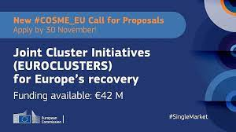
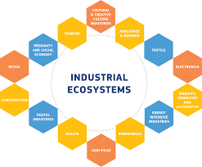



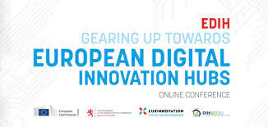
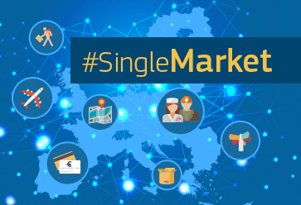









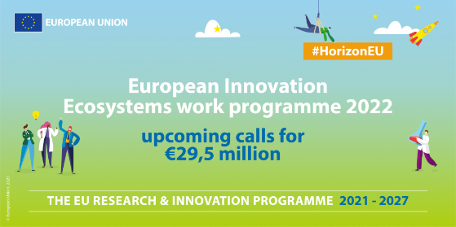
The EU interterritorial collaboration landscape
Twin Transition Strategic Autonomy Recovery and Resilience

Slide 3
A twin challenge
Accelerate the systemic transformation of EU value chains towards sustainability
Which roles for EU territories and for territorial collaboration? (which collaboration agenda?)
How can EU Instruments be combined in territories and contribute to this collaboration agenda?

Slide 4


Two key elements
Mobilising and pooling funding
Accelerate transformation of ecosystems with
policies and tools

Slide 5
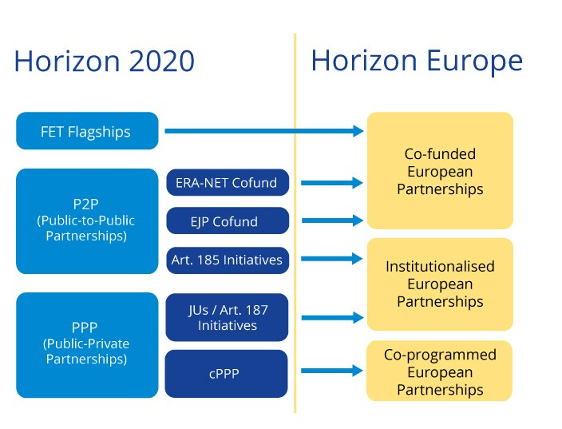
1. Mobilising funding – transnational experiences
Build on the longstanding experience in joint calls, joint programming and transnational partnerships
Barriers and motivations for joint calls between territories - Examples
Increasing efficiency and excellence (fund nationally but evaluate internationally)
Thematic calls may discriminate smaller countries/regions
Better connect basic and applied research across territories
High diversity in funding agencies and budgets available
Too few players in a single territory for critical mass
Time differences in programming cycles
Source: ERA-Learn
Too small field for having calls in 1 territory
Translate to an interregional context
Source: JRC82303

Slide 6
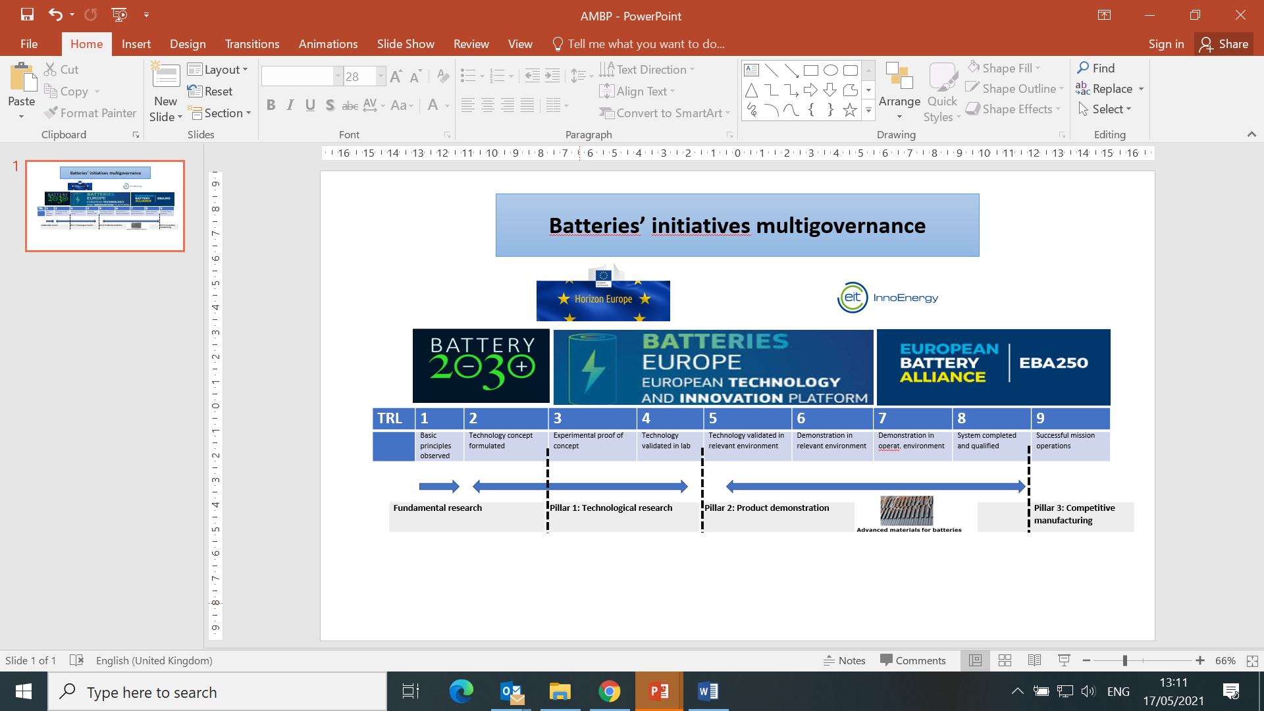





1. Mobilising funding – interregional experiences
Potential of thematic S3 partnerships
Thematic platforms are a pan-European network of networks
They match complementarities in innovation in areas at the core of the twin transition
They can be a backbone to build new and renewed European value chains, through connecting places, investments and innovative solutions
IPCEI on European Battery Innovation
How could they be optimised for systemic innovation?
More involvement from less advanced regions would increase territorial diversity.
Political commitment related to continuous involvement could be reinforced
Advancing collaboration beyond joint business investment
Seek better connections with wider R&I initiatives and EU Missions
IPCEI on batteries
Horizon Europe European Partnership for an Industrial Battery Value Chain
Large-scale and long-term European research initiative
Interregional Smart Specialisation Partnership (31 members)
600 public and private actors from the battery value chain
Alliance for Batteries Technology, Training and Skills (ALBATTS)

Slide 7
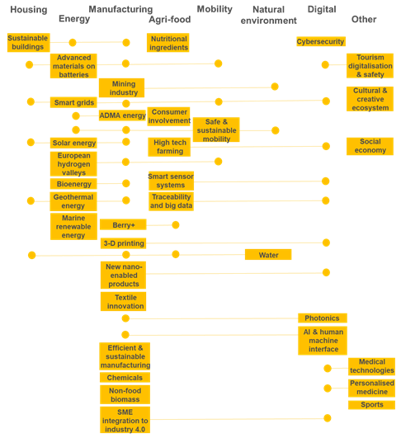
Interregional S3 partnerships and the twin transition ecosystems
Many topics of the interregional S3 partnerships are at the core of the systems that are key for making the twin transition a reality.
The figure also reflects possible collaborations between partnerships within each of the systems.
Source: JRC

Slide 8
1. Mobilising funding: some questions
How can interterritorial joint calls be upscaled for transformative innovation?
What needs and activities should it focus on?
How to diversify funding sources?
Make or buy? What role for buying innovation services?

Slide 9
2. Reinforcing ecosystems with policies and tools
Policies to accelerate transformation of innovation eco-systems
Fiscal policy
Demand side policies, R&D tax incentives, energy consumption taxation,…
Innovation in public administration
Skills, capacity building, incentive schemes, whole-of-government, public sector innovation, green produrement,…
Education and training
Talent and skill development, reskilling, VET, talent attraction, entrepreneurship training,…
Social policies
Ethical issues, societal acceptance, social innovation, RRI, inclusive innovation,…
Regulations
Urban, regional, national EU. Regulatory sandboxes, intersectoral regulations,…
Business support/
industrial policy
Cluster policies, business fora, support to start-ups/SMEs, transition pathways…
S3 and R&I policies
Thematic R&I policies, support to internationalisation,…
Employment policies
New job opportunities, employment schemes, economic reconversion,…
Standardisation policies
Develop new standards, intersectoral, international agreements,…
Digital policies
Digital skills, digitalisation of business, digitalisation of public administration,…
Stakeholder engagement
ODP, co-creation labs, collaborative platforms, participatory governance,…
Environmental/energy policies/urban planning
Climate adaptation, waste management, land use, resilience
Technology transfer and research valorisation
IPR, industry-academy collaboration,…
Fund attraction and funding synergies
Fund attraction capacity, governance for funding synergies,…
Financing
Seed capital, VC, BAN, green financing, incubators, private finance blending,…
New models
New business models, new models of insurance, citizens as producers,…

Slide 10
2. Reinforcing ecosystems with policies and tools
Examples of policy options developed in interregional context
Regulatory frameworks
Standardisation practices for innovative transformation
Train funded researchers on regulatory, ethical and safety issues
Address differences in regulatory frameworks when they apply simultaneously to one product innovation: differences between application areas, between world regions, between professions
Disseminate results of research projects to regulation developers
Organise dialogue between academics, industry, citizens, regulatory agencies & policy-makers
Set up regulatory sandboxes to experiment with impacts of regulations under development
Disseminate results of research projects to standardisation bodies
Align practices in academic environment with standards of industrial laboratories
Combine incremental development of existing standards with the development of new standards for new commodities and services
Align research with both existing standards and those under development
Contribute to renewing international standards
Source: Adapted from JRC82303

Slide 11
2. Reinforcing ecosystems with policies and tools
Tools to make innovation eco-systems more efficient
Localising SDGs
Competences for the twin transition
Taxonomy for sustainable activities
Strategic Intervention Logic
Foresight/Futures literacy
SELFIE tools
Small-scale experimentation
Start-up Villages
Point reviews
Open Education Resources
Measuring and monitoring resilience
Identifying local challenges/local missions
Challenge-led mapping
Digital Innovation Hubs
Citizen science
Tools for Sustainable Urban Development

Slide 12
2. Reinforcing ecosystems with policies and tools: some questions
Which policies and tools are most essential in accelerating transformative innovation?
How can interregional collaboration support advancing those policies and tools?
What multi-level governance is required?
Differences between different industrial ecosystems?

Slide 13
3. Links with EU Instruments
How can EU Instruments support interregional collaboration?
How can interregional collaboration support EU instruments?
How can EU Instruments be combined to support regions?
How can EU Instruments be combined in regions?

Slide 14

Thank you
© European Union 2020
Unless otherwise noted the reuse of this presentation is authorised under the CC BY 4.0 license. For any use or reproduction of elements that are not owned by the EU, permission may need to be sought directly from the respective right holders.
Slide xx: element concerned, source: e.g. Fotolia.com; Slide xx: element concerned, source: e.g. iStock.com
Notes:
Update/add/delete parts of the copy right notice where appropriate.
More information: https://myintracomm.ec.europa.eu/corp/intellectual-property/Documents/2019_Reuse-guidelines%28CC-BY%29.pdf

Slide 15
3. Links with EU instruments
How can EU instruments support interregional collaboration?
How can interregional collaboration support EU Instruments?
How can EU instruments be combined to support regions?
How can EU Instruments be combined in regions?

