Slide 1
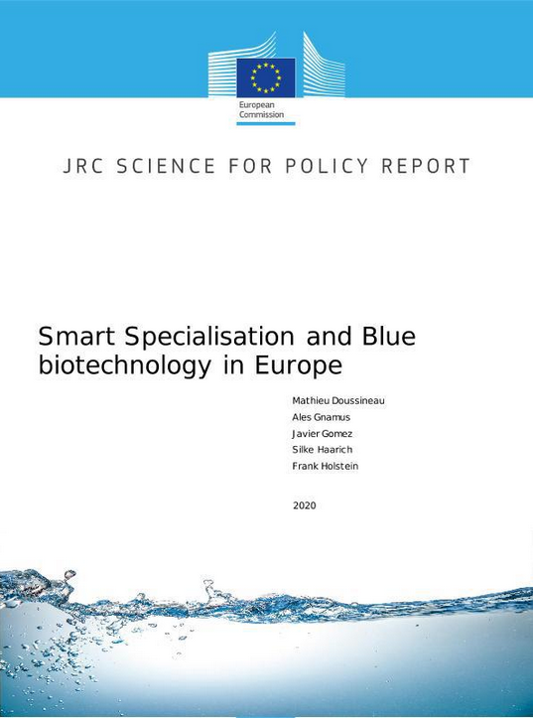
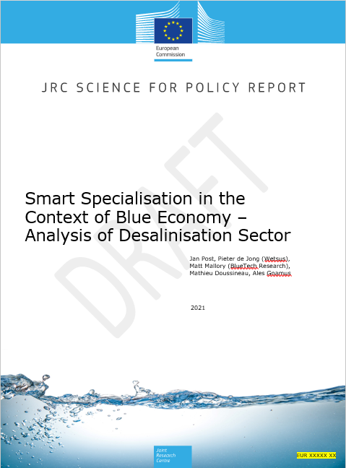
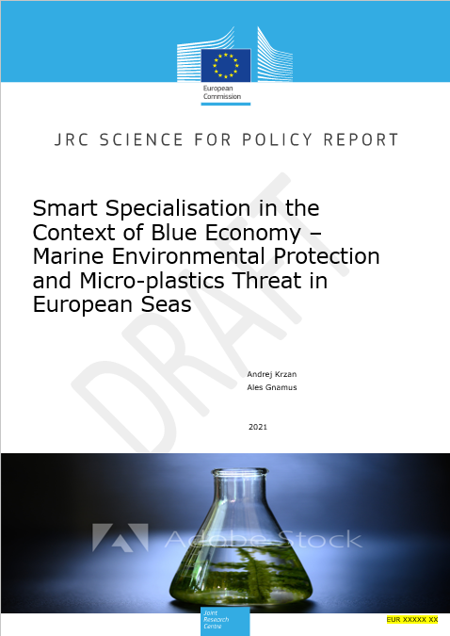
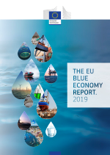


Smart Specialisation and Blue Economy
  JRC Science for Policy Reports -
  - S3 and Blue Biotechnology in Europe
  - S3 in the Context of Blue Economy – Analysis of Desalination Sector
  - upcoming: S3 in the Context of Blue Economy – Marine Environmental Protection
  and Micro-Plastics
  The EU Blue Economy Reports 2019 / 2020 / 2021
  https://s3platform.jrc.ec.europa.eu/blue-growth

Slide 2
Self-assessment Toolbox for S3 interregional partnerships
  To help S3 Partners to measure
  - their own level of maturity of their collaborative activities
  - their effectiveness in putting forward joint investment proposals
  To assess strategic and operational progress of
  - the interregional activities of the partnerships as a whole
  - the effects on interregional dynamics
  The toolbox can serve as a guidance for the effective development of both the partnership itself and its innovative ideas, and to pave the way for long-term solutions to improve their effectiveness

Slide 3
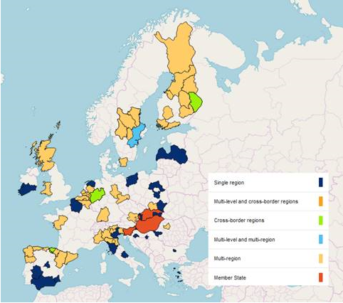
Response to PRI Pilot Action call
  Partnerships for Regional Innovation
  Introducing local missions
  A single steer in the territory promoting synergies between:
    EU policies: Sustainable Blue Economy Communication, the EU Industrial Strategy, the Innovation Communication,…
    EU funding and financing opportunities: Horizon Ocean Mission, Structural Funds, RRPs, Financial support Invest EU / BlueInvest,…).
  Applications of 3 Member States, 29 single regions (NUTS2 or NUTS3) and 6 networks of regions representing together around 50 additional regions

