Slide 1
JRC B4 – Overview of HE research outcomes
HESS IV – 1st Advisory Group meeting 11.02.2022
Dr. Andreia Inamorato (JRC B7)

Slide 2
JRC B4 is the Human Capital and Employment Unit of the JRC Digital Competence Frameworks

Slide 3
Research
Yves’s ccyçe email

Slide 4
Research reports on HE

Slide 5
Open Education (2016-2019)
Open Education

Slide 7
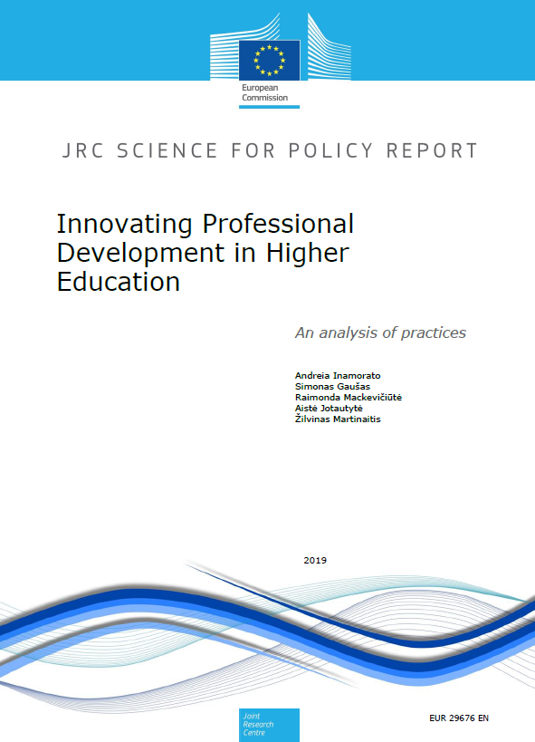
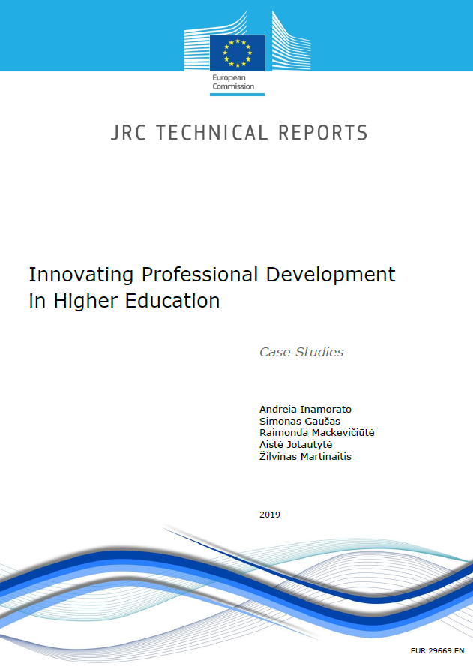
Innovating professional development in HE (2019)
How are HEIs supporting innovative teaching practices?
How can it support academic career paths?
How to overcome known barriers to teacher/educators' PD?
How to address teachers/educators' real PD needs?

Slide 8
Blockchain in Education (2017)
European citizens gain digital control of their educational credentials, significantly reducing verification costs and improving trust in documents’ authenticity.
The report inspired the Diploma Use Case in EBSI (European Blockchain Service Infrastructure), led by DG CONNECT.
It also inspired blockchain for digital credentials initiatives in various Member States, such as the case of Spain, that widely disseminated this report and built upon it to develop a national blockchain strategy for digital credentials.

Slide 9
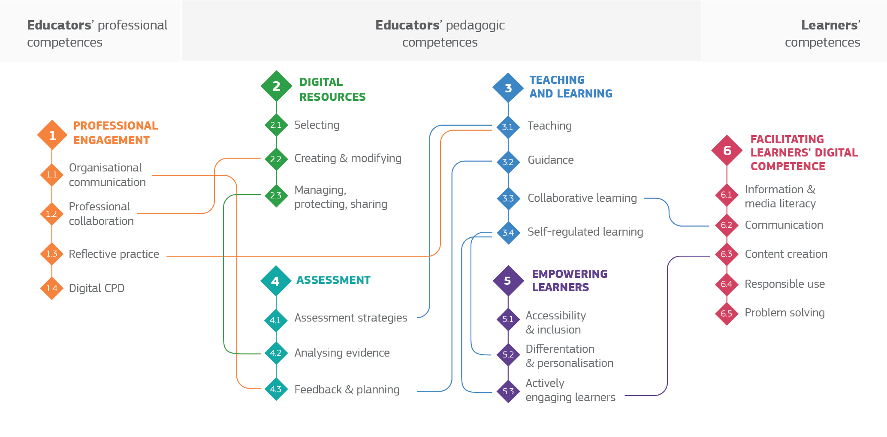
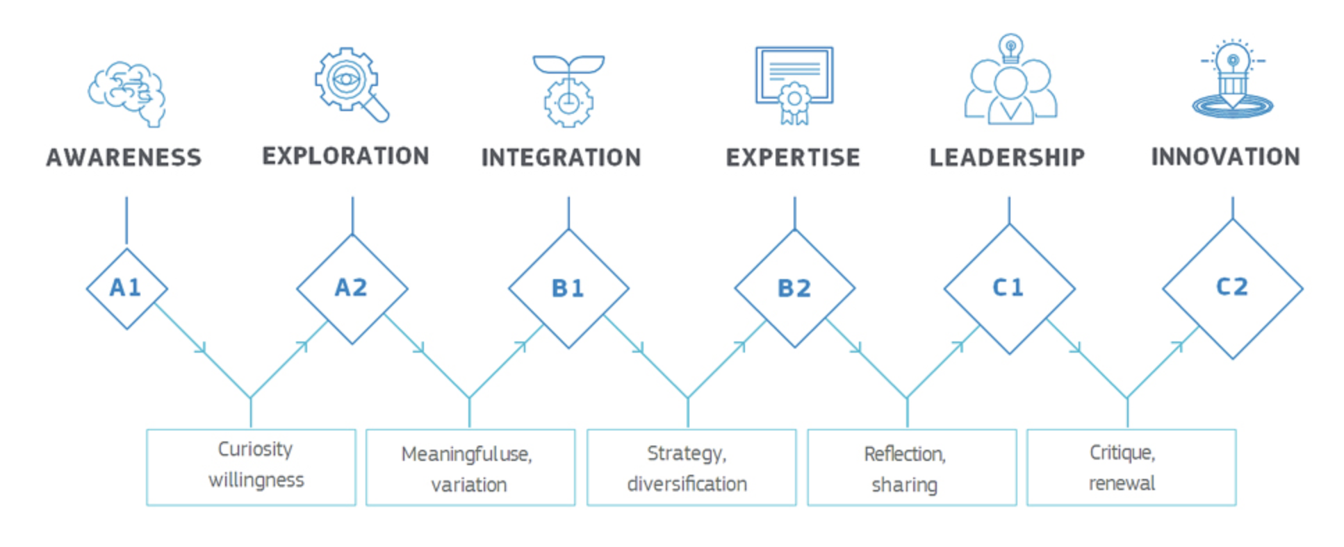
DigCompEdu Digital Competence of Educators (2017)

Slide 10
Check-In: self-reflection tool for HE
Tool based on the DigCompEdu and OpenEdu Frameworks ( digital competence and open education skills). The user goes through a self-reflection questionnaire wehich produces a report to user at the end and steps to level-up. The instruments can be translated and applied in other languages. At he momento available in Spanish and English.
Access the Spanish version (V.2021):
https://ec.europa.eu/eusurvey/runner/CheckIn_HE_v2021_ES
Access the English version (V.2021):
https://ec.europa.eu/eusurvey/runner/CheckIn_HE_v2021_EN

Slide 11
Join the DigCompEdu community for the files to translate and news

Slide 12
Relevant Outcomes from Check-In tool
Iberoamerican study involving 7 countries (collaboration JRC and Metared, Universia Foundation – Santander Bank)
Argentina, Brazil, Colombia, Chile, Peru, Mexico and Portugal
30K+ participants
Level of competence according to academic’s percetion: B1-B2
Dissemination: scientific article
“The digital competence of academics in higher education in seven Iberoamerican countries: perceptions, challenges and recommendations for policy” - submitted
Webinar : https://youtu.be/BsFRPX3LMng

Slide 13
Relevant outcomes from Check-In tool
National inititave in Spain (2021) supported by the Conference of Rectors of Spanish Univeristies (CRUE-TIC), in collaboration with the JRC.
Development of a methodology (quantitative and qualitative) for a representative research in Spain in order to capture the academics’ perception of their digital competence.
1st phase (pilot) in 2020: 10 universities, 500+ academics
2nd phase: implementation in 2021: 53 universities, 5k+ academics
Outcome: picture of the digital competence of academics in Spain. The results inform policies at national and institutional levels.
JRC – CRUE Report to be published Spring 2022

Slide 14
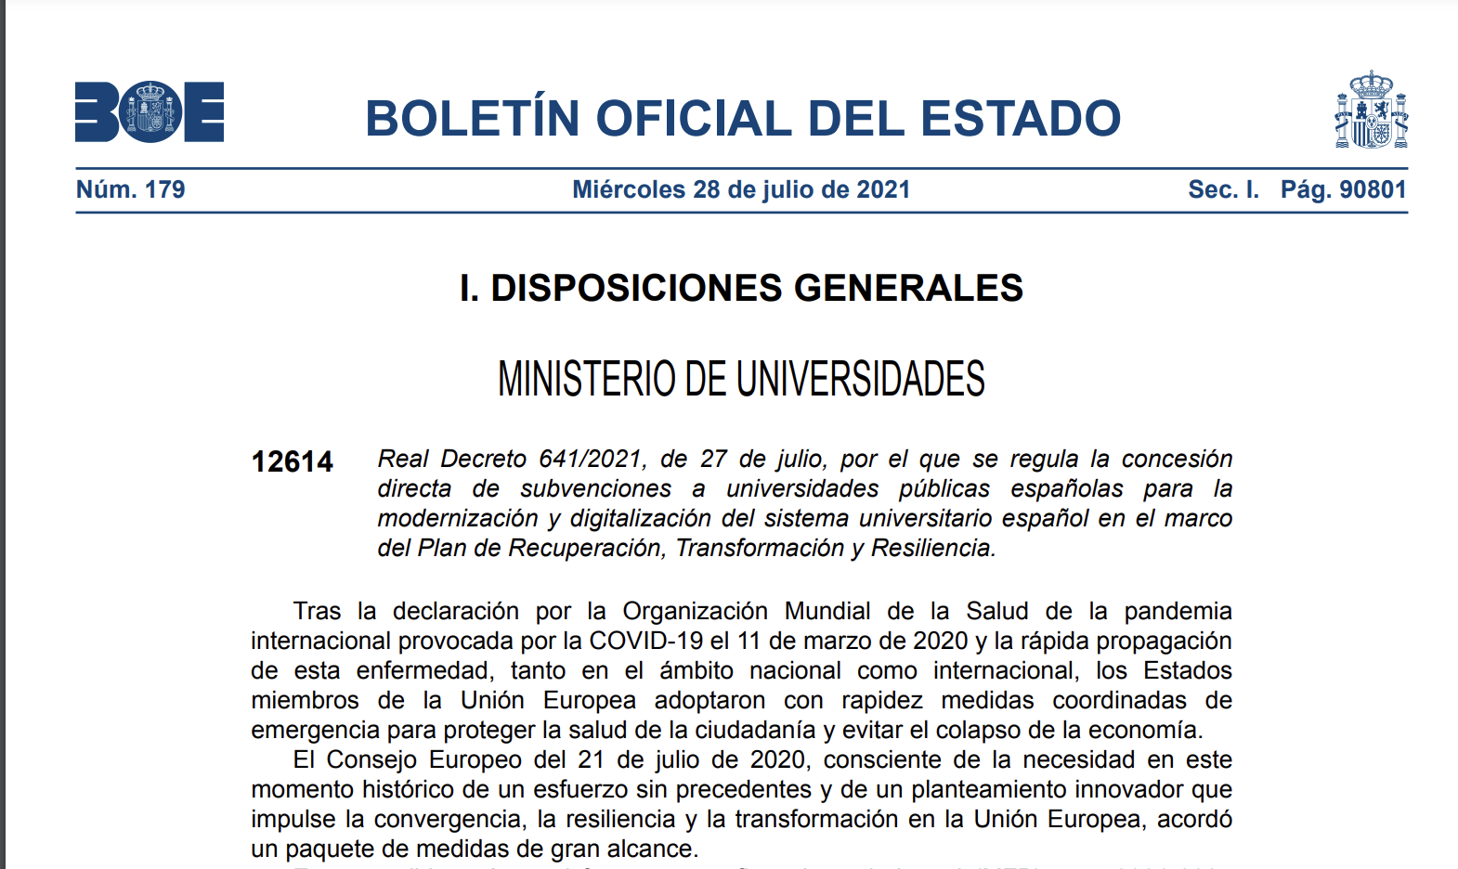
Policy example
B
Digital competence of academics is central in the funding resolution based on the Spanish Recovery and Resilience Funds – universities will receive 750 millones of Euros between 2021-2023 for digital and teachig innovation e.g. Open Education: development of MOOCs and Open Repositories and Digital Competence: Continuous Professional Development Platforms and Courses

Slide 15
JRC is awarded a prize from CRUE-TIC for excellence in collaboration

Slide 16
HESS 4 – WP 2
Exploring a regional dimension for HEInnovate

Slide 17
HEInnovate – EC and OECD tool

Slide 18
Thank you
andreia-inamorato-dos.santos@ec.europa.eu
@aisantos
This presentation has been prepared for internal purposes. The information and views expressed in it do not necessarily reflect an official position of the European Commission or of the European Union.
Except otherwise noted, © European Union (year). All Rights Reserved

