Slide 1
Higher Education for Smart Specialisation
HESS Impact
Advisory Committee Meeting 11 Feb 2022
Eskarne Arregui-Pabollet
JRC B3 Unit Scientific Officer

Slide 2
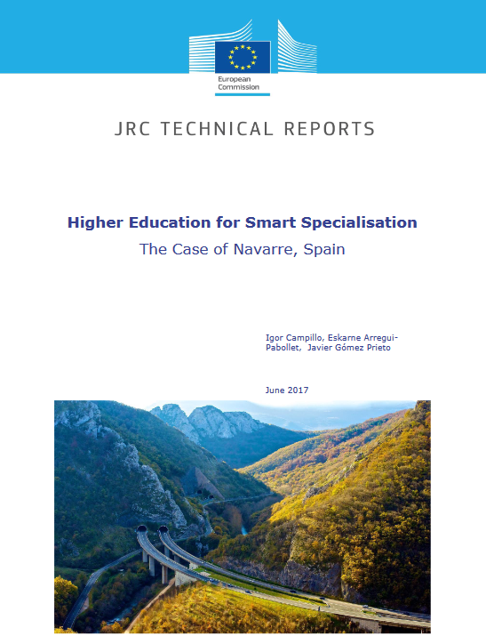
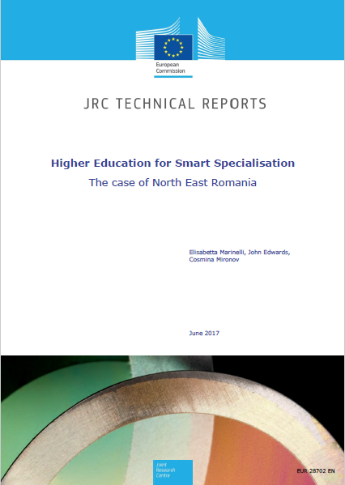
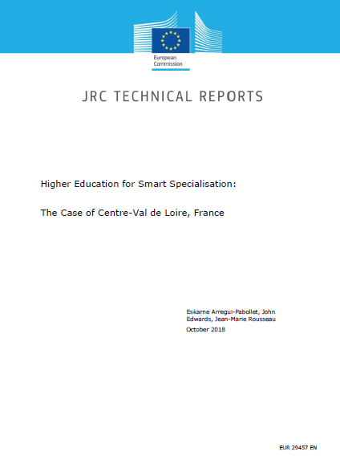
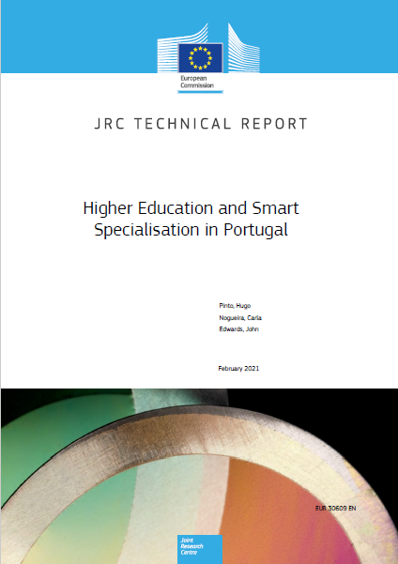
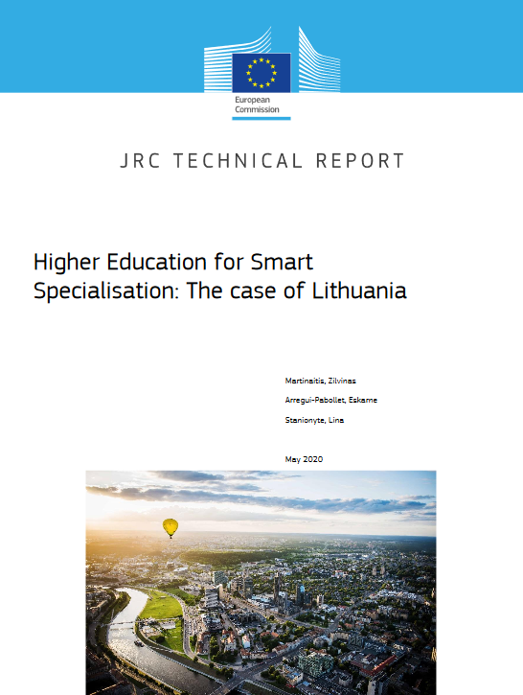
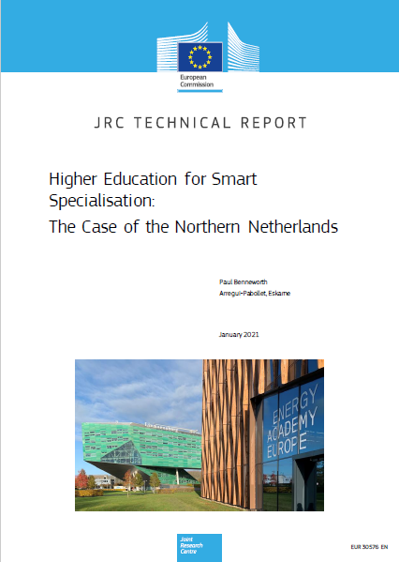
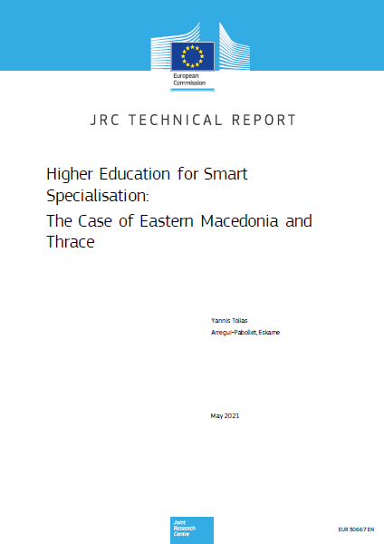
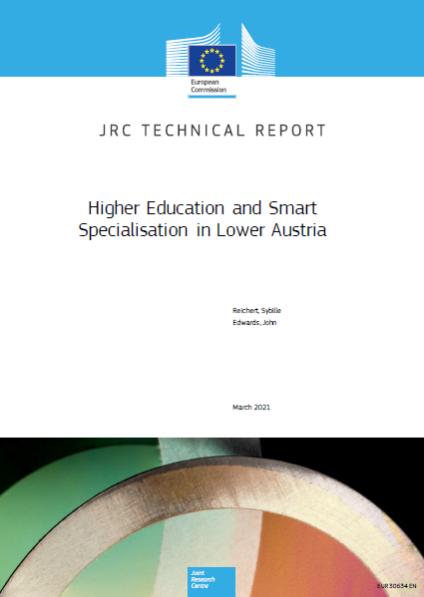
Case Studies

Slide 3
Case studies
Local partnerships to address specific challenges on the role of HEIs in regional development (human capital & skills)
Policy implications that help in S3 implementation and inspire other regions
Evidence on HEI contribution to the implementation of S3, including through the ESIF
RESEARCH
ACTION
REFLECTION

Slide 4
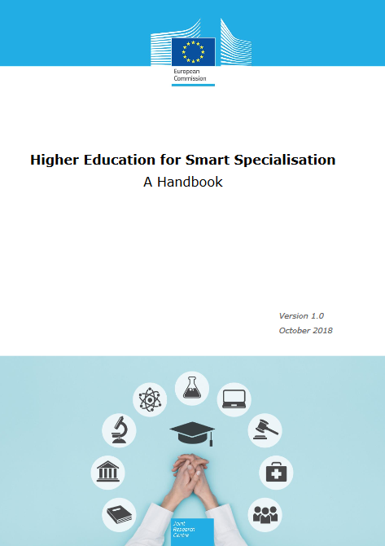
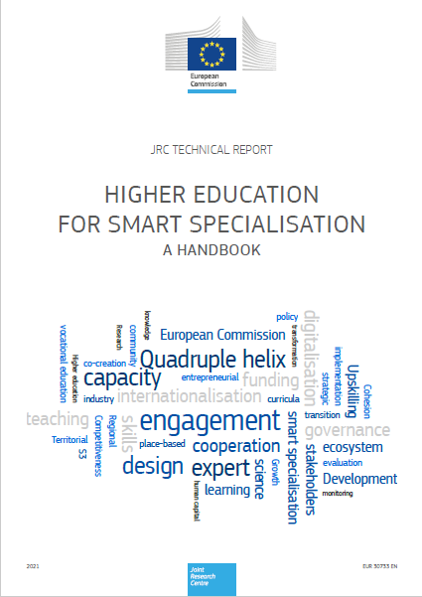
HESS Handbook
Understanding academic career
Recommendations
Monitoring
S3 Governance
EDP
Funding Instruments

Slide 5
Peer-reviews / Synergies / Collaborations

Slide 6
Territorial impact
Differences in HEIs
Funding mechanisms
Leadership
&
Incentives
Integrated missions
HEI contribution to S3 Governance

Slide 7
Policy impact

Slide 8
Thank you!
© European Union 2020
Notes:
Update/add/delete parts of the copy right notice where appropriate.
More information: https://myintracomm.ec.europa.eu/corp/intellectual-property/Documents/2019_Reuse-guidelines%28CC-BY%29.pdf

