Slide 1
Work Package 1
HESS IV – 1st Advisory Group meeting 11.02.2022
Eskarne Arregui (JRC)
Patricia Canto (external expert)
James R. Wilson (external expert)

Slide 2
Collaborations with EIT Knowledge and Innovation Communities

Slide 3
Background
The EIT Strategic Innovation Agenda 2021-2027 includes the objective to create systemic impact in higher education, by supporting them to increase their innovation and entrepreneurial capacity and better integrate into and engage with innovation ecosystems.
EIT HEI Initiative boosting innovation and entrepreneurial capacity of HEIs through the KICs, strengthening the links between HEIs and their local and regional ecosystems

Slide 4
WP objectives
To support the innovation and entrepreneurial capacity of HEIs and foster their integration into local innovation ecosystems.
Identification and mapping of good practice approaches to improving HEI entrepreneurship and innovation in S3.
Inform KICs future calls for proposals to develop the HE contribution to S3.

Slide 5
Activities
HEI Initiative Call 2 text references to Smart Specialisation Strategies:
Call Text: `HEIs selected to participate in the HEI Initiative will contribute to and leverage Smart Specialisation Strategies3, the Regional Innovation Impact Assessment (RIIA) Framework, as well as align to the goals of the EIT Regional Innovation Scheme (EIT RIS).´
Joint event with EIT Raw Materials at EWRC (Oct 2021)
JRC virtual launch of book “Regional Innovation Impact of Universities” (June 2021)
Analysis of HESS case studies innovative practices

Slide 6
1. Analysis of Innovative Practices from HESS Case Studies

Slide 7
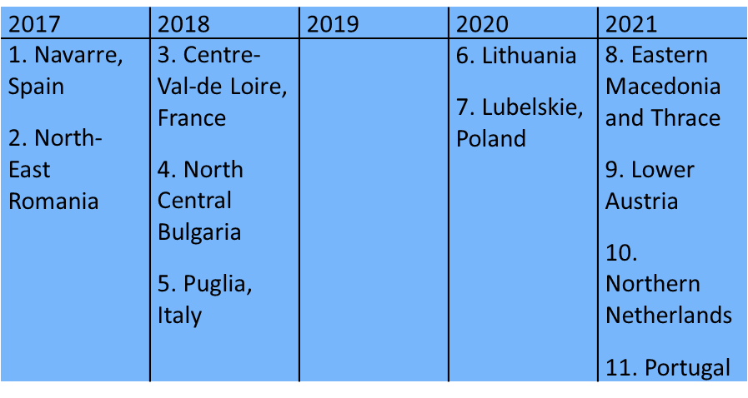
Methodology
Cross-case analysis focused on identifying and characterising innovative practices in two steps:
Within-case analysis guided by concrete questions and conducted by 2 researchers in parallel
Consolidation into a cross-case matrix to facilitate development of a structured typolology of innovative practices

Slide 8
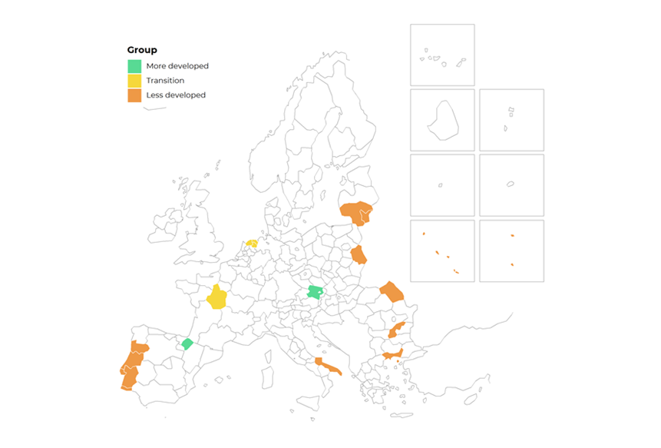
Analysis underlined importance of context
Large heterogeneity in the cases reflective of:
1. Action research approach employed in project
2. Differences in context
Level of development
Multilevel governance
HEI system
Specifics of S3
Design of EDP
Innovation policy mix
Source: : https://ec.europa.eu/eurostat/web/cohesion-policy-indicators/context/cohesion-regions

Slide 9
Four dimensions of innovative practices

Slide 10
Structured typology of innovative practices
Dimension | Innovative practice category
S3 and HEI Governance | Leadership of HEIs in design and implementation of S3 Participation of HEIs in S3 governance bodies S3 stakeholder representation in HEI governing bodies HEI institutional capacity, coordination and multilevel governance
S3 Implementation through HEIs roles in regional innovation system | HEI engagement with business Connecting SMEs and entrepreneurs to S3 HEIs engagement with intermediate institutions Mechanisms for embedding HEIs in innovation ecosystems
Regional upgrading through skills development and alignment | Explicit focus on human capital built into S3 Specific initiatives to meet companies’ skills needs Industrial doctorate programmes Linking HEIs and VET system
Learning with and from others | Cross-border initiatives and International collaboration HESS study EU funded programmes
Lubelskie: Explicit recognition in S3 documents; EM & Thrace: SWOT analysis to inform priority selection; Navarre: Thematic Chairs linking to S3 priorities
NE Romania: academic task force; Portugal: monitoring system
NC Bulgaria: Centre for Entrepreneurship; Navarre: important number of companies participating in teaching and at work placements
CVL: COMUE; Lubelskie: Association of HEIs; NNL: coordination with national and provincial levels

Slide 11
Structured typology of innovative practices
Dimension | Innovative practice category
S3 and HEI Governance | Leadership of HEIs in design and implementation of S3 Participation of HEIs in S3 governance bodies S3 stakeholder representation in HEI governing bodies HEI institutional capacity, coordination and multilevel governance
S3 Implementation through HEIs roles in regional innovation system | HEI engagement with business Connecting SMEs and entrepreneurs to S3 HEIs engagement with intermediate institutions Mechanisms for embedding HEIs in innovation ecosystems
Regional upgrading through skills development and alignment | Explicit focus on human capital built into S3 Specific initiatives to meet companies’ skills needs Industrial doctorate programmes Linking HEIs and VET system
Learning with and from others | Cross-border initiatives and International collaboration HESS study EU funded programmes
CVL: Knowledge transfer partnerships; NE Romania: partnerships among HEIs to cater needs of different sectors
N Netherlands: from innovation workplace to Living Labs (Water Campus)
Lower Austria: Technopole; Portugal: Co-labs
NC Bulgaria: Regional Academic Centre, Ruse University

Slide 12
Structured typology of innovative practices
Dimension | Innovative practice category
S3 and HEI Governance | Leadership of HEIs in design and implementation of S3 Participation of HEIs in S3 governance bodies S3 stakeholder representation in HEI governing bodies HEI institutional capacity, coordination and multilevel governance
S3 Implementation through HEIs roles in regional innovation system | HEI engagement with business Connecting SMEs and entrepreneurs to S3 HEIs engagement with intermediate institutions Mechanisms for embedding HEIs in innovation ecosystems
Regional upgrading through skills development and alignment | Explicit focus on human capital built into S3 Specific initiatives to meet companies’ skills needs Industrial doctorate programmes Linking HEIs and VET system
Learning with and from others | Cross-border initiatives and International collaboration HESS study EU funded programmes
Navarre: Education and Training; CVL: Human Capital NE Romania: Innovation Competences
CVL: Regional observatories NE Romania and Navarre: understanding graduate entry into labour markets
Puglia: Innovative Industrial Doctorates; Lithuania: Life Science University
Puglia: High Technology Schools

Slide 13
Structured typology of innovative practices
Dimension | Innovative practice category
S3 and HEI Governance | Leadership of HEIs in design and implementation of S3 Participation of HEIs in S3 governance bodies S3 stakeholder representation in HEI governing bodies HEI institutional capacity, coordination and multilevel governance
S3 Implementation through HEIs roles in regional innovation system | HEI engagement with business Connecting SMEs and entrepreneurs to S3 HEIs engagement with intermediate institutions Mechanisms for embedding HEIs in innovation ecosystems
Regional upgrading through skills development and alignment | Explicit focus on human capital built into S3 Specific initiatives to meet companies’ skills needs Industrial doctorate programmes Linking HEIs and VET system
Learning with and from others | Cross-border initiatives and International collaboration HESS study EU funded programmes
Navarre: Vanguard Initiative; NC Bulgaria: Danube Transnational Programme
EM & Thrace: Centre for Life-long learning; NE Romania: Academic Task Force
ESIF (ESF and RDF); ERASMUS+, Interreg and Horizon 2020

Slide 14
Thank you

