Slide 1
Higher Education for Smart Specialisation (HESS) IV
Jayne Woolford (JRC)

Slide 2
HESS aims and rationale
Understand how HEIs can play a more effective role in the design and implementation of S3 and act as drivers for innovation and regional development
Strengthening partnerships between HEIs and public authorities, align their strategies.
Difficulties in integrating human capital – investment in skills and human capital can support competitiveness and growth
Closer integration of HESS with the wider EU agenda and move towards more cross-cutting and strategic approach.

Slide 3
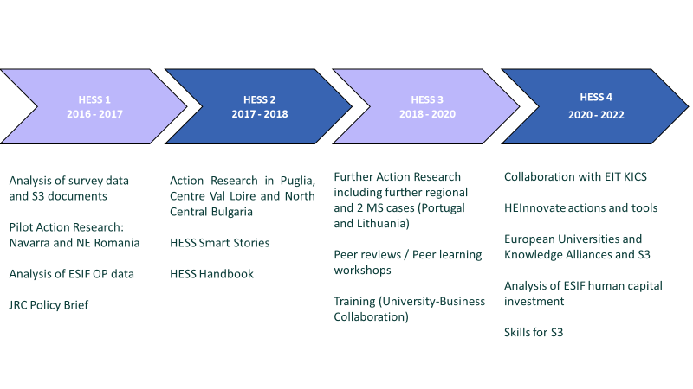
HESS Phases I-IV
Notes:
HESS IV will run until 22nd January 2023

Slide 4
HESS IV 2020-2022 - WPs 1, 2, and 3
1 - Collaborations with EIT Knowledge and Innovation Communities on innovation capacities for HEIs and knowledge triangle integration
2 – Incorporation of a regional dimension into HEInnovate
3 - European Universities and Knowledge Alliances

Slide 5
HESS IV 2020-2022 - WP4
Human capital in ESIF
Analyse ESIF investments in human capital (ERDF specific objective on S3 skills, industrial transition and entrepreneurship): type of initiatives, beneficiaries, collaboration links with local ecosystems, geographical patterns.

Slide 6
HESS IV 2020-2022 - WP5
HESS Advisory Group
Co-creation team of independent experts from higher education and regional/national S3 authorities
To provide direction and reflect on outcomes.
To identify appropriate activities and policy implications.

Slide 7
Purpose, objectives and scope of group (1)
Bring a strong academic and practitioner input to the work of the HESS project and ensure that the outcomes and relevant policy learning is fed back into the different stakeholder constituencies.
Enable a peer review of the work of experts contracted under the HESS project and JRC HESS team outputs and activities and the further refinement of research approaches.
Ensure synergies and complementarities across the different HESS Work Packages and with evolving and emerging policy and regulatory agendas and developments. Identify emerging issues and policy options/developments of interest.

Slide 8
Purpose, objectives and scope of group (2)
Ensure that the role of HEIs is reflected within the work of the JRC’s S4 scientific committee and in the development of the S4 methodology. Consider the implications of the twin transitions and EU missions on HEIs role in regional economic development and the support and lessons learnt in the progression to S4.
Contribute to ensuring the added value and legacy of the HESS project in the broader policy context. Identify gaps in knowledge and potential future HESS-related activity.
Notes:
You all received a copy of the ToR for the group and assume you are happy with it? We take it as so if we don’t hear from you before the first set of minutes are agreed.
Please any comments / thoughts on the group and how it could develop /add most value would be very welcome.

Slide 9
Conclusions / Food for thought
How are the activities and outcomes of the HESS project relevant to international practice? What developments could influence and adapt the projects objectives and activities?
What additional links could be drawn across the different work packages and the activities undertaken under HESS but also more widely?
What is the added value of the group in terms of potential legacy and broader policy context?
What could any future HESS activity look like? Where are the gaps in our knowledge?

Slide 10
Thank you
© European Union 2020
Unless otherwise noted the reuse of this presentation is authorised under the CC BY 4.0 license. For any use or reproduction of elements that are not owned by the EU, permission may need to be sought directly from the respective right holders.
Slide xx: element concerned, source: e.g. Fotolia.com; Slide xx: element concerned, source: e.g. iStock.com
Notes:
Update/add/delete parts of the copy right notice where appropriate.
More information: https://myintracomm.ec.europa.eu/corp/intellectual-property/Documents/2019_Reuse-guidelines%28CC-BY%29.pdf

