Slide 1
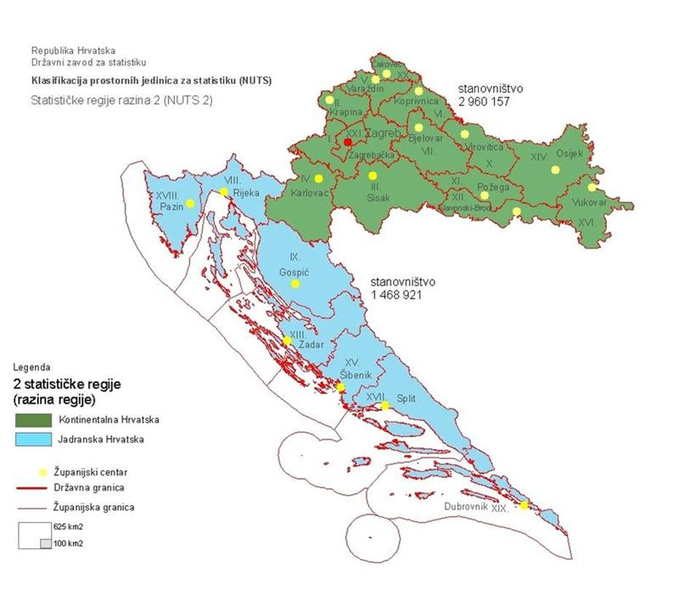
Croatia: Smart specialisation and food: food, gastronomy and bio-economy as elements of regional innovation strategies
<Please insert a map of your country/region>
EXPO 2015 in Milan (Italy)
22 September 2015 Mr. sc. Marija Rajaković

Slide 2
Food and Bio-economy is selected as one of the S3 Thematic Priority Areas in Croatia
Questions Croatia would like peers to discuss after their presentation:
What is a main driver of innovation and promotion of R&D collaboration between main stakeholders in the Food value chain?
How to promote collaboration of key stakeholders (including multinationals, SMEs, research institutions, intermediaries, etc.) in new emerging agro-food (global) value chains?
What can be done and how to improve competitiveness within agro-food priority area?
How to use territorial branding to give value adding to food products?
How can KETs be identified and applied in the area of agro-food?

Slide 3
The aim of smart specialization process in Croatia
Improvement of innovation performance and raising competitiveness of Croatian economy
More effective national innovation system
Competitive research funding contributes to the efficiency of public money invested in research
Promote business investment in RDI
Smart specialisation of Croatian economy and S3 transformation

Slide 4
The process of drafting S3 in Croatia

Slide 5
Process of selection the S3 thematic and sub-thematic priority areas
GLOBAL TRENDS AND SOCIETAL CHALLENGES
Cluster analysis (3 stars methodology) and 12 Competitiveness clusters strategic guidelines
WB analysis:
TradePerformance, Competitiveness & Potential,
Export performance and geography,
Stylized facts on productivity growth: evidence from firm level data
TA analyis: Cross-sector competitive a. analysis,
BERD analysis, KET analysis,
R&D analysis
PRIORITY THEMATIC AREAS AND CROSS-SECTORAL ISSUES
Croatian sectoral strategies
PARTNERSHIP CONSULTATIONS, EXPERT WGs, LEADER MEETING, BILATERAL MEETING, CROSS-BORDER MEETING, QUESTIONNAIRES
1st round of partnership consultation (5 regional workshops)
160 participants
36 R&D sector, 18 BSO, 60 public sector, 46 business sector
2nd round of partnership consultation (6 regional workshops)
188 participants
47 R&D sector, 20 BSO, 59 public sector, 59 business sector, 3 NGO
3rd round of partnership consultation (5TPA workshops + Tourism &Creative industry)
142 participants
26 R&D sector, 11 BSO, 72 public sector, 30 business sector, 3 NGO
4th round of partnership consultation (5 TPA workshops)
94 participants
20 R&D sector, 15 BSO, 38 public sector, 21 business sector
Thematic expert working groups and Decision making working group
Included expert from S3 sub-thematic priority areas and high-level ranking ministries officials

Slide 6
Croatian S3 thematic priority areas
HEALTH AND QUALITY OF LIFE
ENERGY AND SUSTAINABLE ENVIRONMENT
TRANSPORT AND MOBILITY
FOOD AND BIO-ECONOMY
SECURITY

Slide 7
Sub-thematic priority areas
Priority areas
HEALTH AND QUALITY OF LIFE
ENERGY AND SUSTAINABLE ENVIRONMENT
TRANSPORT AND MOBILITY
SECURITY
FOOD AND BIO-ECONOMY
Global challenges
Health, demographic change and wellbeing
Secure, clean and efficient energy / climate change
Smart, green and integrated transport
Secure society
Food security, sustainable agriculture, marine and
maritime research & the Bio-economy
Pharmaceuticals, biopharmaceuticals and medical equipment and devices
Energy systems, technologies and equipment
Added value manufacturing of road and rail vehicles parts and systems
Defense dual-use
Sustainable food production and processing
Mine action program
Environmental friendly transport solutions
Health services and new methods of preventive medicine and diagnostics
Environmentally-friendly technologies, equipment and new materials
Sustainable wood production and processing
Sub-thematic priority areas
Intelligent transport and communication systems and logistics
Cyber Security
Nutrition
CROSS-CUTTING SUB-THEMATIC PRIORITY AREAS
KEY ENABLE TECHNOLOGIES (KETs) | ICT

Slide 8
Sustainable food production and processing (sector’s coverage)
FOOD
AGRICULTURE
FISHERY
AQUACULTURE
FOOD PROCESSING INDUSTRY

Slide 9
RELEVANT COMPETITIVENESS CLUSTERS
Food competitiveness cluster

Slide 10
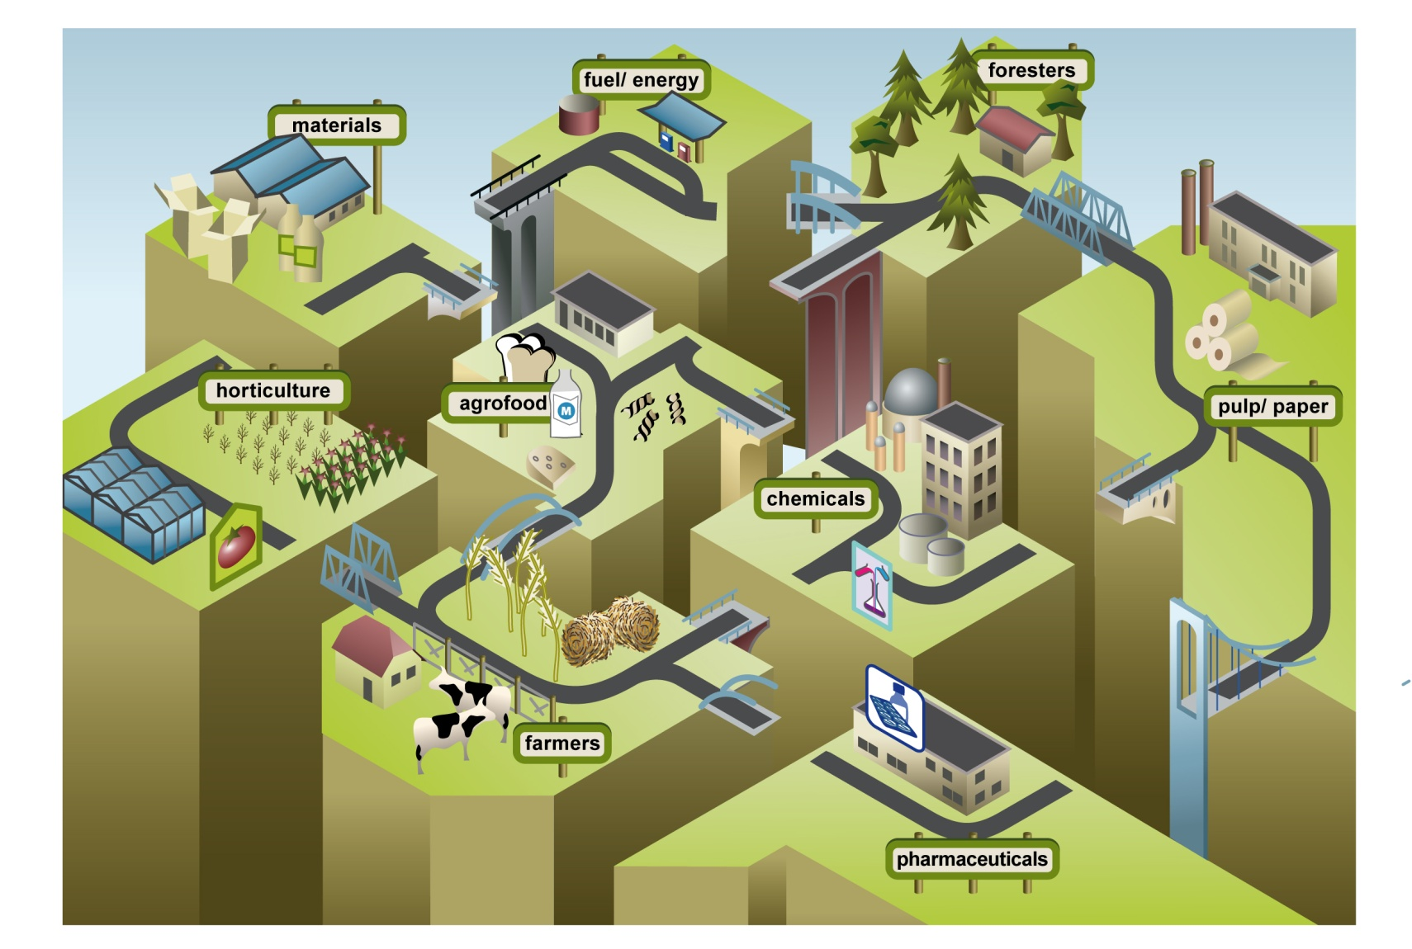
Sustainable food production and processing in the bio-economy value chain
Reinforce innovation, extend current RDI infrastructure and raise competitiveness across the bio-economy value chain

Slide 11
The challenge: Overcoming the innovation & deployment gap
Croatia’s ability to commercialise / produce high value products

Slide 12
R&D TOPICS
Integrated food supply and value chain solutions
Bio-technology (Green and Blue Biotech)
Climate changes adaptation mechanism of plants and animals
Integrated and organic agriculture innovations and agricultural land and water resource management
Development of added value food products
Conservation and sustainable use of agro biodiversity and preservation of products
Innovative technologies and processes for high quality food production
Valorization and exploration of authentic local products
FOR FISHERY AND ACQUACULTURE
Introduction of new species and development of innovative uses for unwanted catches and new breeding technologies
Proizvodnja hrane
Proizvodnja pića
Proizvodnja poljoprivrednih strojeva
Poljoprivredna proizvodnja
Ribarstvo i marikultura

Slide 13
Connected S3 TPA Health and quality of life (STPA Nutrition)
FOOD FOR HEALTH
‘Help me stay healthy’
Natural health products (nutraceuticals)
‘Help me recover’
Functional food and enriched products
‘Help me live well’
Dietary supplements

Slide 14
STPA “Food” strategic goals
Reinforce innovation, extend current RDI infrastructure, enable structural changes (modernization and diversification) and raise competitiveness across the Food value chain
Build on Key national and regional advantages
Develop and articulate powerful future vision for TPA’s development
Coordinate and consolidate different scope of private and public interests into the programme to accomplish the vision
Undertake Research and Development that will generate new initiatives, projects and programmes for activating regional development

Slide 15
Delivery instruments
Development of Innovation for Network and creation of Thematic Innovation Platforms
Preparation of Science and Technology Foresight
Creation of Centres of Competence
Increase R&D ability for conducting top quality research and cooperation on national and international levels
Support to business investment in RDI
Support to social innovation
Support to research organizations conducting R&D projects directed towards the needs of economy
Strengthening National Centres of research excellence
Building stairway to research excellence by enabling synergies with ERC grants
Financial engineering instruments
Support to competitiveness cluster initiatives
Innovation friendly business environment for SMEs
Strengthening links between scientific and business sector through support to technology transfer Offices and Science Technology Parks
Future skill needs assessment
DELIVERY INSTRUMENTS

Slide 16
Coverage of delivery instruments in Croatian innovation system

Slide 17
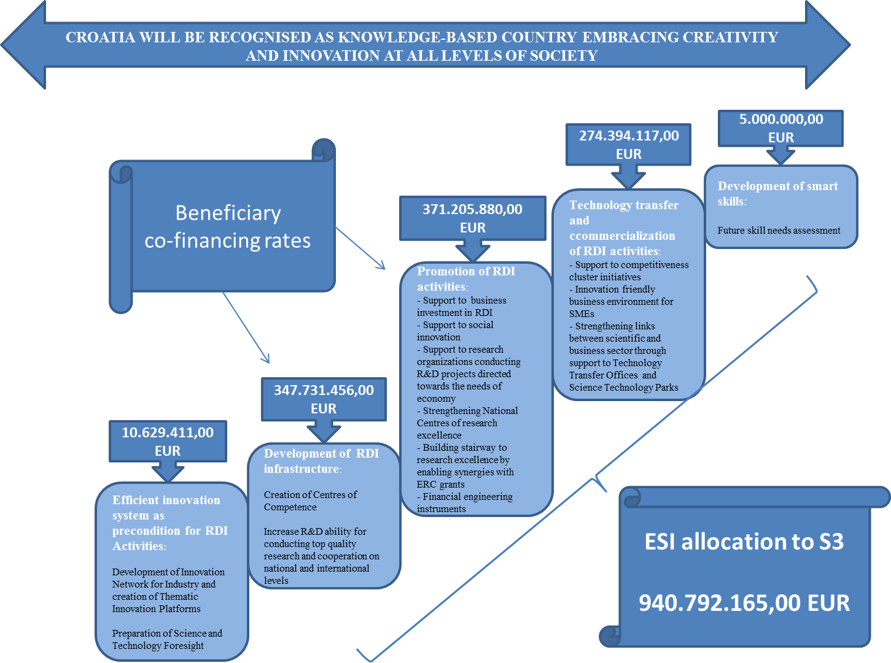

Slide 18
NEXT STEPS: CONTINOUS ENTREPRENEURIAL
DISCOVERY PROCESS
Entrepreneurial discovery process is planned to be ensured through Establishment of Innovation Network for Industry (INI) and Food and Bio-economy Innovation Platform
Operation of INI and Food and Bio-economy Innovation Platform will be ensured through Strategic project of Ministry of Economy - financed through ESI allocations (7,5 mil EUR) + National budget (1.6 mil EUR)
Activities to be supported through Strategic project:
Analysis and mapping of RDI capacities of business sector
Establishment and support to the institutional set-up
Drafting RDI TPA strategy for the business sector
Preparation of project pipeline and support to preparation of RDI projects
Sub-thematic Priority Action Groups
Established under S3 Thematic Innovation Councils
RDI Strategy for business sector
Covering vision, objectives, priorities, delivery mechanism and indicators of S3 Sub-thematic priority areas
Monitoring Framework
Monitoring of performance at sub-tehmatic priority areas level (output, outcome/result and contexrt indicators)
Sub-thematic Priority Areas Action Plans 2017-2020
Covering activities, responsible institutions and timelines for implementation RDI Strategies for business sector for each Sub-thematic priority areas
Sub-thematic areas Project pipelines
Preparation for funding opportunities and proving RDI capacities of Sub-thematic Priority areas

Slide 19
Cooperation in food-related smart specialisation

Slide 20
Question 1:
How to promote collaboration of key stakeholders (including SMEs, large companies, multinationals, SMEs, research institutions, intermediaries, etc.) in new emerging agro-food (global) value chains?
Notes:
This slide focuses on your question: try to formulate on this slide your answers to the following questions:
What is your question/issue?
Has something been done by policymakers in your region to address this issue or is it a completely new issue?
If you have done something in this area, what are the things that worked well for you?
If there was anything you have done to address this issue and it did not work, it would be useful for other participants to learn from your experience.

Slide 21
Question 2:
What can be done and how to improve competitiveness within agro-food priority area?
Notes:
This slide focuses on your question: try to formulate on this slide your answers to the following questions:
What is your question/issue?
Has something been done by policymakers in your region to address this issue or is it a completely new issue?
If you have done something in this area, what are the things that worked well for you?
If there was anything you have done to address this issue and it did not work, it would be useful for other participants to learn from your experience.

Slide 22
Question 3:
How to use territorial branding to give value adding to food products?
Example: Croatian Flagship project “Gourmet Croatia”

Slide 23
Question 4:
How can KETs be identified and applied in the area of agro-food?
Croatia recognized following R&D topics related to possible KETs application in Food development:
Biotechnological (White, Grey, Blue and Green Bio Tech) for Environment sustainability – Plants & Soil and Water management, Food security, Food processing and Healthy food ingredients
KETs for food packaging systems for preserving food from microbial contamination and for improving shelf life and cost-efficient consumer food packaging with increased environmental sustainability
AMT - Processes for the cost-efficient conversion of various biomass to biofuels
Advance material for coatings and surfaces
Main instruments: Stakeholders education about KETs relevance for Food development,
RDI collaborative projects, KETs WEB platform, KETs as an chapter under Food RDI strategy for business sector

Slide 24
Thank you!

