Slide 1
Peer Review Event on RIS3
In Eastern Macedonia And Thrace
Overview of RIS3
Marek Przeor
Team Leader – Smart Growth
DG Regio and Urban Policy
European Commission
13 February 2014, Alexandroupolis, Greece
Notes:
1
Plenary session
Europe 2020 and Smart Specialization Strategy Implementation towards Regional Growth
Objective:
Discuss Smart Specialization Strategies and their link with the Europe 2020 Strategy for jobs and growth. Scrutinise the progress, trends, results achieved by RIS3 related flagship initiatives of the Europe 2020 Strategy, including synergy between cohesion policy, Horizon 2020, EEA, Norwegian and national financial instruments. Outline resulting issues in the light of the policy priorities of the new Commission’s policy guidelines.
Speakers:
Speaker delegated by the EC – DG Regional and Urban Policy – Ms. Charlina Vitcheva, Director, Smart and Sustainable Growth and Southern Europe, DG Regional and Urban Policy, European Commission
Speaker delegated by the EC – DG Research and Innovation – Mr. Dimitri Corpakis, Head of Unit - Spreading excellence and widening participation Directorate for the Innovation Union and the European Research Area
DG Research & Innovation, European Commission
Speaker delegated by the EC – Joint Research Centre – Mr. John Bensted Smith, Director, Institute for Prospective Technological Studies, Joint Research Centre
Speaker delegated by the Research Council of Norway – Ms. Anne Kjersti Fahlvik
Deputy State Secretary, Director of Science, Technology and Innovation Department, Ministry of Education and Science – Ms. Agrita Kiopa
Representative from the Committee of the Regions – ???
Discussion:
What are the lessons learned from the mid-term review of the Europe 2020 Strategy?
What needs to be done for better coordination and complementarity between regional, national, EEA, Norwegian and EU-level policies and financial instruments?
How can less advanced regions catch up with innovation leaders? What should they do differently?
Moderation: Representative of the Joint Research Centre – Mr. John Bensted Smith, Director, Institute for Prospective Technological Studies, Joint Research Centre

Slide 2
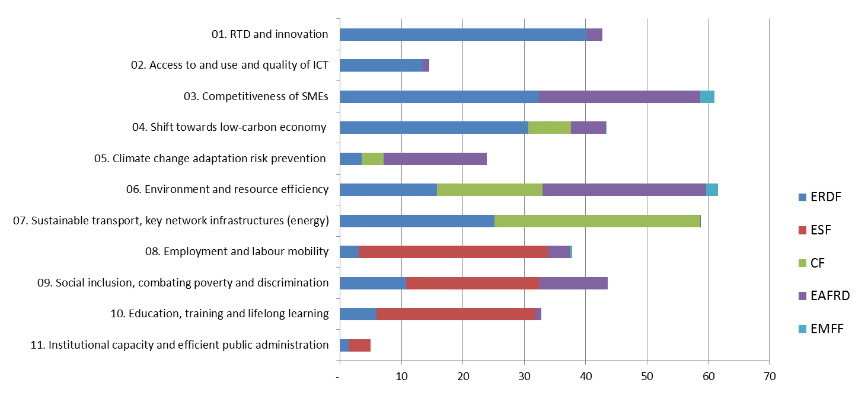
Operational Programmes adoption: State of play
As of 31 January - (205 formal OPs received in 2014)
- 130 OPs adopted, 35 are ready for adoption by end February, 40 under negotiation
- 77 action plans for TO1
Over €160 billion
of which
40 billion ERDF for TO1
In billion EUR
Source: Final ESIF partnership agreements as of December 2014
Notes:
Clear shift in terms of funding priorities- increase of ERDF funding made available to innovation and R&D, ICT, SMEs, and the low carbon economy (thematic concentration)
Visible increase in ERDF investments in low carbon economy due to minimum funding requirements

Slide 3
Greece allocation: 1,3 billion Euro out of total 19,7 billion Euro in ESIF for Greece in 2014-20
  Share of TO1 in total ESIF allocation by country*
EU average: 10% out of 425 billion Euro of ESIF on TO1
*based on PA / subject to possible modifications after finalisation of the negotiations of Operational Programmes

Slide 4
State of play of RIS3 Process
Strengths
Paradigm shift in innovation policy design
Concept academically accepted
Ex ante conditionality gives clout
Fresh start for innovation policy governance & priorities in many countries & regions
Role & potential of regions in innovation policy (place-based)
Collaboration among research, innovation, industry policies also at EU level
Weaknesses (in some cases)
- Re-packaging of old strategies in some MS
Entrepreneurial Discovery Process unbalanced and non-participatory
Policy mix conservative & horizontal
Intervention logic fuzzy
Lack of vision / ambition for transformation
Popular / catch-all "priorities"
Multi-level governance unclear
International outlook & connectivity low
Threats (in some cases)
Silo-thinking: Science-Industry-Agriculture-Social&Employment-Transport-Energy-Environment-Health …
Missing links: Demand side, public sector innovation, social innovation, skills gaps
Low impact due to unclear concentration commitments & narrow ERDF-TO1 view
Monitoring systems unfit to spot changes in priorities
Drop in motivation after EAC fulfilment
Lack of administrative capacities
Opportunities
Synergies across EU programmes and national funds
Critical mass, value chains via trans-national cooperation: Vanguard, Macro-regional strategies, INTERREG, COSME& Horizon2020
Info-exchange: Monitoring, data collection..
Improved innovation support policy mix & delivery mechanisms
Mutual learning
Action Plans & technical assistance
More precise RIS3 priorities in revision

Slide 5
Main challenges for Commission to make smart specialisation work:
Keep the ball rolling: RIS3 is conceived as an on-going (and reiterative) process with stakeholder involvement (Entrepreneurial Discovery Process), monitoring and adjustments until 2020…
Implementation tools & capacities: quality of the implementation and impact depend on suitability of the support tools, the administrative capacities to design such tools and manage them effectively and efficiently
International opening and cooperation: generate critical mass via combining forces, complementing capacities and getting the chain links together for value chains. Role for synergies with Horizon 2020…
President Juncker's focus for Commissioner Creţu:
• Ensuring that the new conditionality provisions of the Funds are respected and perform their role…"
• Contributing to:
- 300bn investment package
- Energy Union
- Digital Single Market
• Ensuring coherence and coordination between all funds covered by the Common Strategic Framework, as well as maximising synergies with instruments available at EU level…

Slide 6
Lessons from yesterday
Table A-1 Governance mechanism: cooperative structures, leadership and animation skills, neutrality in decision taking, resistance to political shocks, TO1 only for RIS3 and to boost regional/national economy, clear rules between national and regional,
Table B-1 Implementation of RIS3 / Action Plans: strategy into implementation (paper into jobs); who? what? when? action plans are dynamic linked to EDP, existing eco-system, selection criteria crucial
Table C-1 Mobility agreement: critical mass of resaerchers needed, use of EU programmes to attract good researchers, Phd courses for enterpreneurs or employees, traineeships in companies in university curriculum, research-industry short-term staff exchanges
Today session
Table A-2 Monitoring & Evaluation System
Table B-2 State aid rules and legislation opportunities and restrictions
Table C-2 Mobility agreement and training needs

Slide 7
Thank you for your attention!
For more information:
on Cohesion Policy:
http://ec.europa.eu/regional_policy/index_en.cfm
on Smart Specialisation Strategies
http://s3platform.jrc.ec.europa.eu/s3pguide

