Slide 1
The Smart Specialisation Platform
S3 Platform
John Edwards
Alexandroupoli, 12 January 2015

Slide 2
Smart Specialisation Platform
Created in 2011 to provide science-based
professional advice to EU national and regional
policy-makers for the establishment and implementation of their RIS3, make better use of the ESI Funds and thus contribute to the Europe 2020 goals.
Managed by JRC-IPTS in Seville in the frame of a wider EU effort including several EC services and support by CoR and EP.
A privileged perspective:
Outside the Commission
Inside the Commission
In the scientific community

Slide 3
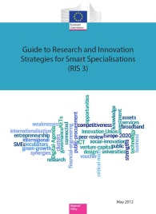
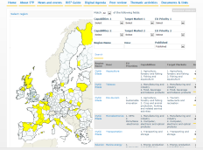
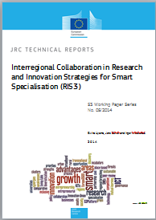
Main activities of S3 Platform
7. Research agenda
1. The RIS3
methodological Guide & the Digital Agenda Toolbox
Eye@RIS3
6. Interactive tools, S3 Newsletter and Website
2. Trans-national learning, Peer Review & thematic workshops
3. Country- and Macro-region events and targeted seminars at IPTS
5. Trans-regional collaboration
4. RIS3 assessment
and support to REGIO desks ; ICT experts
Notes:
Inger

Slide 4
Why is collaboration so important in RIS3?
YOU ARE NOT ALONE! - Your region or country is a node in a global network!
Globalised networks and economy calls for regional innovation policy
that goes beyond regional/national borders
that takes into account the degree to which actors in a region are able to connect to and benefit from global innovation networks and value chains
Collaboration increasingly necessary to succeed in sustaining growth, jobs and welfare in Europe
Place-based approach in S3 to avoid fragmentation, but depends on connectedness in order to succeed
Notes:
Inter-regional and trans-national collaboration in research and innovation is becoming increasingly relevant and necessary to succeed in sustaining growth, jobs and welfare in Europe. The importance of global innovation networks thus calls for a type of regional innovation policy that goes beyond regional borders and takes into account the degree to which actors in a region are able to connect to and benefit from such networks. The place-based approach in research and innovation strategies for smart specialisation (RIS3) has further reinforced this need.
As inter-regional collaboration is a key component of the implementation of the RIS3,
The importance of global innovation networks calls for a regional innovation policy that goes beyond regional borders and takes into account the degree to which actors in a region are able to connect to and benefit from such networks.

Slide 5
Intensity of collaboration?
Information sharing only e.g. innovation policy initiatives, research programmes, market intelligence
Concrete, ad hoc, projects, limited in time.
Policy coordination, for instance aligning funding programme conditions or mobility incentives
Jointly funded programmes or actions addressing common problems
Joint Strategies that are commonly designed, funded and implemented by the partner regions, and which inform a mix of policies and actions.

Slide 6
Aligning innovation roadmaps
Across the EU around Europe2020 goals
(e.g. H2020 co-operation initiatives)
Between national and regional levels
(e.g. through RIS3)
Around networks, technologies, value chains
(e.g. Interreg IV C, H2020/ESIF mainstream)
Over physical and political borders
(e.g. Interreg, IPA CBC, EU macro-regions)
… making smart specialisation priorities "smarter"

Slide 7
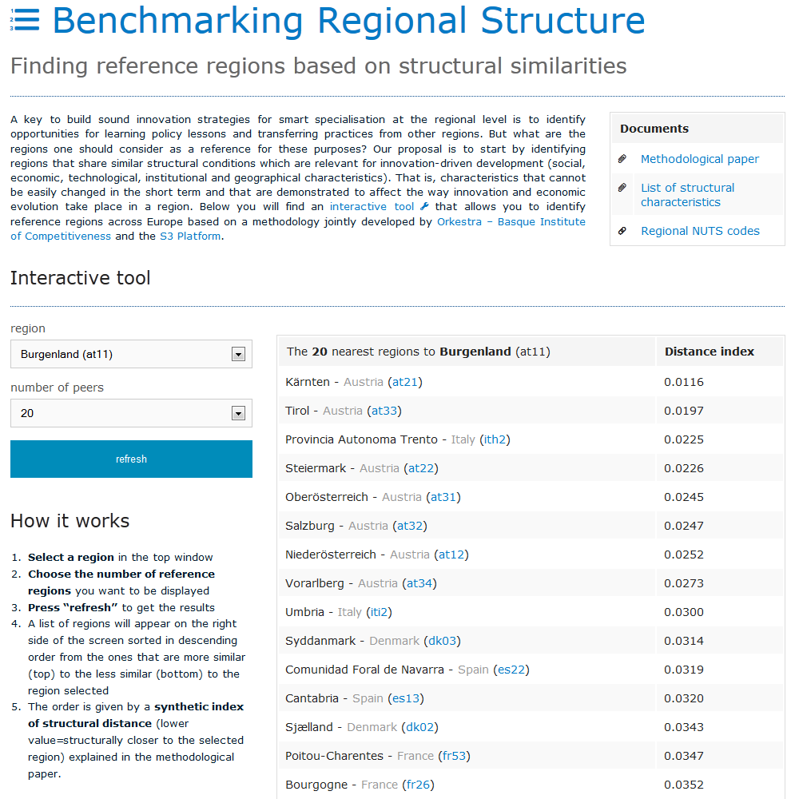
Benchmarking regional structure
Identify regions with similar conditions
Self-assessment and targeting of priorities
Potential cooperation opportunities

Slide 8
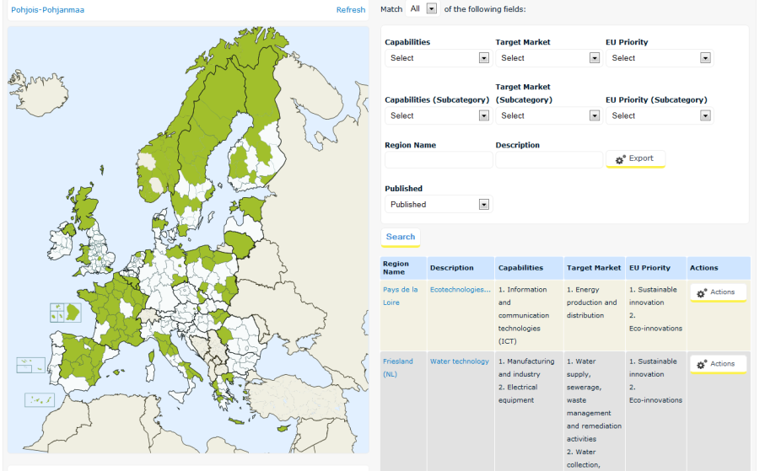
Eye@RIS3 – an online database for RIS3 priorities
Enable Regions and Member States to position themselves,
To find their unique niches
To seek out potential partners for collaboration
Categories are not perfect matches
Approx 190 regions and more than 800 priorities
Specialisation fields are emerging that are related to:
Energy
Life science
ICT
Environment
Agro-food
Tourism
http://s3platform.jrc.ec.europa.eu/map
Notes:
Data from peer reviews, expert assessment reports, and national reports
Data on regions, then each priority has four dimensions, short text based description, and three categories with fixed two level categories, connection to EU prioritised policies, regional capabilities and target markets.
The data base can be searched in all these dimensions
And data can also be uploaded
Categories are not perfect matches, but serves the purpose of an easy to use tool to give initial indications of where regions are aiming with their priorities.

Slide 9
Nurturing connectedness …
Smart use of ESI Funds - Not only INTERREG …
… "unlock the 15%" (art. 70.2 CPR)
"The managing authority may accept that an operation is implemented outside the programme area but within the Union, provided that …:
(a) the operation is for the benefit of the programme area;
(b) the total amount allocated under the programme to operations located outside the programme area does not exceed 15 % of the support from the ERDF ... at the level of the priority …"
For thematic objective 1: allocations reach ~ 42 billion EUR (source: final and draft partnership agreements as of October 2014).

Slide 10
Time is now!
28 Partnership Agreements and 21 Operational Programmes adopted by EC
First new INTERREG programme adopted end November.
Launch of INTERREG-EUROPE early December.
First H2020 calls published.

Slide 11
Thank you!
http://s3platform.jrc.ec.europa.eu
JRC-IPTS-S3PLATFORM@ec.europa.eu
Notes:
11

