Slide 1
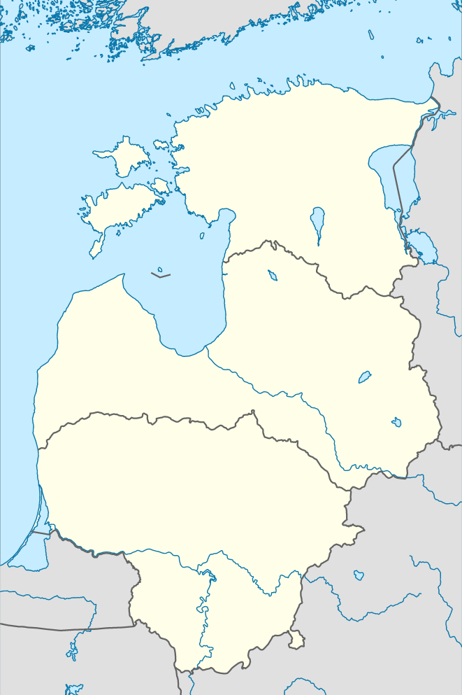
Jurgita Petrauskienė 2014 02 25
A plan for Implementation of lithuanian smart specialization

Slide 2
MOSTA
State budgetary institution established by the Ministry for Education and Science of the Republic of Lithuania (April 27, 2007) which:
Provides recommendations on the development of the national research and HE system;
Organizes research and HE monitoring;
Analyses the conditions of Lithuanian research and HE system;
Participates in development and implementation of research and higher education policy.

Slide 3
From analysis to implementation
Priority field
6 broad Priority fields
Analysis of research potential and structure of economy
Priorities
20 Priorities within 6 broad Priority fields
In-depth analysis in every Priority field + expert panels
Roadmaps
For every Priority (total 20 roadmaps)
Expert panels + broad survey
Priority implementation programmes
Developed according to roadmaps (total 20 programmes)
Consultation with National expert institutions + implementing ministries

Slide 4
Logic of roadmap + instruments
5. Generation of critical mass
4. Introduction to the market: final features of the technology (product, service, etc.)
3. Prototyping: possible features of the new technology (product, service, etc.)
2. Preparation of technical concept or model: possible solutions for the identified problems
1. Search for new solutions
Levels of preparedness/ Timeframe | 2014-2015 | 2016-2017 | 2018-2019 | 2020-2022
Pool of instruments (example):
2
1
Preparation of specialists (Ministry of Science and Education)
R&D infrastructure (Ministry of Science and Education)
Pre-seed capital (Ministry of Economy)
Fundamental research (Lithuanian research council)
Joint science-business projects (Agency for Science, Innovation and Technology)
Prototyping and commercialization (Ministry of Economy)
2
1
1
2
1
1

Slide 5
Monitoring and management
Do we need additional support for the Priority? Or maybe we should discard it?
Strategic R&I council
Consists of:
Prime Minister
Science institutions
Ministries
Agencies
Business representatives
How is going? Does the actual implementation meets the planned results?
Coordination function
Consists of:
Ministries
Agencies
Other stakeholders
Monitoring function
Interim evaluation. Do we need new priorities? What is the impact already?
Priority:
Various projects by public and private entities within the thematic field
2014
2017
2020
Entrepreneurial discovery

