Slide 1
Comments to Claire NAUWELAERS a Nordic perspective
Åge Mariussen

Slide 2
Nauwelaers identifies several crucial problems
How to translate broad strategies into efficient and integrated policy mixes
How to overcome policy-makers resistance to long-term investments
Need for cross-domains, cross-level and cross-border policies
Need to move from silo-driven to outcome driven policies

Slide 3
My comments
How do you build political support for a smart, long-term, cross sector, outcome oriented strategy of investments in education, science, innovation and growth?
In a Nordic context: by putting the private sector (business leaders, employer organizations and unions) in the front seat,
OK, but how?
By looking for problems and solutions together with them
GAP analysis and transnational learning
A POSSIBLE SOLUTION (INTEGRATED POLICY MIX) FROM FINLAND:
What do you do when the technological university your regional industries need is not there?

Slide 4
GAP analysis: IDENTIFY YOUR PROBLEMS, LOOK FOR SOLUTIONS
GAP analysis comes from business studies, it is well known in the business community
We have applied GAP analysis on the tripple helix policy mix
Questions to business leaders:
What is your expectations to research and education (and other sectors) in your region – and
what are your experiences?
GAP is the difference.
A large GAP indicate a problem
A small GAP indicates that there might be a good solution
compare GAPs across regions in different countries, and in the same region through time
Dialogue on PROBLEMS, search for HAPPY solutions.

Slide 5
GAP analysis: Why are Finns happier that Norwegians? (it cannot be results in the olympics)
Nordland Processing Industries
Ostrobothnia, energy
THE TECHNOLOGICAL UNIVERSITY IS NOT THERE
education
0 1 2 3 4 5

Slide 6
Example of a good solution reducing the GAP: University Consortium
It is set up in a peripheral rural area or a small industrial town
The municipal investment is a house fitted for education
Scientific equipment (laboratories etc) are to a large degree donated by industries in the region or EU Structural Funds
The staff is employed by national Finnish universities located in other parts of Finland
The salaries of the staff is based on regular state funding to these universities
The scientific quality of research and education is guaranteed by the national universities

Slide 7
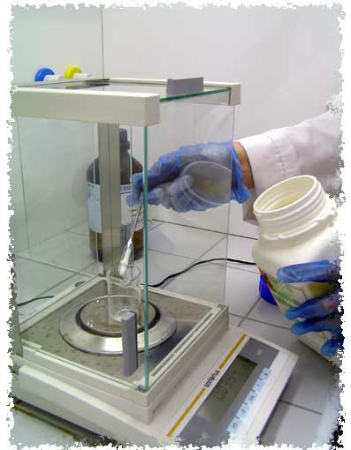
Kokkola University Consortium Applied chemistry
Students are mostly adults, working in the regional industries
Their academic degrees are based on research which often also is innovation projects in the firms where they are working

Slide 8
University Consortia in Finland
Location | turnover | staff | students | Univerities
Kajaani | 11 mill | 130 | 2400 | Oulo, Eastern Finland Jyvaskyla, Lappland
Kokkola | 7,5 mill | 100 | 3000 | Oulo, Jyvaskyla, Vasa
Lahti | 12 mill | 160 | 4000 | Alto, Helsinki, Lappeenranta
Mikkeli | 19 mill | 200 | 4900 | Alto, Helsinki, Lappeenranta
Pori | 15 mill | 180 | 3800 | Alto, Tampere, Turku
Seinajoki | 7 mill | 90 | 4000 | Tampere, Helsinki, Vasa
total |  |  | 22100

Slide 9
University consortia
Education and research is coordinated with regional industries, with an over-all objective to promote regional development
This policy-mix is based on a combination of
National policies
University strategies
Structural funds
Business and union strategies
Individual strategies among students/ empoyees

Slide 10
efficient and integrated policy mixes
Overcomes the classic silo-problems of public sector bureaucracy through public – private partnerships, with the private sector in the driving seat
Creates good local/ regional solutions

