Slide 1
Opportunities in Eastern Partnership Territorial Cooperation Programmes
Erikas Jankauskas, EaPTC Support Programme
S3 Design Learning Workshop
Chisinau, Moldova/ 18-19 February, 2016

Slide 2
Topics for discussion
Introducing ourselves…
Eastern Partnership Territorial Cooperation: concept, principles, programmes…
Synergies between programmes of territorial cooperation and actions for smart specialization…

Slide 3
Concept of territorial cooperation

Slide 4
EaPTC: Origins
Part of regional development/social-economic development
  Initiative of EC, well accepted by EaP countries
  Pilot-testing programmes
Allocation in budget: ENPI 2013 regional progamme
In EaP countries, emulate cross-border cooperation programmes:
  Programming
  Joint structures

Slide 5
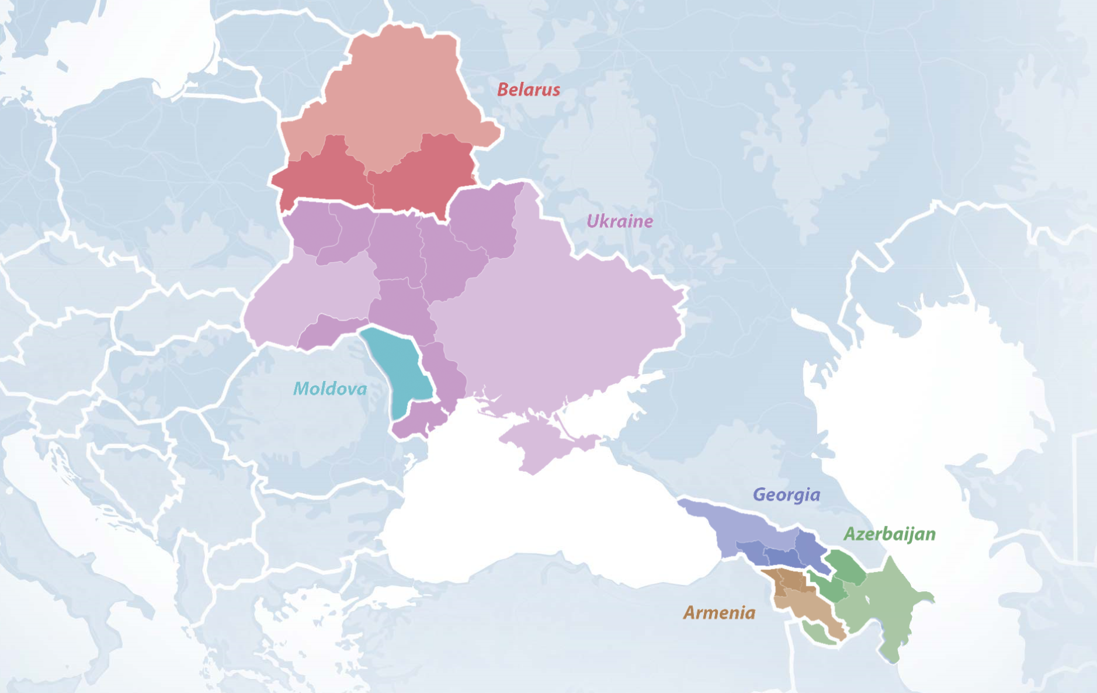
EaPTC: Four Borders

Slide 6
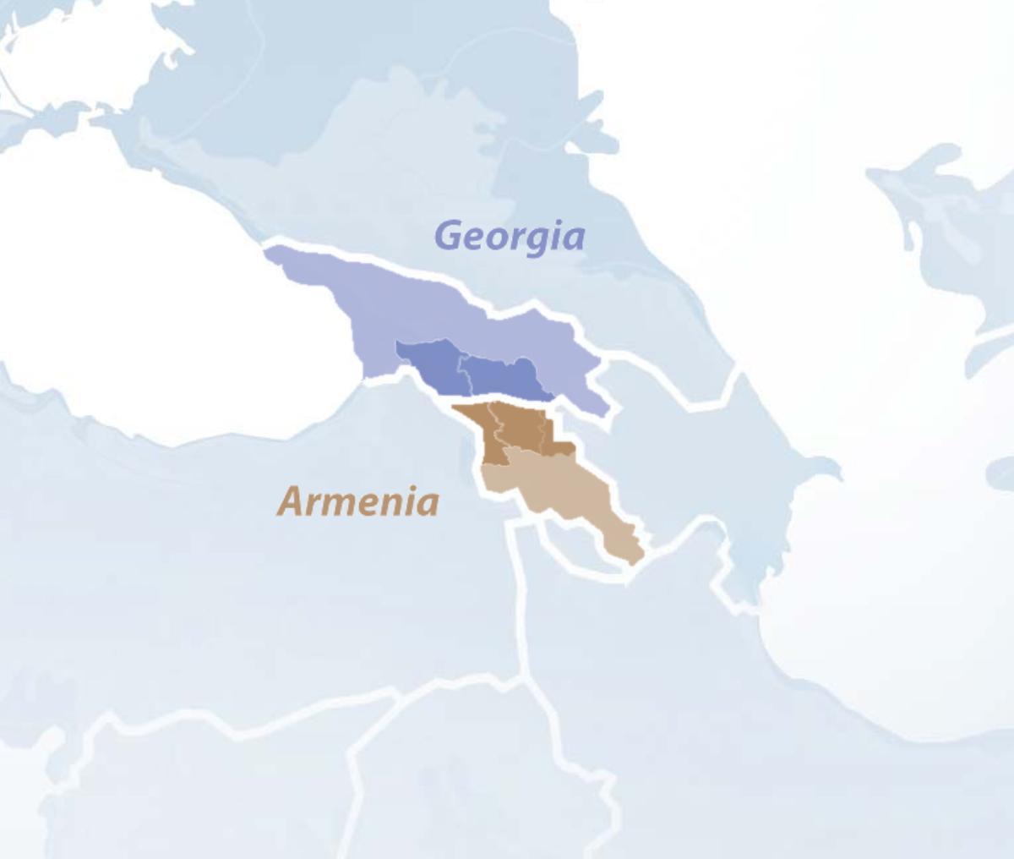
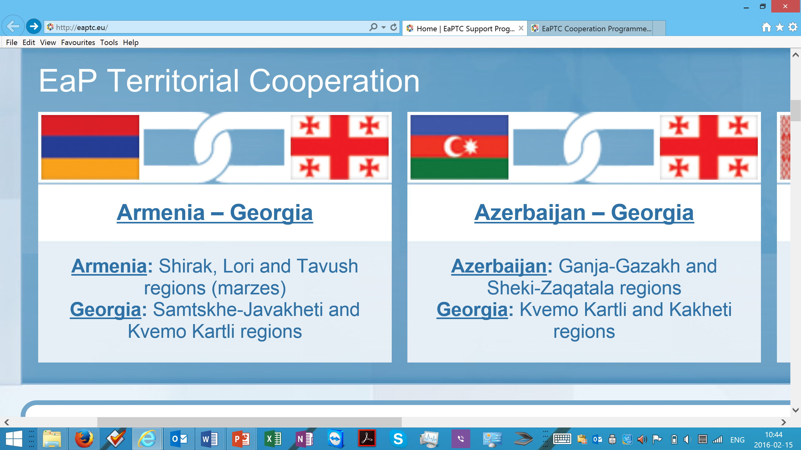
Geographical Coverage: AM-GE

Slide 7
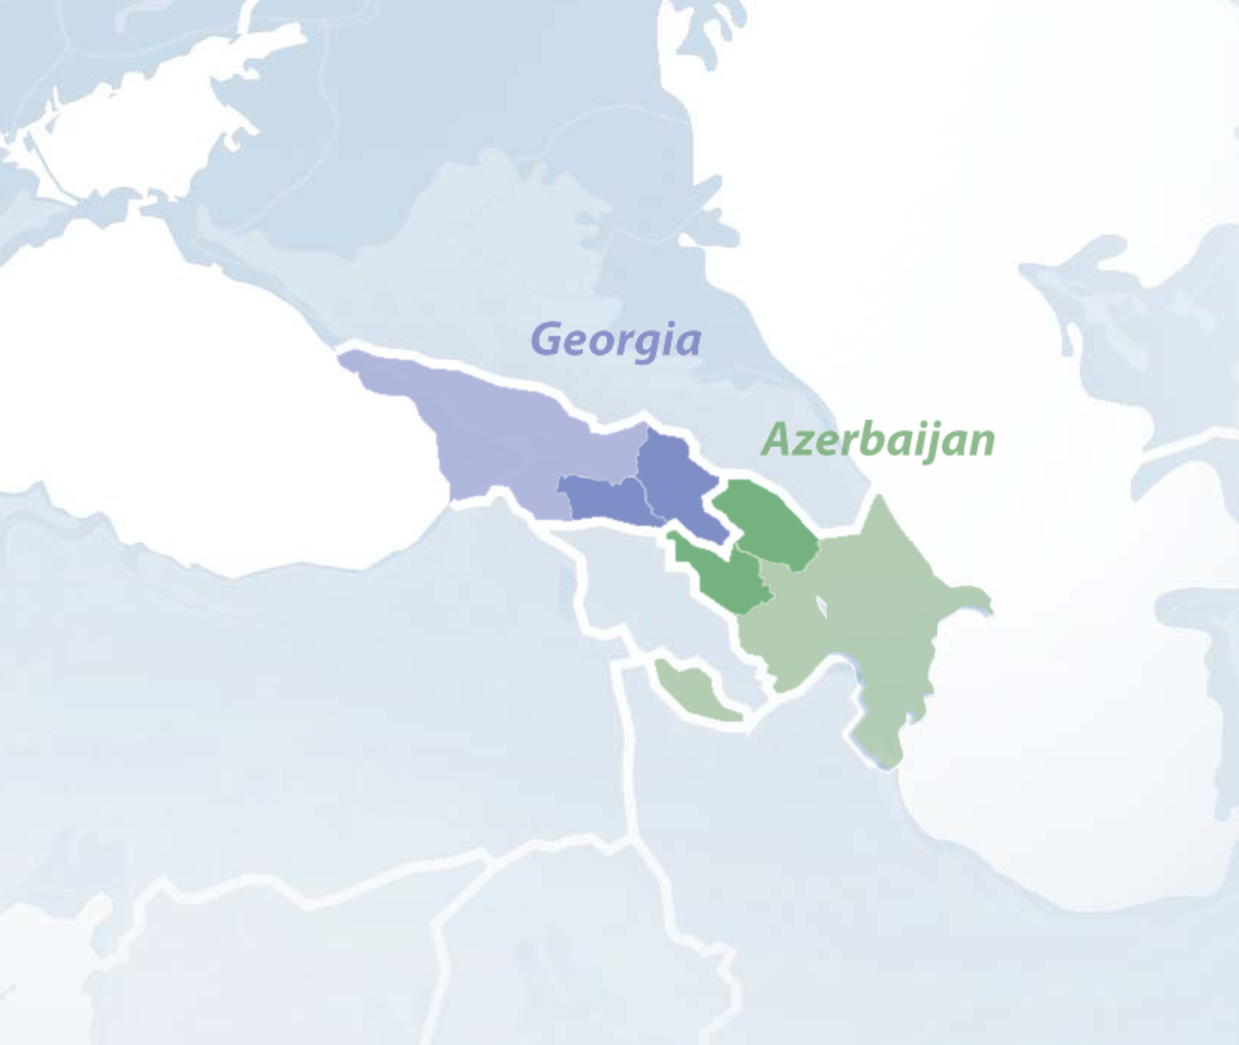
Geographical Coverage: AZ-GE

Slide 8
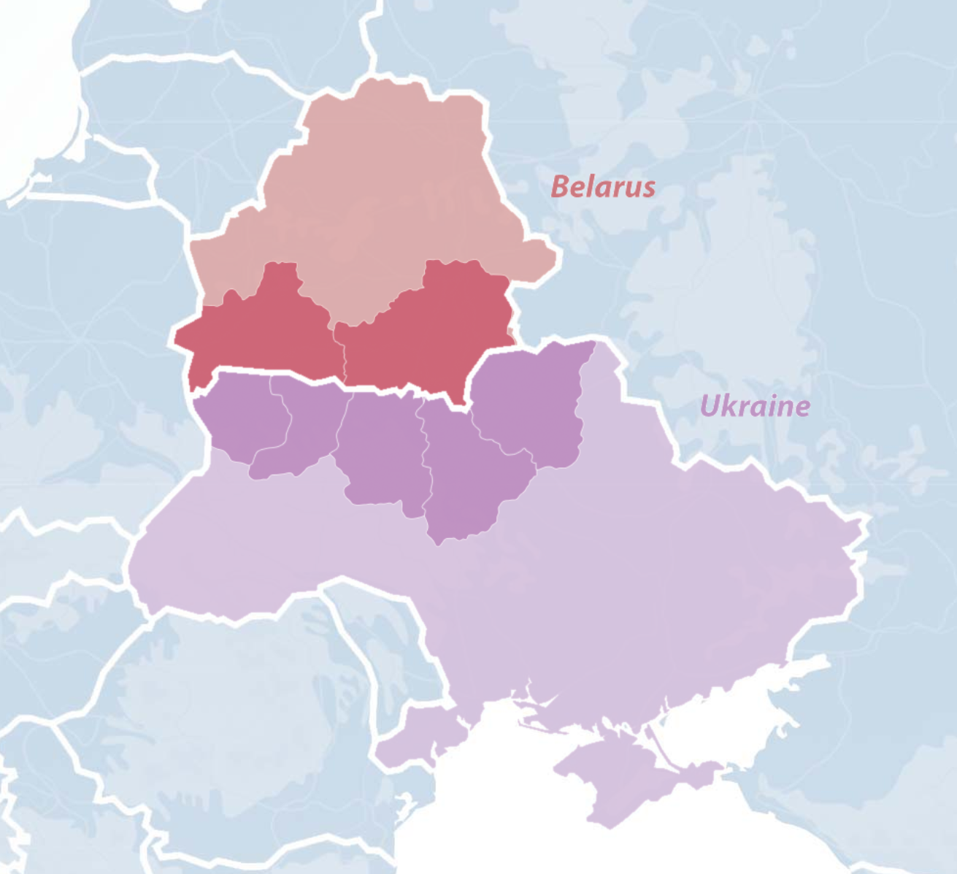
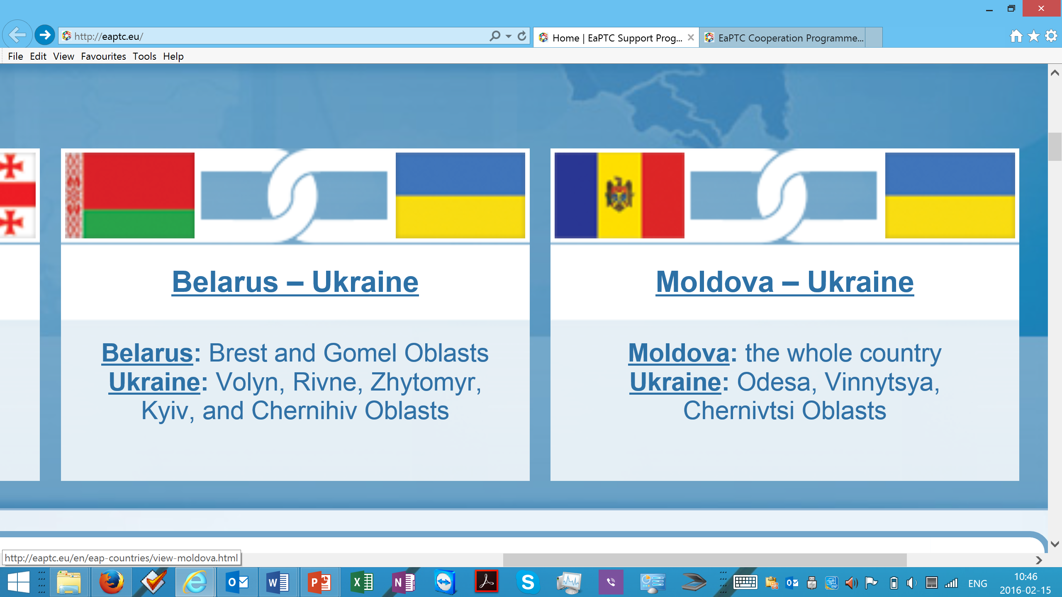
Geographical Coverage: BY-UA

Slide 9
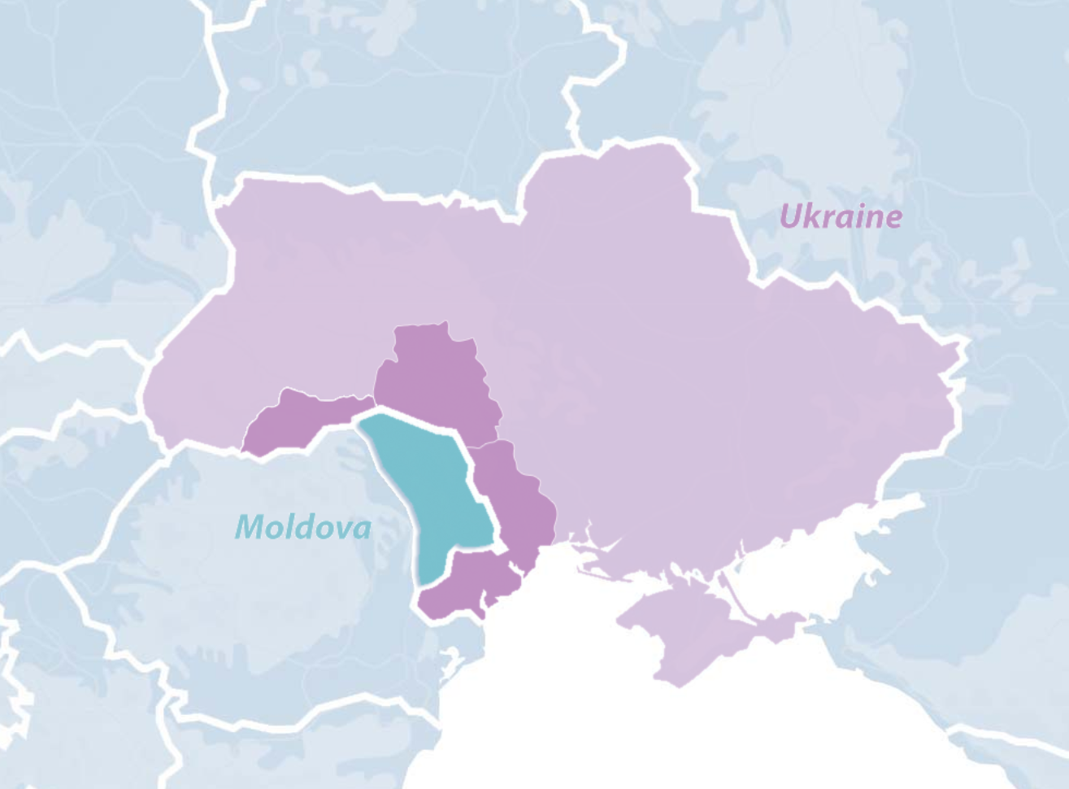
Geographical Coverage: MD-UA

Slide 10
Thematic Coverage: Objectives
Overall objective:
  sustainable territorial cooperation between border regions benefiting their social and economic development
Specific objectives:
  strengthening cross-border contacts between local authorities, communities and civil society organisations so as to allow for the development of joint solutions to common social and economic development challenges

Slide 11
Thematic Coverage: Priorities
Improving the living conditions of local communities through joint projects supporting economic and social development:
  Agriculture and rural business
  Entrepreneurship and employment
  Tourism and alternative income
Addressing common challenges in the fields of common interest having a cross border dimension:
  Environment and management of natural resources
  Emergency situation management
Culture, education and sports
  People-to-people exchange in culture and education
  Youth exchange
  Common social issues

Slide 12
Thematic Coverage: Target Groups
Local and regional organisations based in the programme eligible areas:
  Local and regional authorities;
  State service providers (e.g. public health institutions)
  Academic, educational and research institutions;
  Sport and cultural institutions, including museums, libraries, youth organisations;
  Civil society organisations;
  Business associations and unions

Slide 13




EaPTC: Fact Sheet
 | Budget | No. of applications | No. of projects
AM-GE | 1.35 mEUR | 40 | 10
AZ-GE | 1.35 mEUR | 29 | 10 (est.)
BY-UA | 3.3 mEUR | 120 (est.) | 20 (est.)
MD-UA | 3.3 mEUR | 154 | 18 (est.)

Slide 14
How Programmes work

Slide 15
Structures in EaPTC
(Potential) Applicants and Beneficiaries
(State and non-state actors)
Managing Authority (delegated to GIZ)
EC
Joint Decision Making Committees
EaPTC Support Programme
EaP Countries’ Administrations

Slide 16

EaPTC Support Programme Team Contacts:

Slide 17
Opportunities in EaPTC. Which Opportunities?...

Slide 18


Territorial Cooperation and Smart Specialisation:
Can there be synergies between EaPTC and S3?
Competitiveness of regions
Networking and partnership
Joint response to common challenges
Building viable “eco-systems” to change social-economic structures
+
= ???

Slide 19

Building “Eco-Systems”
Handset providers
Software developers: OS and apps
Hardware component suppliers
Aesthetic designers
Material scientists
….

Slide 20
Future of Eastern Partnership Territorial Cooperation
Discussion at the policy level to continue support to territorial cooperation beyond 2017
Moving from “traditional” to “smart” approach
Ensuring innovation and research are woven to the EaPTC programmes

Slide 21

Questions?
Comments?
Suggestions?

Slide 22
… And thanks a lot for your attention!

