Slide 1



Ricard Esparza Masana, PhD
Universitat Autònoma de Barcelona
Towards the RIS3CAT
Chisinau (Moldova), February 19th 2016

Slide 2
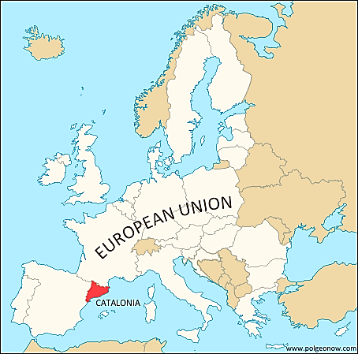

Slide 3

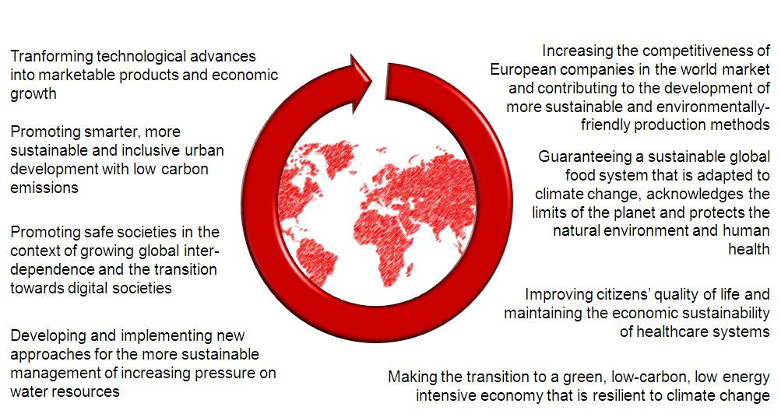
Global Challenges Facing the European Economies
From the official presentation of the

Slide 4

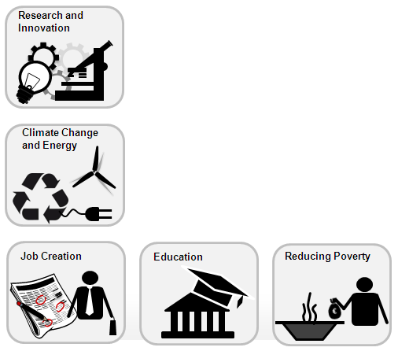
Europe 2020 Priorities
From the official presentation of the

Slide 5
From the official presentation of the
Priorities for the Regional Funds
Concentration of the regional funds in 11 thematic objectives to achieve Europe 2020 objectives
ERDF
ESF
1. To strengthen research, technological development and innovation
2. To enhance access to and use of ICTs
At least 80% of ERDF resources
3. To enhance the competitiveness of SMEs
4 To support the shift towards a low-carbon and energy-intensive economy in all sectors
5. To promote climate change adaptation and risk prevention and management
6. To protect the environment and promote resource efficiency
7. To promote sustainable transport and remove bottlenecks in key network infrastructure
8. To promote employment and support labour mobility
9. To promote social inclusion and combat poverty
At least 80% of ESF resources
10. To invest in education, skills and lifelong learning
11. To enhance institutional capacity and ensure an efficient public administration

Slide 6
R&I Strategies for Smart Specialisation (RIS3)
From the official presentation of the
To promote economic and knowledge specialisations adapted to potential for innovation in each region, based on its assets and capacities:
Economic specialisation
R&I specialisation
Global trends
International value chains
Clusters
Stakeholder cooperation

Slide 7
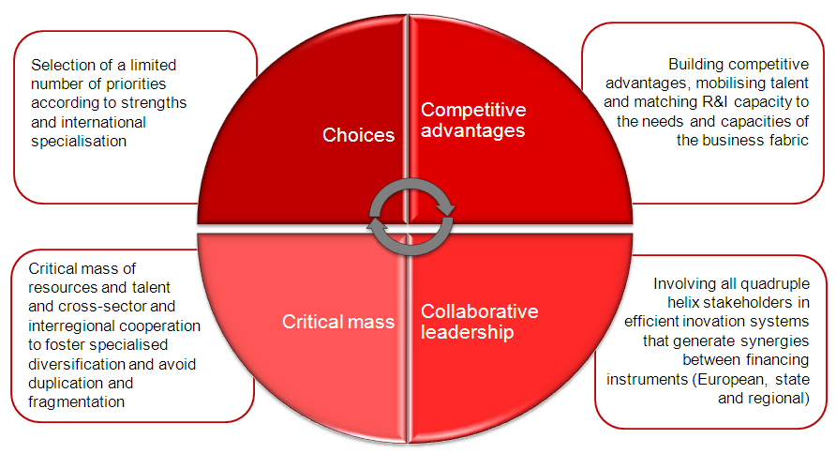
R&I Strategies for Smart Specialisation (RIS3)
From the official presentation of the

Slide 8
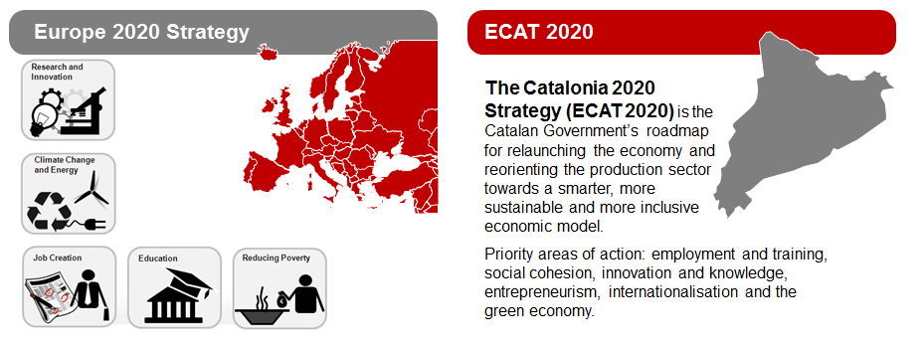
From the official presentation of the

Slide 9
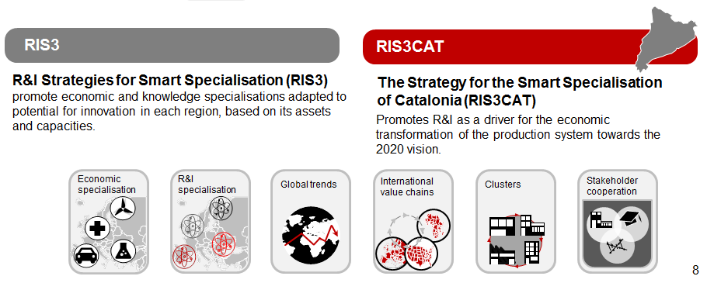
From the official presentation of the

Slide 10
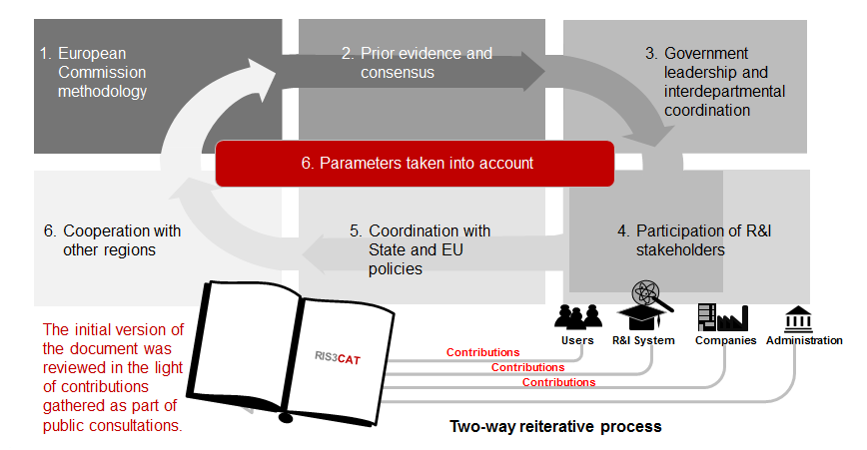
The process of drafting the RIS3CAT
From the official presentation of the

Slide 11
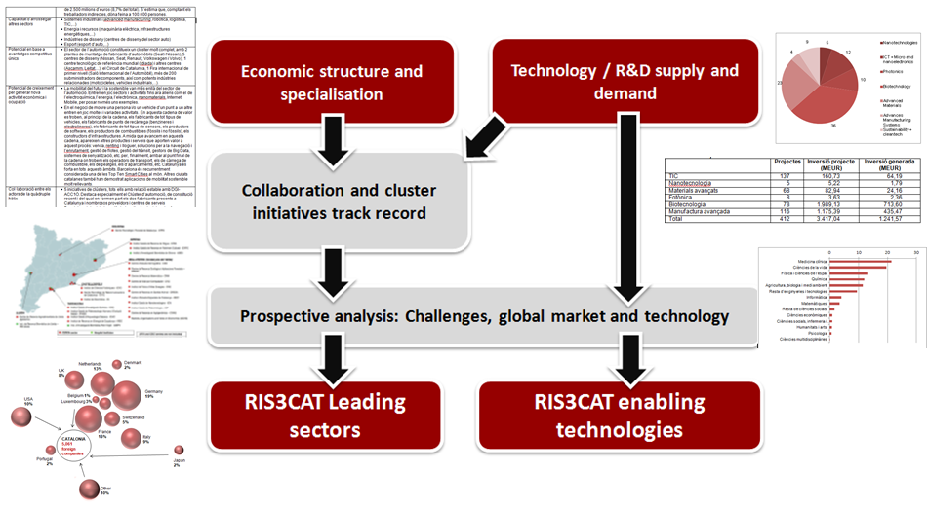
Qualitative and quantitative analysis
From the official presentation of the

Slide 12

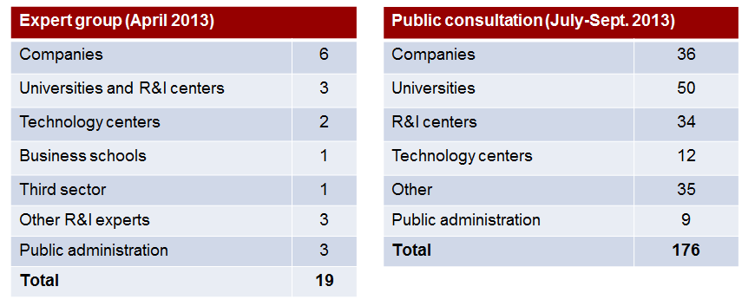
Participation and validation
From the official presentation of the

Slide 13
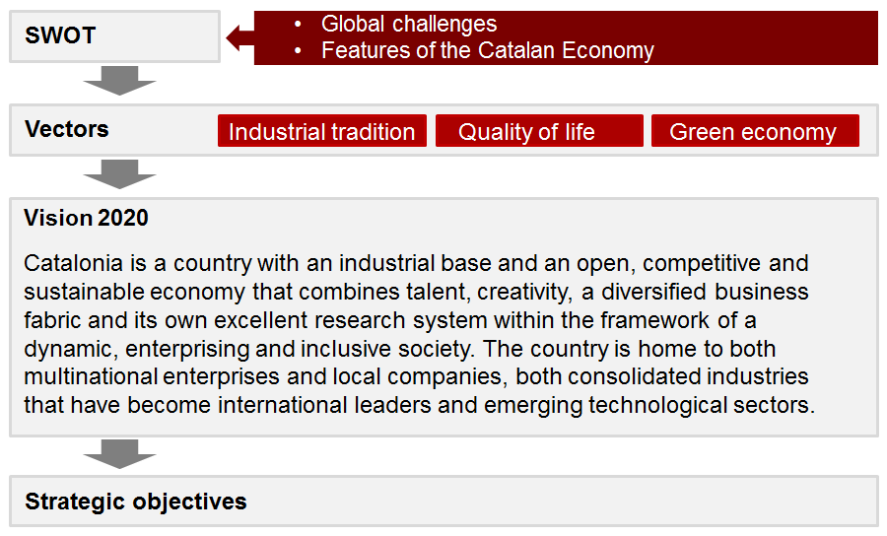
Vision 2020
From the official presentation of the

Slide 14
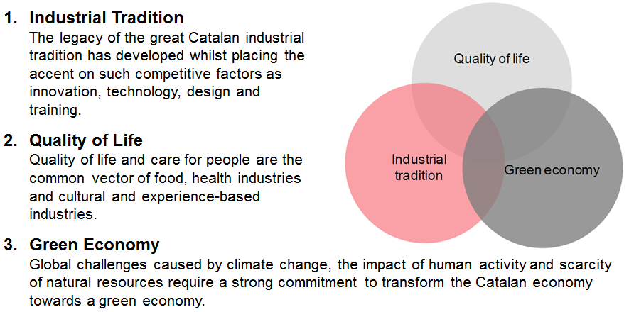
Vectors Driving the Transformation of the Catalan Economy
From the official presentation of the
Three key vectors that will enable Catalonia to successfully tackle the great social and economic challenges of the 21st century:

Slide 15
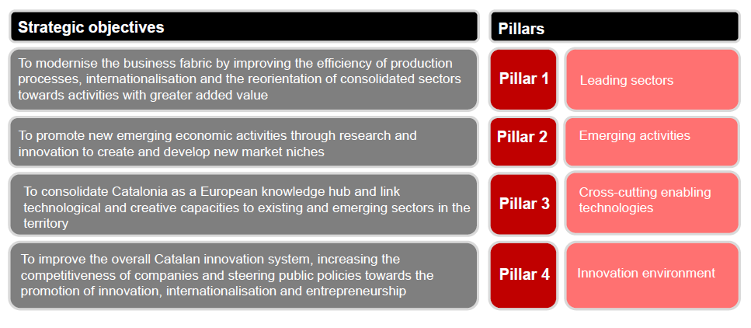
Structure: 4 Pillars of Action for 4 Strategic objectives
From the official presentation of the

Slide 16
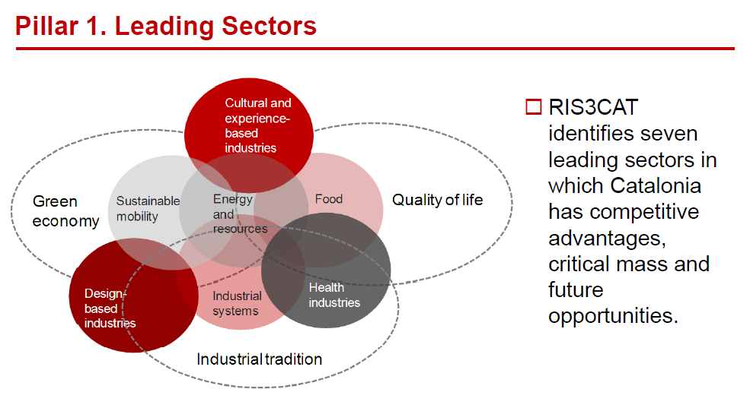
From the official presentation of the

Slide 17
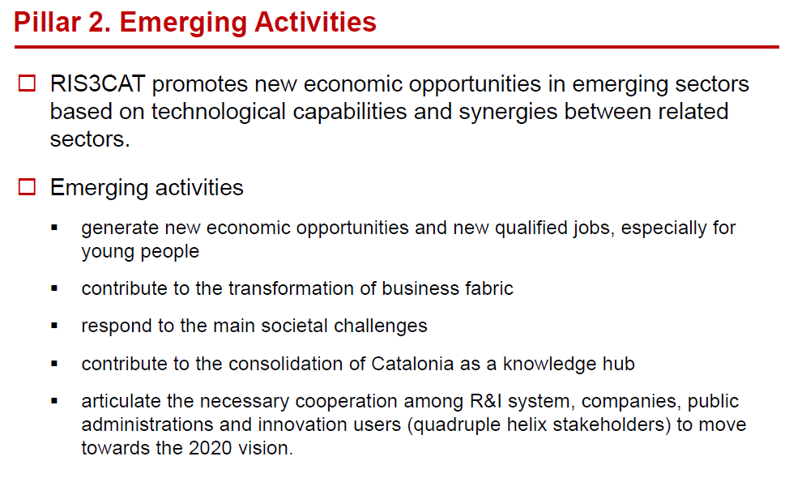
From the official presentation of the

Slide 18
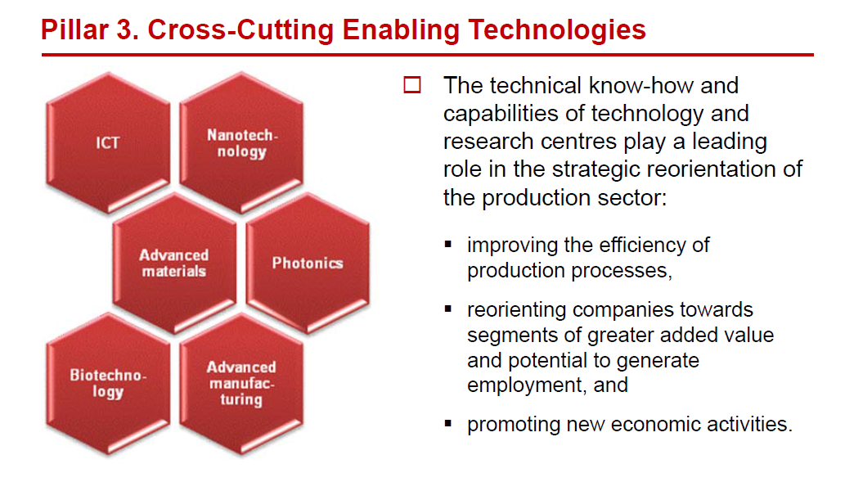
From the official presentation of the

Slide 19
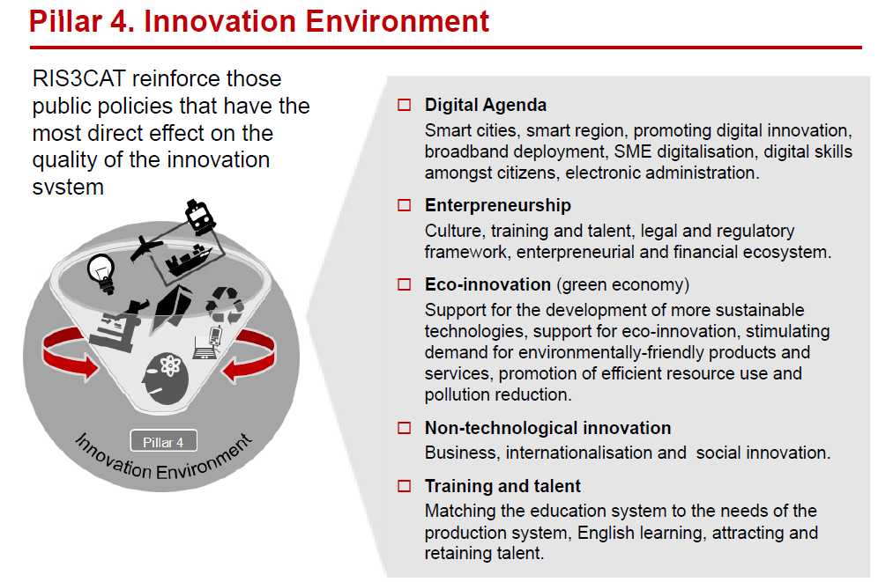
From the official presentation of the

Slide 20
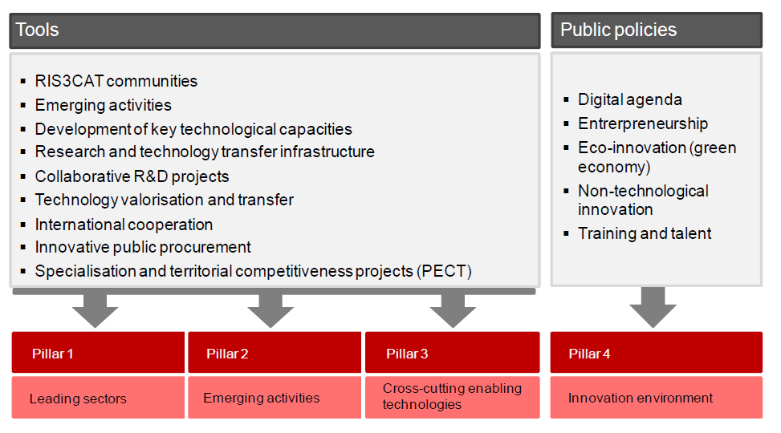
From the official presentation of the

Slide 21
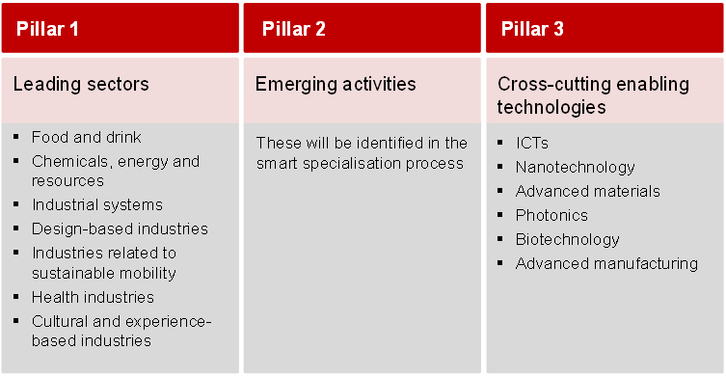
From the official presentation of the

Slide 22
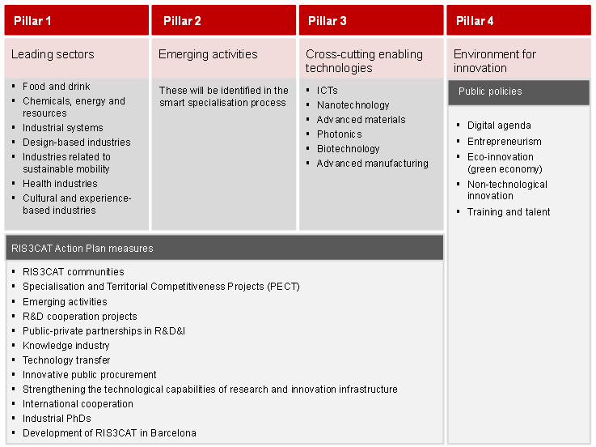
From the official presentation of the

Slide 23
Thank you for your attention
Mercès per la vostra atenció
Vă mulțumim pentru atenție
ricard.esparza@uab.cat

