Slide 1
Experience of S3 priority setting of West Region Romania
Chișinău, 19.02.2016

Slide 2
“Research is the transformation of money into KNOWLEDGE.
Innovation is the transformation of knowledge into MONEY.”
Dr. Geoffrey Nicholson,
former Vice-President of 3M International

Slide 3
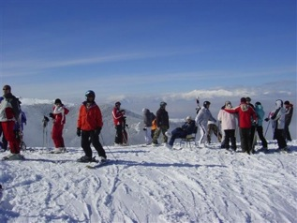
West Region Romania Overview

Slide 4
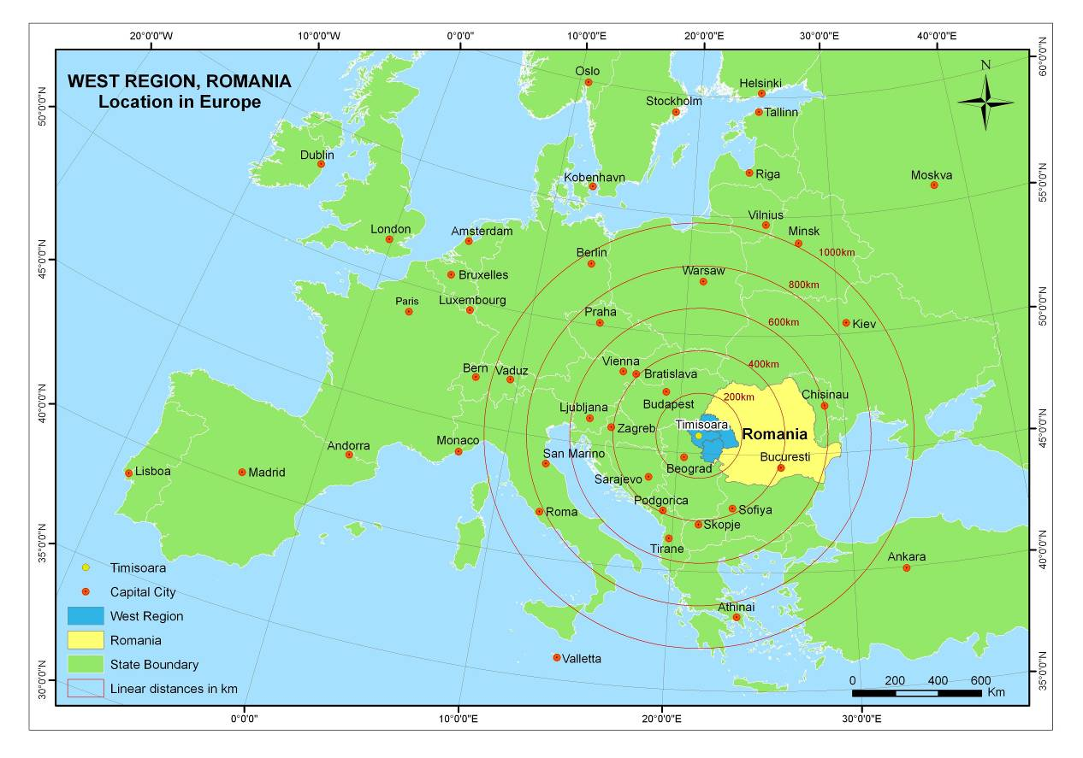
WEST REGION – OVERVIEW
Region West is
traditionally a part
of Central Europe
Distances:
Budapest – 330 km
Belgrade – 160 km
Vienna – 570 km
Munich – 1020 km
Brussels – 1700 km
Rome – 1560 km
Stuttgart – 1250 km

Slide 5
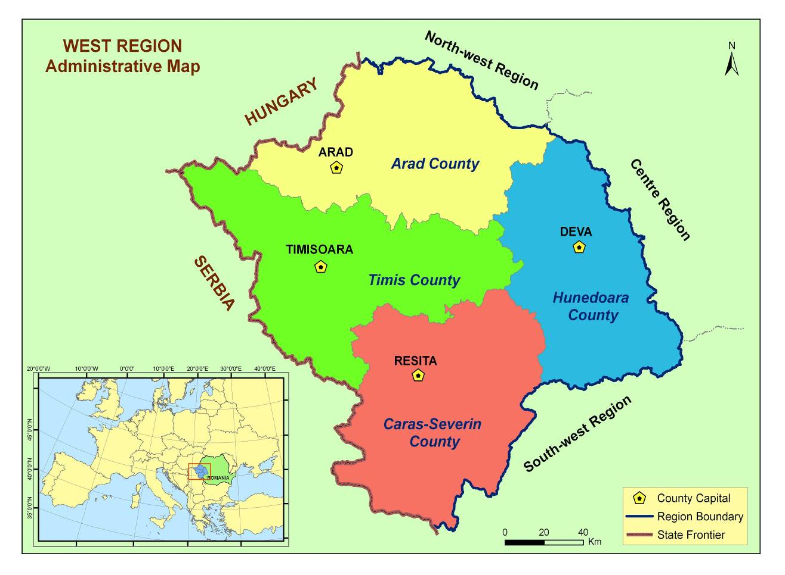
WEST REGION – OVERVIEW
4 counties
Surface: 32.034 sqm
Population: 1.894.437
Graduates: 13.410
Enrolled students: 49.449
Regional GDP 59% from EU 28 average
GDP: 12, 34 bil. Euro
SMEs: 50.048
Tourist: 541.808
ILO Unemployment Rate : 4,1%

Slide 6
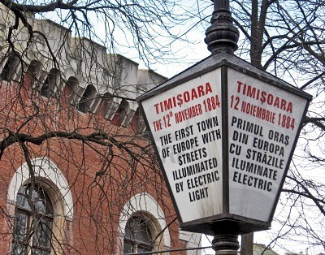
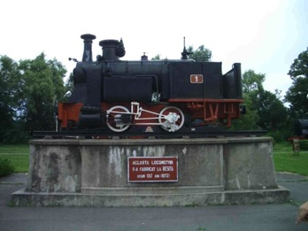
WEST REGION – OVERVIEW
Major economic sectors: automotive components, ITC & electronics, manufacturing, agro-food, construction, tourism
First town in Europe that introduced street lighting (Timisoara, 1857)
First railway steam engine built in Reşiţa (1872)
First Romanian PC built at the Politehnica University in Timisoara (1969)

Slide 7
WEST REGION –
COMPETITIVE ADVANTAGES
Regional Economy
growing region; traditional industrial area; business locations; clustering
Strategic location
border area; TEN T Network; international airports
High Quality of Human Resources
young; good coverage of all qualification levels; diversity and multiculturality
Quality of Life
good cost of living; tourism; unique natural elements; rich natural resources
Advanced Services
Costumers services; Headquarter for multinational company

Slide 8
West Region Romania Experience in
Regional Innovation Strategies

Slide 9
REGIONAL INNOVATION STRATEGY
IN WEST REGION
First Romanian Region that developed RIS 2005 -2008
Priorities set up after 2 years of consultation and debate:
- 900 questionaires to SMSs
- 50 interviews to research units
- 25 tehnologic audits
International Partener: Tehnological Institute Aragon
International Consultant: Infyde, Basque Country
Pillot projects from RIS 2005-2008: Tehimpuls, Automotivest, international projects: Before, Mitke

Slide 10
REGIONAL INNOVATION AND
TECHNOLOGY TRANSFER CENTRE
Pilot project of the Regional Innovation Strategy
Legally founded in September 2006
Objective
Stimulate the regional economy and enhancing the competitiveness capacity of the regional enterprises through promotion of innovation and technological development

Slide 11
REGIONAL INNOVATION AND
TECHNOLOGY TRANSFER CENTRE
Achievements:
Technology transfers
Over 90 RTDI products/services /technologies promoted on www.tehimpuls.ro
Over 60 audits to companies
25 innovation vouchers
2 brokerage events
Training sessions delivered Innovation Management, Intellectual Property Management, Management of Investments
Regional Innovation Fair 2013, 2014, 2015

Slide 12
REGIONAL INNOVATION STRATEGY
IN WEST REGION
2009 -2013 – Second RIS for West Region
All along the RIS process…
50 companies are partners in the clustering activity
300 interviews with companies – automotive and IT&C sector studies
35 technology audits to companies
20 vouchers granted to companies
244 companies financed from EC (Phare) and 125 companies from ERDF
(ROP 2007-2013)
Pillot projects from RIS 2009-2013: Regional ICT Cluster, Automotive Competences Center, international projects: Fresh, Prosesc, Co2Free

Slide 13
S3 in West Region Romania

Slide 14
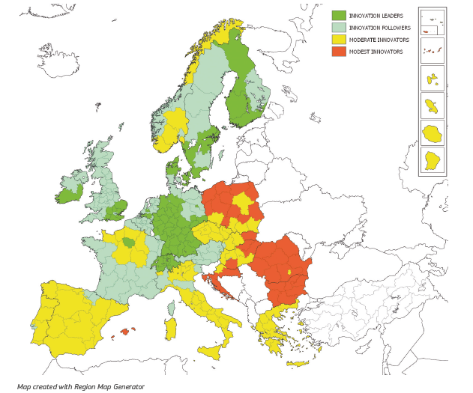
WHERE DOES WEST ROMANIA STAND
IN TERMS OF INNOVATION?
"One-size-fits-all" is impossible!
… BUT every region has some asset that can make it SPECIAL …

Slide 15
PROCESS
Published on the internet web page
Addresses / meetings
West Region Innovation Strategy
Public Consultation
Internal Analyse of Economic Structure
RIS3
First Draft of RIS 3
Consultation with the Regional stakeholders
Actors of knowledge
Investors
Private Enterprises
Regional Economic Specialisation
Study on smart specialisation
Surveys / interviews / meetings with Regional stakeholders
RTDI actors
Private Enterprises
Public entities

Slide 16
RIS 3 GENERAL OBJECTIVE
By investing in R&I, West Region will become:
more productive - based on labor efficiency and a high level of innovation;
dynamic - attract and capitalization skills, ideas and capital; •
permanently up to date - following adding value to the product and process.

Slide 17
PRIORITIES
A) Sectorial priorities:
AUTOMOTIVE, IT&C, TEXTILE, AGRO-FOOD
Innovation, R&D & Creativity
Skills, business growth and internationalization
Economic infrastructure

Slide 18
PRIORITIES
B) Horizontal priorities:
SUPPLY, DEMAND, INTERMEDIARIES AND FINANCIERS FROM R&I
Basic support services (Investment readiness scheme, Proof of concept, Innovation Business Plan competition, Coaching)
Support infrastructure (Fab Labs, Open Innovation Platform / “Open Labs”, Makers eco-system)
Advanced services (innovation management, Commercialization of research results, Vouchers, Entrepreneurs Club, Business Angels)

Slide 19
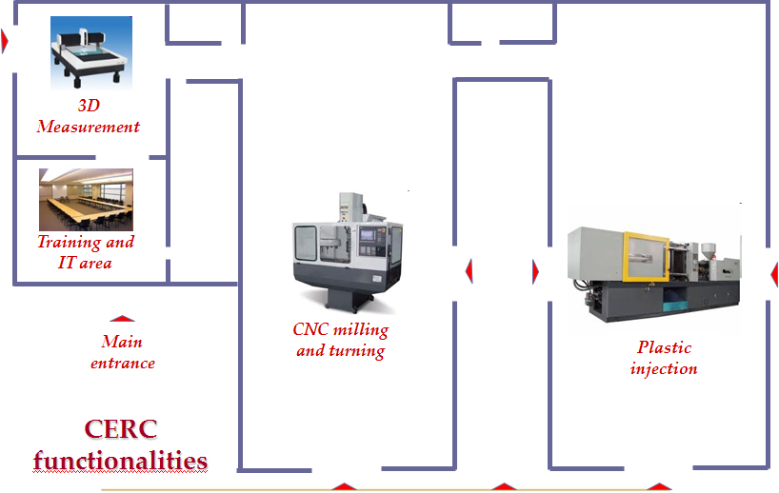
Case Study: Specialisation in Automotive Industry West Region Romania

Slide 20
AUTOMOTIVE INDUSTRY - AT THE GLANCE: - 243 companies: 106 with foreign capital - 64.072 employees - turnover: 4,7 billion Euro - labour productivity: 73.000 euro / employee / year - return of investment: 316,74 million euro - export: 2,28 billion Euro - multinational companies, regional cluster, competence center

Slide 21
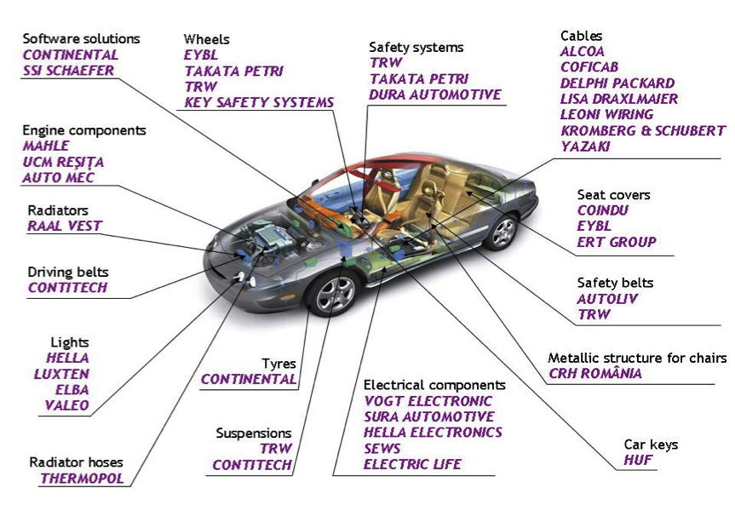
AUTOMOTIVE INDUSTRY

Slide 22
AUTOMOTIVE INDUSTRY
FOCUS
Completing the value chain (finding suppliers, clients, raw materials) in order to reduce costs, increase efficiency and reduce delivery time
REASON
Use of local raw material
Local proven competence
Links with related industries (e.g. IT&C, manufacturing)
Partnership with universities and research centers
National policy promoting automotive sector

Slide 23
AUTOMOTIVE INDUSTRY
IMPACT ON THE REGIONAL DEVELOPMENT MODEL
Diversification
OBJECTIVES
To strengthen automotive component industry in West Region, from both national and multinational companies, in terms of competences, products and clustering effect
To encourage the cooperation between the players in automotive components industry and make it a source of growth & exports

Slide 24
CONCLUSION
S3 is a process … and a journey ….
FROM: TO:
Institutional differences
Small visions
Never ending neggociations
Hanging problems
Cohesion
Integrated vision
Increasing competitivness
Development Projects

Slide 25
THANK YOU !
Adrian MARICIUC
Head of Department for Regional Planning and Urban Development
WEST REGIONAL DEVELOPMENT AGENCY ROMANIA
5, Proclamatia de la Timisoara st., 300054, Timisoara, Romania
Tel. +40 256 491923; Fax. + 40 256 491981
E-mail: office@adrvest.ro
www.adrvest.ro
www.westregion.ro
www.automotivest.ro
www.tehimpuls.ro

