Slide 1
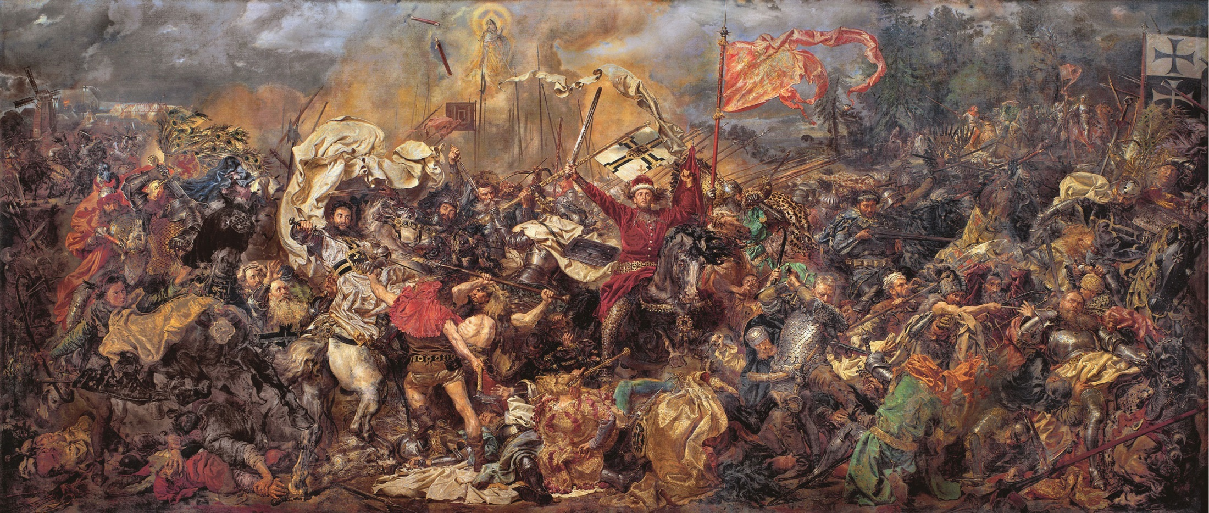
Jurgita Petrauskienė 2016 02 18-19, Chisinau
Governance settings for successful s3 process

Slide 2
MOSTA
State budgetary institution established by the Ministry for Education and Science of the Republic of Lithuania (April 27, 2007) which:
Provides recommendations on the development of the national research, higher education (HE) and innovation system
Organizes research HE and innovation monitoring
Analyses the conditions of Lithuanian research, HE and innovation system
Participates in development and implementation of research, HE and innovation policy

Slide 3
The context: R&D landscape
23 universities: 14 state, 9 private
24 colleges: 13 state, 11 private
21 research institutes: 13 state, 8 private
17 300 researchers, 7 800 with PhDs
300 – 400 new doctoral degrees each year
9.7 % researchers in business and industry
0,92 % of GDP expenditure on R&D
€ 73,6 mil. business expenditure on R&D (2011)
9 granted EPO patents from 64 applications (2002 – 2011)
Source: Ministry of Science and Education, MOSTA, 2013
Notes:
In this slide be more precise on the questions that you would like your peers to discuss, and connect this to the second slide with the issues brought up there.
In order to make the discussion at the workshop as efficient and useful as possible, it is important to move out of the ‘classical’ presenting mood and head towards a more concrete approach to issues that need to be faced on the ground, while establishing and implementing your strategy. For this reason it is important to define a focus of your presentation, which would act as a ‘red thread’ in your presentation.
Furthermore, in the peer review session the audience will be divided into groups that will focus their discussion on the issues that you want to address, i.e. depending on the number of participants there will be around 2-5 groups discussing: i) what they think are the underlying critical factors concerning the issues that you want to discuss and ii) suggestion for policies to address these issues. These discussions will be reported back to you and discussed jointly at the end of each session. In this way you will have comments and feedback from all participants present. This is a way also to advance the discussion towards the areas that you see as most relevant to have feedback on.
Please remember that the more linked to your presentation the questions are, the more concise and relevant feedback you might get. By presenting the questions up front, you allow your peer critical friends to keep them in mind while you give your presentation. The questions (1-5) should be repeated at the end of the presentation. Questions of a very general character can be made relevant for you specific region only if you give related information in your presentation.
When preparing the presentation you might want to go through the rest of slides of this template and try to steer the information so it provides a logic to what you want to discuss, what the issues at hand are. This template provides you with suggestions for areas that can be relevant to bring up in order to explain your strategy and the issues. You may feel that some slides are redundant and do not use these or that you want to add some slides, which is good, but please bear in mind that there is only 30 minutes for presentation, which on average is something like 15 slides, so try not to make the presentation too long.

Slide 4
Why Smart Specialisation?
Cohesion Funds 2007-2013 – 86 billion € for innovation - IMPACT?
Lack of inter-institutional coordination
Regions invest in „fashionable“ areas, great overlap
No critical mass
Funding for R&I capacity building, lack of concentration on results
Lessons learned:
Economical crisis: greater orientation towards efficiency; need to strengthen economic competitiveness
Transformation requires concentration of resources
Need to improve policy development and implementation

Slide 5
Starting position: challenges of innovation system
Dominant traditional sectors – little or no knowledge-based growth
Fragmentation of R&I policy priorities, programmes, funds and institutions
Lack of inter-institutional cooperation
Process-oriented policy implementation
Almost all expenditure on R&D from public sector
High dependency on the SF support

Slide 6
Previous practices to identify RDI priorities
Practice | Issues
Strategic choices
Funding national „champions“ |  | Low motivation for cooperation; Funding as a price for achieved resultsus
Copying best practices |  | No focus on Lithuania’s potential and possible niches
Difficulties to identify priorities |  | No concentration
Definition of priority
Sector of economy of research field |  | No focus on results
Funding the currently running activities |  | More of the same: no economical transformation

Slide 7
Identification of priority fields
PREPARATORY STAGE
METHODOLOGICAL FRAMEWORK
ASSESSMENT OF SOCIO-ECONOMIC CHALLENGES (ANALYSIS, SURVEY AND DISCUSSION)
ASSESSMENT OF CURRENT POTENTIAL IN R&D AND BUSINESS
6 PRIORITY FIELDS PROPOSED
DISCUSSIONS
6 EXPERT PANELS
~ 70 PARTICIPANTS
Communication and dissemination: ~ 30 MEETINGS AND PRESENTATIONS FOR STAKEHOLDERS

Slide 8
Priority fields
PRIORITY FIELDS | R&D potential | Economic potential | Challenges | Valleys
Energetics and sustainable environment | High or prospective | „Consumers“ (excl. IT) | *** | Saulėtekis, Santara, Santaka, Nemunas
Agro-innovation and food technologies | Prospective | „Consumers“ | * | Nemunas
Health technologies and biotechnology | High | „Creators“ and „Consumers“ | * | Santara, Santaka
Inclusive and creative society | Prospective | „Consumers“ (excl. IT) | * | -
New processes, materials and technologies for manufacturing | High | „Creators“ and „Consumers“ | * | Saulėtekis, Santaka, Santara
Transportation, logistics and ICT | Prospective | „Consumers“ (excl. IT) | *** | Saulėtekis, Santaka, Santara, Marine
ICT as well considered as a horizontal priority empowering all fields
* - corresponds to the most important challenges identified by analysis; *** - corresponds to the most important challenges identified by analysis and ranked as most important by the survey

Slide 9
Developing the strategy: Governance and stakeholder involvement
Research and innovation strategic council under PM
Steering group by ministries and implementing agencies
Steering committee
Stakeholder
involvement
Stakeholder
involvement
MOSTA
Analytics
International independent expert group
Expert panels
Governance: main owner of the strategy, but with collective ownership, continuous work of the panels used in the identification process

Slide 10
Implementing the strategy: Monitoring and management
Do we need additional support for the Priority? Or maybe we should discard it?
Strategic R&I council
Consists of:
Prime Minister
Science institutions
Ministries
Agencies
Business representatives
How is it going? Does the actual implementation meets the planned results?
Coordination function
Consists of:
Ministries
Agencies
Other stakeholders
Monitoring function
Interim evaluation. Do we need new priorities? What is the impact already?
Priority:
Various projects by public and private entities within the thematic field
2014
2018
2020
Entrepreneurial discovery

Slide 11
Lessons learned
Learning process – the outcomes might not be visible now;
Persistence vs. Constant communication;
Leveraging between too narrow and too broad;
Mediation between different groups;
Political involvement is critical;
Need for closer collaboration with the neighboring regions;

