Slide 1
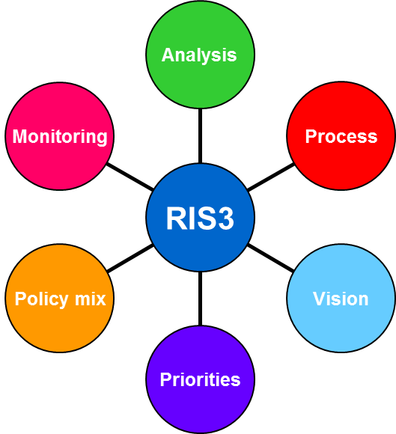
S3 DESIGN LEARNING WORKSHOP
Chisinau, Moldova, 18 February, 2016
THE MAIN STEPS FOR DEVELOPING A RIS3

Slide 2
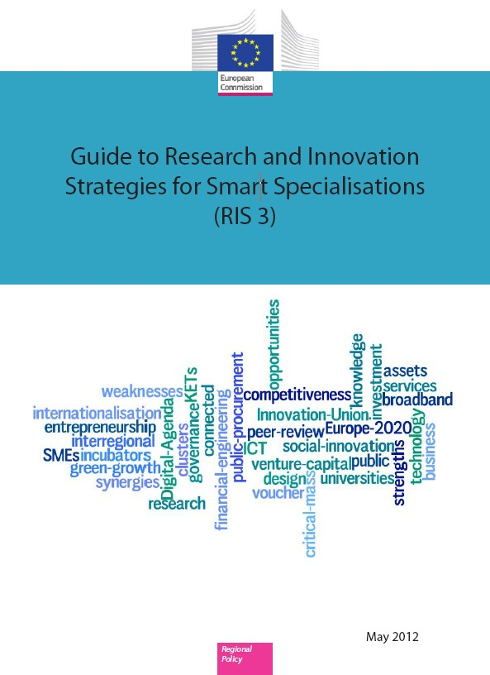
The RIS3 Guide
Methodological guidance for policy makers an implementing bodies
Focused on RIS3 design: developing the concept, helping to understand the S3 method
The guide evolves with the advancement of S3 process
Available on the S3 Platform webpage!
http://s3platform.jrc.ec.europa.eu

Slide 3
RIS3 guide - Key steps for developing a RIS3
Step 1 – Analysis of local context and potential
Step 2 – Governance
Step 3 – Vision for the future
Step 4 – Selection of priorities
Step 5 – Policy mix
Step 6 – Monitoring and evaluation
Analysis
Monitoring
Process
RIS3
Policy mix
Vision
Priorities
3

Slide 4
Step 1 – Analysis of regional context and potential for innovation (I)
A broader definition of innovation, not just RTD-oriented
Assess existing regional assets
Identify regional competitive advantage
Detect emerging niches for smart specialisation
Combine methods (e.g. foresights, SWOT approach, surveys, working groups, interviews, etc.)
Notes:
4

Slide 5
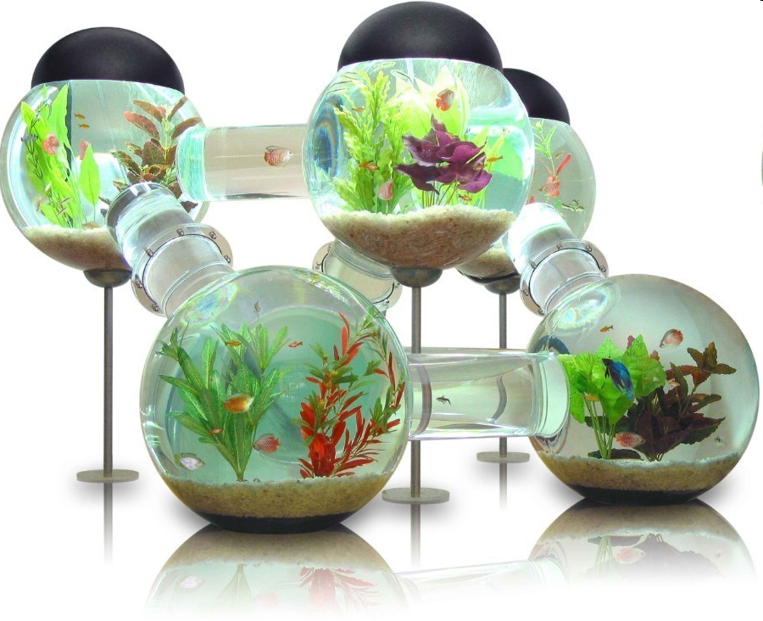
Step 1 – Analysis of regional context – looking out – and potential for innovation (II)
Outward-looking Analysis:
Assess country’s positioning with regard to other countries and regions in Europe
Beware of global companies and value chains
Find complementarities with other regions to join wider networks
Avoid ‘blind’ duplication, discover possibilities for collaboration
Notes:
5

Slide 6
Step 1 – Analysis of regional context and potential for innovation (III)
Analysis of entrepreneurial dynamics and identification of future opportunities:
Different types of actors
Spirit of the entrepreneurial environment
Involvement of entrepreneurial actors in the regional economy
Firms, but also Universities, Technology Centers, Venture Capitalists, Regional Development Agencies..
Notes:
6

Slide 7
Step 2 – Governance: ensuring participation and ownership
Wider engagement of stakeholders:
Interactive and consensus based
From Triple Helix governance model to Quadruple Helix including demand side perspective
Setting up a Steering Group, Management Team, Working groups, flagship projects…
Notes:
7

Slide 8
Step 3 – Developing an overall vision of the region’s future
Shared vision of the region’s potential and main directions for its international positioning:
Shared, ambitious but realistic
Agenda for transformation: formulate different scenarios based on analyses and debate where your region wants to go
Motivating, addressing societal challenges
Notes:
8

Slide 9
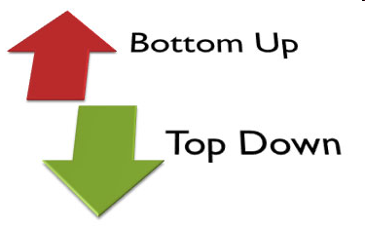
Step 4 – Identification of priorities
Decision-making step where top-down meets bottom-up:
Focus on a limited number of areas with potential for smart specialisation as emerged from entrepreneurial discovery
Areas where the region hopes to excel
Avoid capture by interest groups!
Pay attention to horizontal priorities (Key Enabling Technologies, ICT etc.)
Notes:
9

Slide 10
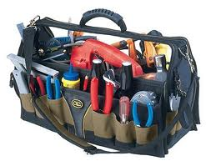
Step 5 – Implementation,
definition of a coherent policy mix, roadmaps and action plan
Defines roadmaps, action plan and pilot projects corresponding to the objectives
Which tools do you need to overcome identified challenges in order to reach your goals?
Includes measurable targets, result and outcome indicators
Defines realistic timeframes
Identifies sources of funding and budget allocations
Notes:
10

Slide 11
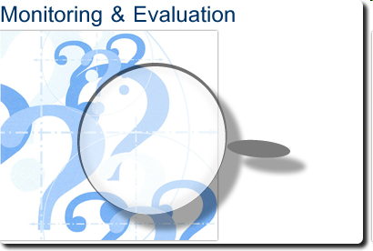
Step 6 – Integration of monitoring and evaluation mechanisms
Mechanisms integrated in the strategy:
Monitoring → to verify the correct and efficient implementation of activities
Evaluation → to verify whether and how strategic goals are met
Importance of measurable targets and output/result indicators
Notes:
11

Slide 12
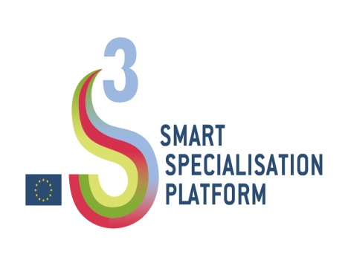
Thank you!
http://s3platform.jrc.ec.europa.eu
JRC-IPTS-S3PLATFORM@ec.europa.eu
Notes:
12

