Slide 1
S3 DESIGN LEARNING WORKSHOP
Chisinau, Moldova, 18 February, 2016
INTRODUCTION INTO DISCUSSION

Slide 2
Discussion – a simulation of the peer review process
Facilitate transnational learning
Discovery of a good practise
Overcoming challenges together
Build common understanding
Identify shared objectives
Stimulating collaboration in S3 topics and networking

Slide 3
What kind of questions do regions ask ?
How to mobilise stakeholders' active contribution?
What indicators to use for monitoring?
How to overcome the risk of a lock in situation when selecting a specific domain?
How to stimulate stakeholder involvement in the implementation
of the strategies?
How can S3 be implemented in a crisis environment?
What approaches should be applied for setting the RIS3 priorities?
How to stimulate the interregional cooperation within RIS3?
What pre-conditions are necessary for S3 entrepreneurial activity to take place?
What kind of policies and framework conditions are necessary to strengthen
the links within Triple Helix?

Slide 4
Questions suggested to discuss today
How to stimulate active participation and involvement of stakeholders, how to involve business into the process?
How to avoid lobby groups of enterprises that will try to push the smart specialisation in the direction of their interest?
How to create/join networks with other countries and regions?
What is the right balance in priority setting: not to narrow and not too broad?
How to overcome the gap between research and business in smart specialisation strategies?

Slide 5
This is what we will do
Splitting in tables for further discussions
? 1.
? 2.
? 3.
? 4.
? 5.

Slide 6
The structure of the discussion
1. Table discussion – Round 1 - What are problems or questions behind the original question posed? (decoding the question) Please write down your common understanding on yellow post-its.
2. Table discussion – Round 2 - Policy recommendations, suggestions for how this/these issue(s) can be addressed? Please write down 3-5 recommendations, policy measures on green post-its.
3. Table discussion – Round 3 – What are the relevant lessons, findings of the discussion for the participants of the table? Please write down your common understanding on pink post-its.

Slide 7
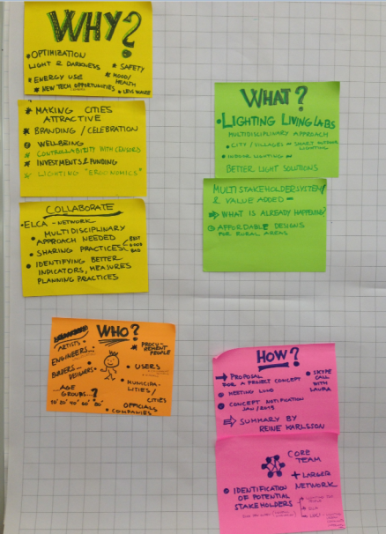
Each table needs to have
A moderator – to explain the process and to follow the timeframe
A rapporteur – to summarise the results of the discussion and to report in the closing session
Feedback
To be presented in the closing session by a rapporteur

Slide 8
Moderators & Questions
Jurgita Petrauskienė
How to stimulate active participation and involvement of stakeholders, how to involve business into the process?
2. Peter Wostner
How to avoid lobby groups of enterprises that will try to push the smart specialisation in the direction of their interest?
3. Petri Räsänen
How to create/join networks with other countries and regions?
4. Radu Gheorghiu
What is the right balance in priority setting: not to narrow and not too broad?
5. Stefan Vratny
How to overcome the gap between research and business in smart specialisation strategies?

Slide 9
What we expect from you…
Be engaged!
Share your experience – you hold a piece of the mutual learning!
Be critical… but friendly
Be open – listen and be curious
Explore your peers – overcome your challenges together!
Mix – do not sit with your colleagues or nationals
Network…

