Slide 1
RIS3 support in
Lagging Regions
Bari, 11 July 2016
Project team: Mark Boden, Karel Haegeman, Elisabetta Marinelli, Patrice dos Santos, Susana Valero
www.jrc.ec.europa.eu
Serving society
Stimulating innovation
Supporting legislation

Slide 2
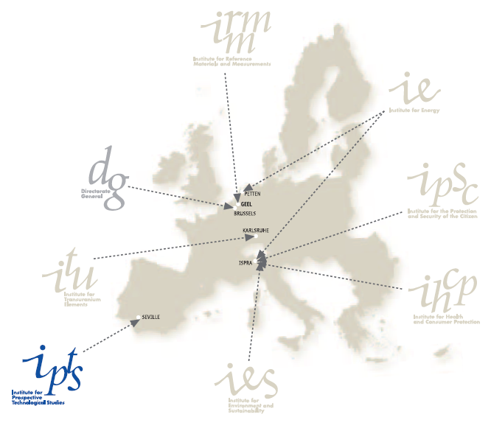
Joint Research Centre (JRC)
The European Commission's in-house science service. Serving society, stimulating innovation, supporting legislation.
Institute for Prospective Technological Studies (IPTS)
Developing science-based responses to policy-challenges

Slide 3
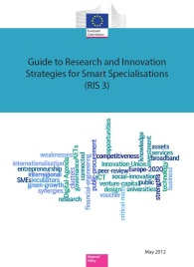
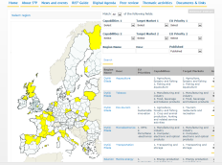
Activities of the S3 Platform
TARGETED SUPPORT
The RIS3
Guide & the Digital Agenda Toolbox; S3 policy briefs
Synergies ESIF-H2020
Eye@RIS3
Trans-national learning and Peer Review
Interactive web tools, S3 Newsletter and Website
Thematic focus on actors, process, common features and priorities
Value chains and alignment of innovation roadmaps
RIS3 assessment
and support to REGIO desks; ICT experts
Notes:
The role of the S3Platform as an interactive and highly participatory interface between up-down and bottom-up processes. This cannot be underestimated.
We are facing a policy experiment unique in terms of complexity and geographical extension. 271 (check) and 28 Member States are asked to provide their specific answer using the same conceptual model (S3).
Do regions, and regional policy makers in particular, have the right cognitive capabilities and competencies to identify key sectors and specializations, and to combine new and old specializations and skills in the "smartest way"? Or, is there the risk that an "old" conception of specialization will prevail, that will make the implementation of the S3 inefficient?
2) By now, what are the main strengths and weaknesses which have been identified in the early process of S3 implementation?
6 steps of the Guide
1) Analysing the innovation potential 2) Setting out the RIS3 process and governance 3) Developing a shared vision 4) Identifying the priorities 5) Defining an action plan with a coherent policy mix 6) Monitoring and evaluating
Strengths
Analysis BUT missing an outward looking
Weaknesses
Governance
EDP
Strategic vision capacity (the region as seen from the future). This point is missing in the assessment grid but is inherent to the whole process.
Monitoring and evaluation
What was the impact of S3Platform activities?
Consider that 2 regions outside EU have also joined the S3Platform.
How many regions have been profiting from this opportunity?
Peer-review: regions, MSs (Italian regions: )
Thematic workshops: regions (Italian regions: )
Message: Italian regions could have been profiting much more from the S3Platform.
Why have they not?

Slide 4
RIS3 in Lagging Regions: aims & background
Aims
To support the refinement and implementation of the RIS3 of selected EU regions
To generate lessons and a model for other regions
To serve as a test-bed for theories on Smart Specialisation – understanding of RIS3
Background
Extends successful activities on Eastern Macedonia and Thrace
Implements two European Parliament "Preparatory Actions"

Slide 5
Lagging Regions: Policy issues
Policy issues and definitions
Slow and limited growth – despite investment
Lack of understanding → lack of effective actions to identify, understand, address issues
Low growth regions - GDP/capita below EU average and did not converge to EU average post-crisis (Greece, Italy, Spain, Portugal)
Less developed regions - GDP/capita <50% of EU average (Bulgaria, Hungary, Poland, Romania)

Slide 6
European Parliament Support – 2 Preparatory Actions
PA 1: Support for growth and governance in lagging regions
Regions from 8 EU MS
Stakeholder engagement, mutual learning, support for RIS3 implementation
Cross-cutting approaches to key issues of growth and governance
Refinement of the RIS3 model
Further development of practical support for regions across EU
PA2: Competitive advantage and potential for smart specialisation in Romania
In depth support for 2 Romanian Regions (North East, North West)
Close complementarity - but deeper engagement
Differing stages of RIS3 development between regions
Coordination with national level RSI3

Slide 7
Implementation
Partnership
JRC, DG REGIO, other DGs, regional and national authorities
Flexibility
approach tailored to needs and problems identified by stakeholders
Transnational dimension
Identify and share common challenges and solutions
Synergies with other activities
S2E, Less Developed Regions initiative, Vanguard Initiative, S3P, etc.

Slide 8
Bottom Up Dynamic
Business idea as main driver
Business idea
E.g. use of wine-making residues
Idea decomposed
Research and innovation components and fundability
Idea refined
Partners, business and research aspects, roadmap, funding sources
EDP focus group
Project Development Lab 1 (PDL 1)
Online consultation and PDL 2
Bottlenecks for implementation
State aid issues
Avoid double funding between national/regional calls
Sustainability/viability
Role for KETs
Need for champions/leaders
Address training needs
International scope
Peer review
Board of critical friends
Working groups Mobility &Governance
Analysis of role of KETs
RDI funding guide and case studies
Mapping international R&I collaborations
Technical meetings regional/national/EU

Slide 9
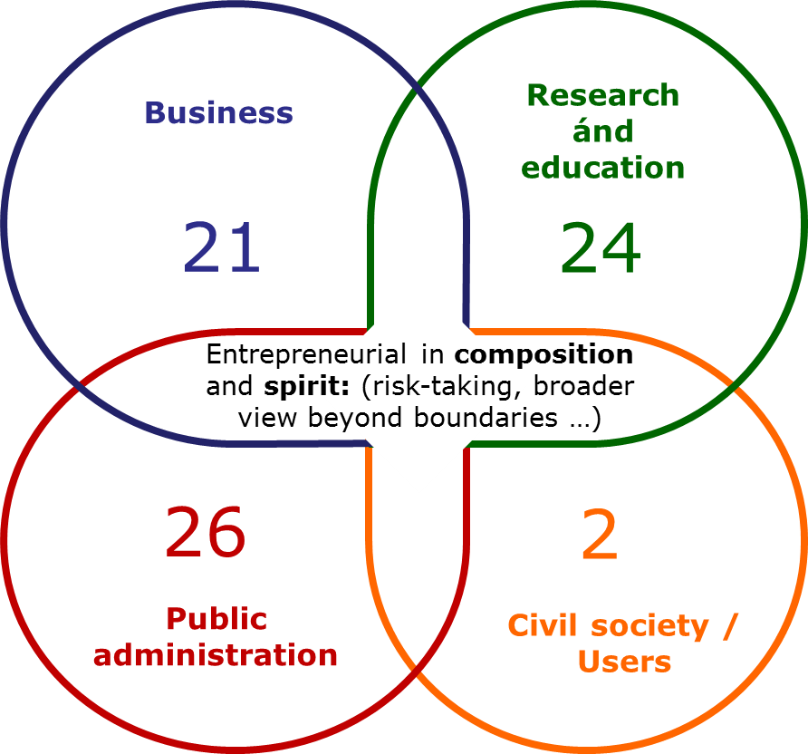
Entrepreneurial Discovery Process Focus Group
Cluj – May 2016
Cosmetics and food supplements based on natural resources
Stakeholder representation (Quadruple helix)
73 participants
38 business ideas generated
Examples of business ideas:
Database of plant resources - Edible plants consumed traditionally for anti-ageing / healthy ageing purposes
Anti-acne products - testing efficiency locally
Transylvanian Cosmatopea Cluster
Locally branded bio products
In-house technology for determination of own natural cosmetic products' validity date and for quality control of ingredients and final product
Smart packaging: with anti-microbe protection or smart labels changing colour if expired
Cosmetics and (para)pharma: From harmful to beneficial cosmetics
Key role for international stakeholders
Notes:
9
Commission support
Support for smart specialisation strategy development (over 100 expert contracts, S3Platform, e.g. Guide on RIS³ regarding entrepreneurial discovery process) including synergies issues
Sections for synergies in templates for Partnership Agreements & Operational Programmes
Provide guidance & training to OP negotiators (vade-mecum for synergies issues; recommended wordings in OPs and PAs)
Support for teaming up of MS & regional innovation actors around shared smart specialisation fields (Vanguard Initiative, RIS³ thematic platforms, Eye@RIS3 mapping, workshops, INTERREG) to be better prepared for trans-national Horizon 2020 calls and EIP etc. involvement
Guide for policy-makers and implementers (both on Horizon 2020 and ESIF side)
Dissemination: Synergies seminars in MS and with NCPs ; Stairway to Excellence pilot project ; Seal of excellence support for JTIs' MoUs … etc.

Slide 10
Toolbox
Objectives | Tools
Idea generation, trust building and support cooperation | EDP focus group methodology
Open up to wider (online) communities | Online stakeholder engagement
Address brain drain, build skills | Mobility Working Group
Increase coordination between national and regional levels | Methodology Project Development Lab 1
Widen funding sources to draw on for idea implementation | Methodology Project Development Lab 2
 | Online RDI Funding Guide
 | Case descriptions
Optimise RIS3 governance structure | Governance working group
Support ongoing stakeholder engagement | Stakeholder round table discussions
Identification of barriers and possible solutions
 | Tailored peer review events
Mutual learning
 | Board of critical friends
Support international cooperation | Collaboration spotting tool

Slide 11
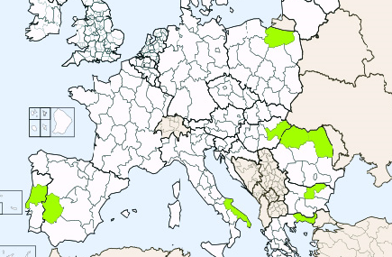
Focused on 9 regions in Eastern and Southern Europe: selection of regions
Support to RIS3 implementation in Lagging Regions
Warminsko Masurskie
Észak-Alföld
Nord-Vest
Nord-Est
Centro
Severen Tsentralen
Extremadura
Puglia
Eastern Macedonia
and Thrace

Slide 12
REGIONS
Bulgaria - Severen Tsentralen
Greece – Eastern Macedonia and Thrace
Hungary - Észak-Alföld (city focus - Debrecen)
Italy – Puglia
Poland - Warminsko Masurskie
Portugal - Centro
Romania - Nord-Est and Nord-Vest
Spain – Extremadura

Slide 13
Horizontal issues (i)
Governance - Working Group(s) on Governance
long-term sustainability of the EDP process
relationship between national and regional levels
synergies between structural funds and other resources
Transnational cooperation – essential to RIS3
Potential transnational collaboration
Cooperation within EU and with neighbourhood countries
Thematic cooperation across EU (Value chains/KICs/…)
Methodological cooperation/mutual learning

Slide 14
Horizontal issues (ii)
Implementation of RIS3 –critical issues for sustainable RIS3 implementation:
State Aid rules
Sustaining EDP
Instruments beyond the ROP (synergies between ERDF and H2020, but also with other (EU) funding opportunities)
Appropriate monitoring and evaluation systems
Components of the R&I system and design of the policy mix - Role of universities, RTOs, and research-active firms
Outward-looking orientation

Slide 15
Outcomes
Regions
Commission
Specific support
e.g. instruments
e.g. synergies between funds
support to continuous EDP
Advancing understanding of RIS3 implementation
Horizontal support
E.g. Monitoring, governance
E.g. Cross-regional exchange
RIS3 - an entry point to broader issues
Dissemination
Codification of methodologies
Publications
Other media
Improve understanding of slow and limited growth

Slide 16
Impacts - Eastern Macedonia and Thrace
Trust building
and commitment
Willingness/openness to collaborate
Increased trust in the "quadruple helix"
Enhanced understanding of RIS3
Focus on the process and the ideas emerging
Need to align regional strengths, international trends and opportunities
Participatory capacity building
Increased participation of stakeholders in policy activities (EDP focus groups, working groups, online consultations)
Other
Momentum created and sustained
Sense of collaboration between actors
Sustained commitment
Approach adaptable to other regions
Identifying Challenges
Legal and administrative
Capacities and experiences

Slide 17
Specific outcomes
Six Entrepreneurial Discovery Process (EDP) Focus Groups: four in REMTh (2014-5); two in Romania (2016)
Wine EDP (Drama, 2014) –fostered collaboration between local wine producer and Italian university
Cosmetics EDP (Cluj, 2016) – highlighted potential for EU collaboration with French cluster
Draft Calls for funding proposals – based on EDP focus groups – targeting SMEs, increasing applied research and dissemination of results – 2016 call on polymers
EDP methodology further refined and applied:
in REMTh: chemical/ polymer materials and electronic/ electrical equipment )
Greek regions (Attica and Thessaly)
Romanian regions (NW and NE)

Slide 18
Project website
http://s3platform.jrc.ec.europa.eu
Thank you!

Slide 19
State of play
Exploratory visits/meetings and first events
First stakeholder events took place in Nord-Vest, RO and Nord-Est, RO - Entrepreneurial discovery focus groups:
On cosmetics & food supplements based on natural resources (CLUJ – 26 May)
On biotechnology (IASI – 06 June)
TAIEX-REGIO Workshop on Tech Transfer and RIS3 (8 June - BUCHAREST)
Exploratory visit in IASI (7 June) of HESS project with pilot in Nord-Est (HESS=Higher Education in Smart Specialisation)
Identification of horizontal activities across regions involved: diversifying RIS3 instruments, RIS3 governance, RIS3 monitoring, state-aid, etc.
Inception report under preparation
Board of "Critical Friends"

Slide 20
Future activities – 2016 -2017
Roadmap for future activities under refinement:
RIS3 development and action plan based on further EDP focus groups and other stakeholder interaction
Support in developing a concept note for Romanian regions as input for national level
Governance and alignment between national and regional level
Tackling concrete implementation issues related to RIS3: stakeholder interaction, multiple funding sources, state aid, monitoring,…
Transnational cooperation (essential to RIS3): cross-border, thematic (Value chains/KICs/…), methodological cooperation/mutual learning
Capacity building: human resources and mobility, entrepreneurship, …

Slide 21
Objectives
appropriate and specific support to the implementation of RIS3 and related activities in selected lagging regions
develop and implement horizontal approach to key issues in growth and governance of lagging regions
improve understanding of slow and limited growth in EU regions and links to macro-economic framework conditions
RIS3 - an entry point to understanding broader structural problems (e.g. in RDI, education, business environment and governance) - links with the 'lagging regions initiative'
contribute to advancing relevant theory on (implementation of) smart specialisation by codifying hands-on experiences
develop and disseminate lessons for other EU regions

Slide 22
Work Packages
National/Regional Profiling - stocktaking and assessment of state of RIS3 implementation in selected countries/regions
RIS3 implementation and refinement in Romanian regions - reinforcement of linkages between national and regional RIS3 and support to development of EDP
Specific support activities - undertaken in selected regions
Horizontal support and peer learning - addressing common issues and with wider relevance
Analysis, tool development and policy recommendations
Coordination, cooperation, and communication

