Slide 1
RESULTS & IMPACT
Vanguard Pilot Projects
Progress, Successes and
remaining Challenges
Wim De Kinderen
Brainport Eindhoven – South Netherlands
w.dekinderen@brainportdevelopment.nl

Slide 2
VI Pilot Projects
new industrial value chains / accelerate market development / industry-led cross-regional demonstration projects
5 Pilot Projects
Efficient and Sustainable Manufacturing (Catalonia + Lombardy)
High Performance Production through 3D Printing (Flanders + Norte + South Netherlands
ADMA for Energy related Applications in Harsh Environments (Basque Country + Scotland)
New Nano-enabled Products (Skane + Tampere)
Bioeconomy (Lombardy + Randstad)

Slide 3
VI Pilot Projects
30 DemoCases
cooperation projects between companies and knowledge institutes in specific technology field or application domain
demonstration, no research (post prototyping, distance to market <5 years)
added value compared to what exists at regional level
industrial commitment (to lead/participate/co-invest)
(expected) significant impact (economic and social returns)
European Network of Demonstrators
no “one off” projects / building of VCs through pipeline of (investment) projects
NEW : Shared Funding of the Pilot Management Cost
coordination of the work is huge effort, and thus cost
VI is an open initiative, and the Pilot Projects even more
but : no more participation if no contribution to management cost (from 2017 onwards)
the réal cost is the cost of each region’s own organised engagement

Slide 4
GENERAL ASSEMBLY
All member regions
Political Meeting
Annual meeting
Directors Meeting
Annual meeting
Brussels Network Meeting
6-8 times per year
BOARD/
COORDINATION GROUP
10 regions
TG Vanguard Pilot Monitoring
South Netherlands
TG Policy Influencing
Wallonia
TG Financial Instruments
Scotland
TG Communication
Dalarna
TG Future of Vanguard
Auvergne Rhône Alpes

Slide 5
Task Group
Vanguard Pilot Monitoring
Lombardy& Randstad
Catalonia & Lombardy
Flanders Norte, South-Nether-lands
Basque Country, Scotland
Skåne, Tampere
BIO-ECONOMY Interregional cooperation on innovative use of non-food biomass
EFFICIENT AND SUSTAINABLE MANU-FACTURING
High performance production through 3D-PRINTING
Advanced manufacturing for ENERGY-RELATED APPLICATIONS in harsh environments
New NANO-ENABLED PRODUCTS
7 DemoCases
5 DemoCases
8 DemoCases
6 DemoCases
5 DemoCases

Slide 6
S3P
Industry Modernisation /AgriFood/Energy/...
Task Group
Vanguard Pilot Monitoring
Lombardy& Randstad
Catalonia & Lombardy
Flanders Norte, South-Nether-lands
Basque Country, Scotland
Skåne, Tampere
BIO-ECONOMY Interregional cooperation on innovative use of non-food biomass
EFFICIENT AND SUSTAINABLE MANU-FACTURING
High performance production through 3D-PRINTING
Advanced manufacturing for ENERGY-RELATED APPLICATIONS in harsh environments
New NANO-ENABLED PRODUCTS

Slide 7
S3P
Industry Modernisation /AgriFood/Energy/...
VI Pilot Projects
all other Partnerships
Lombardy& Randstad
Catalonia & Lombardy
Flanders Norte, South-Nether-lands
Basque Country, Scotland
Skåne, Tampere
BIO-ECONOMY Interregional cooperation on innovative use of non-food biomass
EFFICIENT AND SUSTAINABLE MANU-FACTURING
High performance production through 3D-PRINTING
Advanced manufacturing for ENERGY-RELATED APPLICATIONS in harsh environments
New NANO-ENABLED PRODUCTS

Slide 8
VI Methodology – 4 step approach
u p s c a l e
learn
developing a scoping paper
mapping questionnaire
connect
matching events for complementary partners
developing demonstration cases
demonstrate
networked demonstration
pilot lines and first-of-a-kind factories (TRL6-8)
commercialise
Identify lead regions and actors
launch of new ventures and start-ups
new value chains (TRL 9)
Industry Inspired
Industry Driven
Industry Owned

Slide 9
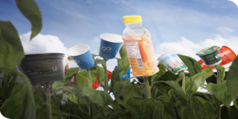
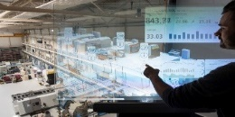
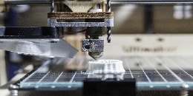
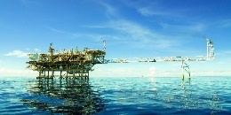
VI Methodology – 4 step approach
LEARN
CONNECT
TODAY’S CHALLENGE
DEMONSTRATE
COMMERCIALISE
TODAY’S
Bio-economy
ESM
UPSCALE
3D-printing
ADMA-Energy
Nano-technology

Slide 10
projects/activities per Pilot phase
Pilots / Phase | LEARN | CONNECT | DEMONSTRATE | COMMERCIALISE
3DP
ESM
Energy
Nano
Bio
ALL
3DPening
AM-Motion
MANUNET
EIB expert
contract
Innosup 03 - Clean Technologies
ERICA
Blue Technology innovation transfer -call
S34GROWTH
30 Demo
Cases
Shared Funding
VI MatchMaking Event
RE-CONFIRM
WATIFY
Inno_Infra_Share

Slide 11
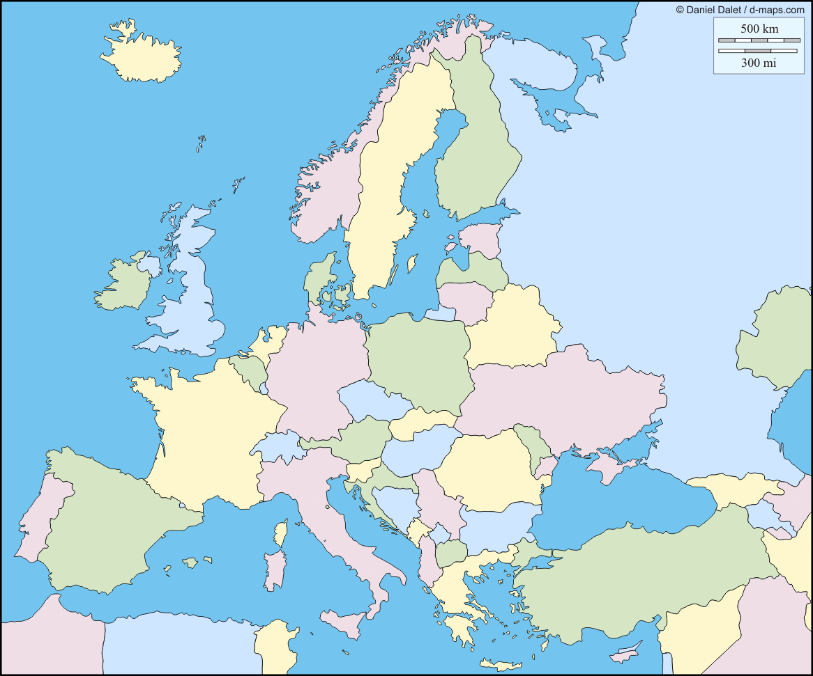
3DP Case: ‘Reducing weight in automotive, machinery and aerospace applications’ via 3D-Printed hybrid components
TEST 1
Fatigue - durability
TEST 2
Crash
Product specification
COMPANIES
Design specification
Raw materials, moulds
MANUFACTURE
DESIGN FOR MANUFACTURING

Slide 12
Funding & Investment Needs
VI at a turning point ...
➔ No further progress without appropriate funding for demo-cases
however: specific investment & funding needs ...
... calling for new, ad hoc solutions (adjusted / new funding instruments)
... and mobilising experts from our regions...

Slide 13
Funding & Investment Needs
VI DemoCases common objectives
establish shared facilities for demonstration of new technologies
facilitate access to shared facilities
lower technology uncertainty, risks and costs
stimulate industrial replication & upscale (hence market uptake)
each DemoCase =
combination of complementary demonstration facilities
group(s) of companies accessing infrastructure (TRL6-8)
industrial replication & upscale (if the above is successful) (TRL8-9)
3 types of DemoCases
connecting existing infrastructures
building brand new demonstration infrastructure
connect & upgrade existing infrastructure (hybrid format)

Slide 14
Different Investment Needs
Cat 2 Demo-Cases
10% to 20% of VI demo-cases
Creating / building new facilities
Demonstration / upscaling through:
Category 3 Demo-Cases
« Connecting & upgrading what already exists »
30% to 40% of VI demo-cases
« Building & connecting new demo facilities »
Connecting existing facilities
Category 1 Demo-Cases
« Connecting what already exists »
Ca. 50% of VI demo-cases
Investment size
0,5-10€ Mio
+/- 10-50€ Mio
+/- 50-200€ Mio (poss. even higher …)

Slide 15
General Financial Structure – three layers
Basic Demonstration Infrastructures – Initial Costs related to the setting up of the infrastructures and platform
Public Support
(100% coverage ‘non-profitable top’ through public funds, structural)
Layer 1
Regional, national and EU Subsidies
Projects-related activities (within the platform; TRL 5-7/8) - Operating costs
Layer 2
(e.g. 50% subs, project based)
Public Subsidies and private co-investments
ROI based on industrial upscale
(Repayable Loans, Bankable Business Pl)
Replication – Indus. Upscale (TRL8/9) 1
Replication – Indus. Upscale (TRL 8/9) 2
Replication – Indus. Upscale (TRL 8/9) 3
Replication – Indus. Upscale (TRL 8/9) 4
Etc.
Layer 3
Private investments, public (EIB-like) loans
Revenues generated from Replication/Industrial upscale and production
Notes:
Layer 1 (to some extent Layer 2 as well) contains « non-profitable top » (hence the subsidies)
Layers 2 & 3 can’t be functioning if « top » not financially secured (➔ no bankable plan !)
Layers inter-dependent; smooth flow between them key !

Slide 16
Crossing Investment Needs
and 3-Layers’ Funding Model
 | Category 1 “Connecting the existing” | Category 3 “Connecting & Upgrading” | Category 2 “Building brand new demo facilities” | Blending of different solutions
Layer 1 Initial costs – establishing the demo infrastructure | LOW | MEDIUM | HIGH | No suitable instrument so far in cross-regional, pan-European setting. New solutions needed
Layer 2 operating costs of the interregional demonstration platform | HIGH | HIGH | HIGH | Some EU solutions in place (I4MS, ActPhast, INNOSUP, Interreg NEW BIoBase NWE etc) but with uncertain access; no structural solution
Layer 3 industrial replication | MEDIUM | MEDIUM | HIGH | New instruments (e.g. Energy Demo Pilot under InnovFin) available but more convergence needed
Public Investment Fund
(multi-regional fund or centrally managed EU fund)
Expanded Interreg B
Vouchers
Expanded InnovFin, EFSI

Slide 17
@VI_Brussels #Vanguardinitiative
www.s3vanguardinitiative.eu

Slide 18
Pilots & DemoCases (1/3)
3DP
Automotive 1 – hybrid materials for lightweight, structural components (metal-CFRP)
Automotive 2 – functionally graded components (metal, non critical)
Machinery & tooling – structural parts with complex shapes
Creative industries – fashion, 3D printed wearables, lighting
Textiles – adding a dimension to 2D textiles
3DP Smart Bike – 3DP printed bike and accessoires
Healthcare – customized insoles and ortheses
Additive Substractive transversal pilot lines

Slide 19
Pilots & DemoCases (2/3)
Efficient and Sustainable Manufacturing
Adaptive and Smart Manufacturing Systems
De- & Remanufacturing
Energy and environmental efficiency
Advanced components and materials
Digital and virtual factory
ADMA Energy
Cost Reduction in subsea environments
Corrosion in water
Advanced manufacturing processes
Composites, New Materials, and Materials Testing
Power Transfer and conversion
Sensing, Instrumentation and Monitoring

Slide 20
Pilots & DemoCases (3/3)
BioEconomy
BioBased Aromatics
Lignocellulosic Refinery
Biogas beyond Energy
(Waste)Gas into Value
Bio Aviation Fuel
Food and Feed ingredients from Algae
Food and Feed from Agrofood Waste
Nanotechnology
Nano wires for ICT and energy
Printed electronics
Nanomedicine
Manufacturing of nanomaterials
Integrated nano bio systems

