Slide 1
EC Support for Smart Specialisation Platform Agri-Food: Kick-Off Event
Jan Larosse
Competence Centre 'Smart & Sustainable Growth'
DG Regio - European Commission
Florence, 6-7 December

Slide 2
S3P Agri-Food Working Arrangements: Overview
Guiding principles
Work Flow to enable partnerships in thematic areas
How can a Region participate?
Governance ('joint initiative')
Support by the European Commission:
Support by DG Regio
Support by DG Agri
Support by DG RTD
Support by DG JRC
Support by other DGs

Slide 3
Guiding principles
Open, inclusive and transparent partnership approach for any committed European Region
• work with clusters and other intermediaries (triple helix /SME platforms)
• involve EU value chains and other interregional business networks
• generate a pipeline of investment projects in targeted smart specialisation thematic areas

Slide 4
Work flow in an investment pipeline:
Scoping Note To establish a partnership in a targeted thematic area
Mapping Exercise Targeting specific value chains: identification of business and research actors and of innovation support infrastructure
Matchmaking Events Bringing targeted actors together
Preparing & implementing investment projects
Thematic Area for Agri-Food
Scoping Common vision & roadmap
Mapping of competences & matching of business opportunities
Business cooperation and design of projects
Business Plan &
Funding Mix
Calls!
Investment Projects
Demonstrators
Bundled small projects
Single cross-regional large scale project
Large individual projects

Slide 5
How can regions join?
Any European region can become member of a 'partnership'
that is targeting R&I investments in a common focus area:
As a 'leading region' (political commitment)
Being a EU 28 region
Having the thematic focus area as RIS3 priority
Committing to support the 'set-up' costs of the partnership
As a 'participant region' (implementation commitment)
Being a European region
Engaging to support partnering via mobilising local cluster organisations (or other intermediaries) and business
Ready to commit funds for good projects!

Slide 6
Governance of the thematic area:
Partnerships: composition
Co-lead regions (=strong political commitment); min 2 is preferable; leading-regions have to bring a unifying vision (in the scoping document);
Active participant regions (=mobilising stakeholders / cluster organisations in the focus area); starting with minimum 3;
Open to all active regions and their innovation actors (=critical mass in the Value Chain).
Partnerships: mission
Engage regional S3 investments in (joint demonstration) projects
to enhance private investments in the thematic focus area
through promoting new (interregional) agro-food value chains

Slide 7
Governance of the Platform
Joint Initiative with three components
S3 Platform (Seville) as operational hub
Partnerships – active components:
EC-services: all DGs that can contribute support (synergies) DG AGRI, RTD, Regio, JRC (not limited)
Steering Group
Composed of leading DGs and leading regions (representing partnerships)
Monitoring of progress of the partnerships & problem solving in the investment pipeline. Managing synergies with other initiatives; Structured dialogue EC- committed regions
Co-organising joint events; cross-partnership learning

Slide 8
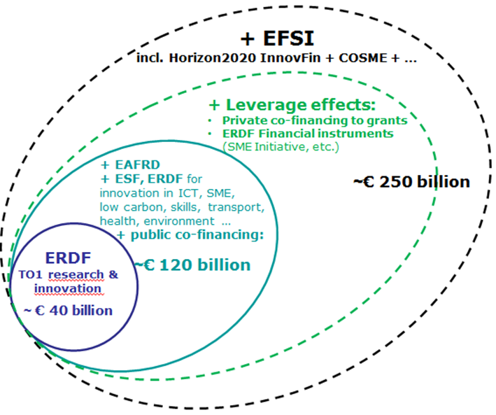
Support by DG Regio
Implementing RIS3 to leverage transformation in European value chains
Smart Specialisation
*
Key Facts
121 national/regional strategies tailored to specific strengths and potentials new growth dynamics and a transformation of EU economies towards innovation driven growth
Mobilising up to € 250 billion:
European Structural and Investment Funds
National & regional public funds
Private investments
Horizon2020, COSME …
EFSI
Projects are now being launched like testing facilities, incubators, technological transfer offices, research infrastructures, pilot plants, crowd-sourcing platforms, cluster services, collaborative spaces, etc.
Source: http://ec.europa.eu/regional_policy/en/policy/evaluations/data-for-research
and: https://cohesiondata.ec.europa.eu/

Slide 9
Support Instruments by DG Regio: Political support
Policy: Regional and Urban Policies (integrative approach for societal challenges; solution driven)
Direct support: Urban Innovative Actions Initiative (371 mio euro)
Developing the Smart Specialisation approach
S3 Steering Team: aligning within the Commission
S3 Communication in May 2017 (featuring interregional cooperation)
Shared Management: Monitoring Committees OPs
Coaching role (Article 70) / RIS3 Mid-Term Review 2017-18
Territorial cooperation policies (levels of proximity)
Macro-regional strategies (Baltic/Donau/Alpine..): towards joint programming
Interreg A (cross-border projects) & B (15 transnational projects in 15 areas - 2,1 bn)
Interreg Europe: Projects (Call March 2017) & Policy Learning Platform

Slide 10
Support Instruments by DG Regio: Technical Support
AMI-list: Pool of Experts for cohesion policy (incl R&I):
Advise on Scoping Notes; on Mapping; …
Taiex: Technical Assistence and Information Exchange for Peer 2 Peer exchange among Managing Authorities
Expert Missions; 2. Study visits; 3. Workshops
JASPERS: Joint Assistance to Support Projects in European Regions (for preparing 'major projects'/ Financial Instruments)
Administrative Agreement with DG JRC for S3 Platform:
Support for implementation phase: capacity building and focus on Thematic Smart Specialisation Platforms!

Slide 11
Support by other DGs
DG GROW
European Strategic Cluster Partnerships for Smart Specialisation Investments
COSME – e.g. Watify (support for matchmaking between regions for digital
entrepreneurship
3. European Enterprise Network (EEN) – matchmaking support
DG CNECT: Digital Innovation Hubs
DG EAC – EIT: Knowledge and Innovation Community (KIC) Food
DG EMPL: Skills Agenda
DG Mare: Demonstrations
…

Slide 12
Questions and Answers

Slide 13
Support in practice
Combining instruments to accelerate investments in promising Agro-Food areas
S3 Platform will facilitate work flow; partnerships are self-organising
Structured dialogue between the partnerships and the EC services
First Meeting of Steering Group
End of January
Thematic Area for Agri-Food
Scoping Common vision & roadmap
Mapping of competences & matching of business opportunities
Business cooperation and design of projects
Business Plan &
Funding Mix
Investment Projects
Demonstrators
Bundled small projects
Single cross-regional large scale project
Large individual projects

