Slide 1
DG RTD support: FOOD 2030 and the Smart Specialisation Platform for Agri-Food
Kick-off meeting S3P-AF
Florence, 6-7 December 2016
Alexandra TUIJTELAARS
European Commission
DG Research & Innovation
This presentation shall neither be binding nor construed
as constituting commitment by the European Commission

Slide 2
FOOD 2030 & the Food System
Good soil, water, land & biodiversity
Sustainable
Resilient
Connecting land & sea
Responsible
Diverse
Competitive
Food & Feed: trade, relations, culture, jobs, etc
Inclusive

Slide 3
FOOD 2030 Priorities
Nutrition: Reducing hunger & malnutrition, addressing food safety and diet-related diseases, and helping citizens adopt sustainable diets and healthy lives
Climate: Building a climate and global change-resilient food system
Circularity: Implementing sustainability and circular economy principles across the whole food system
Innovation: Boosting market creating innovation and investment, while empowering communities

Slide 4
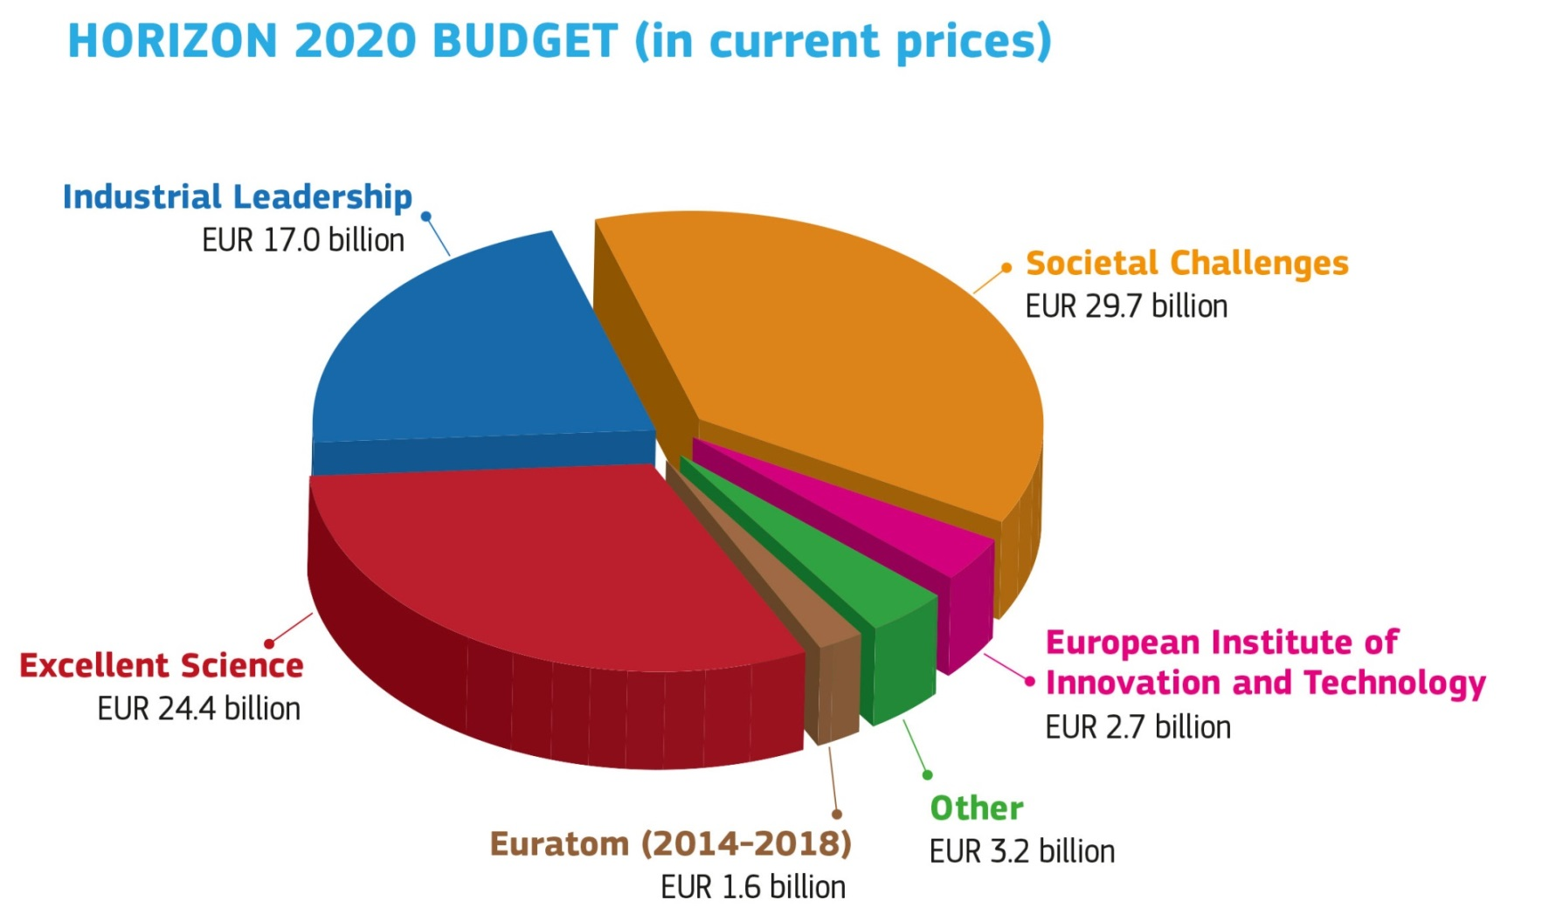
Funding Research & Innovation
Horizon 2020
For period 2014-2020
EUR 3.7 billion for SC2
'Food security, sustainable agriculture and forestry, marine and maritime and inland water research and the bioeconomy'
Notes:
EU key funder of research and innovation. HORIZON 2020 a multi-annual programme that covers the period 2014-2020 and has approximately EUR 80 billion at its disposal. Open to the world - participation. 3 pillars:
1) Support for "Excellent Science" – including grants for individual researchers from the European Research Council and Marie Skłodowska-Curie fellowships (formerly known as Marie Curie fellowships);
2) Support for "Industrial Leadership" – including grants for small and medium-sized enterprises and indirect finance for companies through the European Investment Bank and other financial intermediaries; stimulating private R&I funding
3) Support for research to tackle "societal challenges“; this is the biggest part, and within that 3.7 bln EUR is spent over 7 years on food and nutrition (through societal challenge 2)
How does it work: participants/consortia develop proposals in reply to calls for proposals; proposals are selected for funding based on peer-review evaluation by independent expert evaluators and they are granted in maximum 8 months.

Slide 5
H2020-ESIF
Synergies between ESIF and HORIZON 2020
ESIF
Horizon 2020
€100 billion for innovation in wide sense
€ 79.4 billion
"Stairway to Excellence"
"Research
Excellence"
Hopefully also excellence, but "Innovation Excellence"
National/RegionalR&I systems
Capacity Building
Research & Development
Innovation
Market
"Up-stream"
"Down-stream"
Notes:
ANNEX I to Common Provisions Regulation: COMMON STRATEGIC FRAMEWORK
4. COORDINATION AND SYNERGIES BETWEEN ESI FUNDS AND OTHER UNION POLICIES AND INSTRUMENTS
4.3 Horizon 2020 and other centrally managed Union programmes in the areas of research and innovation
2. Member States shall develop national and/or regional 'smart specialisation' strategies in line with the National Reform Programme, where appropriate. Such strategies may take the form of or be included in a national or a regional research and innovation strategic policy framework for 'smart specialisation'. Smart specialisation strategies shall be developed through involving national or regional managing authorities and stakeholders such as universities and other higher education institutions, industry and social partners in anentrepreneurial discovery process. The authorities directly concerned by Horizon 2020 shall be closely associated with that process. Smart specialisation strategies shall include:
(a) "Upstream actions" to prepare regional R&I players to participate in Horizon 2020 ("stairways to excellence") to be developed, where necessary, through capacity- building. Communication and cooperation between Horizon 2020 national contact points and managing authorities of the ESI Funds shall be strengthened.
(b) "Downstream actions" to provide the means to exploit and diffuse R&I results, stemming from Horizon 2020 and preceding programmes, into the market with particular emphasis on creating an innovation-friendly environment for business and industry, including SMEs and in line with the priorities identified for the territories in the relevant smart specialisation strategy.
3. Member States shall encourage the use of the provisions in this Regulation that allow the ESI Funds to be combined with resources under Horizon 2020 in the relevant programmes used to implement parts of the strategies referred to in point 2. Joint support shall be provided to national and regional authorities for the design and implementation of such strategies, to identify opportunities for joint financing of R&I infrastructures of European interest, the promotion of international collaboration, methodological support through peer reviews, exchange of good practice, and training throughout regions.
4. Member States and, where appropriate under Article 4(4), regions, shall consider additional measures aimed at unlocking their potential for excellence in R&I, in a manner that is complementary to and creates synergies with Horizon 2020, in particular through joint funding. Those measures shall consist of:
(a) linking excellent research institutions and less developed regions as well as low- performing Research, Development and Innovation (RDI) Member States and regions to create new or upgrade existing centres of excellence in less developed regions as well as in low-performing RDI Member States and regions;
(b) building links in less developed regions as well as in low-performing RDI Member States and regions between innovative clusters of recognised excellence;
(c) establishing "ERA Chairs" to attract outstanding academics, in particular to less developed regions and low- performing RDI Member States and regions;
(d) supporting access to international networks for researchers and innovators who lack sufficient involvement in the European Research Area (ERA) or are from less developed regions or low-performing RDI Member States and regions;
(e) contributing as appropriate to the European Innovation Partnerships;
(f) preparing national institutions and/or clusters of excellence for participation in the Knowledge and Innovation Communities (KICs) of the European Institute of Innovation and Technology (EIT); and
(g) hosting high-quality international researcher mobility programmes with co-funding from the "Marie Sklodowska-Curie Actions".
Member States shall endeavour to use where appropriate, and in accordance with Article 70, the flexibility to support operations outside the programme area, with a level of investment sufficient to attain a critical mass, in order to implement the measures referred to in the first subparagraph as effectively as possible.
7.2 Cross-border, transnational and interregional cooperation under the ERDF
Member States and regions shall seek to make use of cooperation to achieve critical mass, inter alia, in the field of ICT and research and innovation, and also to promote the development of joint smart specialisation approaches and partnerships among educational institutions. Interregional cooperation shall, where appropriate, include fostering cooperation between innovative research-intensive clusters and exchanges between research institutions taking into consideration the experience of "Regions of Knowledge" and "Research Potential in Convergence and Outermost Regions" under the Seventh Framework Programme for Research.
2. Member States and regions shall, in the areas concerned, seek to draw on cross-border and transnational cooperation to:
(a) …
(b) exploit the economies of scale that can be achieved, in particular with regard to investment related to the shared use of common public services;
(c) promote coherent planning and development of cross-border network infrastructure, ..;
(d) achieve critical mass, particularly in the field of research and innovation and ICT, education and in relation to measures improving the competitiveness of SMEs;
(e) strengthen cross-border labour market services to foster the mobility of workers across borders;
(f) improve cross-border governance.

Slide 6
Combining H2020 projects & ESIF … through sequential or parallel projects
H2020-ESIF
Capacity Building
National/Regional R&I systems
Research & Development
Innovation
Market
Horizon 2020
ESI Funds
R&I Infrastructures and Equipment (IP1)
KETs (IP1)
Business Innovation (IP1+3)
Procurement
Excellent R&I
Demonstration Pilots
PPPs
prizes
ESFRI
Marie Skłodowska-Curie
KETs
procurement
SME instrument
Skills
KICs
SME
Pilot lines
Financial instruments
Business Advisory services
Grant agreements

Slide 7
H2020-ESIF
EU Funds working together for jobs & growth
Examples of synergies between Horizon 2020 and the European Structural and Investment Funds (ESIF)
This publication prepared describes the rationale for developing links between the different funding sources and explains how they can be combined.
It showcases examples of synergies that have emerged at strategic, programming and project implementation levels and also highlights initiatives with a high potential for synergies
On internet at:
https://ec.europa.eu/research/regions/index.cfm?pg=publications
Notes:
7

Slide 8
SEAL OF EXCELLENCE
Key Features
Excellent proposals receive
the SEAL OF EXCELLENCE certificate
Certificate by the Commission
awarded to
Horizon 2020 evaluation:
Funding threshold due to H2020 budget availability
Funded
Quality threshold:
Pilot using the SME Instrument
Close to intervention logic of ESIF authorities:
Single company
Small scale R&I actions
Close to market
Regions/MS taking-up 'seal of excellence' proposals:
Benefit from pre-screening by H2020
Make the most of a unique, high quality evaluation process
Better use the resources
Invest on high local impact proposals
Research and
Innovation
Notes:
SEAL OF EXCELLENCE CERTIFICATE:
Main message: PROPOSAL SUCCESSFUL IN HIGH COMPETITION – MERITING FUNDING
Basic data on proposal (proposal number, title, call topic, applicant, legal name and address)
SIGNED BY BOTH COMMISSIONERS
The accompanying letter will indicate that:
the certificate can be used to get in contact with other funding bodies to explore other funding possibilities, as for instance from national/regional Managing Authorities of the Structural Funds (hyperlink to a website to find the relevant Managing Authority)
REGIONS / MEMBER STATES willing to support
'SEAL OF EXCELLENCE' proposals
BENEFITS:
FULLY EXPLOIT HIGH QUALITY EVALUATION PROCESS
USE RESOURCES EFFICIENTLY IN A PERIOD OF SCARCE RESOURCES
GAIN TIME
INCREASE R&I PERFORMANCE AND IMPACT IN THE TERRITORY
MAXIMIZED IF 'AUTOMATIC FUNDING'
598 (41%) proposals above threshold not funded - phase 1
684 (76%) proposals above threshold not funded - phase 2

Slide 9
H2020 CSA SCREEN Synergic Circular Economy across European Regions
Examples of support
Aim: Definition of a replicable systemic approach towards a transition to a circular economy in EU regions in context of RIS3
How: Identification and implementation of operational synergies between H2020 and ESIF
Bottom-up process with regional participation to identify most promising sectors, investment needs and operational actions along relevant value chains for circular economy
Project duration: Nov 2016 – Oct 18
Project coordinator: Regione Lazio (IT)
Notes:
- Sustaining regional actors' participation at H2020
Encouraging entrepreneurial initiatives based on project results
"Recovery" of well ranked unfinanced proposals
I would suggest that you only add after "…to identify most promising sectors, investment needs and operational actions along relevant value chains for circular economy".

Slide 10
RTD Study 'Mapping of EU Member States'/regions R&I plans and Strategies for Smart Specialisation (RIS3) on Bioeconomy'
Examples of support
Including agro-food as thematic focus
Task 1 Data gathering and desk review of RIS3 strategies EU-28
Task 2 Data analysis
Task 3 Case study analysis
Final Report expected by end of February 2017
Notes:
The overall objective of the study is to map the intended priorities and activities of EU Member States (MS) and regions with regard to research and innovation (R&I) on Bioeconomy, according to the current national or regional Smart Specialisation Strategies (RIS3) and programmes supported by the European Structural and Investment Funds (ESIF) for 2014-2020.
This information will help to define similarities, commonalities and specificities among the regions in the European Union, to identify and describe successful regional initiatives with a potential to be transferred to other regions as well as bottlenecks and gaps.
In general, the study will produce conclusions and policy recommendations that will serve the Commission and regional policy-makers as an evidence-base for future policies and initiatives strengthening the Bioeconomy.

Slide 11
EIB Study 'Access-to-finance conditions agri-food value chain'
Examples of support
Aim and focus: assess investment and funding needs, access-to-finance conditions for
- Digital technologies for smart agri-food sector
- Novel processing technologies,
- Adoption of new food contact materials, incl packaging
Timeline: Inception report Q1 2017, final report Q4 2017
InnovFin Advisory http://www.eib.org/products/blending/innovfin/products/advisory.htm
Notes:
Timeline postponed: inception report Q1 17; progress report Q3 17, final report Q4 17.
AF value chain is facing access-to-finance challenges
InnovFin Advisory aims to improve the bankability and investment-readiness of large projects that need substantial, long-term investments. It will also provide advice to improve the conditions for access to risk finance for R&I through horizontal activities such as sector studies, criteria reports and better information tools. The main clients foreseen are promoters of large R&I projects that meet Horizon 2020's Societal Challenges.

