Slide 1

Notes:
“to reinforce the effectiveness of cohesion policy”
“identification and dissemination of good practices with a view to their transfer principally to operational programmes under the Investment for growth and jobs

Slide 2
Rationale of Interreg Europe
European Union | European Regional Development Fund
INTERREG: 3 strands and 79 different programmes (EUR 10.2 billion)
INTERREG
A
cross-border
  60 programmes
  74% - 6,6 MEUR
B
transnational
  15 programmes
  20.3% - 2,1 MEUR
C
interregional
  1
  programme
INTERREG EUROPE
5.6%
571.6 MEUR
  3
  programmes
URBACT
INTERACT
ESPON
networking
Exchange of experience to improve performance of policies
for regional development, in particular Structural Funds programmes

Slide 3

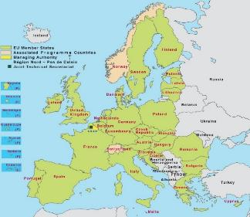



Two interrelated actions
Policy Learning Platforms
Open to all regions
Enrich
Contribute
Interregional cooperation projects
Project 1
Project 2
Project 3

Slide 4
First two calls: thematic overview
472 projects submitted
130 projects approved
Higher success rate under TO1 (41%)
Lower success rate in TO6 (21%)
Notes:
1100 partners from 30Partner States
900 policy instruments addressed (ROP, RIS3)
200 EUR
4 projects on agri food

Slide 5




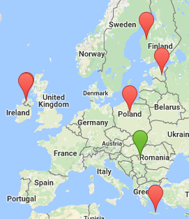
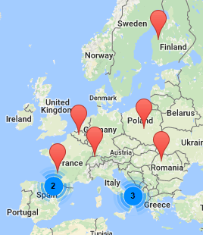
1st Call projects
Innovation in food sector:
Building innovative food value chains in regions
Support to food sector:
Enhancing SME competitiveness and sustainability in the organic sector
LP: Regional Development Agency of the West Region Romania (RO)
LP: Regional Development Agency of Navarra (ES)

Slide 6





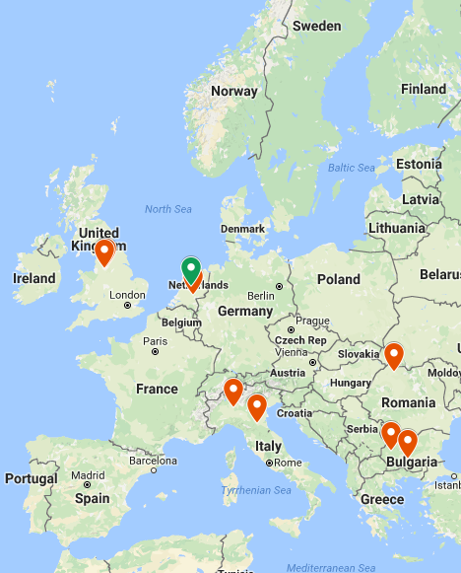

2nd Call projects
FoodChains 4 Europe
ECOWASTE 4 FOOD
Innovation in food sector:
Strengthening regional innovation policies to build sustainable food chains
Waste management:
Supporting eco-innovation to reduce food waste and promote a better resource efficient economy
LP: Province of Flevoland (NL)
LP: Mediterranean Agronomic Institute of Montpellier (FR)

Slide 7
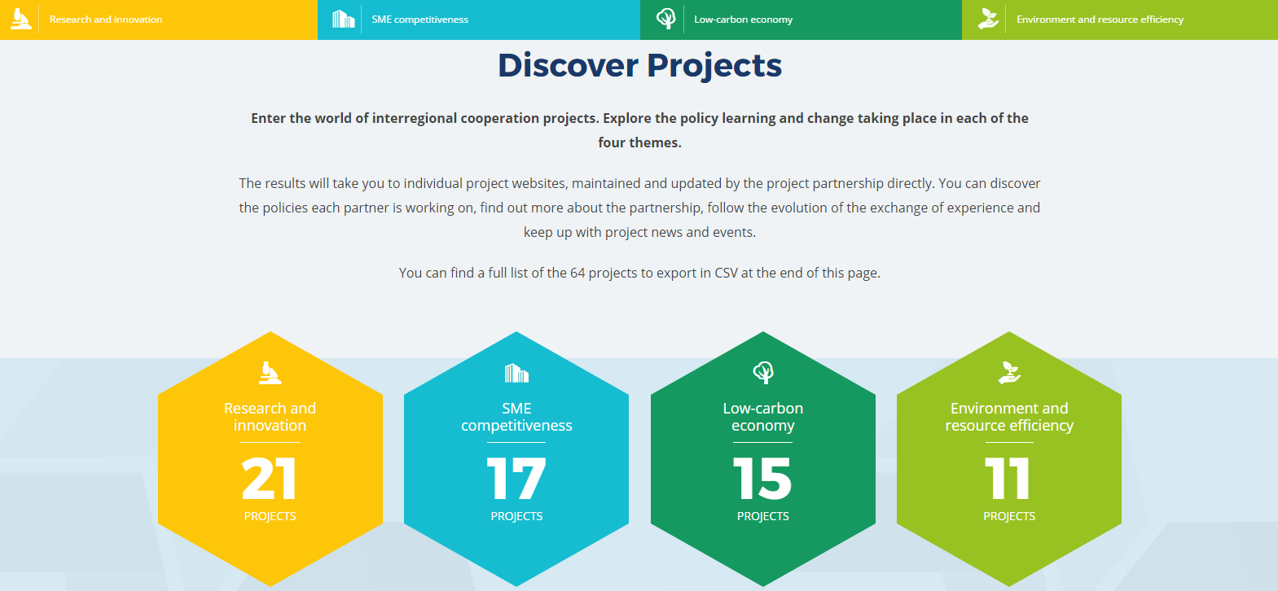
www.interregeurope.eu
Notes:
Synergies with Vanguard Initiative:
Smart Pilots (3 of the 5 Smart Pilots regions (Flanders (BE), ZuidHolland (NL), Lombardy (IT)) are involved in Vanguard),
S34GROWTH (The idea and consortium are based on the partners’ cooperation in the context of the Vanguard Initiative),
ClusterFY (involving external experts from Vanguard),
MANUMIX (LP - Basque Government is involved in Vanguard, the project plans to participate in Vanguard events and platform)

Slide 8




Policy Learning Platforms
facilitate continuous policy learning across EU by creating a community of policy makers & practitioners to improve regional policies
Internal capitalisation
Better exploit the projects’ results
Open up the programme results to anyone interested
External
capitalisation
#policylearning
Online collaborative tool
With relevant functionalities
+ Expert team
Content and coordination role

Slide 9
Policy Learning Platforms
A service-portfolio provided per priority axis via:
Online collaborative tool
With relevant functionalities
Expert team
Content and coordination role
+
#policylearning

Slide 10




www.interregeurope.eu/policylearning
Services accessible to all public
Knowledge bank
Networking opportunities
Good practices Database
Policy recommendations,
EU policy news
Thematic studies
Practitioners Database
Matchmaking events
Discussion forums
Partnering events
Services accessible to registered memebers
Expert helpdesk
Expert support
Policy advice
Guidance in the
databases
Analysis data
Updated information
Peer reviews
Benchmarking exercises
Thematic workshops
Capacity building events
#policylearning
Notes:
The 4 services following interest for involvement of the users. These are the seed services to kick off the platforms.

Slide 11

PLP and Smart Specialisation Platform on Agri-Food
No Wrong Door approach
  Liaise closely and align agendas
  Exchange of information
  Contribution to capacity building workshops
  R&I PLP - insights on:
  Interreg Europe actors’ actual needs/ challenges
  Future trends in innovation policies beyond S3

Slide 12
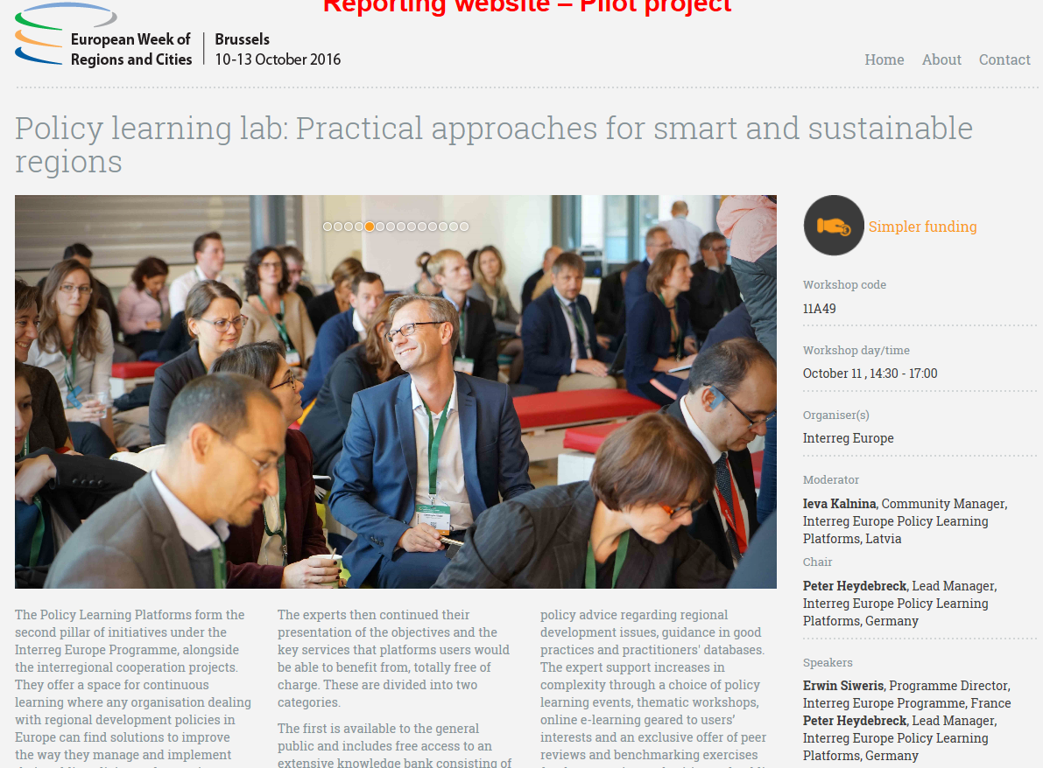
Policy Learning launched in EURWC
#policylearning

Slide 13

Interreg Europe = community
Over 8000 members…Sign up!

Slide 14
Thank you!
Magda Anagnostou
Coordinator Policy learning platforms
Interreg Europe Joint Secretariat
m.anagnostou@interregeurope.eu

