Slide 1
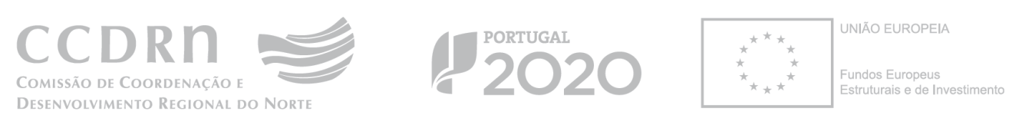

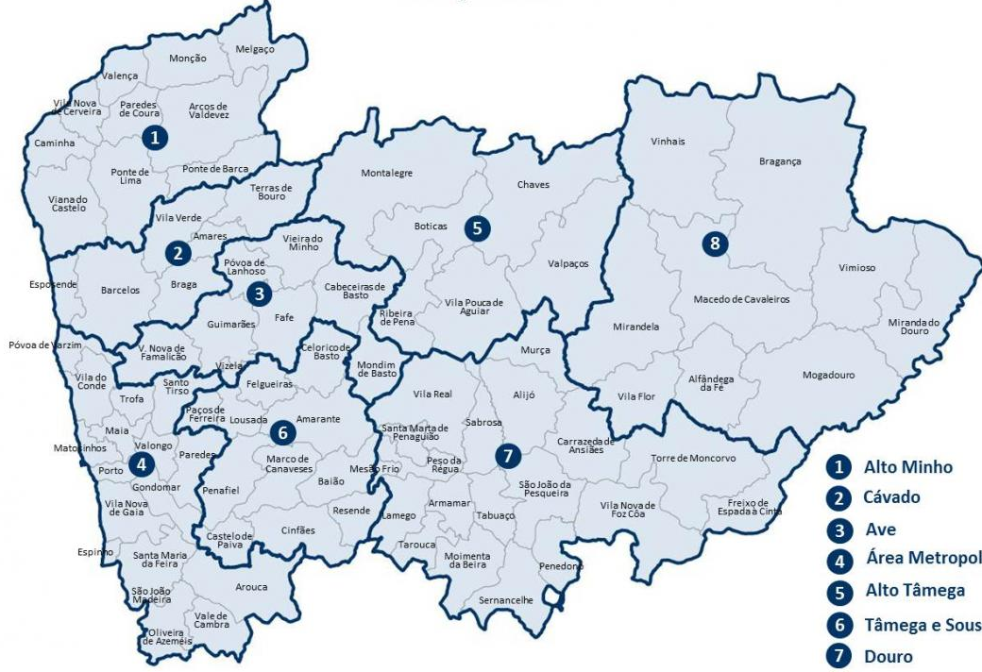
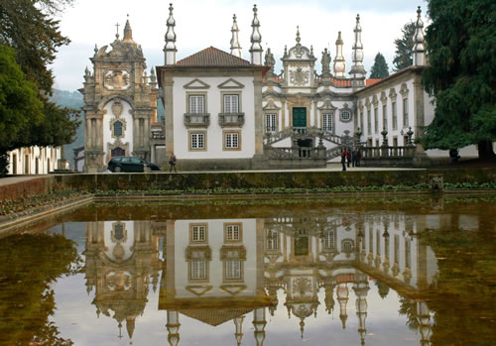
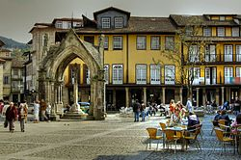
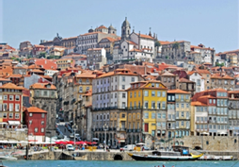
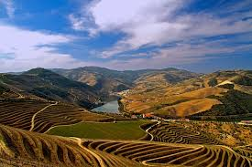
Norte Portugal
RIS3 and its application to cultural heritage in North Portugal
Rome, 25th November 2016
Ester Gomes da Silva
SMART SPECIALISATION and CULTURAL HERITAGE. An engine for innovation and growth – S3 Platform thematic workshop

Slide 2

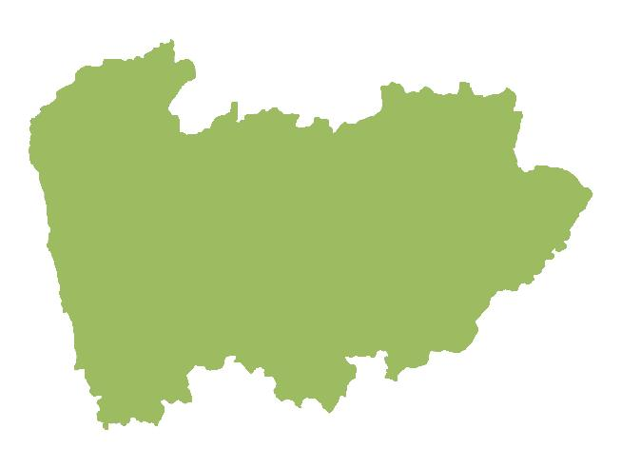
NORTE 2020 STRATEGIC SECTORS
SYMBOLIC CAPITAL, TECHNOLOGY AND TOURISM SERVICES
CULTURE, CREATIVITY AND FASHION
FOOD AND ENVIRONMENTAL SYSTEMS
MARINE AND MARITIME ECONOMY
HEALTH CARE AND LIFE SCIENCES
ADVANCED ENGINEERING TECHNOLOGIES
MOBILITY AND ENVIRONMENT INDUSTRIES
HUMAN CAPITAL AND NEARSHORE SERVICES
Cultural Heritage, related to symbolic capital, seen as a key factor for differentiation and creation of competitive advantage in tourism activities.
Investment in cultural infrastructure is intimately connected with tourism upgrading.
2
SMART SPECIALISATION and CULTURAL HERITAGE. An engine for innovation and growth – S3 Platform thematic workshop
Notes:
2

Slide 3
STRONG INVOLVEMENT OF STAKEHOLDERS
NORTE 2020 STRATEGIC SECTORS
FIRMS | BUSINESS ASSOCIATIONS
RATIONALE
Hoti Hoteis, SGPS
Douro Azul
Process followed the quadruple helix model, stressing participation and collaboration;
Commitment: decisions influence the allocation of funds.
Eusébio Rodrigues.
The Yeatman
Hotel Teatro.
UA/DEGEI
Aeroporto
Sá Carneiro
Direção Regional
Cultura do Norte
Porto Business
School
INESC Porto
ADDICT
Termas de Portugal
Feira Viva
UP
UP
TNSJ.
INSTITUTIONS
SCIENTIFIC AND TECHNOLOGICAL SYSTEM
3
SMART SPECIALISATION and CULTURAL HERITAGE. An engine for innovation and growth – S3 Platform thematic workshop
Notes:
3

Slide 4
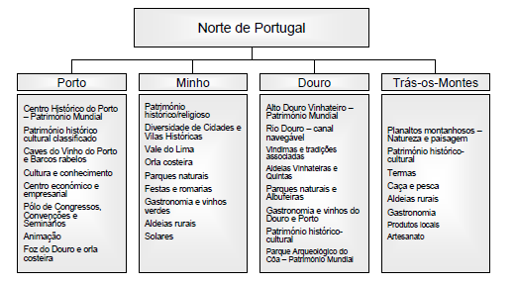
DIAGNOSIS: RESOURCES AND ASSETS
NORTE 2020 STRATEGIC SECTORS
4
SMART SPECIALISATION and CULTURAL HERITAGE. An engine for innovation and growth – S3 Platform thematic workshop
Notes:
4

Slide 5
DIAGNOSIS: SWOT ANALYSIS
NORTE 2020 STRATEGIC SECTORS
Strenghts | Weaknesses
Wealth of endogenous differentiating resources, with national and international dimension (e.g. wine); Vast historical-cultural landscape, natural and architectural patrimony; 4 UNESCO World Heritage sites; Douro: world's oldest wine demarcated region; | Inability to retain visitors; Lack of a global strategy for the promotion of the region; Shortage of qualified human resources Lack of coordination between the agents operating in tourism.
Hospitality, safety, strong traditions;
International Airport.
Opportunities | Threats
OMT predictions of international tourism growth in the region; New consumption trends, favoring destinations that offer diverse experiences/ high degree of authenticity and quality; Growth in the supply of low-cost travel; Tourism cruise terminal. | Difficulties in placing the northern region within the main international markets; Need to increase networks and scale and to improve the strategic regional coordination; Bureaucratic and legal barriers-for approval and licensing of tourism projects.
5
SMART SPECIALISATION and CULTURAL HERITAGE. An engine for innovation and growth – S3 Platform thematic workshop
Notes:
5

Slide 6
MAJOR GOALS: RIS3 rationale
NORTE 2020 STRATEGIC SECTORS
Upgrading of cultural and territory resources
Create a destination of excellence and historical-cultural authenticity, backed by the world heritage classified sites and the historic-cultural heritage;
Promote wine tourism;
Promote nature and rural tourism, based on the regional network of protected areas;
Promote tourism for health and wellness.
Focus on the regeneration of historic centres
Promotion of tourism upgrading by developing scientific and technological capacities (management, marketing and ICT)
Increase in the number of overnight stays in hotels, resorts, apartments and other (from 4,652 overnight stays per year to 5,500 to 6,500 overnight in 2023)
Increase in the number of visits to sites of cultural and natural heritage (target value 2023: 600,000 visitors per year)
Targets:
6
SMART SPECIALISATION and CULTURAL HERITAGE. An engine for innovation and growth – S3 Platform thematic workshop
Notes:
6

Slide 7
STRATEGY
NORTE 2020 STRATEGIC SECTORS
Funding of cultural infrastructures is conditional upon the completion of the mapping of intervention needs;
Infrastructural investment is circumscribed to the mapped historical-cultural goods, jointly defined by the CCDR-N, the North Region Direction of Culture, the Intermunicipal Communities of the North and the Metropolitan Area of Porto;
Promotion of joint interventions with other levels of governance (regional and subregional)
In particular: urban rehabilitation determined in articulation with municipal territorial planning (PARUs and PEDUs).
7
SMART SPECIALISATION and CULTURAL HERITAGE. An engine for innovation and growth – S3 Platform thematic workshop
Notes:
7

Slide 8
STRATEGY
NORTE 2020 STRATEGIC SECTORS
Calls of Norte 2020 thus consider the following priorities:
Promotion of the areas included in the UNESCO World Heritage list;
Consolidation of territorial and thematic networks of material heritage (route of cathedrals, Romanesque of Northern Portugal, religious heritage, network of monasteries, castles and fortresses, baroque of Northern Portugal and the castros);
8
SMART SPECIALISATION and CULTURAL HERITAGE. An engine for innovation and growth – S3 Platform thematic workshop
Notes:
8

Slide 9
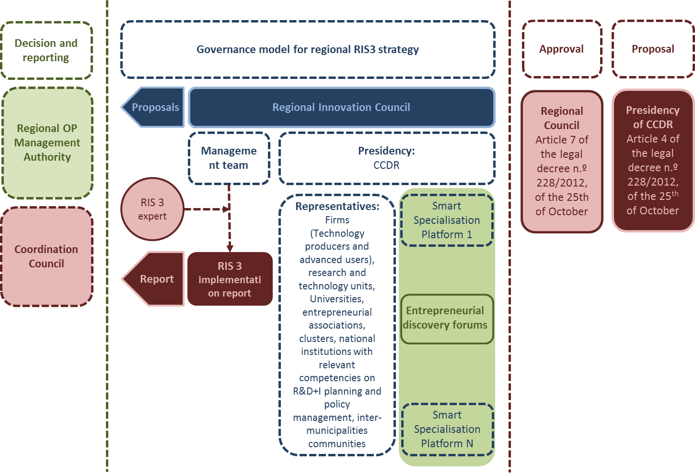
MONITORING
NORTE 2020 STRATEGIC SECTORS
9
SMART SPECIALISATION and CULTURAL HERITAGE. An engine for innovation and growth – S3 Platform thematic workshop
Notes:
9

Slide 10
ILLUSTRATIVE EXAMPLES
NORTE 2020 STRATEGIC SECTORS
Objectives:
Recovery and valorization of the cultural heritage
Provision and promotion of cultural equipment,
Qualification and modernization of cultural services and activities;
Valorization of "Specific Resources", "regional tourism excellence" and "PROVERE-Economic Recovery programmes of endogenous resources“
10
SMART SPECIALISATION and CULTURAL HERITAGE. An engine for innovation and growth – S3 Platform thematic workshop
Notes:
10

Slide 11
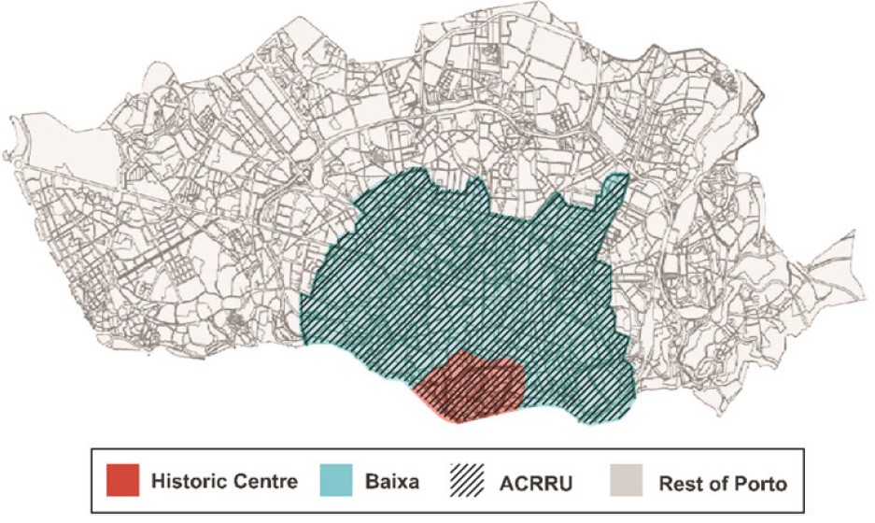
PORTO HISTORIC CENTRE
NORTE 2020 STRATEGIC SECTORS
Diagnosis
Buildings deterioration directly related to the old and low rental practices, poor and socially fragile population and activities, weakness of public services and accesses.
Very old, deserted and profoundly degraded urban fabric.
Goals
è Revitalization of neighborhoods
Attraction of new residents, in particular young people
Deployment of new economic activities and tourism services
è Improvement of the image of the covered areas, and more generally, of the historic site
11
SMART SPECIALISATION and CULTURAL HERITAGE. An engine for innovation and growth – S3 Platform thematic workshop
Notes:
11

Slide 12
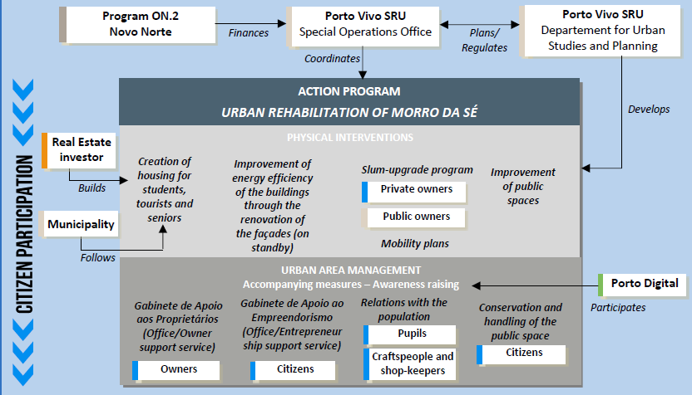
PROJECT IMPLEMENTATION
NORTE 2020 STRATEGIC SECTORS
Source: Historic Cities in Development: Keys for Understanding and Acting, 2012.
12
SMART SPECIALISATION and CULTURAL HERITAGE. An engine for innovation and growth – S3 Platform thematic workshop
Notes:
12

Slide 13
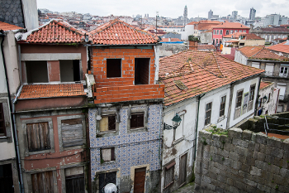
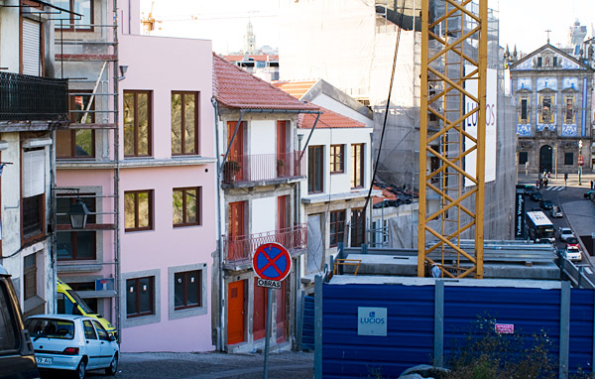
PROJECT IMPLEMENTATION
NORTE 2020 STRATEGIC SECTORS
Urban Rehabilitation: Morro da Sé
13
SMART SPECIALISATION and CULTURAL HERITAGE. An engine for innovation and growth – S3 Platform thematic workshop
Notes:
13

Slide 14
RESULTS
NORTE 2020 STRATEGIC SECTORS
Considerable impact in the community by generating a new urban regeneration dynamic that is both innovative and perceptible (Porto’s urban centre is a lot livelier than it was prior to the activity of the SRU);
Noteworthy increase in the quantity of permits issued for recovery works in the areas of intervention;
Public investment multiplier in terms of induced rehabilitation in downtown Porto = 9
Increasing rate of new businesses.
BUT:
Problems of financial sustainability;
Efficiency in recovering buildings, but not so much in improving and preserving the public realm;
Gentrification: in some cases, rents did not remain affordable for lower income households following the urban regeneration
Part of the housing is still rented under the rent protection initiatives of the dictatorship period, making the maintenance of buildings problematic.
14
SMART SPECIALISATION and CULTURAL HERITAGE. An engine for innovation and growth – S3 Platform thematic workshop
Notes:
14

Slide 15
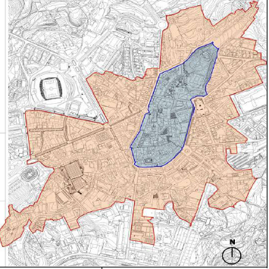
GUIMARÃES HISTORIC CENTRE
NORTE 2020 STRATEGIC SECTORS
Intervention
Local Technical Office (GTL (Gabinete Técnico Local)) is
the responsible entity for managing the interventions
in buildings
Rationale
Local maintenance and minimal impact through the use of skilled local labor, materials and traditional techniques.
Multiple constraints for urban renewal: facades design, colors and materials should be maintained as the originals; the same with regard to buildings interior.
Delimitation of Guimarães historic
centre classified as World Heritage (blue) and its protection zone (red)
15
SMART SPECIALISATION and CULTURAL HERITAGE. An engine for innovation and growth – S3 Platform thematic workshop
Notes:
15

Slide 16
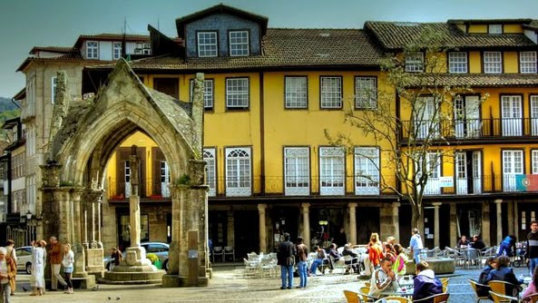
PROJECT IMPLEMENTATION
NORTE 2020 STRATEGIC SECTORS
Urban Rehabilitation: Historic Centre Guimarães
16
SMART SPECIALISATION and CULTURAL HERITAGE. An engine for innovation and growth – S3 Platform thematic workshop
Notes:
16

Slide 17
CHALLENGES/QUESTIONS
NORTE 2020 STRATEGIC SECTORS
The concentration of funding in specific areas according to the idea of Smart Specialization raises some challenges:
What actions should be promoted in order to diminish the potential inequality problems among territories?
How to ensure that rural actors and assets are included in the RIS3 implementation?
Can area-based pilots be a possible way to fix hard investment in physical rehabilitation of cultural heritage with RIS3 soft investments?
17
SMART SPECIALISATION and CULTURAL HERITAGE. An engine for innovation and growth – S3 Platform thematic workshop
Notes:
17

Slide 18
CHALLENGES/QUESTIONS
NORTE 2020 STRATEGIC SECTORS
Mapping of classified cultural heritage (density)
18
SMART SPECIALISATION and CULTURAL HERITAGE. An engine for innovation and growth – S3 Platform thematic workshop
Notes:
18

Slide 19
CHALLENGES/QUESTIONS
NORTE 2020 STRATEGIC SECTORS
What are we currently doing:
Positive discrimination for low density areas either through specific calls for tenders, bonus rules in project evaluation or increasing the co-financing rate;
Integrated Territorial Investment (ITI), Community-led Local Development (DLBC) and Integrated Actions for Urban Sustainable Development (AIDUS);
PROVERE initiative: strategic partnerships for the implementation of innovative territorial development plans.
19
SMART SPECIALISATION and CULTURAL HERITAGE. An engine for innovation and growth – S3 Platform thematic workshop
Notes:
19

Slide 20
Norte Portugal
Thank you!
SMART SPECIALISATION and CULTURAL HERITAGE. An engine for innovation and growth – S3 Platform thematic workshop

