Slide 1
RIS3 support in
Lagging Regions
Monitoring Working Group: First Meeting
Barcelona, 16 February 2017
Project team: Mark Boden, Karel Haegeman, Elisabetta Marinelli, Marina Ranga, Patrice dos Santos, Susana Valero
www.jrc.ec.europa.eu
Serving society
Stimulating innovation
Supporting legislation

Slide 2
RIS3 in Lagging Regions: aims & background
Aims
To support the refinement and implementation of the RIS3 of selected EU regions
To generate lessons and a model for other regions
To serve as a test-bed for theories on Smart Specialisation – understanding of RIS3
Background
Extends activities in Eastern Macedonia and Thrace
Implements two European Parliament "Preparatory Actions"

Slide 3
Lagging Regions: Policy issues
Policy issues and definitions
Slow and limited growth – despite investment
Lack of understanding → lack of effective actions to identify, understand, address issues
Low growth regions - GDP/capita below EU average and did not converge to EU average post-crisis (Greece, Italy, Spain, Portugal)
Less developed regions - GDP/capita <50% of EU average (Bulgaria, Hungary, Poland, Romania)

Slide 4
European Parliament Support – 2 PAs
PA 1: Support for growth and governance in lagging regions
Regions from 8 EU MS
Stakeholder engagement, mutual learning, support for RIS3 implementation
Cross-cutting approaches to key issues of growth and governance
Refinement of the RIS3 model
Further development of practical support for regions across EU
PA2: Competitive advantage and potential for smart specialisation in Romania
In depth support for 2 Romanian Regions (North East, North West)
Close complementarity - but deeper engagement
Differing stages of RIS3 development between regions
Coordination with national level RSI3

Slide 5
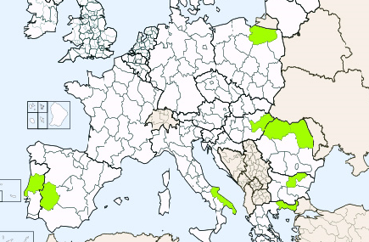
Support to RIS3 implementation in 9 Lagging Regions
Warminsko Masurskie
Nord-Vest
Észak-Alföld
Nord-Est
Centro
Severen Tsentralen
Puglia
Eastern Macedonia
and Thrace
Extremadura

Slide 6
Objectives
to develop and provide appropriate and specific support to selected regions in RIS3 implementation, building on EDP
to develop and enhance linkages between RIS3 at regional and national levels (particularly in Romania)
to develop and implement horizontal approaches to key issues in the growth and governance of RIS3
to develop and disseminate lessons and a tool box for other EU regions
to improve understanding of slow and limited growth in EU regions and links to macro-economic framework conditions

Slide 7
Implementation
Partnership
JRC, DG REGIO, other DGs, regional and national authorities
Flexibility
approach tailored to needs and problems identified by stakeholders
Trans-national dimension
Identify and share common challenges and solutions
Synergies with other activities
Less Developed Regions initiative, Bridges, Beyond EDP Vanguard Initiative, S3P, S2E etc.

Slide 8
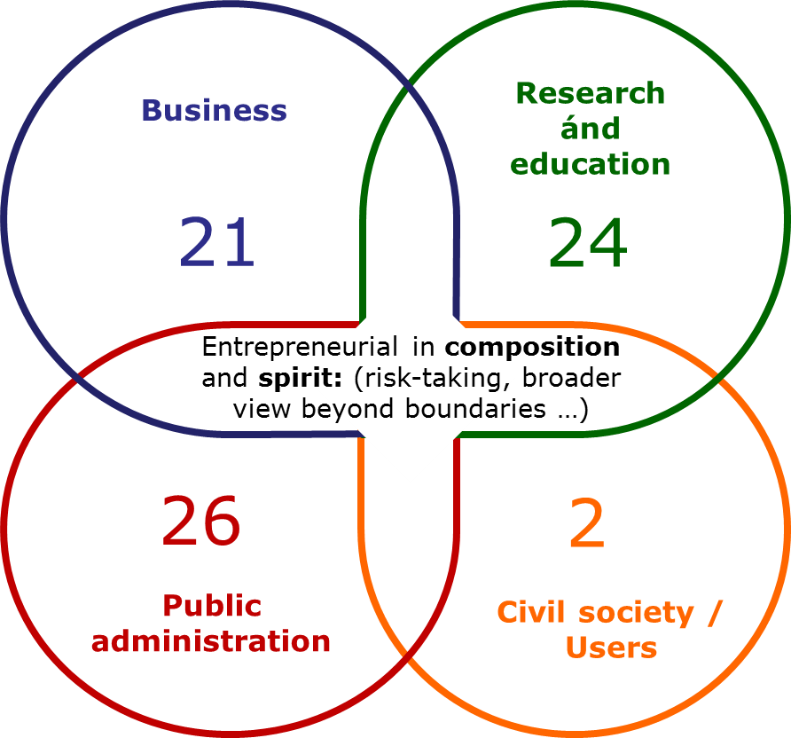
Entrepreneurial Discovery Process Focus Group
Cluj – May 2016
Cosmetics and food supplements based on natural resources
Stakeholder representation (Quadruple helix): 73 participants
38 business ideas generated
Examples of business ideas:
Database of plant resources - Edible plants consumed traditionally for anti-ageing / healthy ageing purposes
Anti-acne products - testing efficiency locally
Transylvanian Cosmatopea Cluster
Locally branded bio products
In-house technology for determination of own natural cosmetic products' validity date and for quality control of ingredients and final product
Smart packaging: with anti-microbe protection or smart labels changing colour if expired
Cosmetics and (para)pharma: From harmful to beneficial cosmetics
Key role for international stakeholders
Notes:
8
Commission support
Support for smart specialisation strategy development (over 100 expert contracts, S3Platform, e.g. Guide on RIS³ regarding entrepreneurial discovery process) including synergies issues
Sections for synergies in templates for Partnership Agreements & Operational Programmes
Provide guidance & training to OP negotiators (vade-mecum for synergies issues; recommended wordings in OPs and PAs)
Support for teaming up of MS & regional innovation actors around shared smart specialisation fields (Vanguard Initiative, RIS³ thematic platforms, Eye@RIS3 mapping, workshops, INTERREG) to be better prepared for trans-national Horizon 2020 calls and EIP etc. involvement
Guide for policy-makers and implementers (both on Horizon 2020 and ESIF side)
Dissemination: Synergies seminars in MS and with NCPs ; Stairway to Excellence pilot project ; Seal of excellence support for JTIs' MoUs … etc.

Slide 9
Toolbox
Objectives | Tools
Idea generation, trust building and support cooperation | EDP focus group methodology
Open up to wider (online) communities | Online stakeholder engagement
Address brain drain, build skills | Mobility Working Group
Increase coordination between national and regional levels | Methodology PDL1
Widen funding sources to draw on for idea implementation | Methodology PDL2
 | Online RDI Funding Guide
 | Case descriptions
Optimise RIS3 governance structure | Governance working group
Support ongoing stakeholder engagement | Stakeholder round table discussions
Identification of barriers and possible solutions
 | Tailored peer review events
Mutual learning
 | Board of critical friends
Support international cooperation | Collaboration spotting tool

Slide 10
Horizontal issues (i)
Governance - Working Group(s) on Governance
long-term sustainability of the EDP process
relationship between national and regional levels
synergies between structural funds and other resources
Transnational cooperation – essential to RIS3
Potential transnational collaboration
Cooperation within EU and with neighbourhood countries
Thematic cooperation across EU (Value chains/KICs/…)
Methodological cooperation/mutual learning
Appropriate monitoring and evaluation systems

Slide 11
Horizontal issues (ii)
Implementation of RIS3 –critical issues for sustainable RIS3 implementation:
State Aid rules
Sustaining EDP
Instruments beyond the ROP (synergies between ERDF and H2020, but also with other (EU) funding opportunities)
Components of the R&I system and design of the policy mix - Role of universities, RTOs, and research-active firms
Outward (and forward) -looking orientation
Implementing monitoring and evaluation systems

Slide 12
Work Packages
National/Regional Profiling - stocktaking and assessment of state of RIS3 implementation in selected countries/regions
RIS3 implementation and refinement in Romanian regions - reinforcement of linkages between national and regional RIS3 and support to development of EDP
Specific support activities - undertaken in selected regions
Horizontal support and peer learning - addressing common issues and with wider relevance
Analysis, tool development and policy recommendations
Coordination, cooperation, and communication

Slide 13
Outcomes
Regions
Commission/EP
Specific support
e.g. instruments
e.g. synergies between funds
support to continuous EDP
Advancing understanding of RIS3 implementation
Horizontal support
E.g. Monitoring, governance
E.g. Cross-regional exchange
RIS3 - an entry point to broader issues
Dissemination
Codification of methodologies
Publications
Other media
Improve understanding of slow and limited growth

Slide 14
Organisation of the day – 3 key moments
RIS3 Hearing
Comparing approaches to monitoring
Working groups
Peer exchange on S3 monitoring challenges
RIS3 monitoring clinic
Feedback from experts and critical friends
Definition of objectives

Slide 15
RIS3 Monitoring Clinic: First co-definition of objectives
Define overall operational objective for the WG
(e.g. develop process and output indicators for priorities a,b,c)
Milestone for each WG meeting
(e.g. M1 indicators for priority a and b; M2 indicators for priority c)
Feedback
JRC in between workshops
Experts and peers during workshops
Template 2

Slide 16
Project website
http://s3platform.jrc.ec.europa.eu
Thank you!

