Slide 1
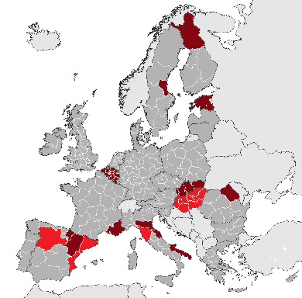
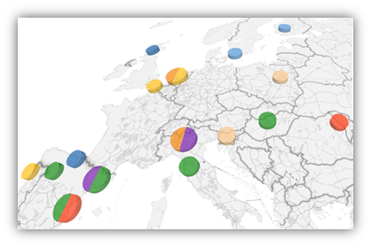
Partnership
“Industry 4.0. and SMEs” – S3 Platform for Industrial Modernization
Lead regions and member states of officially accepted partnerships:
O Advanced manufacturing for energy application
O Bio-Economy
O Efficient and sustainable manufacturing
O High performance production through 3D printing
O Industry 4.0
O Innovative textile
O New nano enabled products
O Smart and adaptive manufacturing
17 March 2017
Brussels

Slide 2

Partnership “Industry 4.0 and SMEs”
Regional initiatives in industry 4.0 in execution
Co-Leading regions:
Tuscany: ICT Photonics, Smart Factory, Chemicals and Nanotechnologies, Platform Industry 4.0 and Advanced Manufacturing
Valencia: Quality of Life, Innovative products and customized environments, and Advanced manufacturing and new industrial systems
Castilla y León: Advanced Materials, ICT, Biotechnology, Advanced processes and manufacturing
Hungary: Advanced technologies in the vehicle and other machine industries, ICT and information services
Catalonia: Transversal Technology Facilitators Industrial Ring 4.0, Stimuli project and Platform Industry 4.0
Participant and/or interested regions:
- Lapland (Finland) - Slovakia - Marche (Italy)
- Gavleborg (Sweden) - Nord East (Romania) - Navarra (Spain)
- Estonia - Provence Alpes Côte d’Azur (France)
Flanders (Belgium) - Puglia (Italy) - Aragon (Spain)
- Wallonia (Belgium) - Emilia Romagna (Italy) - …..
- Helgeland (Norway) - Bielsko-Biala (Poland)

Slide 3











Partnership “Industry 4.0 and SMEs”
Infraestructures, Strategies and Commitment for Industry transformation
Tuscany: sector-specialised Technological Districts and Regional Platform on Industry 4.0. - Advanced Manufacturing (network of 15 universities and research institutes + more than 500 companies mapped + regional PP steering committee)
Valencia: IVACE, the network of technological centres and innovation clusters, for the support and deployment of the R&D&I policies
Agenda Industria 4.0 –CV. The evolution of the productive system of the Valencian Community towards the concept of a new, sustainable, intelligent and integrating industry through the digitization and through the performed actuation of the public and private sector ina context of global action.
Castilla y León: Entrepreneurship and Innovation Network (more than 100 entities), a community open to entrepreneurship, talent and innovation through public-private partnerships, the strengthening of inter-sectoral relations, the interconnection of its partners to generate new value projects
Plan Industry 4.0 of Castilla y León
Catalonia: Transversal Technology Facilitators Industrial Ring 4.0, Stimuli project and Platform Industry 4.0.
Hungary: manufacturing-driven and RTDI-driven EU co-funded large Industry 4.0 adoption projects in Hungary, there has been the opportunity to assess both public and business & academia interest in the matter

Slide 4
Partnership “Industry 4.0 and SMEs”
Digital transformation is one of the most important business trends
SMEs are the key economic players in our regions.
Not single companies, but the whole value chain, even large ones with traction capacity
Three strategic axes:
  Awareness: opportunities from Industry 4.0 and added value from cross-border cooperation.
  Platforms: creation of DIHs, digital ecosystems based on Open Source Platforms, accelerating time-to-market, speed up innovation and minimize risks. SaaS facilitates SMEs’ access to innovative digital services without having to invest on expensive infrastructures or licenses.
  Projects: promoting tools and approaches that can be effectively integrated within the SME production through innovation projects.
Reinforce interregional cooperation, surveying both the demand and supply side and providing demonstrational and development services in order to accelerate and catalyze the process of matchmaking within the European Value Chain.
Activities included in our proposal:
Step 1: Mapping and analysis, using innovative methods and research tools
Step 2: Joint strategy and road map through seminars, foresight workshops with relevant European clusters and other stakeholders.
Step 3: Platform - architecture and solution description, possible pilots identification, validation and verification.
Step 4: Pilot projects design and implementation. Scaling up and extension to other sectors, regions, etc.
Step 5: Communication - this is an ongoing support activity of the project implementation. Recruitment of SMEs participating, demonstrational events and development planning.
Step 6: Project Management - Standard support activity for project implementation, including organizational tasks, new partners, administration, financing, etc.

Slide 5
Partnership “Industry 4.0 and SMEs”
Expected outcomes
Mapping of regional specialisations, synergies, matchmaking...
Learning from others: “DO’s” and “DON’TS”
New professional profiles: identification, training pilots, etc.
European value chains: real specialisation of participating regions, increased investments of companies.
Mobilising financial support for joint Industry 4.0 projects: cascading grants, eranets, etc.
To promote best practices, competence centres, solution suppliers, manufacturers and financial opportunities for i4.0.
To act as a network for filtering opportunities, instruments and services provided by different EU DG´s in relation with i4.0, and make them easily accessibles to regional companies.
To co-work in the definition of new and adapted inter regional cooperation instruments and services to support i.40.
To serve as a collaboration platform to define and launch proposals to EU calls on i4.0.

Slide 6
Partnership “Industry 4.0 and SMEs”
If you wish to participate in this partnership please do not hesitate to contact us!
Contact details:
Tuscany: Silvia Burzagli, e-mail: silvia.burzagli@regione.toscana.it
Castilla y León: Wim Martens, e-mail: martenwi@jcyl.es
Valencia: Javier Minguez, e-mail: minguez_fra@gva.es
Hungary: Dr. Krisztina Bárdos, e-mail: bardos@ifka.hu
Catalonia: Silvia Castellví, e-mail: silvia.castellvi@i2cat.net

