Slide 1
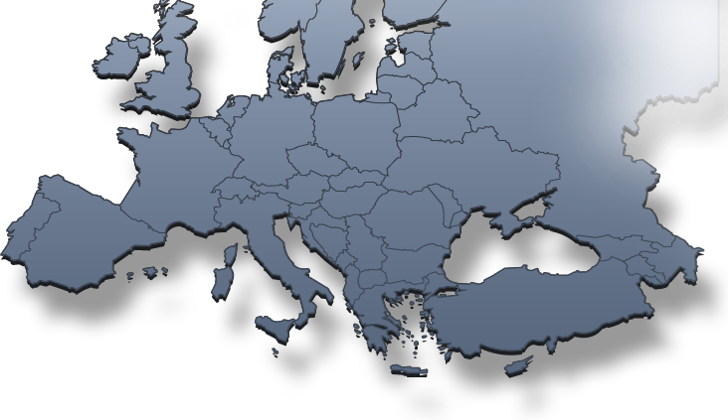
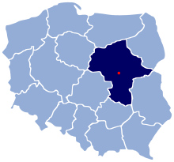



Smart Engineering and Tooling
Smart & Adaptive Production Systems
Production Performance Monitoring Systems
17 March 2017, S3 IM Steering Committee
Jordan MĘŻYK
Anna SACIO-SZYMAŃSKA
Ales HANCIC
Instytut Technologii
Eksploatacji – PIB
Slovenian Tool and Die
Development Centre

Slide 2
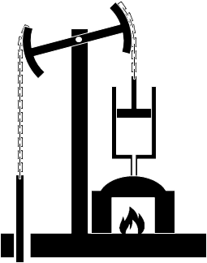



What is our partnership about
I
II
III
IV
Working on the fundamental principle of “Connected, smart and adaptive production”, the joint alliance of the cross-regional industrial modernization partnership aims to consolidate and boost the production processes.
Two sub-areas were identified:
(1) High-speed production
monitoring technologies;
(2) Overall Equipment Efficiency measurement and management.
"Christoph Roser at AllAboutLean.com."
Notes:
consolidate the infrastructures, technologies and know-how capabilities in order to boost the production processes and enable companies to quickly adapt to market requirements.

Slide 3
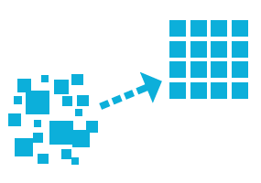
Delineating the collaboration area
The scope of the partnership should be the development of
a system to collect data from the machine and infrastructure to enable people working in the factory to use these data and act on that basis in a more efficient way.
This system would be first implemented at machine- and company levels, but the regions consider setting up a cross-regional platform as well.
The first possible test-bed would be the sector of CNC-Machine users.
At the technical level, operationalising such partnership in the field of CNC-machines would enquire questioning:
Hardware,
Business needs,
Programming.
Notes:
When assessing the factors hampering possible Business-to-business (B2B) collaborations in the machinery and tooling sectors, an area appeared to 1) stand as a key challenge; 2) cover an untapped potential that could benefit all companies regardless of their competitive position; and 3) that would benefit from a public/private and cross-regional setting. This area is the one of industrial production monitoring in the context of which, under non-disclosure conditions, companies would be willing to share information as to develop a digital hub for the improvement of machinery.

Slide 4


Next steps
Selection of steps | Timing
Validation of the concept note by a larger group of companies in both regions (through an open seminar or consultation) | February – April 2017
Collection of letters of support / letters of intent from the companies willing to engage into the operational partnership project | March – April 2017
Apply for a “Strategic Cluster Partnership” | March – April 2017
Validation by responsible authorities in both regions – discussion on cross-regional financing opportunities | February – July 2017
Alignment and seeking complementarities with other regions through: Vanguard Initiative (primarily in ESM Pilot) Thematic Smart Specialisation Platform “Industry Modernisation” Bilateral and multilateral contacts through other channels (e.g. EFFRA, I4MS, Etc.) Feasibility study on new Digital Innovation Hubs in EU-13 regions | September – November 2017
Apply for any other H2020 opportunity under “Factories of the Future” (FoF), INNOSUP, SPIRE, CIRC, PILOT, “Fast Track to Innovation”, etc. | All year – 2017
Assess to what extent own regional funding can be activated for your purposes. Investigate possibilities of ERDF-driven funding and networking. | All year – 2017
4

Slide 5

What type of support do we seek
Specific needs for support from the Platform:
enabling contacts from other regions and other initiatives (Vanguard, EFFRA...);
providing venues, infrastructure and logistics for the meetings, match-making events,
professional guidance to prepare plans and following actions of the initiative (incl. options for suitable funding mix);
lobbying to EU Commission to prepare thematic calls suitable for the participants of the Platform;
disseminating results of the initiative research and demo cases to higher levels of EU Commission, to other regions.

