Slide 1
Smart Specialisation Platform for Industrial Modernisation Steering Committee Meeting Brussels, 17 March 2017

Slide 2
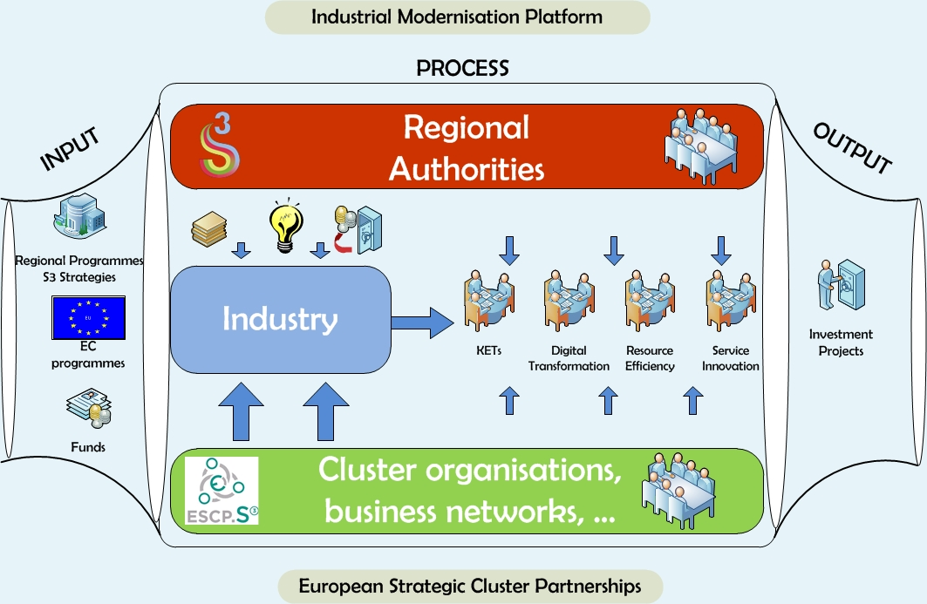
Support industrial modernisation in Europe
through smart specialisation and inter-regional cooperation along EU value chains
Facilitate the development of a pipeline of investment projects

Slide 3
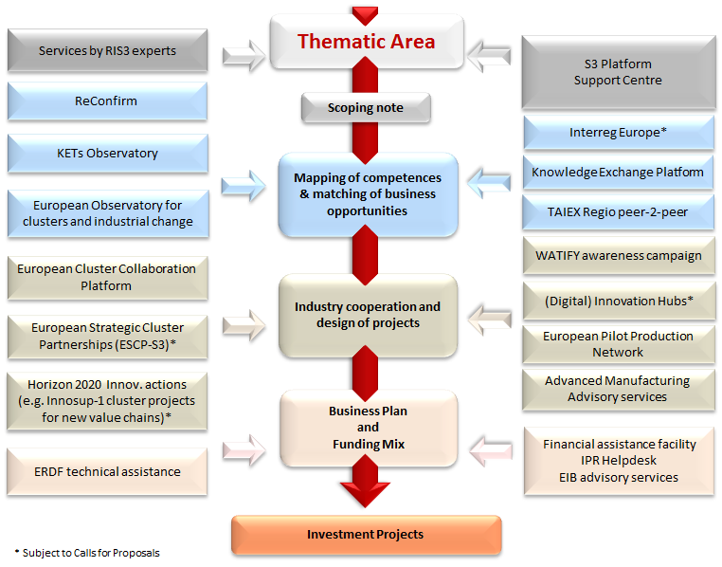

Slide 4
Smart Specialisation Platform for Industrial Modernisation
Objective, Composition and Tasks
of the Steering Committee
Steering Committee Meeting, 17 March 2017

Slide 5
Objective and Tasks
Ensure the overall governance and well-functioning
of the S3P-Industry in an open, transparent
and inclusive way
Assess the progress achieved for each partnership;
Discuss any difficulties and propose solutions;
Provide strategic guidance for the next period

Slide 6
Composition
Leading Regions from each regional partnership
(represented at which level?)
+
relevant Commission services and the CoR
+
(who else?)

Slide 7
Management and Meetings
Steering Committee co-chaired by the Commission
(and who else?)
Steering Committee Meetings:
(Hosted only by the Commission?)
(How often to meet?)

