Slide 1
Support actions for cluster cooperation along value chains towards industrial modernisation
Carsten Schierenbeck
GROW.F2 – Clusters, Social Economy and Entrepreneurship
Industry 4.0: opportunities, challenges and strategies for the industry of the future
Toscana Tech, Florence, 28.02.2017

Slide 2
Thematic Area
S3 Platform (JRC)
Support centre
Service provided by RIS3 Experts
RECONFIRM
Project
Mapping of competences & matching of business opportunities
European Cluster Observatory
WATIFY
Project
European Cluster Collaboration Platform
Industry cooperation and design of projects
Financial Assistance Facility (Q3 2017)
European Strategic Cluster Partnerships
IPR Helpdesk
ADMA Advisory services (Q3 2017)
Business Plan
and
Funding Mix
EIB advisory services
EFSI Advisory Hub
InnovFin – Advisory service
JASPERS
EPEC - for PPPs
Investment Projects

Slide 3
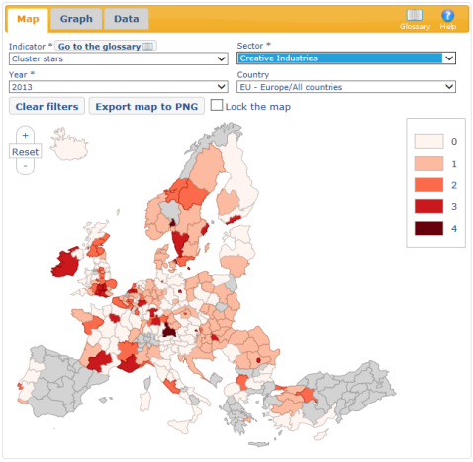
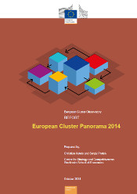
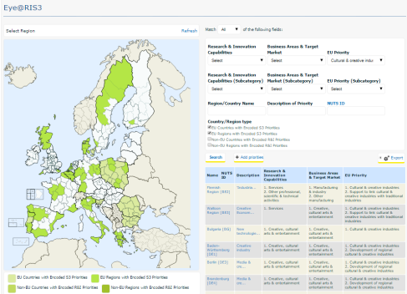
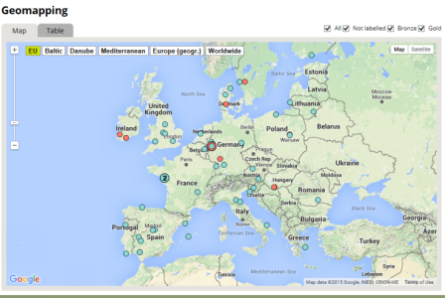
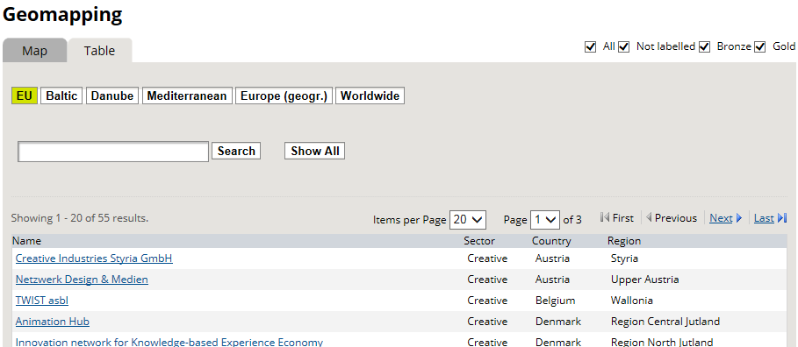
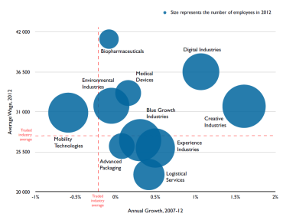
Regional strength
(sectoral and cross- sectoral cluster mapping)
European
Cluster
Observatory
Regional priorities
(research and innovation policy priorities)
Smart Specialisation Platform
Regional partners
(cluster organisations, European Partnerships)
European Cluster Collaboration Platform
Cluster Mapping tool
http://ec.europa.eu/growth/smes/cluster/observatory/
Eye@RIS tool, http://s3platform.jrc.ec.europa.eu/
http://www.clustercollaboration.eu

Slide 4
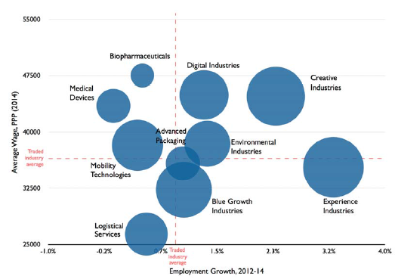
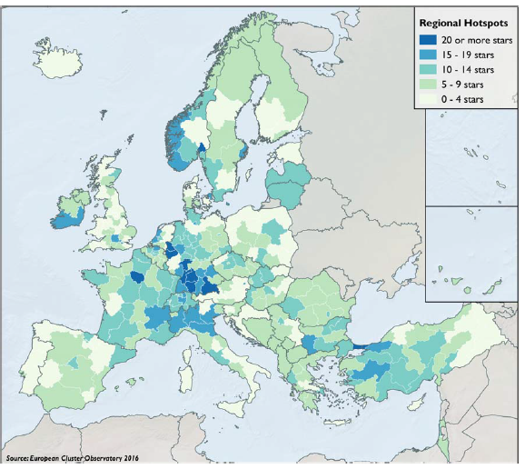
European Cluster Panorama 2016
- 3043 strong clusters account for more than 54 million jobs
- Gazelles in strong clusters employ 35 staff compared to 24 elsewhere
- Wages in strong clusters are 3% higher than elsewhere
- 40% of activity in emerging industries concentrated in 20% of regions
http://ec.europa.eu/DocsRoom/documents/20381

Slide 5
www.clustercollaboration.eu

Slide 6
Using clusters to facilitate value chain innovation and industrial transformation
Customised SME support
18.5 mio € (04.04.17)
Value Chain Innovation
Regional and
International Strategy
2-stage procedure
75% to support innovation in SMEs
Cross-sectoral
Collaboration
Innovation action: "Cluster facilitated projects for new industrial value chains" (annual calls, next one: INNOSUP-1-2017)
https://ec.europa.eu/research/participants/portal/desktop/en/opportunities/h2020/topics/6084-innosup-01-2016-2017.html

Slide 7
Thematic focus areas of cluster projects proposals under INNOSUP-1-2015

Slide 8
European Strategic Cluster Partnerships for smart specialisation investments
aims to strengthen industry participation and inter-regional collaboration in implementation of smart specialisation strategies
addressed to cluster organisations, other business network organisations, technology centres and science parks
focuses on industrial modernisation
Call for expression of interest for partnering process open until end of 2016 via
Call for proposals (COSME 2.8 mio) for 1./2. Quarter 2017 to support ca. 8 cluster partnerships & give ESCP-S3 label to good non-funded
Advisory support services to ESCP-S3 labelled partnerships from the European Observatory for Clusters and Industrial Change
http://www.clustercollaboration.eu/news/call-expression-interest-towards-european-strategic-cluster-partnerships

Slide 9
European Strategic Cluster Partnerships for smart specialisation investments
Preparatory
Phase
Implementation
Phase
Investment
Phase
Partnership building
Joint strategy formulation
Implementation roadmap
SME surveys
Value chain mapping
Matchmaking
Joint activities, demonstration projects, pilots, preparation of bankable proposals
Additional private/public financing
Acceleration support
Showcasing results
Joint activities to strengthen cluster cooperation across the partnership
Gathering feed-back from SMEs on their barriers to innovation, skills, cooperation and investment
Building linkages with other European, national and regional initiatives and networks

Slide 10
Supporting SME internationalisation and cluster excellence
Promoting cluster cooperation for industrial leadership in global markets & supporting capacity building in cluster management
Cluster Internationalisation Programme for SMEs (COSME, €19 m)
European Strategic Cluster Partnerships – Going International
- 15 Funded + 11 labelled only
European Cluster Collaboration Platform
http://www.clustercollaboration.eu/
International cluster matchmaking events in third countries and Europe
- 2016: Hannover Messe, Taiwan (Computex), Mexico City (Green Expo), Lyon, (Pollutec with Brazil and EU clusters), Brussels (Cluster Conference)
Cluster Excellence Programme for SMEs (COSME, €8.25m)
Cluster strategy, training, benchmarking & labelling
(871 cluster organisations labelled Bronze, 57 Silver, 78 Gold)

Slide 11
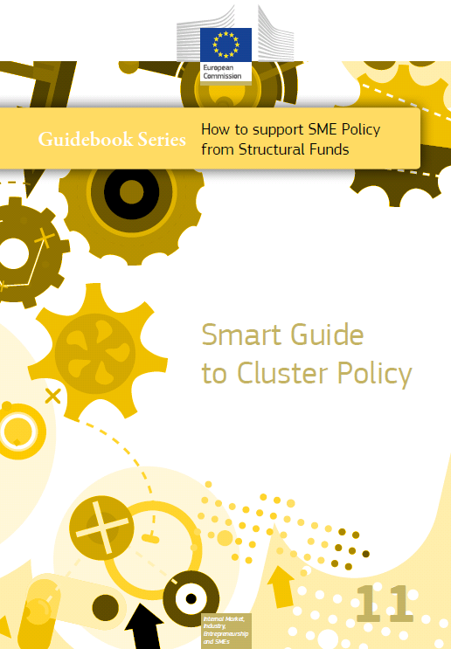
Smart Guide to Cluster Policy
A couple of concepts,
Eight Do’s and Don’ts, and
Plenty good practice examples …
of how to make better use of clusters for promoting regional industrial modernisation, supporting the growth of SMEs and encouraging smart specialisation.
Available at http://ec.europa.eu/growth/smes/business-friendly-environment/regional-policies/

Slide 12
Do's and Don'ts of Modern Cluster Policy
Don’ts | Do’s
Support individual specialised firms | Support new activities, in particular those being undertaken by groups or networks of related industries
Create clusters from scratch | Facilitate the growth of clusters by building upon existing strengths
Fund large numbers of widely varied clusters | Fund strategic cluster initiatives that focus on promoting the strengths, linkages and emerging competences and which are in line with the aims of national/regional smart specialisation strategies
Follow growth trends without reflection | Capitalise upon regional competences to diversify into new activity areas and to develop emerging industries
Follow a narrow sectoral cluster approach | Follow a systemic cluster approach focusing on related industries by capturing cross-sectoral linkages
Develop and implement cluster policy in isolation from other policy areas | Adopt an inclusive and participatory cluster approach
Support cluster initiatives that are only inward looking | Support cluster initiatives that have an international perspective on the positioning of the cluster in international value chains
Focus exclusively on strengthening regional partnerships | Build regional partnerships as a basis for joining European Strategic Cluster Partnerships

Slide 13
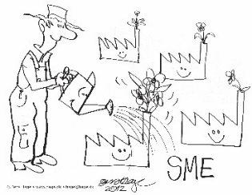
For more information see Smart Specialisation Platform for Industrial Modernisation http://s3platform.jrc.ec.europa.eu/industrial-modernisation Smart Guide to Cluster Policy http://ec.europa.eu/growth/tools-databases/newsroom/cf/itemdetail.cfm?item_id=8838 Digital transformation of industry and enterprises: http://ec.europa.eu/growth/sectors/digital-economy/index_en.htm Reports of the Strategic Policy Forum on Digital Entrepreneurship: http://ec.europa.eu/growth/sectors/digital-economy/entrepreneurship/strategic-policy-forum/index_en.htm Blueprint for cities and regions as launch-pads for digital transformation http://www.digitallytransformyourregion.eu/
Clusters, Social Economy and Entrepreneurship unit (GROW.F2)
Innovation and Advanced Manufacturing Directorate
European Commission's Directorate-General for Internal Market, Industry, Entrepreneurship and SMEs
GROW-F2@ec.europa.eu
http://ec.europa.eu/growth/smes/cluster/ http://clustercollaboration.eu

