Slide 1
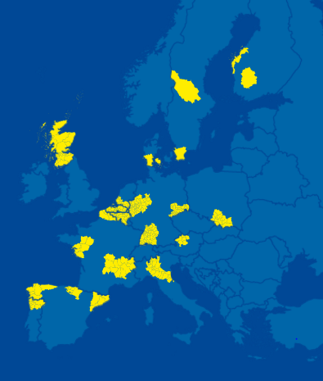
« High Performance Production through 3D-Printing » (‘3DP Pilot’)
Mr Wim De Kinderen
Brainport Eindhoven – South Netherlands
S3P on Industrial Modernisation – 1st Steering Group
Brussels, 17/03/2017

Slide 2
Pilot’s Objectives
Key Objective : “accelerate market uptake of 3DP applications in the EU through development of industry-led, transregional demonstration platforms”
• AM identified as on of the most promising technologies at global level, empowering transition from mass production to mass customisation
• high growth potential of the market
• the fragmented character of capabilities and their lack of visibility for technology deployment
• existing capacities in (original) VI members, part of RIS3 → draw strength from synergies and complementarities
Launched autumn 2014
3 co-lead regions Flanders (BE), Norte (PT), South Netherlands (NL)
23 regions Asturias, Aragon, Catalonia, Andalusia, Skane, Orebrö Lan, Tampere, Baden Württemberg, Nord Rhine Westphalia, Saxony, Wallonia, Auvergne Rhône-Alpes,
Hauts de France, East Netherlands, Randstad, Emilia Romagna, Lombardy, Trentino, Upper Austria, Lower Austria
Following the “Vanguard Initiative Methodology” : Learn – Connect – Demonstrate - Commercialize

Slide 3
Pilot’s State of Play
Mapping of existing VCs in participating regions
• > 1.000 actors identified (+650 companies)
• identification of 7 largest application domains
• capturing ambitions of participants
• identifying missing assets
--> potential for interregional industrial cooperation
6 DemoCases in development
• Multi-materials components by hybrid 3D-printing manufacturing (metal-CFRP)
• Mono-material metal 3D printing for automotive components and tools for large, medium and small parts
• 3D-Printing complex parts for machinery & tooling
• Additive subtractive high precision and high finish pilot production hubs
• 3D-Printed customized components for orthosis, exoskeleton and exoprosthesis
• Mass-customized consumer goods in creative industries

Slide 4
Pilot’s State of Play
DemoCases
establish / connect shared facilities for demonstration of new technologies
facilitate access by companies to shared facilities
lower technology uncertainty, risks and costs
stimulate industrial adoption and replication → market uptake & European born/made global value chains
evolve at different speeds
may focus at the start on small scale activities within one sector, but show large potential within other sectors as well (example of hybrid material printing for automotive sector) → broad sectoral coverage / large impact
require strong technical and business minded leadership and capacities
when arriving at the stage of demonstrate, all are confronted with the issue of missing appropriate funding, limiting further progress and risking to alienate industry engagement
testing the potential to develop an online database of 3DP demonstration capacities in the network, connecting offer and demand
organised in February 2017 a MME in cooperation with Watify

Slide 5
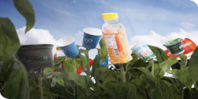
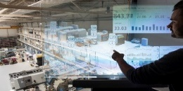
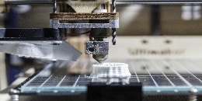
VI Methodology – 4 step approach
LEARN
CONNECT
TODAY’S CHALLENGE
DEMONSTRATE
COMMERCIALISE
TODAY’S
Bio-economy
ESM
UPSCALE
3D-printing
ADMA-Energy
Nano-technology

Slide 6
Support Needed for Pilot
Directly by the S3P Industrial Modernisation
value chain analysis
tool that allows to easily update and develop the VC mapping + detecting new cooperation potential
financial support for coordination capacity for Pilots and DemoCases
regular assessment of DemoCases :
help to keep focus, re-focus
technology check “beyond state-of-the-art”
support in MMEs (Watify)
legal support to set up Investment Platform for “Pooled Investment Projects”
support to get to “bankable business plans”
support in setting up IPR regime for (shared) demonstration facilities
support in business model set-up for (shared) demonstration facilities
More suitable H2020 and COSME project calls with larger budgets
Innosup-01
Innosup-03
I4MS IA on 3D Printing
3DP Pilot Lines
EE23 Innovative Financing Schemes, for 3DP
etc
Structural and substantial support
See presentation in next discussion block

Slide 7
3DP Pilot Project Contact
Flanders
Barbara Cattoor
Barbara.cattoor@ewi.vlaanderen.be
Norte
Pedro Rocha
Pedro.rocha@produtech.org
South Netherlands
Wim De Kinderen
w.dekinderen@brainportdevelopment.nl

