Slide 1
Monitoring Working Group Meeting #3
M. Lucila Castro Rovillard
Extremadura’s RIS3 Technical Office

Slide 2
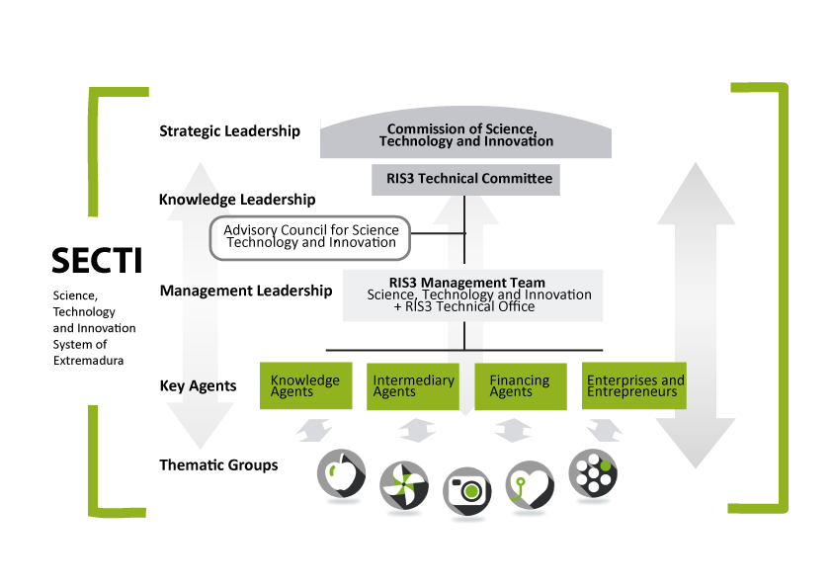
RIS3 Governance Structure

Slide 3
RIS3 Monitoring and Evaluation
Mid-term evaluation
THEMATIC WORKING GROUPS
OUTPUT INDICATORS
CONTEXT & RESULT INDICATORS
[QUALITATIVE APPROACH]
MAIN OBJECTIVES OF ANALYSIS:
Degree of specialisation of Extremadura so far
Influence of actions/instruments in the specialisation process
Trends and potentialities
[QUANTITATIVE APPROACH]
1ST EVALUATION REPORT

Slide 4
Questions
HOW TO ENSURE THE PROPER “USE” OF THE INFORMATION GATHER IN THE EVALUATION PROCESS IN ORDER TO TRANSLATE IT IN A BETTER DESIGN OF INSFRUMENTS?
- Main barriers?
- Best approach?
HOW TO OVERCOME THE PROBLEM OF LACK OF OFFICIAL STATISTICAL DATA?
PEER REVIEW OF THE EVALUATION PROCESS ???

