Slide 1
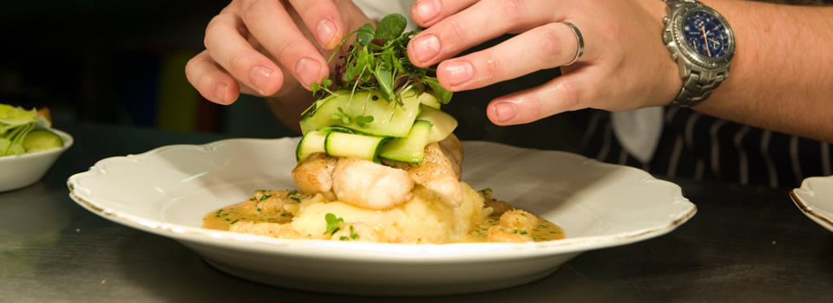
Building a Monitoring System Recipes for Success
Ken Guy
Wise Guys Ltd.
Barcelona, 6 July 2017

Slide 2
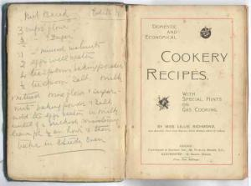
Recipe
Ingredients
Cooking Instructions
Serving Instructions
Tasting Notes
Home Cooking

Slide 3
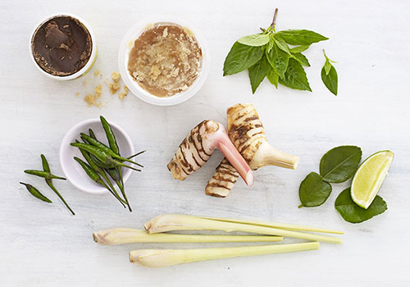
Ingredients
Commitment
Strategy
Champions
Financial Resources
Human Resources
Analytical Skills
Communication Skills
Channels

Slide 4
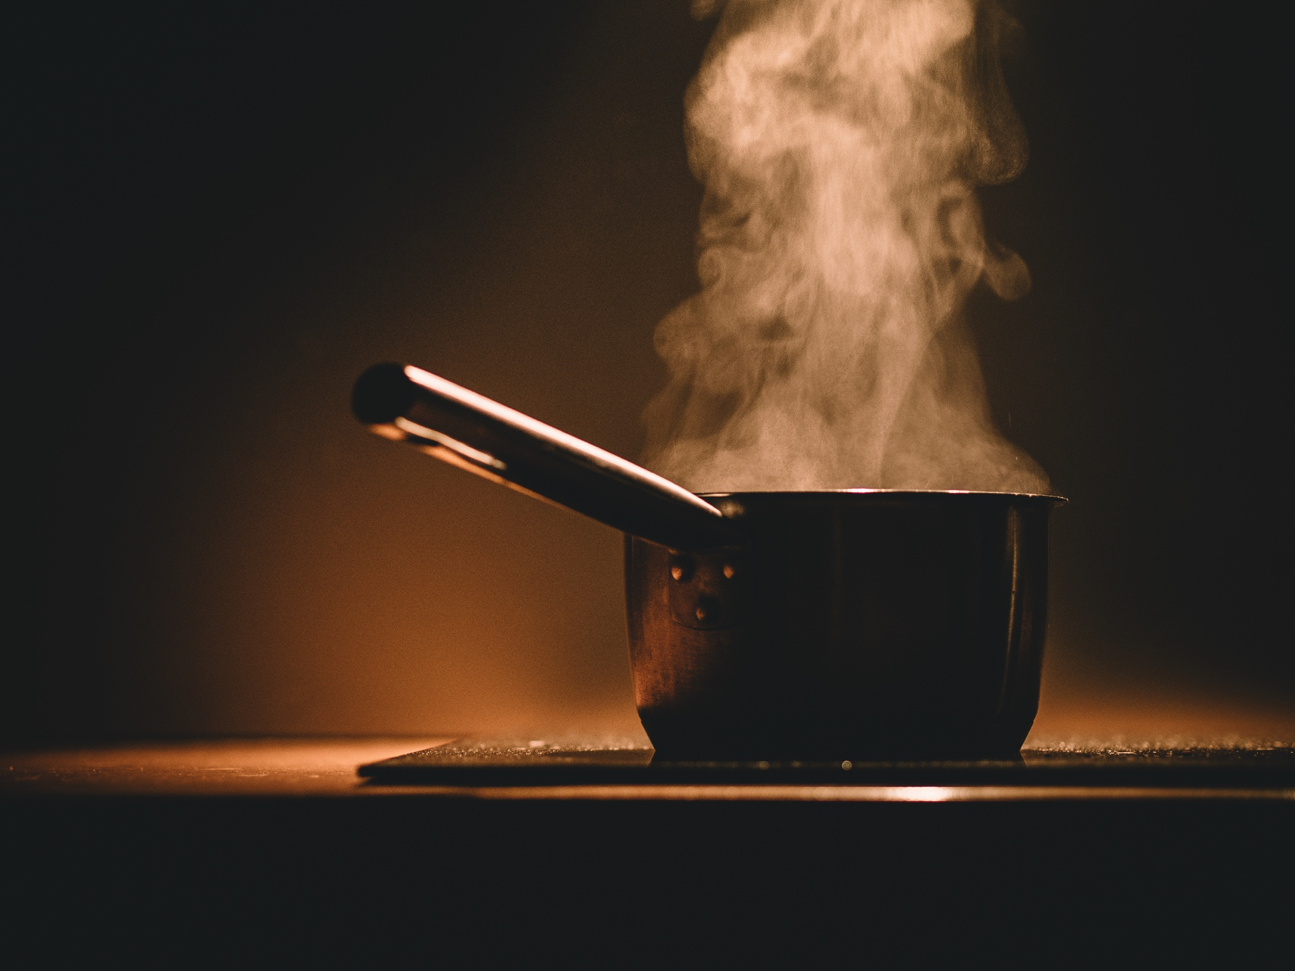
Cooking Instructions
Make sure all ingredients are to hand before starting to cook
And that you have the right utensils
Bring to the boil quickly to seal in flavour
Simmer on a backburner while fighting other fires, but do not let flame go out
Be patient – the proof is in the pudding
Add condiments to make more palatable if necessary

Slide 5
Serving Instructions
Push for return bookings
Then serve desert and recommendations for after dinner entertainment
Allow time for main course to be digested
Serve with complementary ingredients but do not let them distract from the main course
Always serve hot!
Ensure recipients are ready to eat

Slide 6
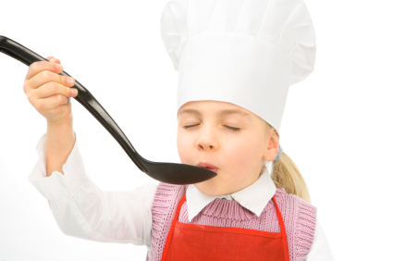
Tasting Notes
Does your organisation… | No | Yes
1…have adequate levels of commitment?
2…have a sound strategy in place?
3…have adequate in-house champions?
4…possess sufficient financial resources?
5…possess sufficient human resources?
6…possess adequate analytical capability?
7…possess adequate communication skills?
8…have access to relevant sources of influence?

Slide 7
Home Cooking
Does your organisation… | V Low | Low | Mod | High | V High
1…have adequate levels of commitment?
2…have a sound strategy in place?
3…have adequate in-house champions?
4…possess sufficient financial resources?
5…possess sufficient human resources?
6…possess adequate analytical capability?
7…possess adequate communication skills?
8…have access to relevant sources of influence?

