Slide 1
FCH JU’s examples on
Blending EU Funds
PEDRO
GUEDES DE CAMPOS
Brussels, March 7th 2018

Slide 2
Is EU funds’ blending possible?
Yes, as long as certain principles are respected
Non-cumulative principle
No two sources of EU funding to the same expenditure item
Co-financing principle
The EU funding is not to replace the minimum co-financing from the beneficiary (own public or private funds)

Slide 3
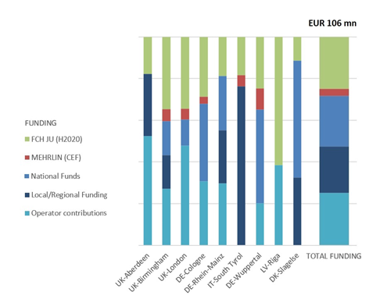
Blending EU Funds and Financing
FCE buses speeding-up to market
Project JIVE/MEHRLIN (Call 2016) – deployment of 139 FC buses in 9 cities. Includes 18 HRS (11 new and 7 upgrade) of which 7 funded by CEF (DG MOVE) and 6 by FCH JU
FCH JU contributed to ¼ of total investment
CEF contributed to 5 cities/regions
National funding programs and support in UK (OLEV), DE (NOW) and DK (ministries)
Regional/Local funding most relevant in IT
Offset funds/costs from bus operators cover ¼
City of Riga secured EIB financing under wider EIB loan pack (EUR 75 mn under Cleaner Transport Facility – DG MOVE)
Notes:
As per the chart below, the projects is also a clear example of the several different funding structures available for the 9 cities/regions involved, which depends markedly on the country/cities’ own framework for promoting investment.
Funding strategy defined by each city and region:
The FCH JU EUR 30 mn 25%
The CEF – MEHRLIN EUR 4 mn 3%
The EIB (Riga)
National hydrogen funding programs EUR 25 mn 24%
(e.g. in Germany and the UK)
National low emission bus support
(e.g. in the UK)
Local budgets for innovation EUR 23 mn 22%
(from municipalities, PTAs or PTOs)
Offset funds/costs from bus operators EUR 25 mn 25%

Slide 4
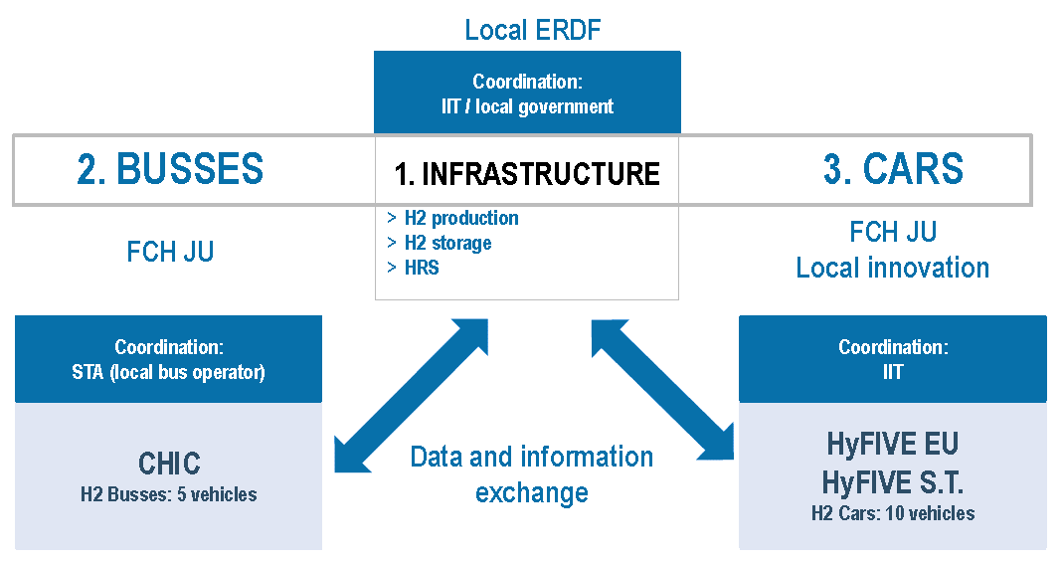
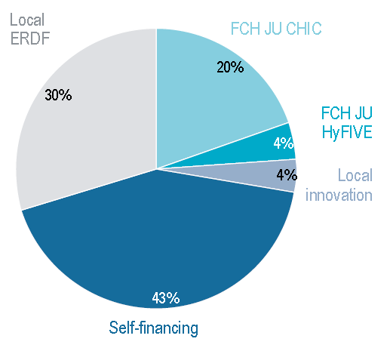
Blending EU Funds and Financing
Creating a Hydrogen Ecosystem from research to technology deployment
Istituto per Innovazioni Tecnologiche Bolzano (IIT – Institute for Innovation Technologies Bolzano)
Complementary projects in South Tyrol region (Italy) (2011-2017) – combines several different and complimentary projects under one single goal
KEY LESSONS LEARNED
One project; different parts; different partners
Funding can be optimised through a combination of different instruments, maximising the EU funds usage (>50%)
Motivated regional partners help to keep the project active and progressing
Involvement of the local government is critical to reach an overall strong commitment on the project
± EUR 20 mn

Slide 5
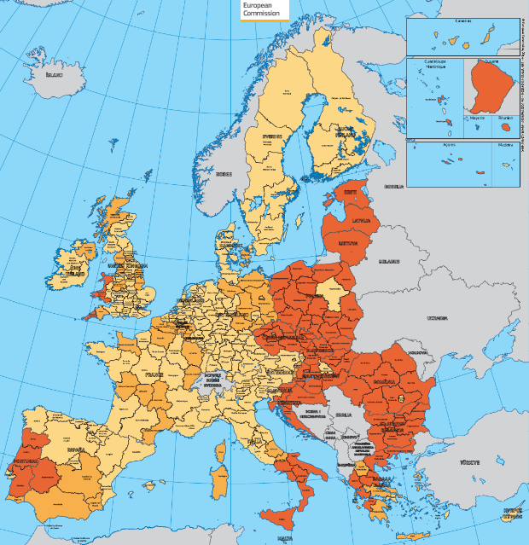
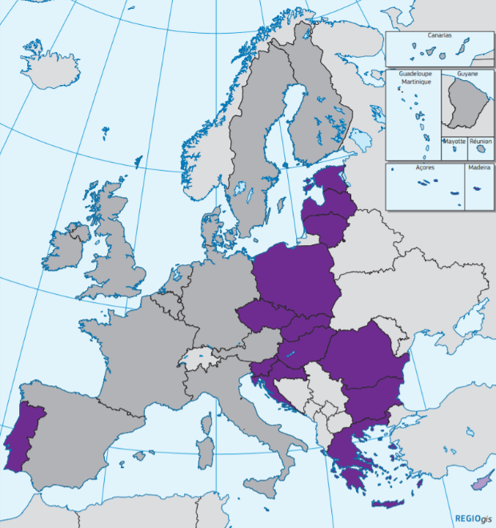
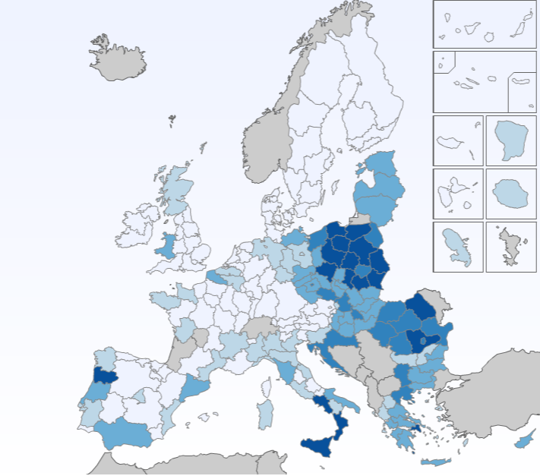


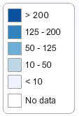





ESIF 2014-2020 regional eligibility
– budget earmarked for Clean Urban Transport (by region)
Structural Funds eligibility
Cohesion Fund eligibility (15 MS)
Clean Urban Transport infrastructure and promotion (including equipment and rolling stock)
Cohesion Countries (#15)
(i.e. 80%)
+ Spain and Italy
(i.e. 93%)
http://s3platform.jrc.ec.europa.eu/esif-viewer
FCH JU to work on synergies and complementary calls with ESIF
Bottom-up (Regions) Vs. Top-down (Member States) approach
Huge discrepancy between the level of EU funding available
Regions in the EUcc15+2 well placed to deploy Clean Urban Transport projects under ESIF budget
Notes:
Links to the last bullet point of the previous slide: “Main challenges are lack of commercial availability of relevant products and lack of funding for the cost premium”
The slide develops on 2 EU maps concerning eligibility to the European Structural and Investment Funds (ESIF) during 2014-2020 (the one on the right refers to Structural Funds and the one on the centre to the Cohesion Fund.
Because of the high appetite of the Regions for sustainable transport, the Map on the right then jumps into the category of intervention “043 - Clean urban transport infrastructure and promotion (including equipment and rolling stock)”. I extracted this map from the ESIF viewer at the S3Platform (i.e. Smart Specialisation (Strategy) Platform). It highlights the huge discrepancy between the level of EU funding for Cohesion Countries (EU15) plus Spain and Italy (+2) compared to the remaining 11 (richest) Member States because the latter have higher GDP and GNI and thus face reduced eligibility for ESIF (mostly the Cohesion Fund and the European Regional Development Fund (ERDF).
The conclusion would be that Regions in the EU15+2 seem good candidates to deploy clean urban transport projects on the back of the ESIF budget for the whole 2014-2020 period as they are eligible for 93% of the EU28 budget allocated to this category of intervention until 2020.
As the richer countries seem to have be more successful in our H2020 calls than the other EU15+2, this is actually an opportunity for the less developed regions to catch-up with the technology gap on FCH technologies.
Also, as this is the scope of the workshop, my suggestion is that you conclude by mentioning that the FCH JU wishes to work closely with the ESIF Managing Authorities, both at the Regional (bottom-up) and Central Government level (top-down) to spur synergies and complementary calls with the ESIF.
It follows the same line of reasoning, i.e. opening the FCH technologies’ access to other sources of funding and financing.
There are several funding and financing schemes for complimentary projects to the ones directly supported by the FCH 2 JU. Reaching out to alternative funding and financing sources leverages the impact of FCH 2 JU projects and enhances the achievement of its objectives.
While this tool is being designed to provide support for the deployment of FCH technologies projects by the Regions and Cities, the tool is expected to also benefit the beneficiaries of FCH 2 JU calls for proposals, enabling them to better navigate around the array of EU funds available in different regions and Member States.
EU map on European Structural and Investment Funds (ESIF) during 2014-2020 for “043 - Clean urban transport infrastructure and promotion (including equipment and rolling stock)” – I extracted this map from the ESIF viewer at the S3Platform (i.e. Smart Specialisation (Strategy) Platform). It highlights the huge discrepancy between the level of EU funding for Cohesion Countries plus Spain and Italy compared to the remaining 11 (richest) Member States because the latter have higher GDP and GNI and thus face reduced eligibility for ESIF (mostly the Cohesion Fund and the European Regional Development Fund (ERDF).
Regions in the EUcc15+2 seem good candidates to deploy clean urban transport projects on the back of the ESIF budget for the whole 2014-2020 period as they are eligible for 93% of the EU28 budget allocated to this category of intervention until 2020: 043 - Clean urban transport infrastructure and promotion (including equipment and rolling stock).
http://s3platform.jrc.ec.europa.eu/esif-viewer?p_auth=GEiQ57ui&p_p_id=generalesifviewertool_WAR_generalesifviewertoolportlet_INSTANCE_uQEMgwAStPS9&p_p_lifecycle=1&p_p_state=normal&p_p_mode=view&p_p_col_id=column-1&p_p_col_count=2&_generalesifviewertool_WAR_generalesifviewertoolportlet_INSTANCE_uQEMgwAStPS9_javax.portlet.action=performSearch
By thematic objective:
04 - Supporting the shift towards a low-carbon economy in all sectors EUR 7,218 mn
MULTI - Multi-thematic objective EUR 2,804 mn
07 - Promoting sustainable transport and removing bottlenecks in key network infrastructures EUR 2,332 mn
M08 - Promoting sustainable and quality employment and supporting labour mobility EUR 7 mn
11 - Enhancing institutional capacity of public authorities and stakeholders and efficient public administration EUR 6 mn

Slide 6




Pedro Guedes de Campos
Financial Engineering Officer
pedro.guedes-de-campos@fch.europa.eu
For further information
www.fch.europa.eu
www.hydrogeneurope.eu
www.nerghy.eu
@fch_ju
Fch-ju@fch.europa.eu
FCH JU

