Slide 1
Workshop “Developing synergies between Joint Undertakings and ESIF
for optimising RIS3 implementation authorities”
REGIONAL COOPERATION WITH JOINT UNDERTAKINGS - BEST PRACTICIES EU15 VS EU13
Clean Sky 2 Case, ANDALUCÍA
Brussels, 7th March 2018
José A. Pascual Sánchez
Head of Innovation, Programmes and Advanced Services Unit

Slide 2

ANDALUSIAN REGIONAL GOVERNMENT
PRESIDENCY AND LOCAL ADMINISTRATION
JUSTICE AND INTERIOR
TREASURY AND PUBLIC ADMINISTRATION
ECONOMY AND KNOWLEDGE
EDUCATION
PROMOTION AND HOUSING
AGRICULTURE, FISHING AND RURAL DEVELOPMENT
CULTURE
EQUALITY AND SOCIAL POLICY
ENVIRONMENT AND LAND PLANNING
EMPLOYMENT, ENTERPRISE AND COMMERCE
HEALTH
TOURISM AND SPORT
AGENCY OF INNOVATION AND DEVELOPMENT OF ANDALUSIA IDEA

Slide 3
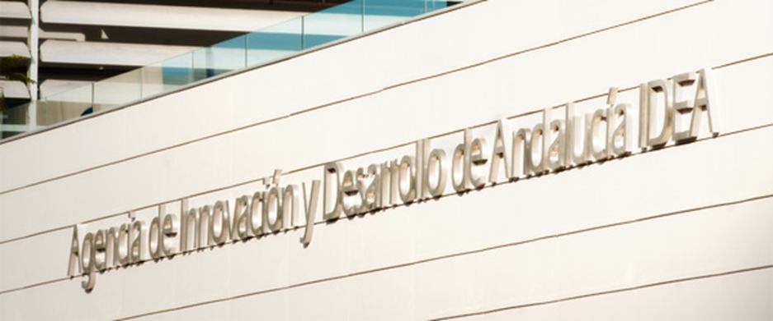
OUR AGENCY
Intermediary body for ERDF Andalusia Global Grant (AGG) since 1991
AAG 2014-2020: 615 M€
Reimbursable Funds
Total: 1.195 M€
  Jeremie: 361 M€
AGG 2007-2015: Incentives
16.837 Projects received
1.124 M€ Public incentives
5.764 M€ Business Investment
25.823 Employment
COSME- ENTERPRISE EUROPE NETWORK-CESEAND
H2020 ERANETS.
TERRITORIAL COOPERATION
IDEA provides different assets to economic and social regional strategies focused to achieve the transformation of the Andalusian productive model. The Agency has an advanced services portfolio available to support innovation and development

Slide 4








RIS3 ANDALUSIA
Andalusian Innovation Strategy
Priorities and Dimensions
MOBILITY AND LOGISTIC
TRANSPORT-RELATED ADVANCED INDUSTRY
TERRITORIALLY BASED ENDOGENOUS RESOURCES
TOURISM, CULTURE AND LEISURE
AGROINDUSTRY AND HEALTHY DIET
RENEWABLE ENERGY, ENERGY EFFICIENCY AND SUSTAINABLE BUILDING
ICT AND DIGITAL ECONOMY
HEALTH AND SOCIAL WELL BEING
Dominio tecnológico
Dimensions
EFFICIENT AND COMPETITIVE INDUSTRY
INNOVATIVE SMES SOURCE OF EMPLOYMENT
OVERSEAS PROJECTION
EDUCATION, TALENT AND CREATIVE ENVIRONMENTS
KEY ENABLE TECHNOLOGIES
SOCIAL INNOVATION
NETWORKING
INFRASTRUCTURE FOR COMPETITIVENESS AND EXCELLENCE

Slide 5


The dimension of
Aviation/Aeronautics in Andalusia
Andalusian Aerospace Sector Report 2016 (presented at Le Bourget, June 2017)
2014-2020
Andalusian Government full Commitment
117 aeronautical companies operate in Andalusia
  1,61% Andalusian GDP
2.400 turnover million
  increase 55 millions €
  2,37% higher than in 2015
Employing 14.463 specialists
  750 more in last year
  5,26% higher than in 2015
Relevant Growth of Auxiliary Enterprises
  employment: increase of 5,8%
  turnover: 11,8% higher than in 2015
RIS3 ANDALUSIA
ANDALUSIA INDUSTRIAL STRATEGY
OP ERDF ANDALUSIA
New Agreement with Tier One: Airbus
to work together in new areas: FoF; Big Data; IoT; ALM; 3D printing; advanced manufacturing,
Priorities
Dimensions
Aerópolis
Tecnobahía
FABLAB
TRANSPORT-RELATED ADVANCED INDUSTRY
EFFICIENT AND COMPETITIVE INDUSTRY
Airbus Group's Final Assembly Line of all military aircrafts are in Seville

Slide 6






RIS3 Instruments: Incentives
ERDF SYNERGIES – H2020 – COSME
RIS3 ANDALUCÍA IMPLEMENTATION
REGULATORY BASIS FOR GRANTS ADDRESSED TO PROMOTION OF INDUSTRIAL RESEARCH, EXPERIMENTAL DEVELOPMENT AND BUSINESS INNOVATION IN ANDALUCIA
INCENTIVE PROGRAM FOR THE PROMOTION OF INTERNATIONAL R&D&I

Slide 7
PROMOTION PROGRAM FOR INTERNATIONAL R&D&I
Supporting to Business R&D&I
Promotion Program for International R&D&I
Leading Open, Strategic and Singular Innovation
  Direct, non-repayable incentives. GRANTS
GOALS TO ACHIEVE:
to increase international dimension of innovators companies in Andalusia
to increase the number of Andalusian SMEs involved in international R&D&I projects
to increase synergies between Structural Funds, Horizon 2020 and other European programs to promote research and business innovation, as well as the integration of Andalusian companies into European collaborative innovation initiatives

Slide 8
What projects can be financed under
IDEA-CLEAN-SKY synergies call for proposal?
Complementary Actions presented linked to Clean SKY2 calls ‘winner projects’.
‘Winner projects’ shall mean those obtaining maximum score within the correspondent "topic" and receiving funds.
A Complementary Action must have received a favourable assessment from Clean SKY2 Evaluation Committee, without having received any funds from this program.
A Complementary Action must count with the participation of an Andalusian company winner of a Clean SKY2 call for proposals project (alone or in consortium).
A Complementary Action may also involve an Andalusian SME that have not participated at the initial project, as long as the Complementary Action (and therefore the participation of this SME) receives a favourable assessment from Clean Sky 2 Evaluation Committee.
As a matter o principle, the projects being at the reserve list of main CleanSky2 calls (that is, 2nd or 3rd position projects for each "topic“) will not be funded. However exceptional cases could be analyzed.

Slide 9
What projects can be financed under
IDEA-CLEAN-SKY synergies call for proposal?
‘COMPLEMENTARY ACTION’
It is ANOTHER PROJECT (but always a R&D one)
a successive project that build on each other, or
a parallel project complementing the main one

Slide 10
Who are the potential beneficiaries of this type of projects?
Projects can be submitted individually or in effective collaboration (at least one SME and no partner with more than 70% of the budget) of a maximum of two companies with operational establishment in Andalusia.
One of these two companies or entities could be a Technological Centre or an Innovation and Technological Centre, provided that it does not have more than 50% of the total budget of the project.
When a project is submitted by two companies being one of them a non-SME, it must fulfil the requirement of subcontracting a Research Organization for at least the 15% of the project’ total budget.

Slide 11
TYPES OF PROJECTS
 | Beneficiary? | % GRANT
No SME | SUBCONTRACTING a R&D ORGANIZATION (>15% BUDGET) | 25% - 40%
MEDIUM ENTERPRISES | YES | 35% - 50%
SMALL ENTERPRISES | YES | 45% - 60%
TECHNOLOGICAL CENTER | IN COLLABORATION WITH A SME (<50% BUDGET) | 35%-50%
Direct, non-repayable incentives (Grant)

Slide 12
ELEGIBLE COST
R&D Projects
Personal Costs (dedicated to the project)
Subcontracting (TT.CC., Universities, Technical Assistance, …)
Materials and depreciation of investments
Indirect Costs (15% Personal Cost)

Slide 13
Combined funding: ESIF programmes and H2020
The Incentives Scheme was signed by the Regional Ministry on 5th June 2017, entering into force on 9th June 2017
General Budget: 84 M€ (coming soon: 119 M€)
The specific call for proposal for ‘International R&D&I Program’ was published on 13th July 2017.
PERIOD FOR SUBMISSION OF PROJECTS:
  Starting date: 17th July 2017
  Open and permanent call for 2017, 2018, 2019 and 2020 years until 30th September 2020 and/or the total allocation budget is exhausted
  Specific Budget: 6,2 M€ (coming soon: 13M€)
Non Competitive call for proposal

Slide 14
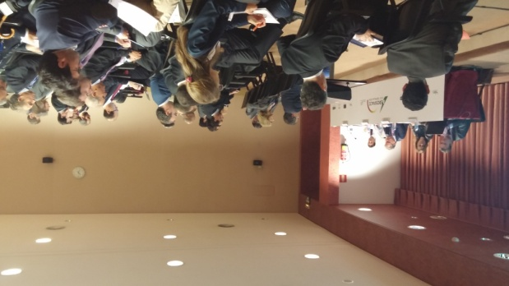




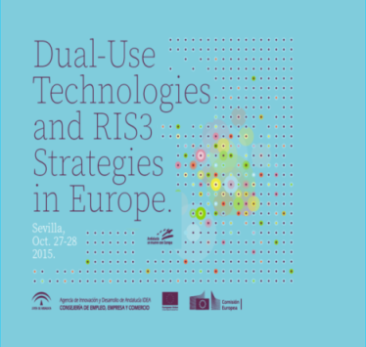

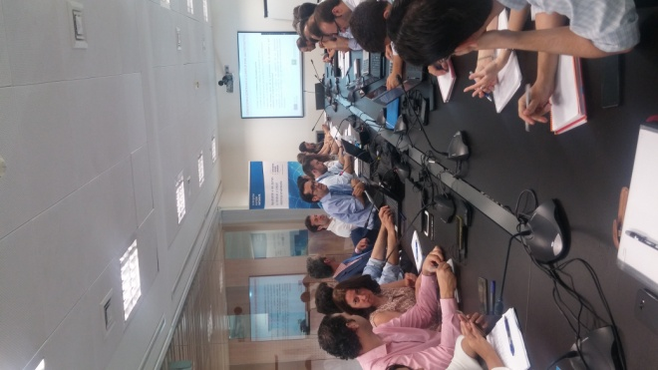



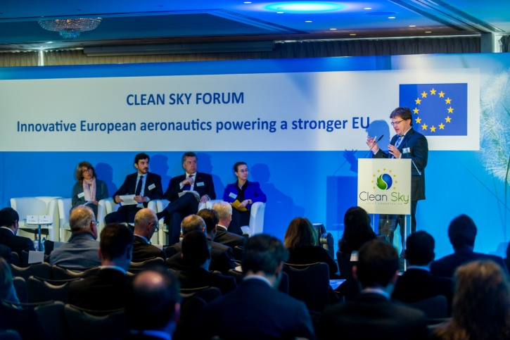
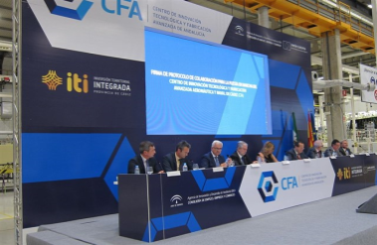
Activities and achievements under Andalusia-CleanSky MoU
May 2016: Clean Sky Round Table
Boosting Innovation in Aerospace Sector
in Andalusia
Dual Use and RIS3
Seville Declaration
2 Workshops on Calls for Proposal Clean Sky 2, Seville – Aerópolis: September 2015
June 2017
Info Day Iberia Clean Sky
Seville, November 2017
Sharing Andalusia experience
at Clean Sky Forums
April 2016: “Looking for Efficiencies:
Synergies with Structural Funds”
FoF –CFA CÁDIZ

Slide 15
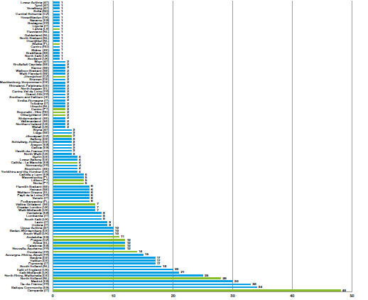



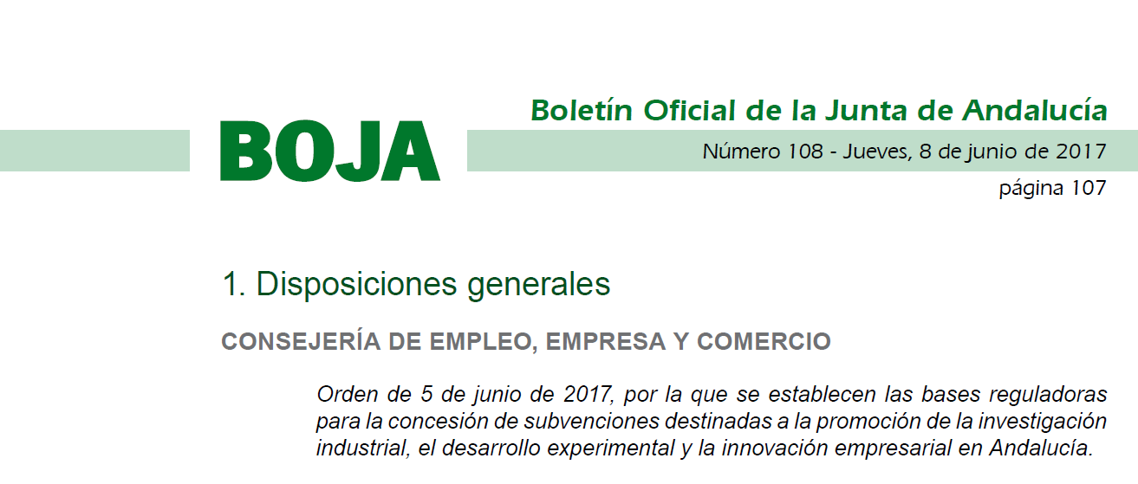
Activities and achievements under Andalusia-CleanSky MoU
April 2017, Agencia IDEA is designated ERDF Intermediary body. Andalusia Global Grant
December 2018: Intensive and active work with Clean Sky
Andalusia reached 12 Winning Participations in succesful proposals in CS 2 calls = Funds attracted: 8.168.521 €
June 2017: Andalusian new Incentives Scheme
Specific line “Promotion of International R&D&I.

Slide 16
Goals (i)
Andalusian Projects Clean SKY CFP

Slide 17
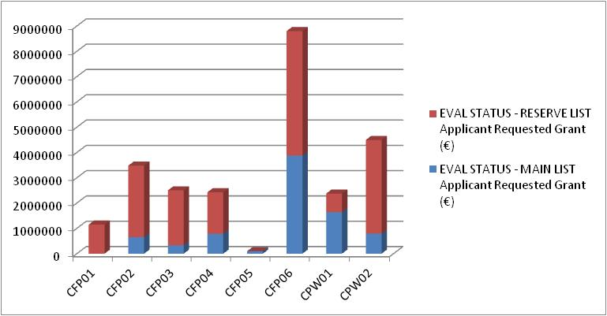
Goals (ii)
Andalusian Projects Clean SKY CFP

Slide 18
Goals (iii)
IDEA CFP
International R&D&I Projects | Projects | Global Budget Submitted (€) | Call for Proposal Budget (€) | Estimated Grant (€)
Technical Assistance to submit R&D&I projects to international calls | 18 | 242.999 | 185.003 | 150.199
International R&D&I Projects | 6 | 3.609.980,30 | 2.550.000 | 1.767.416
Innovative Enterprise International Launch Projects | 3 | 6.223.980 | 3.375.000 | 3.111.990
TOTAL | 26 | 11.214.216 | 6.110.003 | 5.029.605

Slide 19
KEY MESSAGES (i)
Andalusian experience
H2020 and ESIF have different timing and structure, harmonisation of calls is not simple or easy. A better timing coordination is “mandatory”: time, for business, is a serious thing.
Sometimes (most of them) ‘synergy’ means a double procedure.
Impact of the mismatching on the rules governing the application of H2020 and ERDF: State Aid and Eligible Expenditures. Similar projects (even the same) should be analyzed using the same rules.
Incentive effect of the aid. Can we take into account the date of the first submission?
Concerns of uncertainty for regional (or national) auditing authority regarding the fully application of compatibility between ESIF and H2020.

Slide 20
KEY MESSAGES (ii)
Andalusian experience
Difficulties in joining the appropriate international partners. Synergies need a previous activity.
The combination of funds is not the solution to all kind of problems, it's only an option.
Make it easier. The easier (because simple) you make, the most efficient you are.
Convenience of aligning regional programs (and RIS3) with CS calls.
SYNERGIES ARE NOT ONLY A COMBINATION OF FUNDS
What is really important is the strategic planning of relevant actions to complement each other in order to achieve goals which would be not possible without the synergies

Slide 21
KEY MESSAGES (iii)
Andalusian experience
This practice is be-coming a very interesting experience
We consider we are working on the right track pointing the way ahead to continue working in the coming years
Thanks to synergies, we (and the enterprises) can reach further and higher
No one said this was going to be an easy undertaking
This is our challenge
THERE IS NO OTHER ROUTE

Slide 22
jpascual@agenciaidea.es
Thank you for your attention
José A. Pascual Sánchez
Head of Innovation, Programmes and Advanced Services Unit

