Slide 1

RESULTS & IMPACT
Vanguard Initiative
Network, Goals and Pilot Projects Funding & Investment Needs

Slide 2

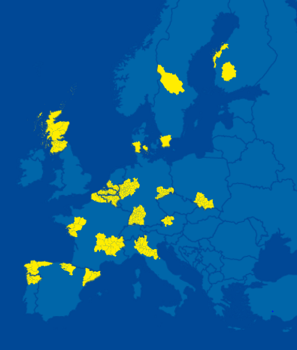
VI – network of many regions
region
industry based S3
ambition
political commitment (Milan Declaration)
mobilizing and organizing industrial stakeholders in the region
active participation in the network structure
active participation in core activities

Slide 3
VI Methodology – 4 step approach
learn
developing a scoping paper
mapping questionnaire
connect
matching events for complementary partners
developing demonstration cases
demonstrate
networked demonstration
pilot lines and first-of-a-kind factories (TRL6-8)
commercialise
Identify lead regions and actors
launch of new ventures and start-ups
new value chains (TRL 9)
Industry Inspired
u p s c a l e
Industry Driven
Industry Owned

Slide 4
VI Pilot Projects
Key features
  New industrial value chains
  accelerate market development
  industry-led cross-regional demonstration projects
  global competitiveness
5 Pilots (testbeds for systemic change)
  Efficient and Sustainable Manufacturing (Catalonia + Lombardy)
  High Performance Production through 3D Printing
  (Flanders + Norte + South Netherlands)
  ADMA for Energy related Applications in Harsh Environments
  (Basque Country + Scotland)
  New Nano-enabled Products (Skane + Tampere)
  BioEconomy (Lombardy + Randstad)

Slide 5
Funding & Investment Needs
VI Demo Cases common objectives
  establish (shared) facilities for demonstration of new technologies
  facilitate access to (shared) facilities
  lower technology uncertainty, risks and costs
  stimulate industrial replication & upscale (hence market uptake)
Each Demo Case =
  combination of complementary demonstration facilities
  group(s) of companies accessing infrastructure (TRL6-8)
  industrial replication & upscale (if the above is successful) (TRL8-9)
3 types of Demo Cases
  Challenge driven or technology driven
  connecting existing infrastructures
  building brand new demonstration infrastructure
  connect & upgrade existing infrastructure (hybrid format)

Slide 6

Different Investment Needs
Creating / building new facilities
Cat 2 Demo-Cases
10% to 20% of VI demo-cases
Demonstration / upscaling through:
Category 3 Demo-Cases
« Connecting & upgrading what already exists »
30% to 40% of VI demo-cases
« Building & connecting new demo facilities »
Connecting existing facilities
Category 1 Demo-Cases
« Connecting what already exists »
Ca. 50% of VI demo-cases
Investment size
0,5-10€ Mio
+/- 10-50€ Mio
+/- 50-200€ Mio (poss. even higher …)

Slide 7
General Financial Structure – three layers
Basic Demonstration Infrastructures – Initial Costs related to the setting up of the infrastructures and platform
Public Support
(100% coverage ‘non-profitable top’ through public funds, structural)
Layer 1
Regional, national and EU Subsidies
Projects-related activities (within the platform; TRL 5-7/8) - Operating costs
Layer 2
(e.g. 50% subs, project based)
Public Subsidies and private co-investments
ROI based on industrial upscale
(Repayable Loans, Bankable Business Pl)
Replication – Indus. Upscale (TRL8/9) 1
Replication – Indus. Upscale (TRL 8/9) 2
Replication – Indus. Upscale (TRL 8/9) 3
Replication – Indus. Upscale (TRL 8/9) 4
Etc.
Layer 3
Private investments, public (EIB-like) loans
Revenues generated from Replication/Industrial upscale and production
Notes:
Layer 1 (to some extent Layer 2 as well) contains « non-profitable top » (hence the subsidies)
Layers 2 & 3 can’t be functioning if « top » not financially secured (➔ no bankable plan !)
Layers inter-dependent; smooth flow between them key !

Slide 8
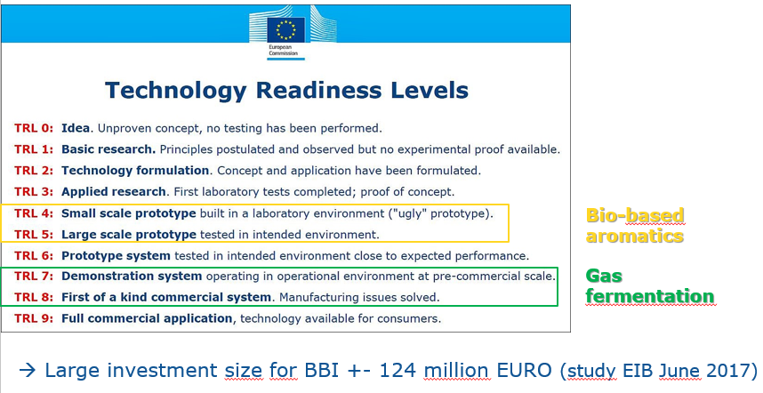
Bio-Based industries: Context

Slide 9

BIC and Vanguard Initiative sign Bioeconomy MoU
Based on the Mou, the Pilot and BIC have agreed to work together on communication and awareness raising activities for mobilizing key stakeholders and promoting the importance of bio economy and bio-based industries.
They have agreed to work together as equal partners on improving access to financial instruments and strengthening synergies between different funding schemestowards the creation of a more favourable investment environment.
Lastly the Pilot and BIC have agreed to connect actors across regions and sectors along new value chains and to explore how the combination of different strengths can lead to a faster deployment of new technologies. Moreover, exchange of information related to BBI topics and Pilot cases will be promoted in order potential synergies to be exploited.
http://s3platform.jrc.ec.europa.eu/documents/20182/212042/Action+Plan+Bio+DEF.pdf/011b5dbe-4bfd-480c-9fa8-3205ac33801a

Slide 10
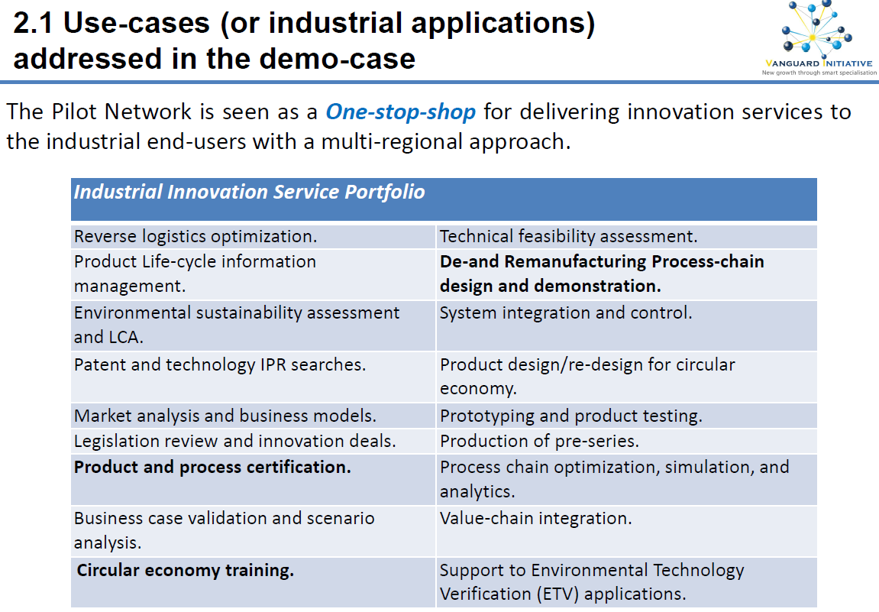

Slide 11
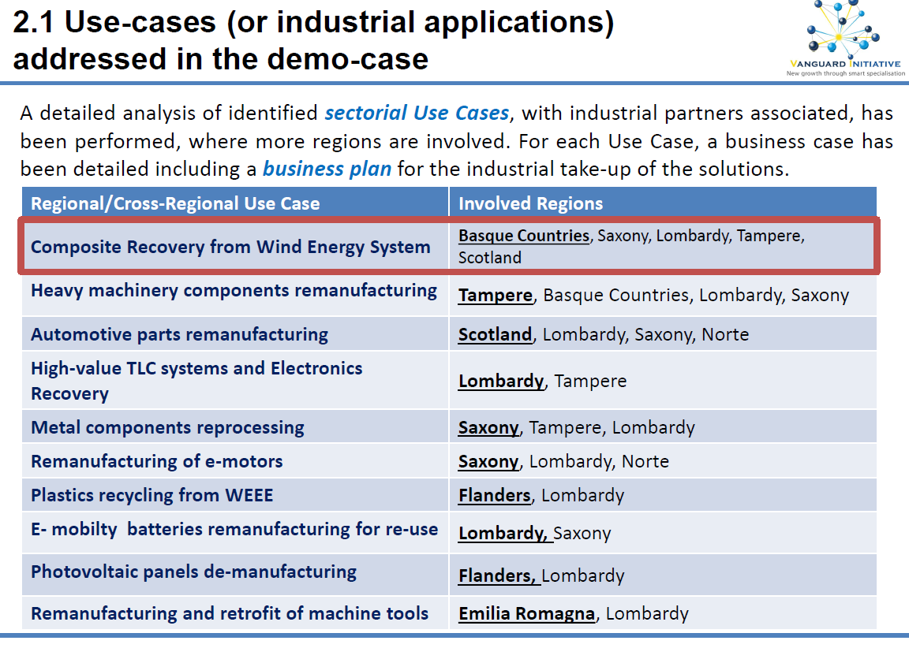

Slide 12
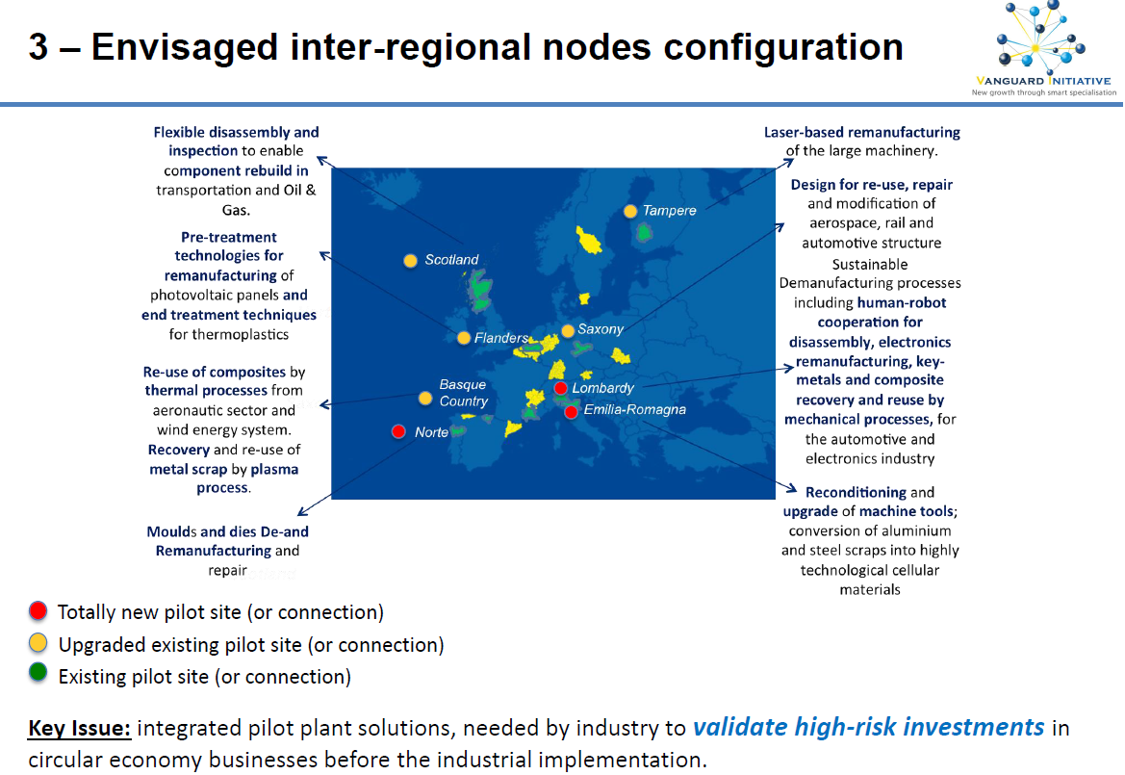

Slide 13
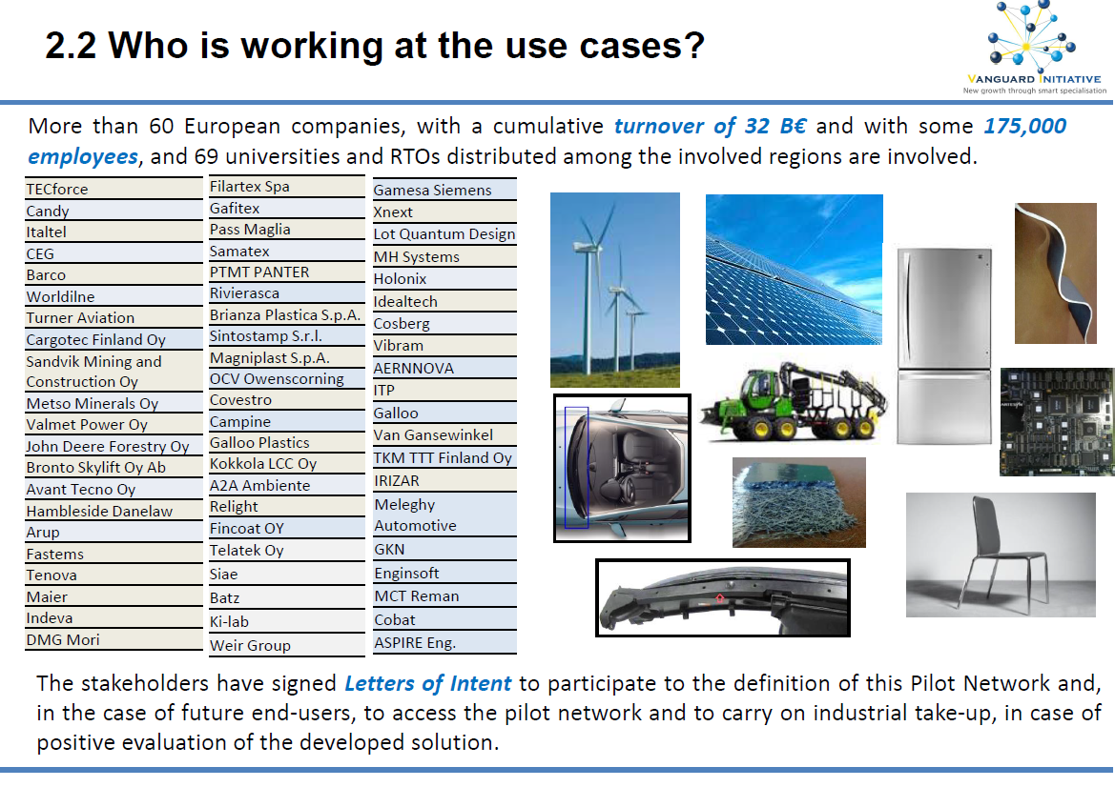

Slide 14
@VI_Brussels #Vanguardinitiative
www.s3vanguardinitiative.eu

Slide 15
Investment Needs accross Layers:
Mismatches and proposals (1/3)
VI Regions + EC
Layer 1 - Initial costs – establishing the shared demo-infrastructure:
  Centrally managed EU fund to support the creation of innovation infrastructure (industry commons) with grants
  Where no single party is able or willing to bear costs and risks
  Mainly cover funding gap at layer 1 (partly at layer 2 also)
  Avoiding complexity of multi-level government and multi-programme collaboration, as well as state aid issue (similar to H2020).
Proposed time-table:
Post 2020: Dedicated « EU Joint Innovation & Demonstration Fund »
  Via FP9
  Via ESIF (fall-back):
  Expanded Interreg B
  Interreg Europe + investment support mechanism (‘revised’ Regions of Knowledge 2.0)
  Demonstration Initiative such as the Urban Innovative Actions initiative
2017-2020 = Joint & aligned call of Interreg B programmes

Slide 16

Investment Needs accross Layers:
Mismatches and proposals (2/3)
VI Regions
+ EC
Layer 2 - Operating costs of the interregional demonstration platform:
  Easily accessible interregional vouchers’ system for SMEs, in order to fund feasibility studies and scale-up work in shared facilities, or
  Combining regional (non-EU) subsidies to compensate for costs incurred to visits to demonstration facilities in other regions, or
  A specific Vanguard Initiative “ERA-Net Co-Fund” (but for higher TRLs: demonstration + end-users) or
  A reinforced and expanded MANUNET (for ADMA, higher TRLs), i.e.:
    MANUNET III (2016-2021) to be expanded towards ‘Joint Programme Art 185 TFEU’ (dedicated budget for ‘research valorisation’) ?
  Short- to medium-term
  Medium-term
Post-2022

Slide 17
Investment Needs accross Layers:
Mismatches and proposals (3/3)
Layer 3 - Industrial upscale and replication:
  Expanding scope and domains of application of the so-called “InnovFin Energy Demo Projects instrument” to cover broader industrial modernisation activities (“InnovFin ADMA”)
    e.g. Energy Demo Pilot =
      loans or loan guarantees between €7,5M and €75M
      « first-of-a-kind commercial scale demonstration projects in the fields of renewable energy, hydrogen and fuel cells »
  ‘Fund-of-Funds’ for Industrial Upscale = multi-layered fund with input from e.g. regions, EIB/EIF, private investors etc.
VI Regions
+ EC + EIB

Slide 18
Investment Needs across Layers:
Mismatches and proposals
 | Assessment existing solutions | Potential solutions | Gap Analysis
Layer 1 Initial costs – establishing the demo infrastructure | No suitable instrument so far in cross-regional, pan-European setting. New solution(s) needed ➔ Critical financing gap remains | EU Joint Innovation and Demonstration Fund (e.g. under FP9 or expanded Interreg B) | Critical
Layer 2 operating costs of the interregional demonstration platform | Some EU solutions in place under H2020 (I4MS, ActPhast, INNOSUP, Fast Track to Innovation, NMBP Pilot Production Network etc) but with uncertain access no structural solution | EU Joint Innovation and Demonstration Fund Combined regional (non-EU) subsidies (e.g. interregional vouchers’ system), or specific “ERA-Net” (>TRL5) (e.g. expanded MANUNET) | Moderate
Layer 3 industrial replication | New instruments (e.g. Energy Demo Pilot under InnovFin) but too restricted scope /application | Expanded InnovFin (i.e. expanding the scope and domains of applications of the Energy Demo Pilot) ‘Fund of Funds’ for industrial upscale (multi-layered: regions, EIB/EIF, private investors) | Moderate
Critical
Moderate
Low

Slide 19
Ongoing Initiatives
  Thematic S3 Platforms:
    Inspired by the Vanguard Initiative
    Involvement of VI Pilots
    On-going discussions about financing needs
  Reflection paper on Harnessing Globalisation
  Upcoming S3 communication
  Mid-term Review Horizon 2020 & WP 2018-2020
  Post-2020 reflection
  Future of Europe process
  VI Annual Political Meeting 20-22 November 2017 (tbc)
  + on going Dialogue at political level with EC
  (Cabinet Junker, Katainen, REGIO, GROW, RTD, EDUC, CONNECT)

Slide 20
Perspectives
  Exploring co-investment possibilities / blending of instruments
  FP9 and its industrial pillar / Strategy on Key Enabling Technologies
  An EU Joint Innovation & Demonstration Fund?
  An InnovFin ADMA?
  An interregional voucher system?
  A reinforced and expanded MANUNET? / A Vanguard Initiative/Industrial Modernisation ERA-net co-fund?
  State aid harmonisation

Slide 21

Pilots & DemoCases (3/3)
BioEconomy
Bio-based aromatics
Lignocellulose refinery
Turning (waste) gas into value
Biogas beyond energy production
Aviation biofuel
Food and feed ingredients from agro-food waste
Food and feed ingredients from algae

Slide 22
@VI_Brussels #Vanguardinitiative
www.s3vanguardinitiative.eu

