Slide 2
Developing synergies between Joint Undertakings and ESIF for optimising RIS3 implementation
Stairway to Excellence
Karel HAEGEMAN,
JRC.B3 Territorial Development
Brussels, 7th of March 2018
karel-herman.haegeman@ec.europa.eu

Slide 3
JRC.B3 Territorial Development
S3 activities

Slide 4
Spreading excellence in a RIS3 context
Main issues hampering optimal capturing of H2020 funding
Projects in place to address these issues
Build regional capacity - RIS3 support to Lagging Regions Project (EP funded)
• Organise participatory governance and monitoring based on entrepreneurial discovery
• Develop Human resources/mobility plans
• Develop & implement long term (RIS3) strategies
Explore different entry points to H2020 - Stairway to Excellence Project (EP funded)
• Training Managing Authorities to build capacities for accessing H2020 open calls
• Collaboration between regions and EIT Innovation Communities (Regional Innovation Scheme)
• Collaboration between MSs/regions and Joint Undertakings through MoUs
Support to universities - Higher Education for Smart Specialisation Project
• Align higher education with regional economy
• Strengthen role of education in RIS3 and regional innovation systems
• Inform EU and national policy-making
Quality of governance
• Need for more participatory (RIS3) governance
• Administrative, legal and technical issues
• Structural bottlenecks in the R&I ecosystem
Capacity building
• Lack of qualified human resources
• Lack of business sector innovation capabilities and weak innovative entrepreneurship
• Lack of openness, weak integration in EU networks
Innovation
• Weak links between academia/PROs and business
• Limited use of available funding and financing sources for R&I
• Limited use of research infrastructures

Slide 5
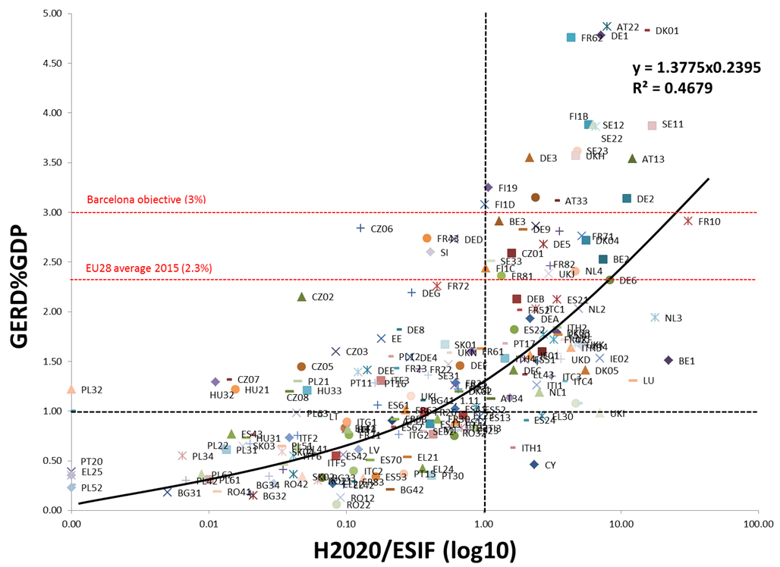
Funding context: Mapping EU Regions (1)
Higher R&I spenders
with ESIF dominance over H2020
44 Regions (22%)
Higher R&I spenders
with H2020 dominance over ESIF
74 Regions (37%)
R&I intensity
H2020/ESIF ratio
Lower R&I spenders
with ESIF dominance over H2020
77 Regions (38.5%)
Lower R&I spenders
with H2020 dominance over ESIF
5 Regions (2.5%)

Slide 6
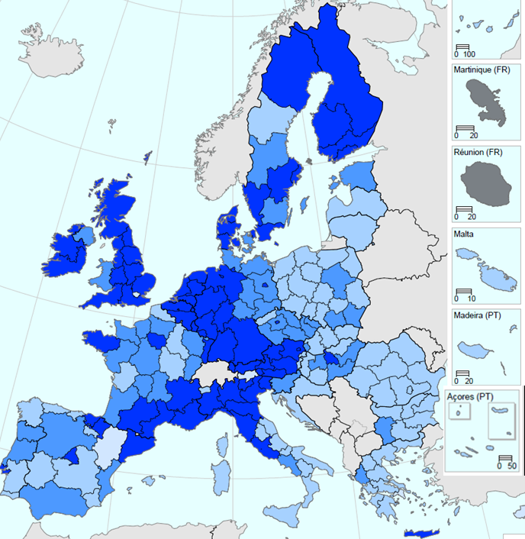
Funding context: Mapping EU Regions (2)
  Higher R&I intensity and H2020 dominance over ESIF
  Higher R&I intensity and ESIF dominance over H2020
  Lower R&I intensity and ESIF dominance over H2020
  Lower R&I intensity and H2020 dominance over ESIF

Slide 7


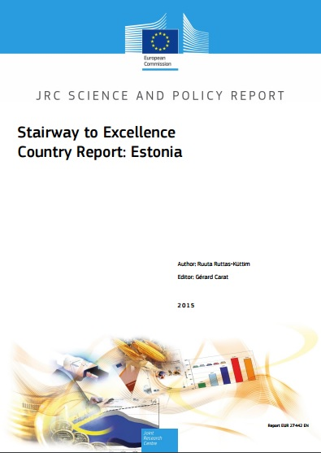
Stairway to Excellence I & II (S2E): 2014-2017
Launched in 2014 to support EU13 MSs and regions to develop and exploit synergies between EU funding.
  Policy Insights - #1 on "Lessons Learnt from S2E National Events" & #2 on "EU13 Participation in International Science"
  National Policy Events & Joint Statements – main challenges and possible actions in each EU13 MS
  National and Regional "Facts and Figures" & "Country Reports" of all EU13 MSs - empirical facts and R&I ecosystems
  Synergy Examples - cases of combined funding
  R&I Regional Viewer - visualise main economic and R&I indicators
http://s3platform.jrc.ec.europa.eu/stairway-to-excellence

Slide 8
S2E III - Closing the innovation gap & helping achieve excellence in EU MS & regions (extended to EU28)
Capacity building for increased H2020 participation
Testing new scenarios for combining funding sources
Trainings for MAs and RIS3 teams
International Project Development Labs
Collaboration of MAs and JUs
Collaboration of MAs and KICs under RIS
- Targetting less developed territories
- Aims to increase H2020 'participation'
- Support international networking
- Explore variety of funding sources
- Thematic S3 platform
- Case of Cleansky JU
- Match-making with Cleansky JU, FCH JU, BBI JU
- Good practices
- Test phase with EIT Climate
- MoU between JRC and EIT
Governance of PROs
Multi-level governance of synergies
Funding guidance
Explore other synergies
- Improving quality of PRO governance
- Aims to increase excellence and support innovation
- Transnational working group on multi-level governance
- Collaboration with LAGREG
- Mapping funding ánd financing in selected areas
- Case of R&I in energy
- Synergies among structural funds (EAFRD, ERDF, ESF,...)
- EIB

Slide 9
Who is attending today?
Are you working with one of the 3 JUs on stage today? (excl. EC)
Cleansky | 39
BBI | 21
FCH | 19
Are you interested in working with one of the 3 JUs on stage today? (excl. EC)
Cleansky | 37
BBI | 34
FCH | 22
180 participants, incl. 35 from EC

Slide 10
Expectations for today (1)
How can JUs contribute to implementing RIS3 at national and regional level?
Technical aspects of synergies: financial rules, stakeholder engagement and commitment, how to launch complementary regional calls, barriers, innovative models of collaborating,…
How to increase collaboration between industry, public sector and the research community, PPPs?
How to increase collaboration between small and big companies?
Mutual learning between regions, between JUs
Learn about synergies between JUs
How to stimulate EU13 to enter into EU partnerships?

Slide 11
Expectations for today (2)
What more could be achieved in the post-2020 period? What are the plans for synergies under FP9?
How to start/intensify collaboration with JUs?
How to inspire higher political level regarding set up of PPPs in the region?
Better understand the expectations for collaboration from the Commission-side
How to strengthen capacity/role of NCPs?
Learn about synergies in view of future JUs
Get feedback from regions

Slide 12
Rationales for this ‘matchmaking’ event
For national and regional authorities: Is it only about money?
  Connect ideas with the money
  Access to open calls
  Access to a European-wide network of excellent partners
  Help focus RIS3 priorities in areas of EU relevance/connect to EU-wide value chains
  Get RIS3 closer to the market
  Access to networks and business
  Support in building specialisation with international relevance
  Use of ESIF to build local capacity and complement the JU research agenda
  There is room for every region

Slide 13
Rationales for this event
For Joint Undertakings:
  Contribution of national and regional programmes to the research agenda of the JUs
  Increasing the critical mass and investment in the topic of the JU
  Increasing the number of partners
For the EC:
  Testing the interest, the benefits and potential for this form of collaboration
  Better understanding barriers
  Ideas for the future

Slide 14
Lessons from synergies event 03/07/17 with Cleansky2
60 national/regional managing authorities, cluster organisations, companies
20 questions debated
More complementarity or more competition between territories?
How can public authorities increase competitiveness?
How to increase SME involvement in JUs?
How to get the support from politicians and public opinion?

Slide 15
Coming soon….
Developing synergies between EIT Innovation Communities and ESIF for optimising RIS3 implementation
Pilot event with EIT Climate KIC on 20 March Lubljana
Uses the RIS outreach scheme as a starting point
(Regional Innovation Scheme)
Part of an MoU between JRC and EIT

Slide 16
Let the matchmaking begin…..

