Slide 1
Developing synergies JU’s and ESIF
--
FCH Cities and Regions initiative
BART BIEBUYCK
Brussels, March 7th 2018

Slide 2




Why the FCH JU works with Regions
EU perspective
Contribute to EU social, economic and environmental policies
Increase outreach of EU bodies
Get closer to citizens by enhancing local collaboration
REGIONS perspective
Increase awareness of emerging FCH technologies
Support local initiatives and strategies
Catalyse local project concepts and help start planning
INDUSTRY perspective
Tap into new market opportunities
Potential for demand aggregation
Helps define product & development
FCH Regions and Cities Initiative

Slide 3




OBJECTIVES OF THE STUDY
    Support regions in assessing various FCH applications
    Identify and maximize the use of regional and Europe-wide funding/financing options
    Develop roadmaps and concepts for the months after the study, prepare and implement deployment projects from 2018
    Support the participating regions/cities to engage their stakeholders

Slide 4






















88 Regions/Cities from 22 countries representing ca. one quarter of Europe participate in the study
Belgium
  Flanders
  Pom West-Vlaanderen
United Kingdom
  Swindon and Wiltshire
  Aberdeen
  Birmingham
  Cornwall
  Dundee
  Fife
  Leeds
  London (Greater London Authority)
  Newcastle
  Orkney Islands
  Oxfordshire
  Perth and Kinross
  Manchester
  Tees Valley
Norway
  Akershus
  Møre og Romsdal
  Oppland County Municipal
  Sogn og Fjordane
Sweden
  Gavleborg
  Mariestad
Germany
  Baden-Württemberg
  Bremerhaven
  Hamburg
  HyCologne- Hydrogen Region Rhineland
  Kreis Steinfurt
  North Rhine- Westphalia
  Heide region
  HYPOS (East Germany)
  Recklinghausen
  Saxony-Anhalt
Finland
  Kokkola
Denmark
  Guldborgsund
  Lolland
France
  Auvergne Rhone-Alpes
  Bourgogne-Franche-Comté
  Centre-Val de Loire
  Grenoble
  Grand Dole
  La Roche sur Yon
  Normandie
  Occitanie-Phyrenees
  Orléans
  Pays de la Loire
  Pays de St Gilles
Spain
  Aragon
  Barcelona
  Cantabria
  Castilla – La Mancha
  Iceland
  Reykjavik
Estonia
  Tallinn
  Murcia
  Port of Valencia
  Puertollano
  Valladolid
Slovenia
  Velenje
Latvia
  Riga
Czech Republic
  Trutnov
Croatia
  Split
  Split-Dalmatia County
Italy
  Lazio
  South Tyrol
  Favignana
  Torino
  Venice
  Toscana
Romania
  Constanta
Bulgaria
  Bulgarian Ports
  Sofia
Netherlands
  Assen
  Drenthe
  Emmen
  Groningen
Greece
  Portugal
  Torres Vedras
  Médio Tejo
Austria
  Tirol
  Alimos
  Agia Paraskevi
  Ierapetra
  Kozani
  Milos
  Vrilissia
  Kalymnos
  Heraklion
  Western Macedonia
  Papagoou-Halargos
  Region of Crete
Notes:
AP to FCH: Please adapt and highlight the countries accordingly

Slide 5














































Over 50 FCH industry players at present
FCH

Slide 6
As a result of Phase 1, motivation to pursue FCH deployments remains high whereas some perceived challenges could be relieved
Comparison of selected answers from 1st and 2nd self-assessment¹⁾
Main reasons for pursuing FCH applications [%]²⁾:
Main obstacles and challenges [%]³⁾:
Reduce local emissions
of greenhouse gases
Lack of funding /
financing
Reduce emissions
of pollutants
Insufficient viability of
the business case
Focus of Phase 1
Create additional
employment opportunities
Improve the
image as "green"
Lack of hydrogen supply
Complexity of permitting and
authorization procedures
Foster industrial
innovation and development
Reduce primary
energy consumption
Lack of industry stakeholder
support
Increase "smart city"
activities
Insufficient technological
readiness
Focus of Phase 1
Increase the usage
of local hydrogen supply
Regulatory barriers
Reduce local emissions
of noise
Lack of political backing
and buy-in
2nd survey
1st survey
Perceived obstacles/challenges addressed in Phase 1 have been considerably reduced
1) Percentage share of participants who set either 3, 4 or 5 points on a 5-point Likert Scale (5 = very important)
2) "What are your region's/city's main reasons for pursuing FCH applications? How relevant and important are typical drivers for FCH technologies to you, also compared to one another?"
3) "Within your region/city, which hurdles and challenges currently pose obstacles to the deployment of FCH applications?"

Slide 7
The FCH applications in scope are heterogeneous – Different tech. readiness, economic competitiveness and deployment complexity
Evaluation results of 10 FCH applications¹ on seven key dimensions
1
TRL
2
Economic competi-tiveness
3
Environ-mental benefits
4
Unique selling propos.
5
Ease of deploy-ment
6
Direct pro-curement
7
Visibility as "show-case"
(Urban) Buses
Transport appli-cations
Cars
Delivery vans
Heavy-duty trucks
Trains
Port operations
Power to H₂
Stationary appli-cations
H₂ injection into gas grid
Residential mCHP
Off-grid power
High
Medium
Low
1) Please note that the selection only contains the ten top-ranked applications as stated by the Regions and Cities in the initial self-assessment survey (June 2017)
2) Results differ depending on location, time horizon, benchmark technology as well as specific use case under consideration

Slide 8
Considerable future FCH projects are planned all over Europe (2017-2022), especially in Central Europe, Nordics and UK
Survey results – Total estimated project volume¹⁾ [m EUR] – APPROXIMATION
9
7
Nordics + LVA
(8 regions/cities)
Benelux
(5 regions/cities)
101
UK (10 regions/cities)
13
Central Europe
(10 regions/cities)
131
France (9 regions/cities)
4
South East Europe
(15 regions/cities)
Iberian + Italy
(10 region/&cities)
2
11
13
20
2012-2017
2017-2022
Countries with regions that participated in the survey
1) Overall project volume in each geographic cluster calculated as sum of all aggregated project volumes of regions/cities; # of regions/cities refers to those with answers to this question
Source: FCH2 JU, Roland Berger

Slide 9
Urban buses, cars, delivery vans, trains and garbage trucks are the most relevant applications for participating Regions & Cities
Survey results on most relevant FCH applications¹⁾
Preliminary indicative deployment volumes [# units]
Buses
Trains
Cars
Buses
H2 production
Garbage trucks
Cars
3,600
Trains
Delivery vans
1,217
Delivery vans
Garbage trucks
H2-to-X
H2 into gas grid
Sweepers
Grid services
Bikes
Bikes
Heavy-duty transport
Scooters
Ships
Ferries
Commercial buildings
Port ops. equip.
Boats
Highly preliminary – Indicative potential as outlined by survey participants where figures have been provided
Sweepers
Ships
Boats
Port operations equipment
Ferries
Resid. use/ mCHP
Commercial buildings
Back-up power
Industrial use cases
Off-grid power
Material handling
Off-grid power
Airport handling equip.
H2 production
Industrial use case
H2-to-X
Scooters
Construction equipment
H2 into gas grid
Aircraft
Grid services
Gen-sets
The survey asked participating Regions & Cities which applications were most relevant to them for deployment in the next 3 to 5 years
  Regions & Cities were also asked to indicate potential deployment volumes for each top 3 application selected in the next 3 to 5 years
1) Ranking according to total points collected for each application based on a Top 1, 2 or 3 priority ranking by each survey participant

Slide 10

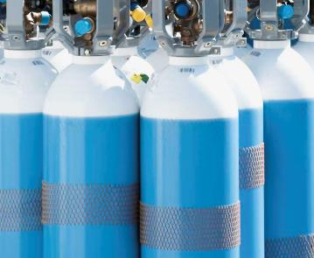
The agreed-upon application framework for Phase 2 comprises five top mobility applications and H₂ production as cross-cutting topic
Application scope for Phase 2 based on consolidated ranking
1
Five FCH mobility applications as focus for detailed business cases
2
Selected further applications as focus for technology development dialog platform
  Buses
  Cars
  Delivery vans
  Garbage trucks
  Trains
  Heavy-duty transport
  Maritime applications
  Commercial buildings
3
(Green) hydrogen production as cross-cutting topic for both consideration in detailed business cases as well as development of project concepts and roadmaps in Phase 2 of the project – for the latter also including a view on secondary applications (depending on interest in the coalition)

Slide 11
The coalition will be divided into two tiers – Target outputs are valley concepts, roadmaps and project ideas, market/funding intelligence
Tier-based project coalition
Tier-specific project outputs
Overall project outputs
FCH Valley Concept Region A
A₁
1
Tier 1 "FCH valleys"
~ 25 Regions & Cities
Market intelligence, e.g. volumes Application₁
(EU) funding priorities for FCH
A₂
Sub-projects
by application
~ 90 Regions
& Cities
FCH Roadmap City B
B₁
Tier 2 "1st FCH projects"
~ 70 Regions & Cities
B₂
2
"1st project"
concepts by app.
Regions & Cities develop, RB facilitates & supports in the process, FCH industry assists with experience and expertise

Slide 12
Regions & Cities are looking to implement the concrete next steps of a long-term development towards widespread use of FCH
FCH market development perspective from the FCH JU Regions & Cities Initiative
Key learnings from the project so far
  Large interest of Regions & Cities to engage in FCH deployment projects
  Many participants see H2 to play a central role in sector coupling and in a broad range of application areas
  To initiate this development, a group of participants aims to realise "H2 Valley" projects covering the entire H₂ value chain and including different kinds of applications
  Besides this, levels of ambition, experience and concreteness of plans are highly heterogeneous, but many regions and cities aim at realising the concrete next steps
  Main challenges are lack of commercial availability of relevant products and lack of funding for the cost premium

Slide 13
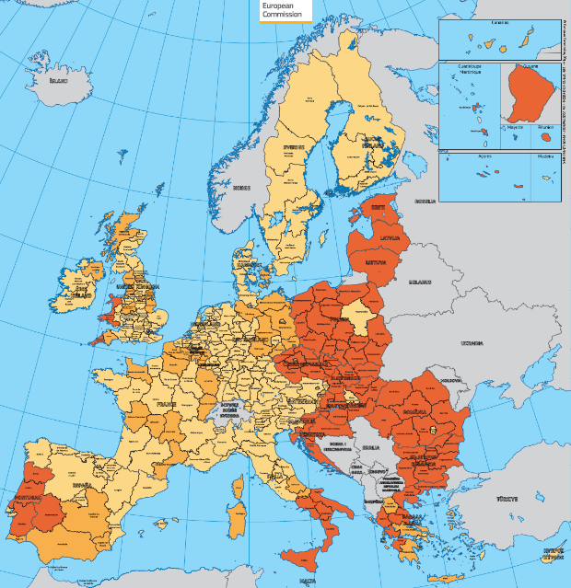
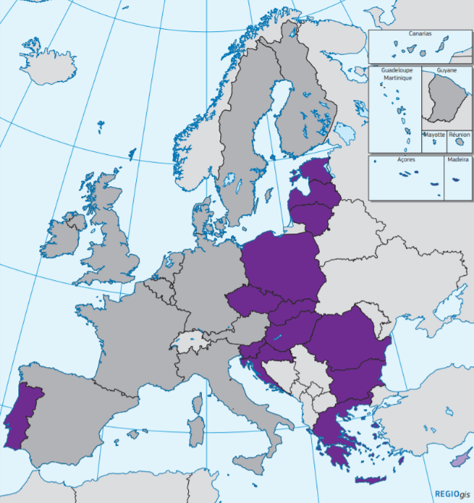
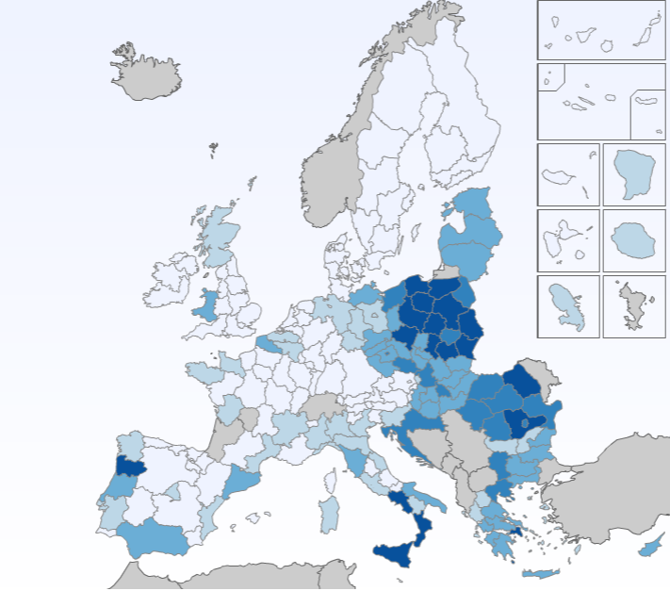


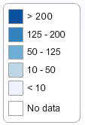





ESIF 2014-2020 regional eligibility
– budget earmarked for Clean Urban Transport (by region)
Structural Funds eligibility
Cohesion Fund eligibility (15 MS)
Clean Urban Transport infrastructure and promotion (including equipment and rolling stock)
Cohesion Countries (#15)
(i.e. 80%)
+ Spain and Italy
(i.e. 93%)
http://s3platform.jrc.ec.europa.eu/esif-viewer
FCH JU to work on synergies and complementary calls with ESIF
Bottom-up (Regions) Vs. Top-down (Member States) approach
Huge discrepancy between the level of EU funding available
Regions in the EUcc15+2 well placed to deploy Clean Urban Transport projects under ESIF budget
Notes:
EU map on European Structural and Investment Funds (ESIF) during 2014-2020 for “043 - Clean urban transport infrastructure and promotion (including equipment and rolling stock)” – I extracted this map from the ESIF viewer at the S3Platform (i.e. Smart Specialisation (Strategy) Platform). It highlights the huge discrepancy between the level of EU funding for Cohesion Countries plus Spain and Italy compared to the remaining 11 (richest) Member States because the latter have higher GDP and GNI and thus face reduced eligibility for ESIF (mostly the Cohesion Fund and the European Regional Development Fund (ERDF).
Regions in the EUcc15+2 seem good candidates to deploy clean urban transport projects on the back of the ESIF budget for the whole 2014-2020 period as they are eligible for 93% of the EU28 budget allocated to this category of intervention until 2020: 043 - Clean urban transport infrastructure and promotion (including equipment and rolling stock).
http://s3platform.jrc.ec.europa.eu/esif-viewer?p_auth=GEiQ57ui&p_p_id=generalesifviewertool_WAR_generalesifviewertoolportlet_INSTANCE_uQEMgwAStPS9&p_p_lifecycle=1&p_p_state=normal&p_p_mode=view&p_p_col_id=column-1&p_p_col_count=2&_generalesifviewertool_WAR_generalesifviewertoolportlet_INSTANCE_uQEMgwAStPS9_javax.portlet.action=performSearch
By thematic objective:
04 - Supporting the shift towards a low-carbon economy in all sectors EUR 7,218 mn
MULTI - Multi-thematic objective EUR 2,804 mn
07 - Promoting sustainable transport and removing bottlenecks in key network infrastructures EUR 2,332 mn
M08 - Promoting sustainable and quality employment and supporting labour mobility EUR 7 mn
11 - Enhancing institutional capacity of public authorities and stakeholders and efficient public administration EUR 6 mn

Slide 14
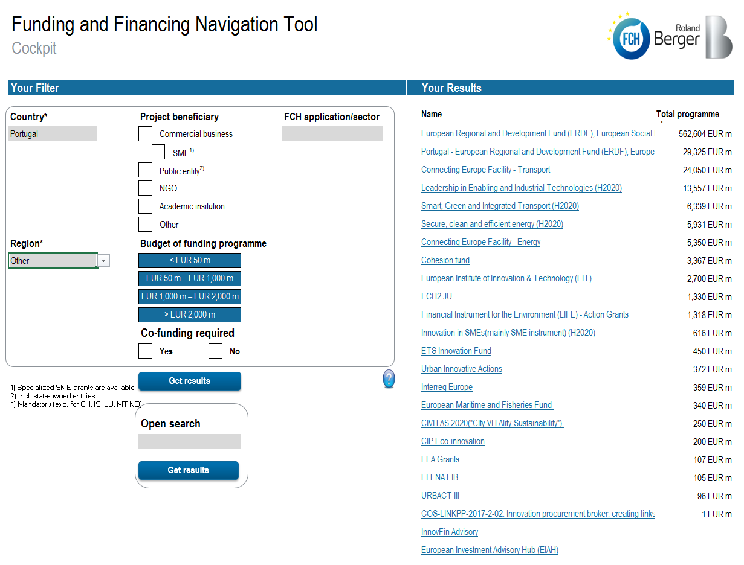
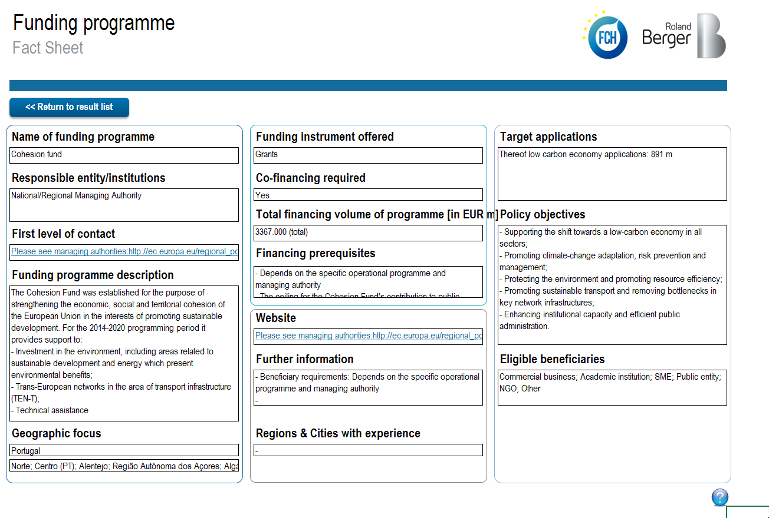
Funding and Financing Navigation Tool
One of the various practical outputs of the FCH Regions and Cities Initiative
The cockpit of the funding and financing navigation allows you to set different filters to identify potential sources for local FCH projects
As search result, comprehensive fact sheets summarize information on the individual funding programmes
Identify and maximize the use of regional and Europe-wide funding/financing options

Slide 15



Bart Biebuyck
Executive Director
bart.biebuyck@fch.europa.eu
For further information
www.fch.europa.eu
www.hydrogeneurope.eu
www.nerghy.eu
@fch_ju
Fch-ju@fch.europa.eu
FCH JU

