Slide 1
Meeting new governance challenges in less developed regions: insights from Extremadura and Puglia Madrid, 20 February 2019 Federica Bertamino, federica.bertamino@agenziacoesione.gov.it Ana Fernandez, a.fernandez.zubieta@ucm.es Elisabetta Marinelli, Elisabetta.Marinelli@ec.europa.eu
S3 Targeted Support – Horizontal Activities

Slide 2
Introduction
Common traits
Less-developed
Administrative competences
Financial crisis
Lines of comparison
the organisation of the governance system
S3 strategic governance
S3 technical management
S3 bottom-up engagement
the interaction between bodies/stakeholders
Intra-regional interaction
National-regional interaction
Continuous stakeholders involvement
S3: political consensus and stakeholders engagement

Slide 3
Theoretical background: Insights from two streams of literature
Economics of innovation → from sectoral to regional growth
Institutional quality of regions, particularly in less developed regions (i.e. Rodríguez-Posé, 2014)
Ability to integrate stakeholders (i.e. Foray, 2014; Valdaliso et al., 2014)
Policy innovation → policy dimension and coordination mechanisms
Coordination challenges (i.e. Magro et al., 2014; Flanagan et al., 2011)
Multi-layer dimension (different governance levels): i.e. political, administrative and operative
Policy-mix dimension (different policy domains-instruments)
Multi-level dimension (different administrative levels of governance): i.e. local, regional, national and supranational

Slide 4
Methodology
Desk analysis
In-depth interviews
first half of 2018
Interviews for each region
2 strategic responsibilities from the public sector
2 technical responsibilities
2 stakeholders (private and research sector)
1 from national governance system for RIS.
Criteria for interviewees
(1) of “high responsibility”
(2) of “engagement and informative value” (for stakeholders)

Slide 5
Comparing Puglia and Extremadura key characteristics
Source: own elaboration with European Quality of Government (EQI) data based on the Quality of government (QoG) data from the World Bank’s “World Governance Indicators” (WGI) (see more details about EQI data in Charon and Lapuente, 2018).

Slide 6
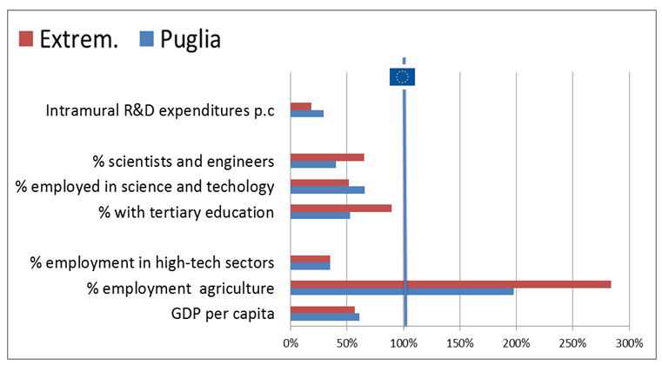
Comparing Puglia and Extremadura % of EU avg

Slide 7
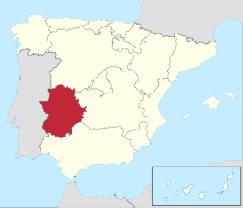
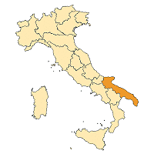
Extremadura vs. Puglia R&I System
The R&D investment level:
Research infrastructures :
UEx + UNED units 4 public Universities and 1 private univ;
Division of competences:
State - exclusive competence on RDTI general coordination Competences for universities are at national level
Regions & State: promotion and financing of RDTI Research competences shared
S3 specialisation areas
Agro-food, Clean energies, Tourism, Health, ICT Sustainable Manufact.; Human & Environ. Health; Digital, Creative and Inclusive Communities
Public Research Bodies (PRB), SES Public research centres: CNR ENEA , INFN, CREA
Financial framework
Plan for Research and Innovation (2017-2020) - €844mln, The S3 has a budget of around € 1.1 bn
TO1 in the regional ERDF - €138mln coming largely from ESIF - TO 1 (€ 672 mln.)
Foundation FUNDECYT
0.8% of total Spanish GERD in 2016 3.2% of national GERD

Slide 8
Strategic governance Multi-layer dimension (political)
EXTREMADURA Three actors: The Commission of Science Technology and Innovation of Extremadura Design and implementation of policy measures on R&I The RIS3 Technical Committee Representatives from the regional government and from the University of Extremadura (Uex) The Advisory Council for Science Technology and Innovation Politicians, top-civil servants, stakeholders. The responsibility of the S3 is of the “regional ministry” (Conserjería) of Economy and infrastructures S3 strategic governance: Nested in broader STI governance. Participatory
PUGLIA Ambidextrous Model for innovation – MAIA” characterized by 2 elements: exploitation capacity: Department for Economic Development, Innovation, Education, Training and Jobs exploration capacity : Regional Agency for Technology and Innovation (ARTI) The President of the Puglia Region is responsible for S3 accompanied by: the Regional Ministry for Economic Development; President of ARTI. The strategic governance level offers limited and ad hoc opportunity to discuss with other actors of the regional innovation system (such as universities and enterprises). S3 strategic governance strongly linked to OP management.

Slide 9
Technical governance Multi-layer dimension (administrative)
EXTREMADURA Formalised RIS3 Management Team includes: General Secretariat of Science, Technology and Innovation (strategic level) RIS3 Technical Office (management level) Hybrid body Head Director of FUNDECYT-PCTEX also a member of The RIS3 Technical Committee RIS3 Technical Office implemented through “Oficina de la Innovación” Limited interaction with other regional government departments (i.a. Agriculture; Health, etc.)
PUGLIA Not Formalised S3 Team: It includes staff from: the Service for Industrial R&I (3 people); the Management Authority of the ROP (3People); ARTI (5people) ARTI is provided with high-skilled human resources and is responsible for: promoting the Regional Innovation System providing analytical support RIS3 monitoring and evaluation activities. Sustained and regular exchanges with stakeholders. The Regional Evaluation Unit provides analytical support for programming and evaluation activities. Limited interaction with other regional government departments (i.a. Agriculture; Health, etc.)

Slide 10
Bottom up level Multi-layer dimension (operative)
EXTREMADURA Implemented Quadruple Helix approach Input provided through the different phases of S3 around 5 thematic groups Toolkit of methodologies (feedback 1280 people Challenges: Firms involved but public sector is dominant Civil society not really involved
PUGLIA In development Design phase: large involvement of all the relevant stakeholders through six thematic working groups ARTI: in-depth analysis to decide whether to organize the 6 working groups around KETs or RIS3 priority-areas. Challenges: -To reach the innovative firms (generally not much contact with the PA) - To reach firms with an innovative potential but not showing an explicit innovation demand. Confindustria Puglia new project: creating some “mediators”

Slide 11
Interaction between national and regional level
Multi-level dimension
Relationship between the national and regional level is very different in the two countries
EXTREMADURA Good-cop vs Bad-cop Main coordination actors: Red IDI: peer learning Two main aspects: MA at national level →“rigidity” and bureaucratisation of the implementations mechanisms of ERDF Distribution of competences across governmental administrative levels → potential conflict of competences
PUGLIA Synergies, Monitoring and Capacity Building National mechanisms supporting coordination of regional S3: NOP & ROP S3s National Monitoring System (common understanding of the different S3s) Capacity Building: “Supporting S3 monitoring and implementation ” Main coordination actor: National Agency for Territorial Cohesion

Slide 12
Final considerations: insights from Extremadura and Puglia
Path dependence
S3 governance is integrated in a R&I system, building on previous existing bodies
High-skills dedicate to S3;
Governance more closely linked to the ROP management
Multi-layer dimension
Coordination Mechanism
“hybrid technical body” at strategic-management level
Informal Coordination Mechanism
clearly identified actors/entities →flexibility but → vulnerability to unexpected changes
Multi-level dimension
MA at national level → administrative OP management (State Aid regulation) and conflicts on competences
Coordination and synergies with national S3, and NOP and ROP

Slide 13
Final considerations:
S3 Technical Body as a coordination mechanism
Being Formal or Informal?
Coordination
S3 Technical Body
Being hybrid or not?
mechanism
Being R&D or OP oriented?

Slide 14
Thanks for your attention

