Slide 1
Is it best for the development of S3 to focus mainly on stakeholders directly engaged in R&D and technological innovation?
Governance hearing
Madrid 20 Feb 2019
Lajos Nyiri

Slide 2
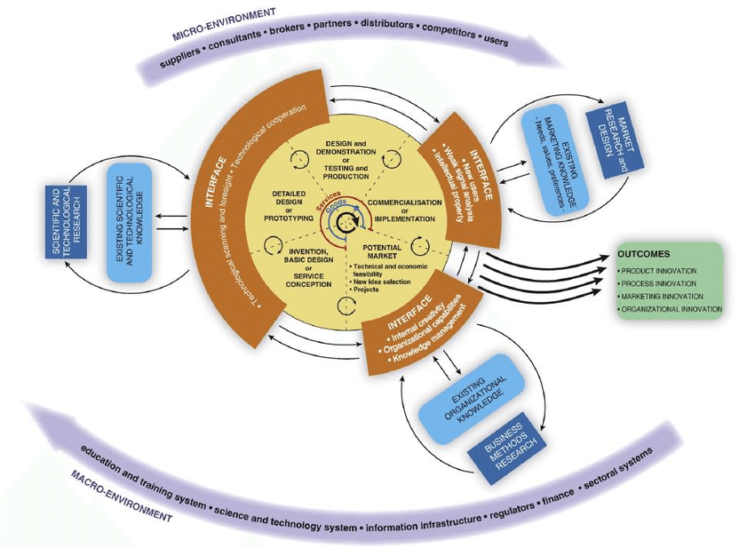
„There is no single model of the innovation process:
enterprises can differ very significantly in their
approaches to innovation”
Smith

Slide 3
Consensus on:
Science is vital to innovation
Fundamental R&D provides the foundation for future innovation
EIS
New doctorate graduates | Foreign PhD students | Tertiery education
Publications | Private-public copublications | International co-publications
GERD | BERD | VC expenditures
Lifelong learning | Opportunity driven entrepreneurship | ICT training
SMEs innovation | SMEs in-house innovation | SMEs collaborating with others
IPR statistics | Exports (knowledge intensive and medium to high tech) | Sales of new-to-market

Slide 4
Main roles of R&D in innovation
To generate new knowledge
To understand new knowledge created anywhere and transmit it to actors in the local market (dissemination role)
To actively involved into the exploitation of knowledge by businesses (contract research, consultancy, joint R&D projects, etc.)
To provide training for businesses & refresh continuously the educational programs
To provide special research services (research infrastructure, contract research)

Slide 5
Typical public policy approach
To boost private R&D expenditures (subsidise, protection of intellectual property rights, direct funding)
Fund public R&D activities
Encourage academia-industry collaboration (mostly in R&D)

Slide 6
Lagging region
Innovation policy focus → technology upgrading
Innovation policy environment →
Limited number of large companies, mostly micro-firms
Higher share of agriculture in regional GDP
Limited number of firms innovating
Affiliates of multinationals act as islands in the innovation system
Few (if any) and unbalanced distribution of research capacity
Poor linkages between local business and academia
Very weak civil society

Slide 7
Upgrading technologies
Research is not the main source of innovation
Focus on disseminating innovation
To generate new knowledge
To understand new knowledge created anywhere and transmit it to actors in the local market (dissemination role)
To actively involved into the exploitation of knowledge by businesses (contract research, consultancy, joint R&D projects, etc.)
To provide training for businesses & refresh continuously the educational programs
To provide special research services (research infrastructure)
Firms need to develop new skills/competencies:
Recognising global innovation trends
Understanding new technologies
Developing human resources
Adapting new technologies successfully

Slide 8
S3 implementation gaps in lagging regions
Interest
Culture in policy making
Communication culture

Slide 9
Is it best for the development of S3 to focus mainly on stakeholders directly engaged in R&D and technological innovation?
Short answer: NO, IT IS NOT THE BEST
Long answer: IT IS THE MOST FEASIBLE OPTION ─ THE OPTIMUM!
Well targeted → on capacity building for technology upgrading
Concentrates the available limited resources to activities with highest return
Good practices are easily available internationally
The critical mass of stakeholders can be mobilised (but it is far the most serious risk factor!!!)
As a side effect, capacities for widening the scope (other types of innovation & non-innovative actors) can also be developed further

