Slide 2
The governance of Smart Specialisation: past challenges and future hopes
Elisabetta Marinelli
Madrid 20th February 2019

Slide 3

Governance of S3 – Why?
True love is like ghosts, which everyone talks about and few have seen.
Francois de La Rochefoucauld
Notes:
TIME IT RIGHT!

Slide 4
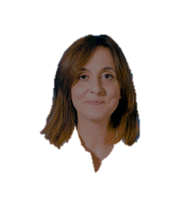
Governance of S3 – Why?
True S3 governance love is like ghosts, which everyone talks about and few have seen.
Francois de La Rochefoucauld
Elisabetta Marinelli

Slide 5
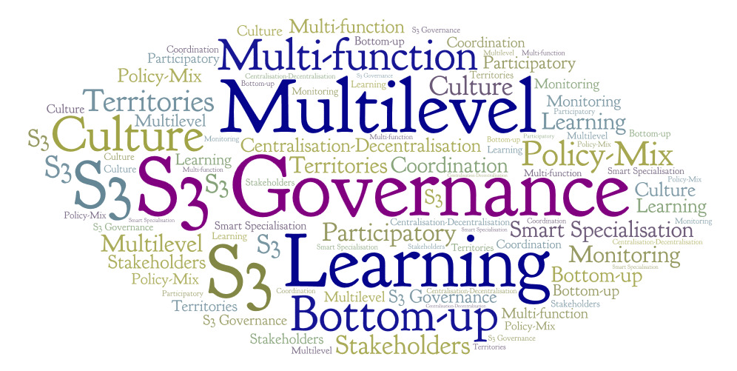
S3 governance –What should it do?

Slide 6
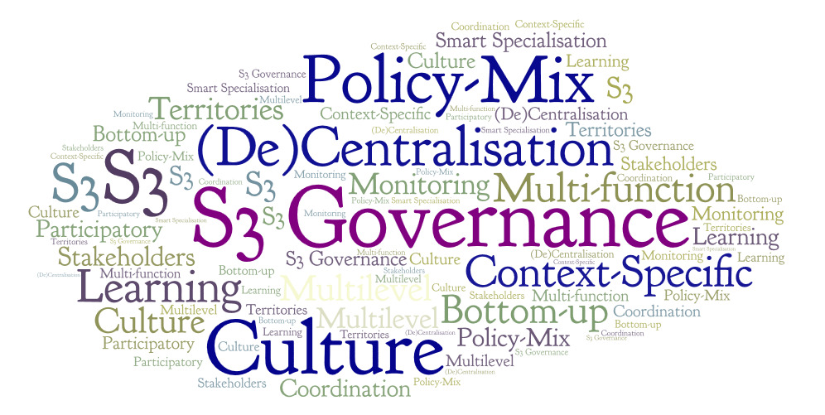
S3 governance – Yes but…
Notes:
MENTION DISTANCE BETWEEN ACADEMIC DEBATE AND PUBLIC LIFE

Slide 7

The bitter truth: S3 as a headless heroine
  Governance body absent or unable to perform
  Unresolved ambiguity between S3 and OP governance

Slide 8

…The light at the end of the tunnel…
Policy objective | Specific objective | Name of enabling condition
1. A smarter Europe by promoting innovative and smart economic transformation | ERDF: All specific objectives under this policy objectives | Good governance of national or regional smart specialisation strategy
Fulfilment criteria for the enabling condition
Smart specialisation strategy(ies) shall be supported by: … Existence of competent regional / national institution or body, responsible for the management of the smart specialisation strategy … … … 7. ….
Notes:
MENTION DISTANCE BETWEEN ACADEMIC DEBATE AND PUBLIC LIFE

Slide 9
Plan of the day
Presentations
Lessons from Lagging Regions 1
Exercise
"S3 body"
Max common denominator
S3 Hearing which actors in S3?
Exercise 2
"S3 body" National perspectives

Slide 10
What do we know about S3 governance? Presentations
Two role-playing games
Intra-regional governance
Multi-level governance
5 case-studies
Puglia-Extremadura
Centro
Bulgaria
Romania

Slide 11



S3 Responsible body – What should it do? Exercise part 1
ERDF Managing Authority
Bottom-up level
.
2
3
Complementary-policy
body
Strategic level
S3 body
1
4
4 tables – international mix
Notes:
MENTION DISTANCE BETWEEN ACADEMIC DEBATE AND PUBLIC LIFE

Slide 12
RACI Matrix

Slide 13
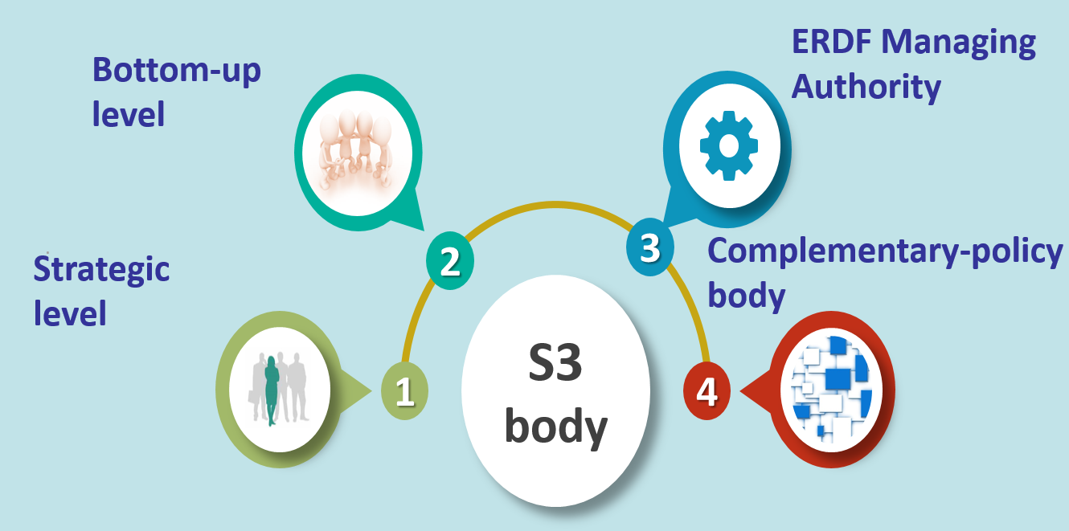

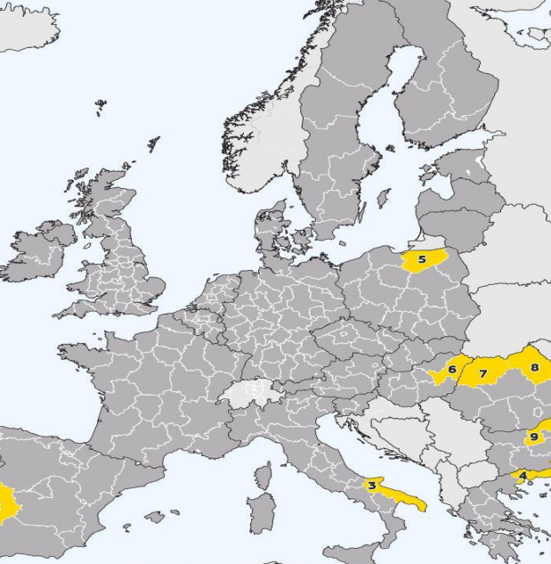
S3 Responsible body – What should it do? Exercise part 2
National perspectives
Relationship with the national level
Relationship with the EU level
4 groups:
  Spain – Italy
  Greece – Porturgal
  Croatia – Bulgaria
  Romania – Hungary
5
6
Regio
Country-Desk
National level
Notes:
MENTION DISTANCE BETWEEN ACADEMIC DEBATE AND PUBLIC LIFE

Slide 14
RACI Matrix

Slide 15

In between: S3 hearing
"It is best for the development of S3 to focus mainly on stakeholders directly engaged in R&D"
Lajos Nyiri
Dimitrios Ponitikakis

