Slide 1

Governance of Digital Government:
The case of Italy
AGID and the National Observatory
on Digital Ecosystem Growth

Slide 2

WHAT AgID DOES DIGITALIZE TO GROW
STRATEGIC PLANNING
COORDINATION OF 22.000 PAs (including schools)
13.500 PAs delivering services and acting as aggregators
427 IN HOUSE companies/15.000 employees
MAIN PLAYERS: ~ 150 (Central PAs, Regions, in house companies, public bodies and agencies)
BUSINESS SECTOR and
CITIZENS
ICT COORDINATION
SUPPORT TO THE DEVELOPMENT AND UPTAKE OF DIGITAL SERVICES
RATIONALISATION OF NATIONAL PHYSICAL INFRASTRUCTURES
CYBERSECURITY IN THE PA
RESEARCH AND INNOVATION
TECHNICAL RULES AND SURVEILLANCE
DIGITAL CITIZENSHIP AND COMPETENCES

Slide 3
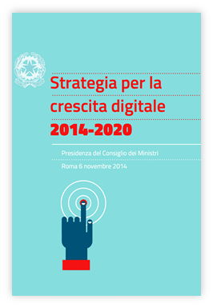
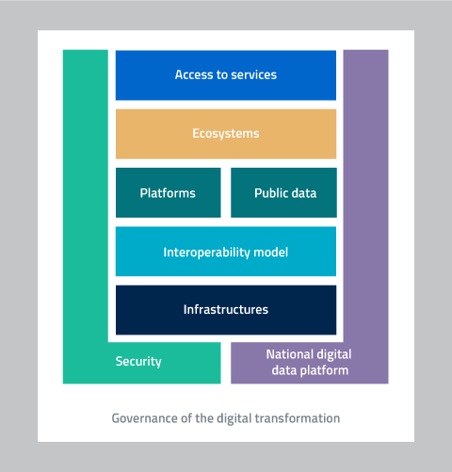

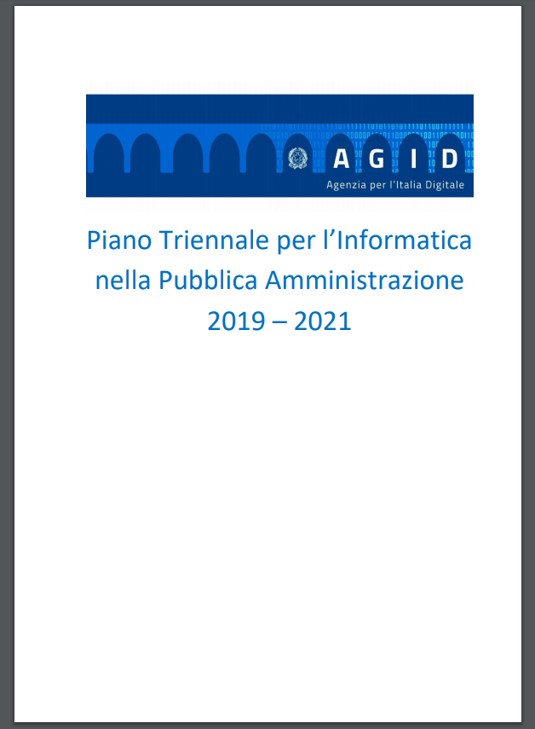
Il From the Digital Agenda to the Three-Year Plan
2014- 2015
The Digital Growth Strategy represents the Italian Digital Agenda endorsed by the Government and the European Commission
2016
The Strategic model of digital transformation of the PA identifies the enabling components for the realisation of the Digital Agenda
2017
2014-15
2016
2019
The Three-Year Plan 2017/19 lays down actions and objectives for each layer of the strategic model
The Three-Year Plan 2019-21 updates and integrates the actions enhancing collaboration among the main digital transformation actors

Slide 4



Main novelties
Three-Year Plan 2019-2021
90 actions for an inclusive growth
Holistic approach &
ONCE ONLY principle
3 dimensions
New key to reading of the Lines of Action that identifies the intervention areas and the impact on citizens, businesses and Public Administrations in the short, medium and long run.
PA
Businesses
Citizens
Take action
to disseminate the culture of change management
Share
innovation programs
Disseminate
digital culture
Public Data
Provide
a range of clustered services that facilitate innovation investments
Raise awareness
on digital rights
Assist
the PAs in the implementation of the Strategy
New Governance structure with the Digital Transition Officers at its core
New Monitoring Tools and Guidance provided to the PAs in the implementation of the Plan

Slide 5




Vision and method: holistic approach
FIRST THE PROJECTS
THEN THE IMPLEMENTING NORMS
Citizens and businesses at the center of processes and projects
Stakeholders engagement: from vision to execution
INCLUSIVENESS
USER-CENTERED
TRAINING
INFORMATION
RE-ENGINEERING PROCESSES APPLYING THE ONCE ONLY PRINCIPLE
one submission only
one control only
one PA only
Digital rights and awareness
Overcome the logic of mere bureaucratic fulfillment
ORGANISATIONAL CHANGES
CULTURE CREATION
IMPLEMENTING NORMS
GENERATING VALUE
PA AS A DRIVER OF GROWTH

Slide 6

5. Public Data
3 relevant actions
5.1. Data bases of national interest
5.2. Open Data
5.3. Controlled vocabulary

Slide 7
11. Governance of the Digital Transformation
The Conference of the Digital Transition Officers (DTO)
DTO
- art. 17 – CAD
- Circular n. 3 (1/10/2018) of the Minister of the PA
- Three-Year Plan 2019-2021

Slide 8

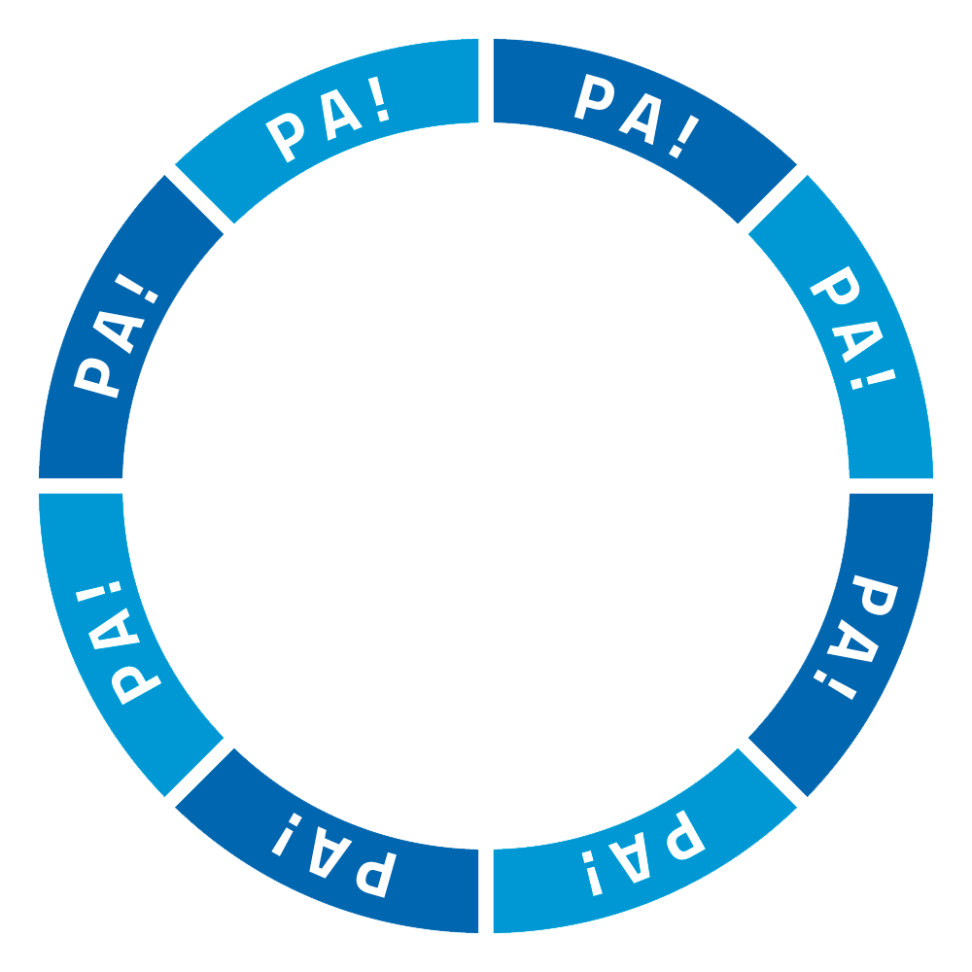




11. Governance of the Digital Transformation
The Conference of the Digital Transition Officers (DTO)
VARIABLE STRUCTURES
based on thematic issues and types of PAs involved, with the participation of the civil society, business associations, academia e research entities
DTO CONFERENCE

Slide 9


O.N.C.E. – National Observatory on Digital Ecosystem Growth
1 community
Measuring innovation on the territories
KPI for the Three-Year Plan
Measuring public ICT expenditure
The PA towards Digital Europe
4 laboratories

Slide 10

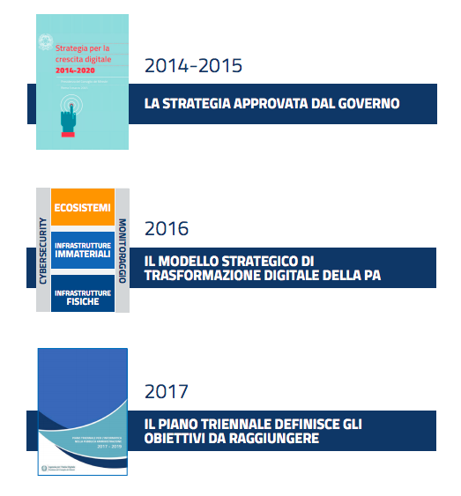


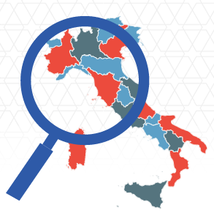

Where ONCE comes from
4 NEEDS collected by AgID
1
2
Digital growth Strategy and
Three-year Plan
Populate the 80 Strategy indicators and identify the phenomena related to the implementation of the Three-Year Plan
Digital data
collect and standardize data on digital phenomena available to all stakeholders
Building a monitoring community for the Italian digital transformation
3
4
ICT expenses
Produce high-quality data on ICT expenditure of the PA and start developing new soldipubblici.it release
Digitization and
European funds
Ensuring the relevance of ongoing digital projects of the PA with respect to the EU programs
(direct and indirect)

Slide 11

Objectives
Building a monitoring community for the Italian digital transformation
Make the different monitoring actions converge into a single framework
Reduce the workload of PAs that provide data or KPIs (Once principle)
Improve the country’s benchmark at European level
Identify KPIs for the Three-year plan
Promote competences, data and KPIs sharing

Slide 12

The methodological approach
Three-year plan – strategic model
funds

Slide 13
The operational approach
territorial expansion
Phenomena expansion
y indicators
(80 + n) indicators
Digital Growth + Three-year Plan
Sectoral expansion
z indicators

Slide 14




Community O.N.C.E: 4 LABORATORIES
MEASURING INNOVATION ON THE TERRITORY
KPI FOR THREE-YEAR PLAN
MEASURE THE ICT EXPENSE OF THE PA
THE PA TOWARDS DIGITAL EUROPE
Identify monitoring indicators for the three-year Plan
Ensure precise measurement of the ICT expenditure
Understand how the measurement of phenomena changes depending on the different territorial levels
Build a shared perspective for Digital Europe 2021-2027

Slide 15



2 Needs to be met
Community O.N.C.E: Territorial lab
Connect:
Different Subjects
Differnt Systems
Different sources
Different needs
A National indicator is not always the sum of the territorial ones

Slide 16
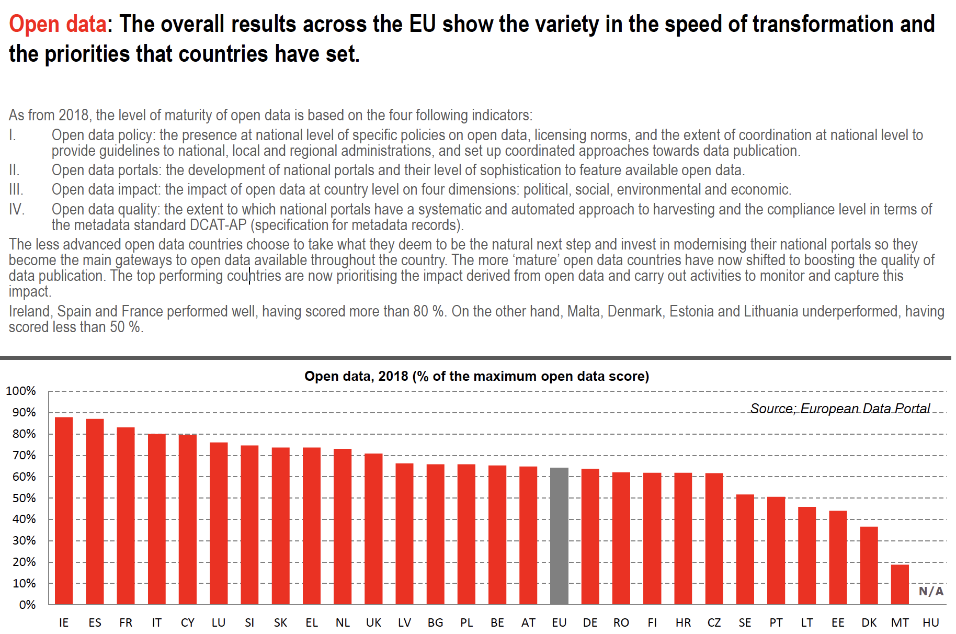
Community O.N.C.E: a good application

Slide 17
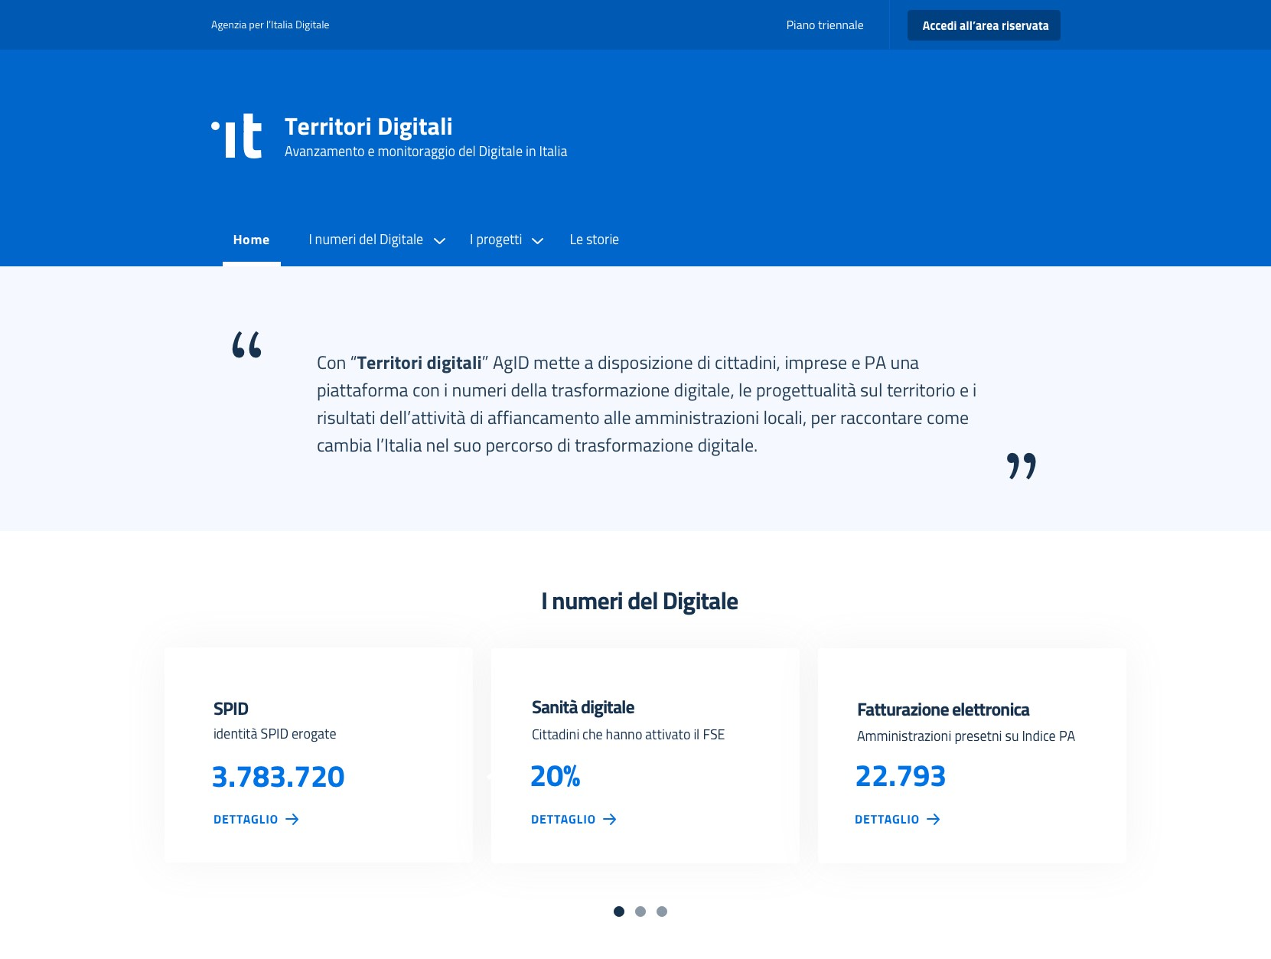

#TERRITORIDIGITALI – the platform

Slide 18
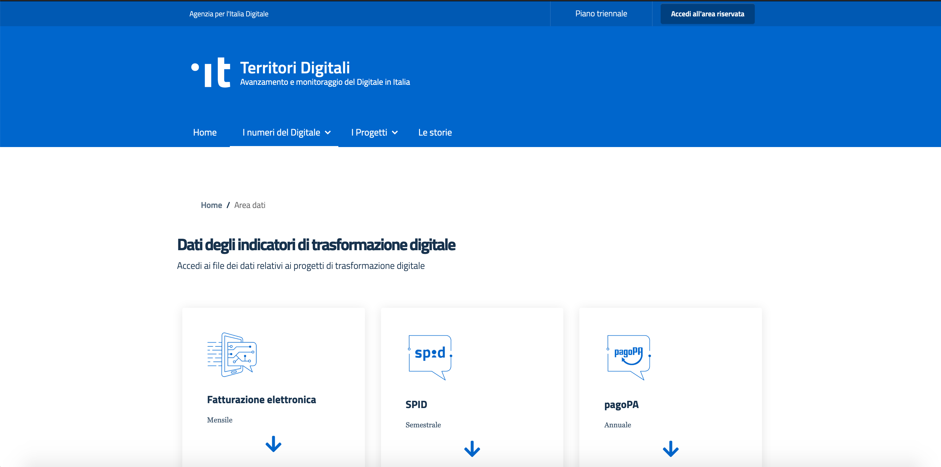
#TERRITORIDIGITALI - OPENDATA

Slide 19
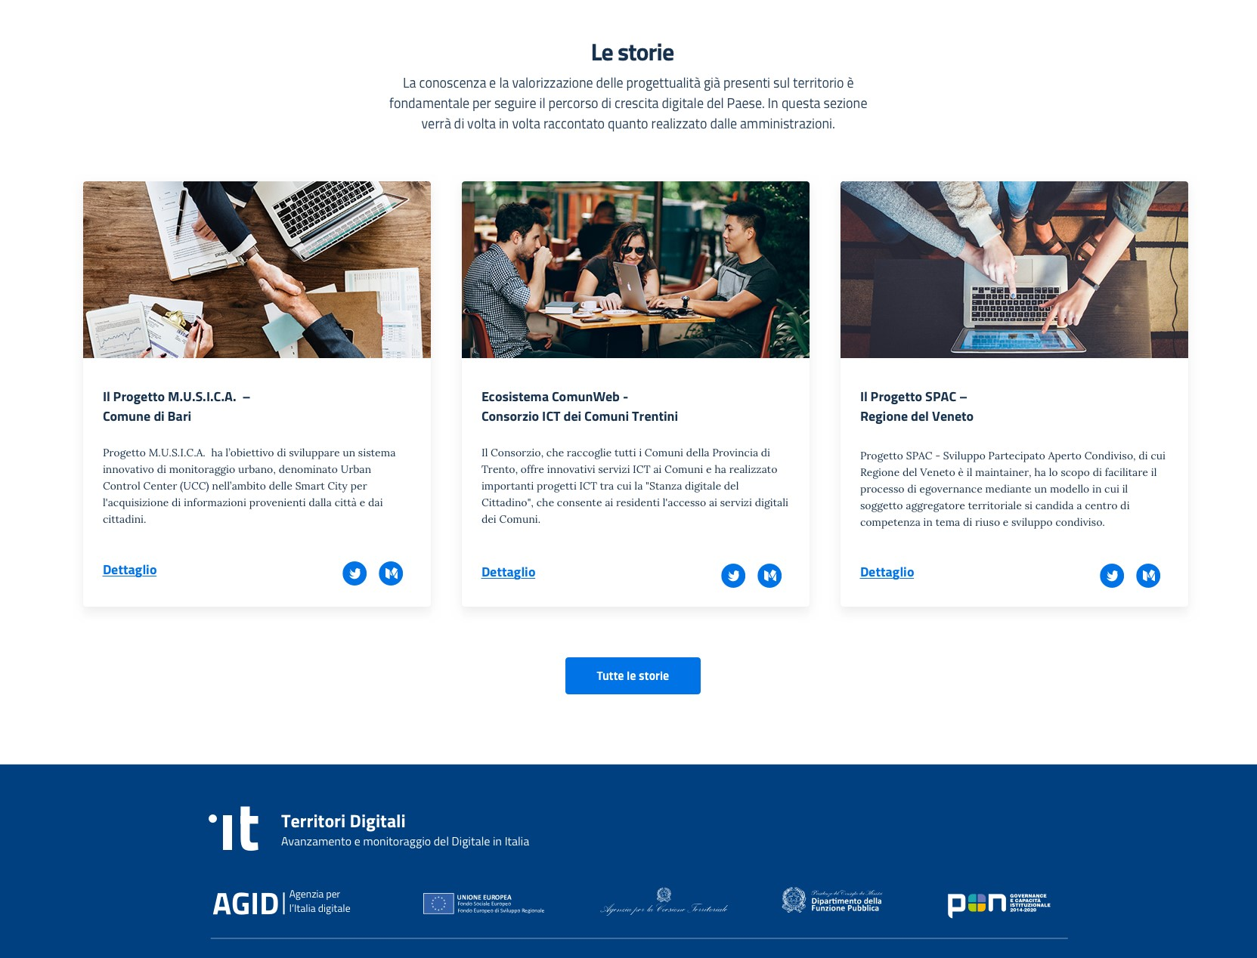
#TERRITORIDIGITALI – Stories and Tools

Slide 20
Link to AgID general web-site: http://www.agid.gov.it
Transparency Portal: http://trasparenza.agid.gov.it/
Open government websites:
http://www.dati.gov.it/
http://soldipubblici.gov.it/it/home
nicola.dechiara@agid.gov.it
ufficioprogettazionenazionale@agid.gov.it

