Slide 1
Some tentative thoughts on the potential effects of monitoring in STI policy
Barcelona, July 2019
Ismael Ràfols
Ingenio (CSIC-UPV), Universitat Politècnica de València
CWTS (Centre for Science and Technology Studies), University of Leiden
SPRU (Science Policy Research Unit), University of Sussex, Brighton, UK

Slide 2
Thinking about the potential effects of
Monitoring Science, Technology and Innovation
Summary of argument - some words of caution
Is Open Data on STI aligned with S3 goals?
  What type of data is available in OD STI activities?
  How is this related to S3 goals?
Monitoring has effects in policy (for good and bad)
  more focus on what is monitored
  less attention to what is NOT monitored
What is easy to monitor in STI with OD... is it also the most important??
DANGER → to focus on what in available data, not on core S3 goals
Notes:
It does not make sense to think about indicators without thinking about the uses of indicators.

Slide 3
Models of innovation

Slide 4
Three innovation frames (Schot and Steinmueller, 2018)
Linear model (postwar until 1980s)
  Science → Technology → Innovation → Well-being
  Input ($, people) and output (pubs, pats) indicators of STI.
Innovation Systems (early 1990s until late 2000s)
  Interactions between stakeholders are key to produce innovation.
  STI interactions → Innovation → Economic Growth → Wellbeing
  OECD Oslo Manual (1992)
Notes:
pp. 75 to 77 in Leach et al. (2010) Dynamic Sustainabilities.

Slide 5
Innovation, economic growth and well-being
  “There is a wide consensus that the disconnection between economic growth and well-being is increasing.
  At the same time research and innovation have become of the main engines of growth. However, these two orveraching trends have not yet been reconciled:
  there is a clear lack of explotaition of innovative solutions to address these social challenges.”
  OECD, 2011, 7-8 cited by Salazar et al. (2014)
  ‘this articulation [of economic and social development] is the basis for an equal, inclusive, and peaceful society’
  cited by Salazar et al. (2014, p. 143).
  “In terms of STI policy, (…) success usually requires following policies that are tailored to local economic and political realities rather than obeying the dictates of the international globalization establishment.”
  Dutrénit and Puchet (2014, p. 212)

Slide 6
Unspoken assumptions about the benefits of STI
STI policy:
  Knowledge from S&T leads to well-being
  State (e.g. universities or funding agencies) is benevolent
  Expertise serves the public good
However – instances of assumptions breaking down
  no agreement on benefits of innovation
    Focus of health research only in pharma, relative neglect of public health interventions?
  the state/admin can favour particular interests
    Focus on nuclear energy, relative neglect of other energy techs?
  experts’ views can be aligned with particular interests
    Not conspiracy -- capture by particular interests

Slide 7
Three innovation frames (Schot and Steinmueller, 2018)
Linear model (postwar until 1980s)
  Science → Technology → Innovation → Well-being
  Input ($, people) and output (pubs, pats) indicators of STI.
Innovation Systems (early 1990s until late 2000s)
  Interactions between stakeholders are key to produce innovation.
  STI interactions → Innovation → Economic Growth → Wellbeing
  OECD Oslo Manual (1992)
Inclusive or transformative innovation (2010s…)
  Attention to diverse types of knowledge
  Participation on directions/goals of research and innovation
    Alignment between STI goals and societal goals
RIS -- In theory, S3 is (3) regional interactions and participation
→ but is this captured in monitoring systems?
Notes:
pp. 75 to 77 in Leach et al. (2010) Dynamic Sustainabilities.

Slide 8
The parable of Prussian scientific forestry and the street-light effect

Slide 9
The parable of Prussian scientific forestry (Seeing like a state, J. Scott)
Forests in Old Prussia
Wild
Uncontrolled
Unpredictable
Inefficient
Enlightenment and Scientific forestry:
Cut the wild forest
Plant Norway spruce –reduce diversity
Increase yield and predictability
Loss of forest activities for peasants:
(fruits, hunting, medicinal herbs, etc.)

Slide 10
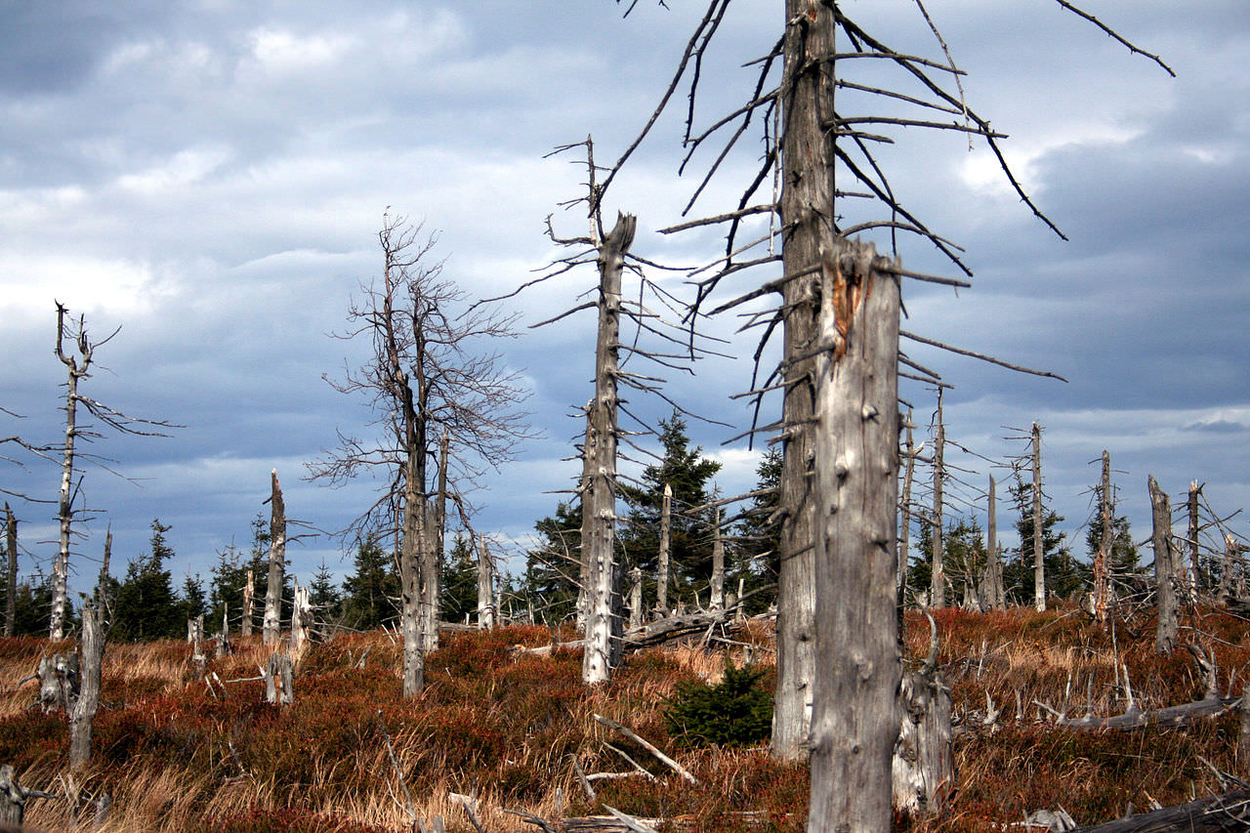
The parable of Prussian scientific forestry (Seeing like a state, J. Scott)
Monocultures and Forest death
Nutrient depletion leading to 20-30% production loss in 2nd generation
Storm felling
Pests due to loss of ‘services’ of insects, birds and animals.
Restoration forestry or forest hygiene:
Artificial ant colonies & spiders
Wooden boxes to provide bird nests
The dangers of dismembering a complex set of relations and processes to isolate a single element of instrumental value
Planning -- cities, agriculture, etc.

Slide 11
The parable of Prussian scientific forestry (Seeing like a state, J. Scott)
Task reduction
“Exaggerating only slightly, one might say that the crown's interest in forests was resolved through its fiscal lens into a single number: the revenue yield of the timber that might be extracted annually.. ”
Performativity
“Backed by state power through records, courts, and ultimately coercion, these state fictions transformed the reality they presumed to observe, although never so thoroughly as to precisely fit the grid.”

Slide 12
potential effects of mONITORING STI

Slide 13
Which type of indicators REALLY matter in S3 for non-high-tech regions?
Some indicators of the EU reg. innovation scoreboard 2017
Of questionable relevance in non-high-tech?
Most-cited publications?
R&D expenditure business sector?
Public-private co-publications?
PCT patent applications?
Direct relation to S3 insufficient unless sector is specified?
Lifelong learning?
Non-R&D innovation expenditures?
SMEs innovating in-house?
Sales of new-to-market and new-to-firm innovations?
(...)

Slide 14
Problems, STI and indicators
Space of problems
Space of STI
Space of STI
indicators

Slide 15
Problems, research, indicators and peripheries
Space of problems
Space of STI
Research
well illuminated
by indicators

Slide 16
Problems, research, indicators and peripheries
Space of problems
STI Peripheries:
STI spaces not
well captured
by indicators
Research
well illuminated
by indicators

Slide 17
Streetlight effect in indicators: mistaking light with “problems”
Space of problems
Problems and research
not well covered is not random:
Space of research
Automobiles in Baden-württemberg
Space of problems
Space of STI
Notes:
Add here:
This could be seen as a purely technical issue.
What is left out is not random – there is politics in exclusion.
We use the term peripheries not to scare the bibliometric community.
We should talk of marginalisation – there is active work.

Slide 18
Streetlight effect in indicators: mistaking light with “problems”
Space of problems
Problems and research
not well covered is not random:
Space of research
Food S&T in
Emilia-Romagna
Space of problems
Space of STI
Notes:
Add here:
This could be seen as a purely technical issue.
What is left out is not random – there is politics in exclusion.
We use the term peripheries not to scare the bibliometric community.
We should talk of marginalisation – there is active work.

Slide 19
Indicators make “peripheral” spaces invisible
Space of problems
Problems and research
not well covered is not random:
Space of research
Agriculture in València
Space of problems
Space of STI
Notes:
Add here:
This could be seen as a purely technical issue.
What is left out is not random – there is politics in exclusion.
We use the term peripheries not to scare the bibliometric community.
We should talk of marginalisation – there is active work.

Slide 20
Streetlight effect in indicators: mistaking light with “problems”
Space of problems
Space of research
Conflating space of
indicators with
...space of problems
...space of STI

Slide 21
Hypothesis: reduced indicator coverage may contract STI space
The societal activities dealt by STI that is under the streetlight effect are more likely to be rewarded
Reduced diversity of
STI efforts...
…reduced coverage
of societal needs
Space of problems
Space of STI
Space of STI
indicators
Potential
goal displacement

Slide 22
Demands for expanding role of STI in society…
Space of problems
Space of STI
Space of STI
indicators

Slide 23
Demands for expanding role of STI in society…
Space of problems
Space of STI
Space of STI
indicators

Slide 24
…may require expanded data sources
Space of problems
Space of STI
Space of STI
indicators

Slide 25
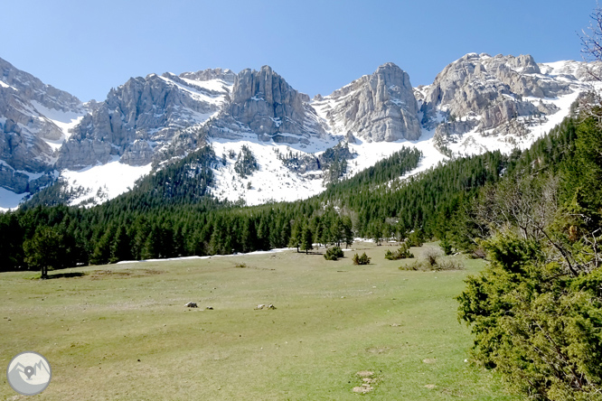
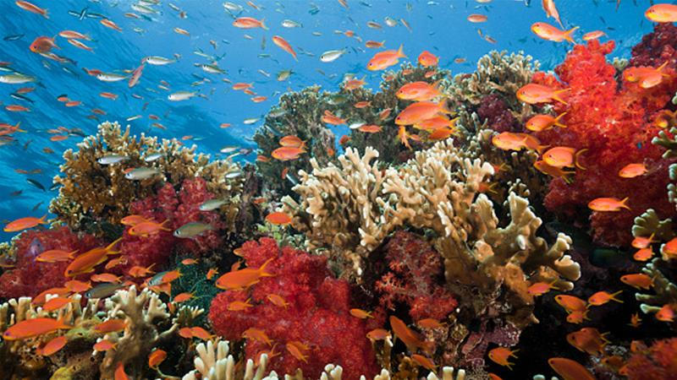
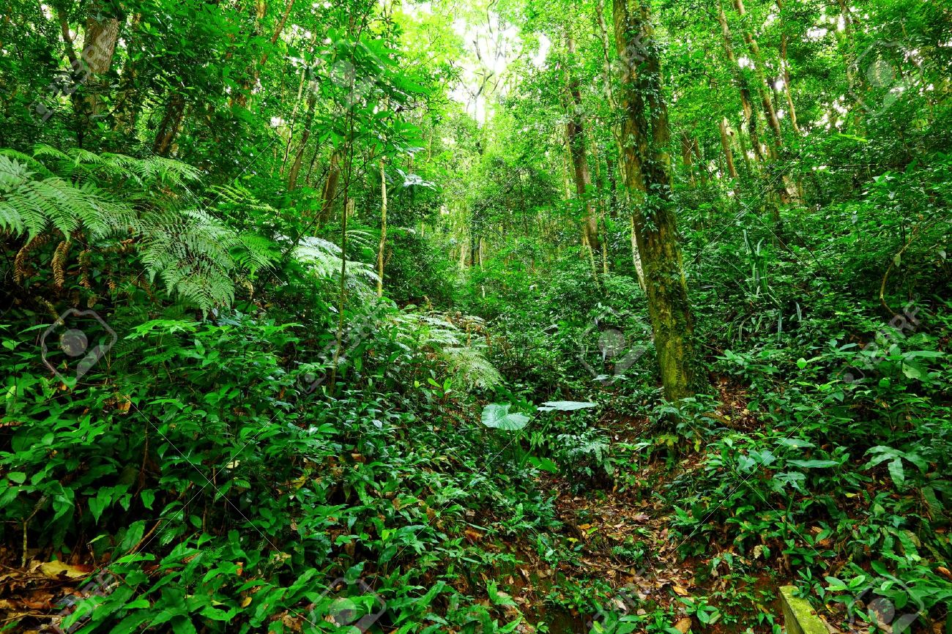

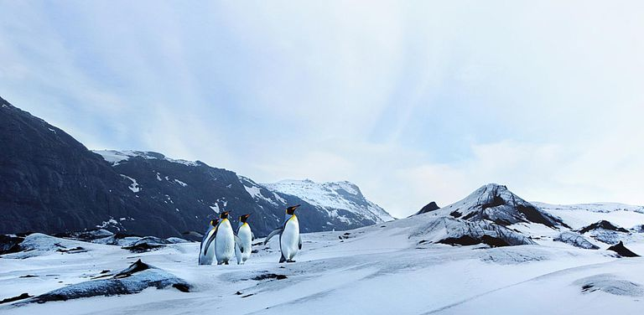
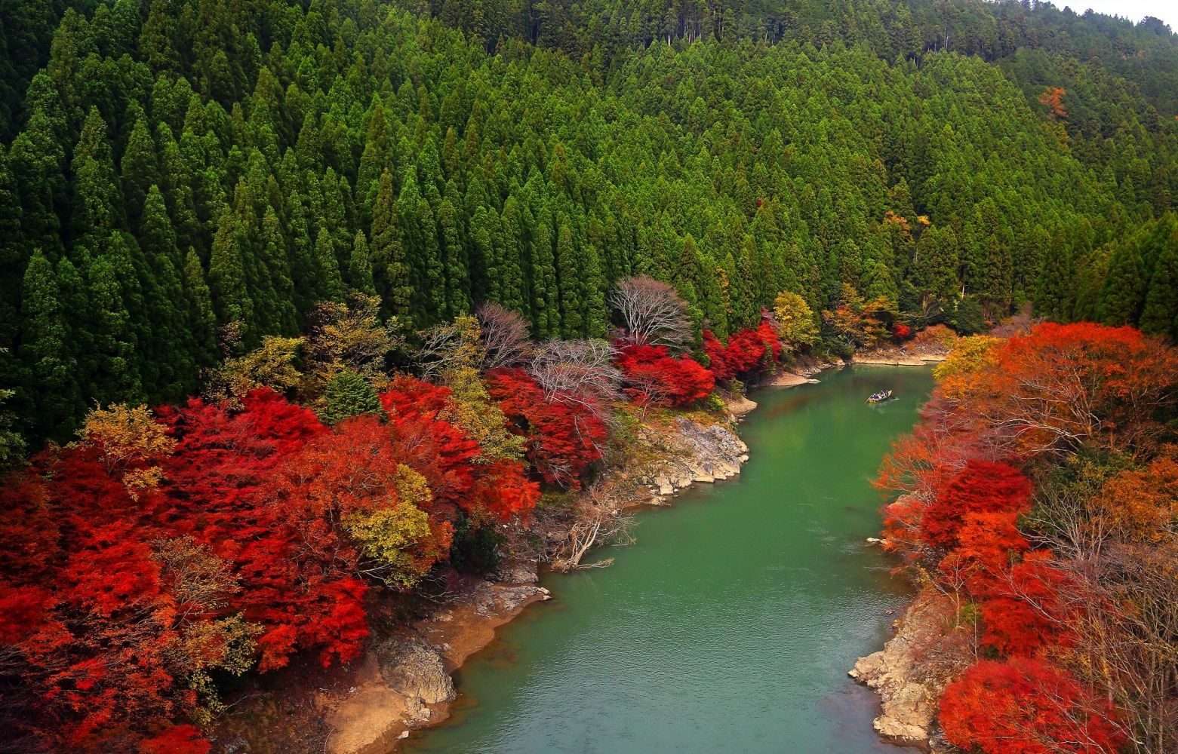
STI as a biosphere with dozens of diverse ecosystems

Slide 26
Which type of indicators REALLY matter in S3 for non-high-tech regions?
Measure what matters -- appropriateness of monitoring
-- From emphasis in measuring ‘formal R&D’ (univ. outputs, patents, etc.)
  assume linear model: Sci → Tech → Innov
  assume ‘formal’ linkages (univ. → Ind)
  do not align with more systemic and targeted S3 goals.
-- Towards mapping ‘innovation’ activities related to S3 goals
  scan formal R&D in topics related to S3 goals (projects)
  BUT need to experiment beyond -- but in Open Data now?
    Community Innovation Survey?
    Innovation in public sector?
    Training activities related to S3?
Slavo Radosevic and Esin Yoruk, “Why do we need a theory and metrics of technology upgrading? (2016)

Slide 28
Towards openness in STI monitoring
Openness in the inputs
  Taking into account diverse indicators
  Transparency → Supported by open data strategies
Openness in the outputs
  Develop visualisation toolkits that allow exploration of perspectives
  Systemic representations & directions (??).
  New ways of presenting indicators
Openness in the policy process (??)
  Develop new social processes on use and choice of indicators

Slide 29
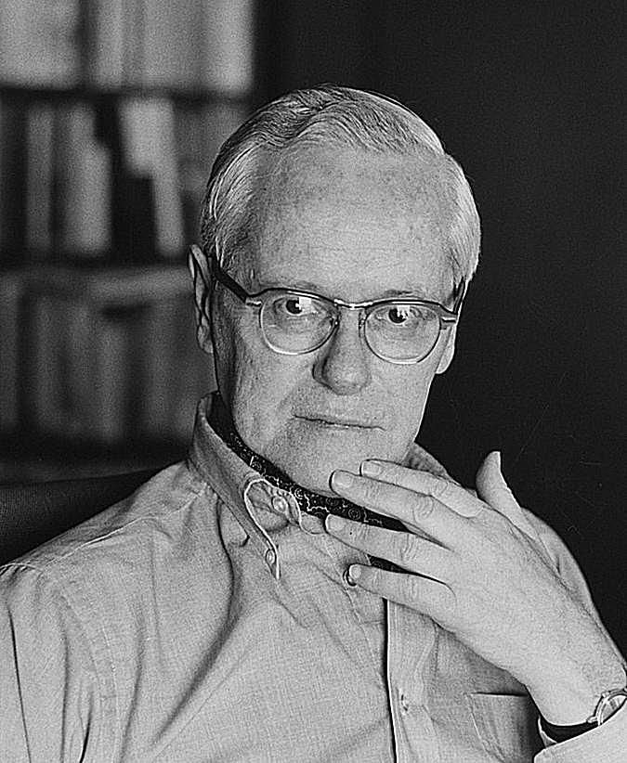
The values of (open) science
In 1942, Merton wrote about
the ‘aspirational’ values of science
-- recovered in Open Science discourse
Communalism (shared knowledge)
Universalism (all humans can participate)
Disinterestedness (public good)
Organised Scepticism (scrutiny & transpar.)
His argument was prompted by use of STI
in authoritarian regimes (1930s-40s):
His answer: Good science blossoms in pluralistic, democratic societies - where views can be questionned.
Contemporary dangers
  Suppression of rights and liberties,
  for migrants or minorities, dissent
  State and judiciary interference in academia
Technocratic orders vs. public good
Robert K. Merton
The normative structure of science
Notes:
RRI is about the citizens, in all their diversity, playing a bigger role in science, shaping science to desirable goals.
Niels gave the example of women participation in science – inverse relationship with country’s wealth.

Slide 30
Evaluations as learning processes
Participation in the evaluation process
  Develop new social processes of evaluation with broader participation of ’experts’ (including social stakeholders)
Diversity in perspectives
  Also through more diverse indicators
Deliberation on options of Direction
  Include exploration of preferred options/choices in deliberation

Slide 32
Uses of indicators: Pressing demands of research management and evaluation --- Can indicators help?
Yes, indicators can help make decisions…
  Reduce time and costs
  Increase transparency and sense of objectivity
  Reduce complexity, accessible to managers
  but do they lead to the “right” decisions?
Dominant missions:
*Academia – excellence *Innovation – economic growth
Missions not well covered: agriculture, public health, defence, development, social inclusion,…
often for populations in marginalised dimensions: geographic, social, linguistic
Notes:
It does not make sense to think about indicators without thinking about the uses of indicators.

Slide 33
Why indicators break down
Sources of misrepresentation | Indicators | Model | Property
Unstable Parameters | UNSTABLE | Correct | Relevant
Incorrect Model | Stable | INCORRECT | Relevant
Irrelevant Property | Stable | Correct | IRRELEVANT
Molas-Gallart and Ràfols (2018)
In practice there are often overlapping reasons -- this is an idealised description

Slide 34
Property of indicator is irrelevant
Indicator for research impact
Citations may be (or not) a correct indicator of academic quality.
BUT
If this is research funded by Health Dept (or Pharma)
The mission of research is to improve public health (Therapeutic innovation) not ‘academic quality’
Compare:
Reduction of disease burden (DALYs) relevant for health dept., but not pharma.

Slide 35
Model is incorrect
Indicators break down when model / assumptions do not hold
The use of citations as an indicator of scientific contribution is based on assumptions:
  Citations recognize a contribution to the reported research (Merton’s theory of recognition)
BUT
Citations have other uses (e.g. persuasion),
  When the assumptions break down (citation in not a cumulative contribution) citation are not CORRECT indicators (e.g. in humanities)

Slide 36
Indicators are not stable
The property may be relevant, the model holds,
but parameters vary across fields, language, topics...
Citations change over research areas.
  Citations need to be carefully normalised to compare like-with-like
  This is an UNSOLVED problem
    Web of Science Categories problematic (van Eck et al., 2012)
    Scopus categories... much worse (Wang and Waltman, 2016)
    Social robustness of article-level clusters is unclear
Multiple issues regarding comparison of topics / languages, etc.
Notes:
Wang, Q., & Waltman, L. (2016). Large-scale analysis of the accuracy of the journal classification systems of Web of Science and Scopus. Journal of Informetrics, 10(2), 347-364.

Slide 37
University stratification reflected in (pay) OA practices
Siler et al. (2018) -- study of OA pubs in global health:
-- “...authors working at lower-ranked universities are more likely to publish in closed/paywalled outlets, and less likely to choose outlets that involve some sort of Article Processing Charge (APCs).”
-- “.. .authors affiliated with high-ranked universities and well-funded institutions tend (...) to choose pay options with publishing.”
-- OA world stratification analogous to those entrenched in more traditional publishing and scientific hierarchies.
-- It follows:
  Indicators of OA may reflect resource availability
  OA indicators would become a further factor in Matthew’s effect
-- Likely to occur in other dimensions of OS -- e.g. OD

Slide 38
Open Science and the Capabilities Approach
Bezuidenhout, Leonelli et al., (2017) studied in African contexts
factors that inhibit the engagement of researchers with Open Data
-- Take into consideration of conditions in low-resourced settings, how scientists engage with data in daily practice.
-- Use Amartya Sen’s capabilities approach.
Do not focus on what researchers HAVE (OA, OD)
Focus on what researchers CAN DO, given resources & environment. “as the means of advancing their desired states of being and doing”
Re-framing:
  From “What OS resources are available?”
  To: “How can researchers effectively provide / utilize OS resources to realize their research goals?
OS resources are useless without capacity for active OS engagement

Slide 39
Indicators inspired on the Capabilities Approach
For research centres with limited resources, the main use of the indicator framework is about LEARNING what they can do.
Empowerment of researchers for engagement:
What are the options for OS given specific goals and local constraints?
Typology of research environment (broad institutional context)
  Funding, bureaucracy, int’l mobility, etc.
Indicators of OS capabilities (OS context)
Data generation: training, equipment, core funding
Data curation: training,
Data sharing: institutional policies, awareness of shared options
Indicators of OS practices:
Data generation
Data usage
Rather than a NPM competitive benchmarking fosters awareness of HOW to improve, via capabilites.
Inspired on Bezuidenhout et al. (2017)

