Slide 1



REGIONAL AND/OR NATIONAL PERSPECTIVES: Andalusia

Slide 2

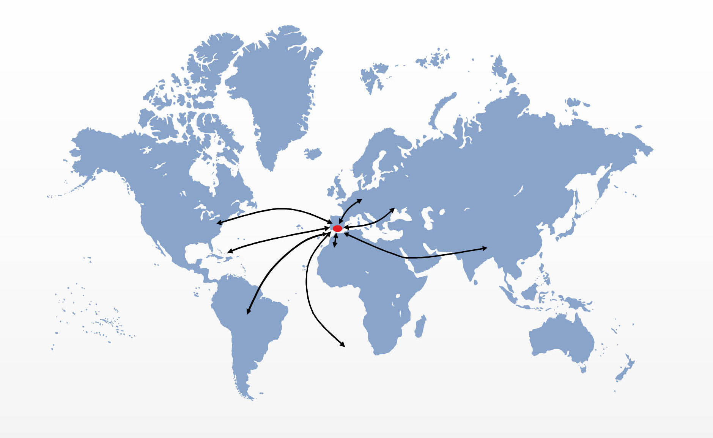
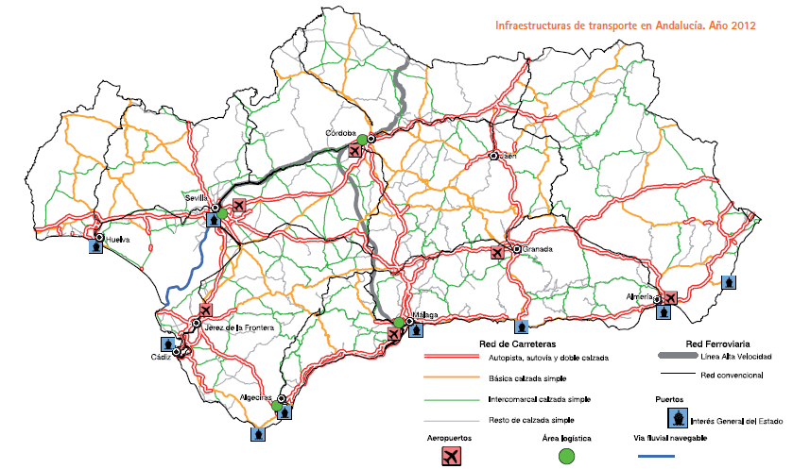
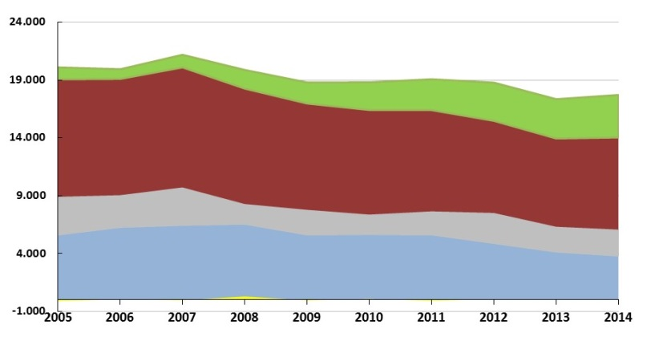
Energy: Regional context in Andalusia
Area
87.597 km²
Population (2014) 8.392.635
Nº of companies (2013) 472.370
83% qualified working population
34,2 % university graduates
Transition Region
Excellent communication networks
GDP 16.666 € pc (2013)
73% pc EU 27 (2011)
Total spending R&D /GDP 1,1%
Private sector 36,3 %
Primary energy (ktoe)
Andalusia has a very high potential of renewable resources due to its geographical situation, climatology and morphology.
The use of renewable energies has tripled in the last 10 years and currently contributes up to 20% of the total energy consumed.
Renewable
Oil
Coal
2
Natural gas

Slide 3
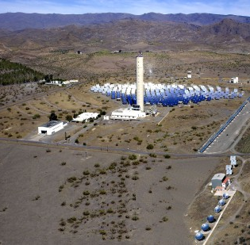
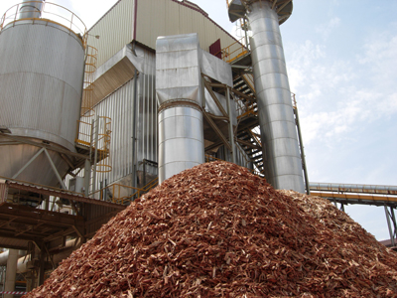
Energy: Regional context of Andalusia
Andalusia: Competitive Advantages
World leader in some areas and technologies of renewable energy, such as solar energy, biomass and biofuels.
Research centres of reference in these areas, such as the Solar Platform of Almeria - considered as one of the most important technological research centres in the world, biomass testing facilities, as well as the Solúcar Platform in Sanlúcar la Mayor (Seville).
Experience in the implementation of a wide set of programmes aimed at improving energy efficiency in construction, tourism and industry, with an important number of companies, some of them being leaders in their field.
Experience in the construction sector, with a high volume of skilled workers in the different industries linked to it and several centres and research groups with experience in the development of new material, such as multifunctional, ceramics or micronised marble that play an important role in knowledge transfer and technology with the sector.
The Andalusian energy sector has experienced an important growth of renewable energy in recent years which has generated a new business field. The sector as a whole is formed of more than 7,800 companies (17.4% in renewables) that generate 125,000 jobs (36.2% in renewables.)

Slide 4
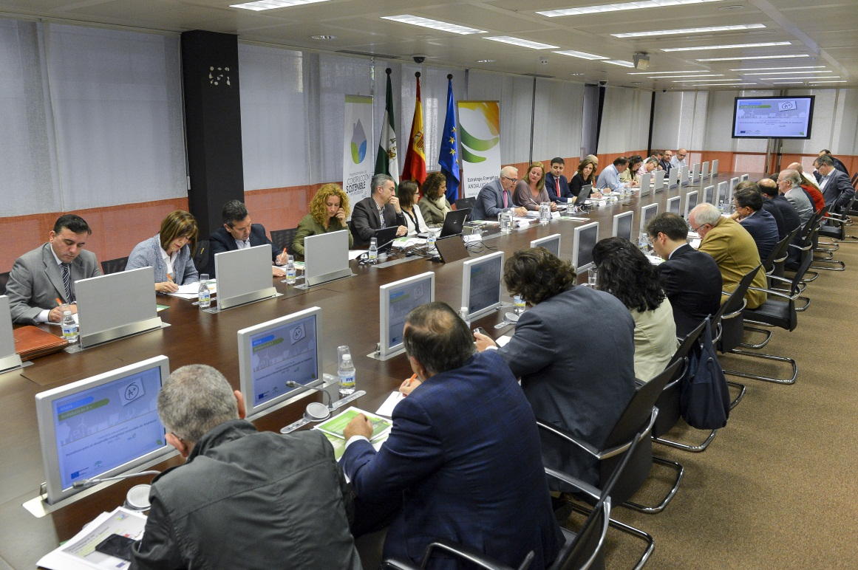
Smart Specialisation Strategy on Energy
Development of land and marine renewable energy
Renewable energy, energy efficiency and sustainable construction
Energy smart grids
High capacity systems of energy storage
Principle of governance
Energy efficiency in businesses, houses and institutions
Energy sustainability in rural areas
New construction designs and materials and sustainable processes

Slide 5





Regional Policy for a low carbon economy in 2014-2020
SMART SPECIALISATION
PLANNING
REGIONAL POLICY INSTRUMENTS
LOW CARBON ECONOMY

Slide 6
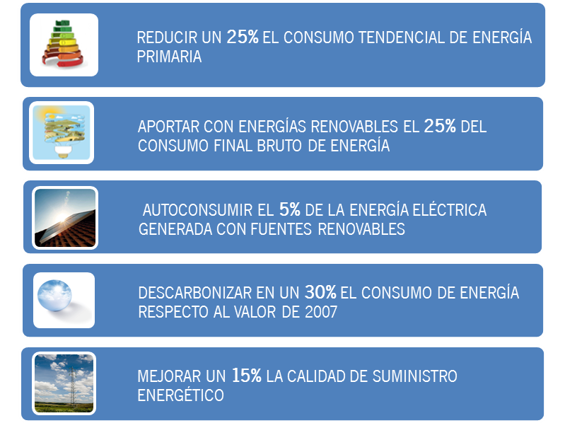
Regional Policy for a low carbon economy in 2014-2020
REDUCE BY 25% THE TENDENTIAL PRIMARY ENERGY CONSUMPTION
PROVIDE 25% OF FINAL GROSS ENERGY CONSUMPTION WITH RENEWABLE ENERGY
5% SELF-CONSUMPTION OF ELECTRICITY GENERATED WITH RENEWABLE SOURCES
DECARBONIZE THE ENERGY CONSUMPTION BY 30% COMPARED TO 2007
IMPROVE BY 15% THE QUALITY OF ENERGY SUPPLY

Slide 7
Energy and Innovation in the Regional Policy for a low carbon economy 2014-2020
Incentives for energy innovation and transfer of results
Dissemination and commercialisation of research results and promotion of technology transfer
Internationalisation of the Andalusian energy sector: improvement of the capacities of Andalusian companies to favour their presence in international markets
Innovation in energy technologies and increase in the potential and use of autochthonous energy resources
Roadmap for the development of biorefineries in Andalusia
Development of the hydrogen economy in Andalusia

Slide 8
Industrial Policy: objectives
Industrialise Andalusia
Increase industrial employment
Improve innovation in industry
Industrial internationalisation
Relational capital of the industrial system
More innovation
More and better companies
More and better quality jobs
More exporting companies and greater foreign investment
More cooperation and collaboration
Innovative manufacturing companies X 2
Raise the GVA in Andalusia to 18%
+ industrial employment
+ 20% exporting companies of the manufacturing industry with an export volume of more than 50,000 € annually
+ 50 % of companies in the manufcaturing industry with innovations in products or processes realised in collaboration
+ 20% innovation intensity of the companies with innovative activities of the industrial sector
+ 50% of GVA generated by mediuim and high technology activities
+ employment in advanced services
+ 20% amount of exports of manufacturing industries
+ 50 % number of national patent appplications
+ 20% of directivas companies in the manufacturing industry and in advanced scientific and technical services
+ 20% of manufacturing companies and industrial services of between 10 and 50 people
- 10% temporality
+ 50% of exports in mediuim and high technology activities
+ 100 % companies of the industrial sector incorporating into the digital market
- 5% energy intensity of Andalusian industry
-30% serious and fatal accidents
+ 30% FDI in the manufacturing industry and in the advanced scientific and technical services in the framework 2014-2020
8

Slide 9
Industrial Policy: AXIS AND ACTIONS
Efficient and competitive industry
(11 actions)
Facilitating technologies
(8 actions)
Innovative SMEs
(11 actions)
International vocation
(3 actions)
Education , talent and creative environment
(8 actions)
Social innovation Innovación social
(14 actions)
Networking
(13 actions)
Infraestructures
(7 actions)
75 horizontal actions
9

Slide 10
Energy and Innovation in the Industrial Policy
Energy R+D+i
43 Hybridization of energy sources
44 Smart energy storage
46 Prodution oriented at bioeconomy
Distribution
47 Smart Grid
48 Smart logistics in new hydrocarbons
49 Distribution grids
Auxiliary energy
50 Tractor integration for renewables
51 International expansion of renewables
52 Energy efficiency services and products
Chemical
54 Innovation in biorefiniries
55 Efficient chemical logistics
56 Energy efficient chemistry
57 Tractor integration for chemical industries

Slide 11
Industrial Policy: Governance
FORUMS
Private sector terrritorial or sectorial meetings
AGENTS: PRIVATE-PUBLIC COOPERATION
TECHNICAL ASSISTANCE
Technical Team
Technical Secretary
DG Industry, Energy and Mining
WORKING GROUPS
Private sector experts-public experts meetings
CO-DECISION COMMITEE
Andalusian Government
Andalusian trade Unions
Andalusian bussiness association
11

Slide 12
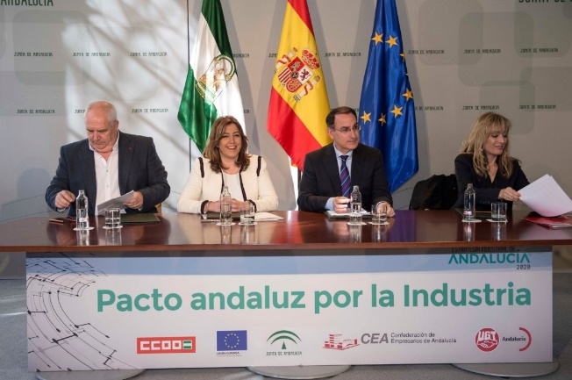
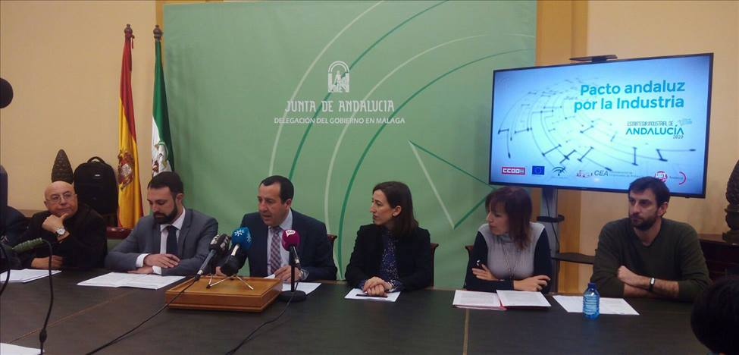
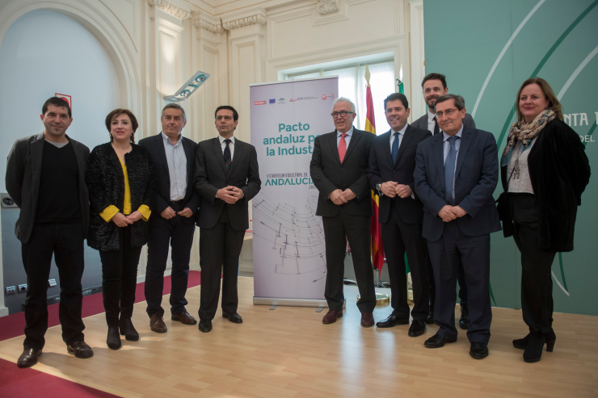
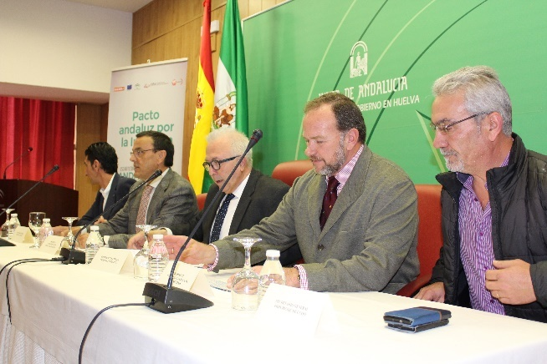
Industrial Policy: Governance
2015 professionals, companies and institutions adhered to the Andalusian pact for the industry
Huelva, 14 de febrero 2017
12

Slide 13
Regional Policy: Budget distribution
(by programmes and beneficaries)
  Need for concentration in the regional Operative Programme
Need to incorporate the following concepts:
  Specialisation and integration of the value chain
  Innovation, knowledge, added value
  Creation of quality employment
  Need for integration of policies to generate wealth: reindustrialisation

Slide 14
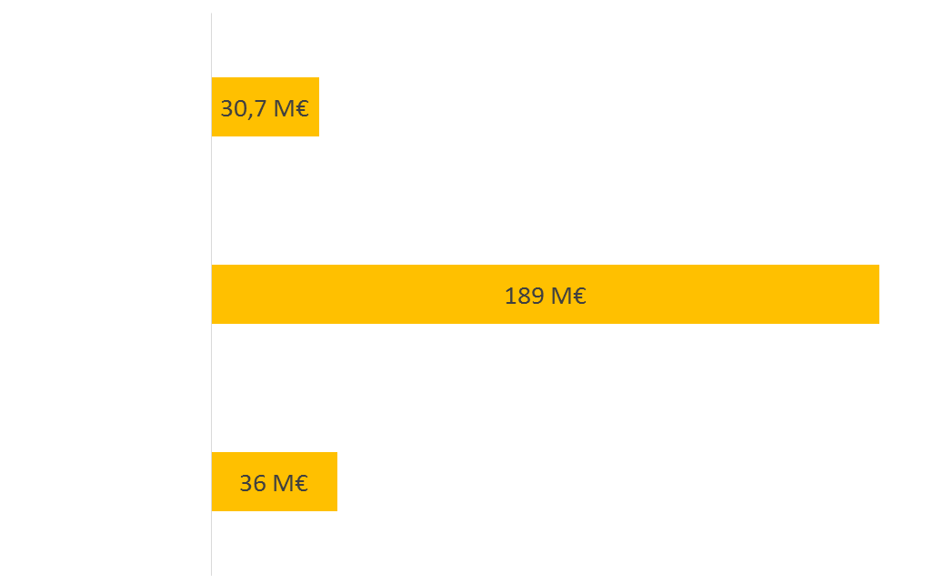

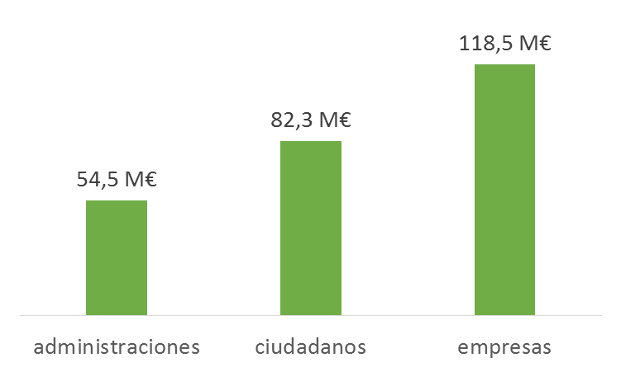


Regional Policy: Budget distribution
(by programmes and beneficaries)
255.3 M€
beneficiaries
programme
Public administ. Citizens Companies

Slide 15
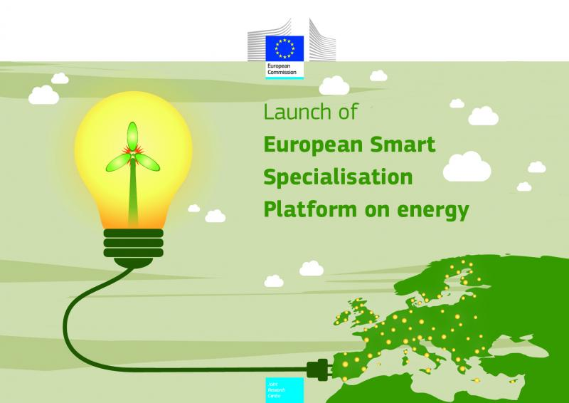
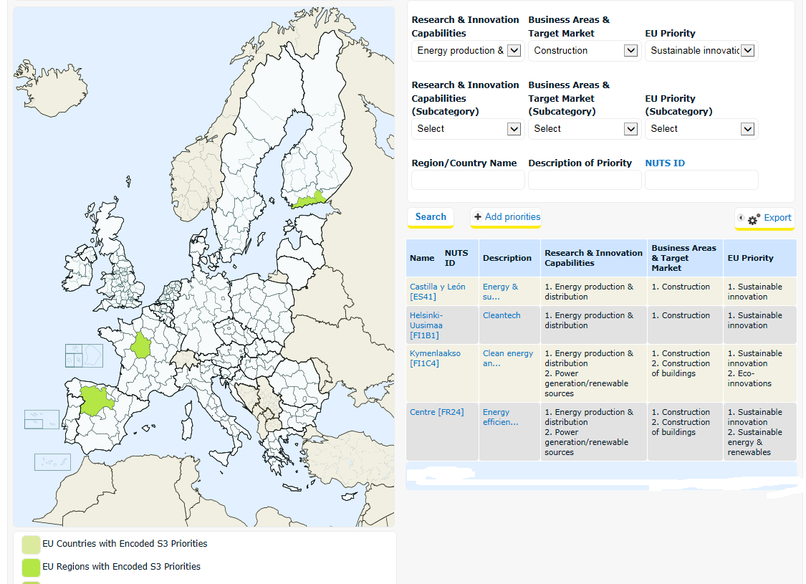
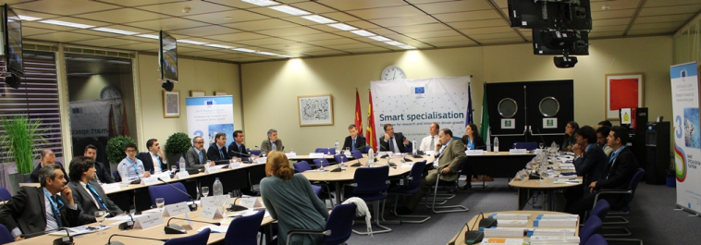
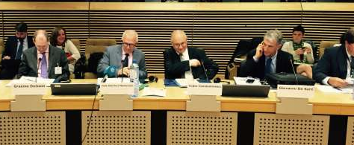
Why cooperation is important to better implement your RIS3 energy-related priorities?
Map of Smart Specialisation: Eye@RIS3
http://s3platform.jrc.ec.europa.eu/.
Towards a Model of Sustainable Construction and Energy Efficient Buildings.

Slide 16



European Partnerships in areas of interest for Andalusia
European Partnership on Advanced Materials for Batteries
22 European regions
15 countries
Wide support from the EC:
1 of the 6 strategic sectors
  Led by Andalusia, Castille and Leon and Slovenia
  Wide Andalusian representation: 23 entities involved
European Partnership on Sustainable Buildings
  Led by Andalusia
  1st pilot project selected by the EC: Smart Campus
53 European regions
23 countries
First Partnership promoted by the European Commission in energy
European Partnership on Heating and Cooling
  Led directly by the European Commission
  2nd pilot project selected by the EC: Network of networks
10 European regions
8 countries
Support to regions in their heating and cooling policies
The European Commission foresees allocating 1,000 M Euros to projects promoted in the framework of these Partnerships. Good positioning of Andalusia.

Slide 17
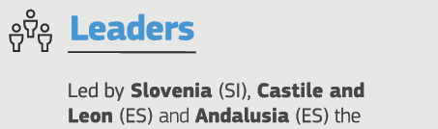
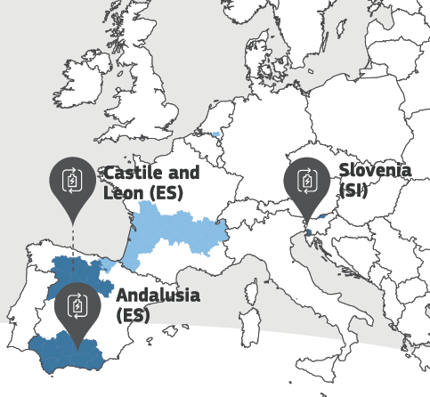
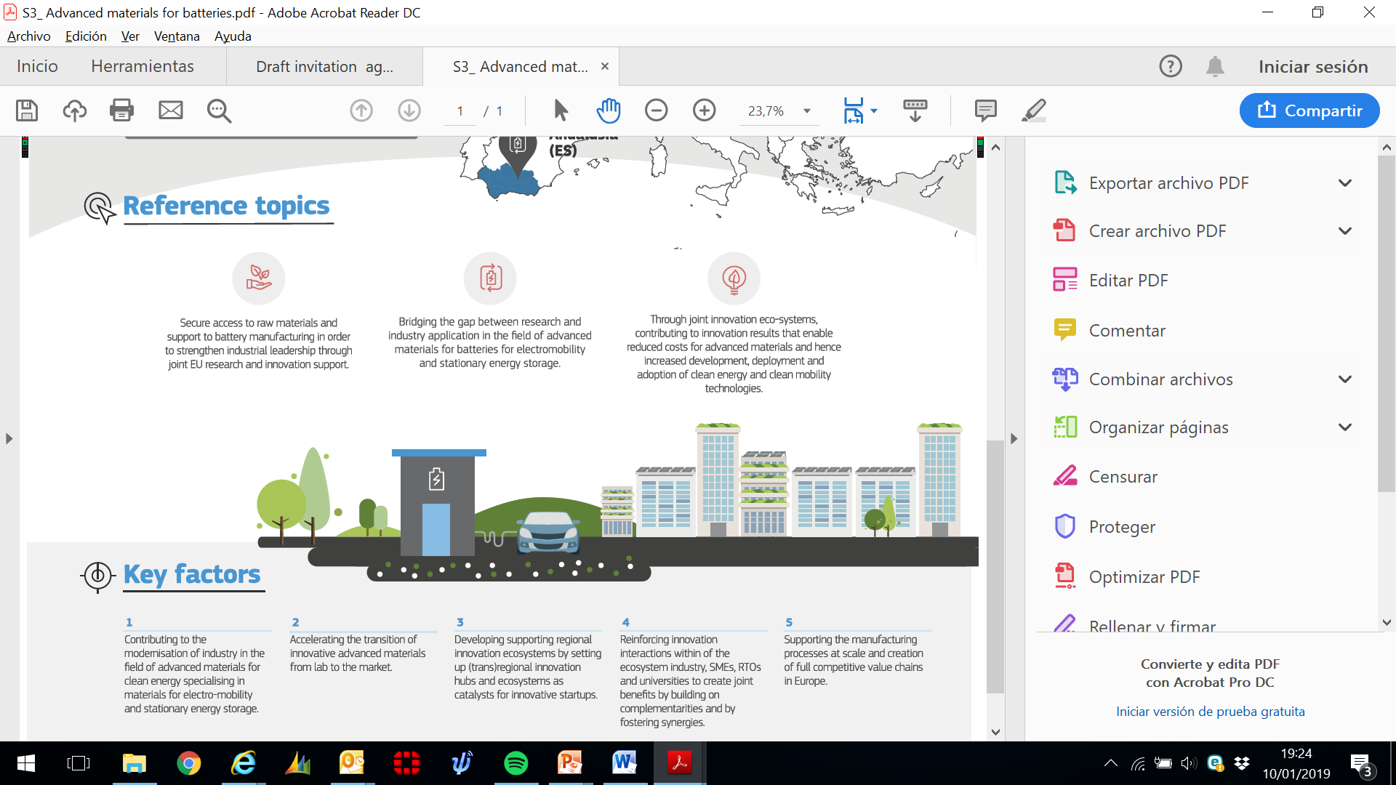
ADVANCED MATERIAL FOR BATTERIES PARTNERSHIP – AMBP
Main aim: develop joint R&D&I projects on advanced materials for application in the field of batteries for electric mobility and to improve the capacity and performance of stationary energy storage
Composition:
22 regions
Key elements:
Contribute to the modernisation of the industry in the field of specialised advanced materials for electromobility and stationary energy storage;
Accelerate the transition from the laboratory to the market;
Support the development of regional innovation ecosystems as catalysts for new innovative companies;
Strengthen interactions between industry, SMEs and universities based on complementarities and promoting synergies; and
Support industrialisation processes and the creation of complete competitive value chains in Europe.

Slide 18
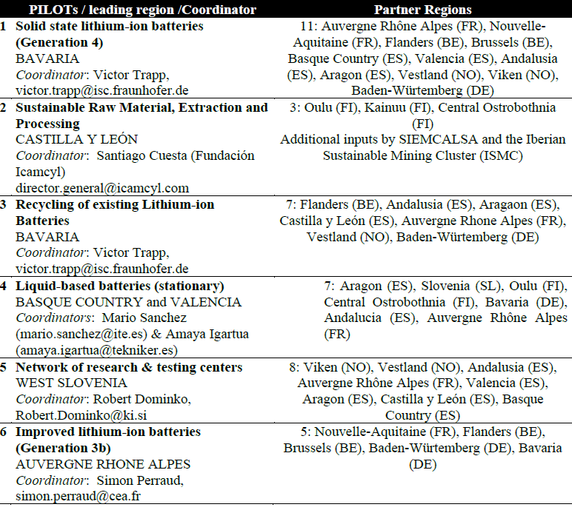
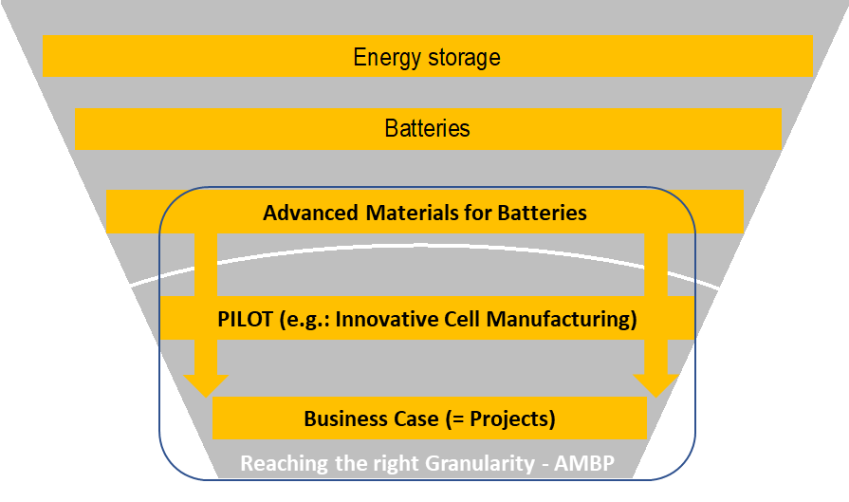
ADVANCED MATERIAL FOR BATTERIES PARTNERSHIP – AMBP

Slide 19
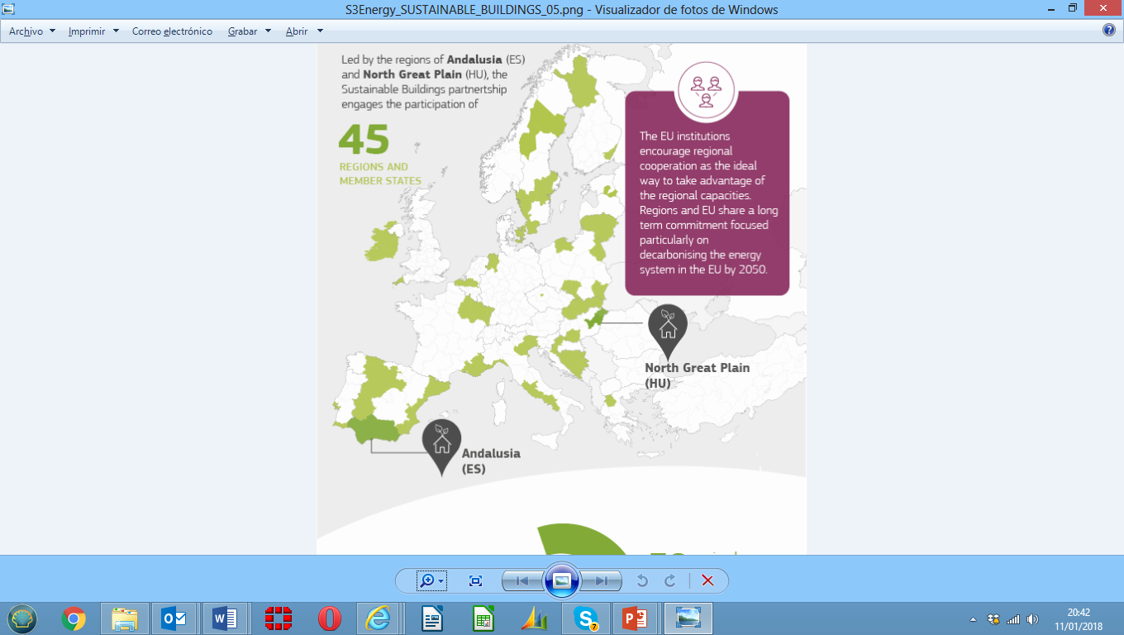
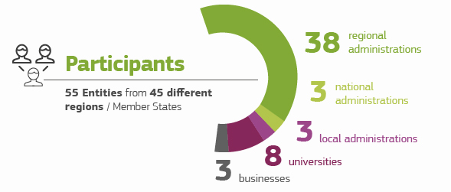
Sustainable Buildings Partnership
Leader | Andalusian Energy Agency, Spain
Co - Leaders | LENERG, North Great Plain Hungary and REGEA, North Croatia Energy Agency

Slide 20
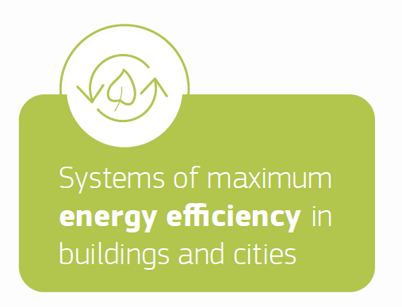
Sustainable Buildings Partnership
Scope: Areas of interest/work for the partnership
Topic 1: New materials with low carbon footprint Topic 2: Innovative constructive processes: light prefabrication of low-cost housing, advanced manufacturing for new construction elements Topic 3: Bioclimatic solutions based on green bio elements (in roofs, facades etc.)
Topic 1: Innovative solutions of high energy efficiency: evaporative cooling, LED lighting, micro-cogeneration.… Topic 2: Smart energy management systems and IoT Internet of Things : Topic 3: Advanced solutions for energy rehabilitation of historical heritage buildings
Topic 1: Climatisation with renewable energies Topic 2: Self-consumption and energy storage Topic 3: Low cost solutions aimed at vulnerable groups

Slide 21

Sustainable Buildings Partnership
Opening of collaboration business offers
Smart Campus Project:
Objective: improve the energy efficiency of University Campuses
Regions involved: Andalusia, LR (ES); Friuli Venezia Giulia Region, SC (IT); Algarve Region (PT); South Karelia (FI); Provence-Alpes-Côte-d'Azur (FR); Central Slovenia (SI)

Slide 22
Sustainable Buildings Partnership
Context:
Interregional Innovation Projects
The pilot action will accelerate
the work done within the TSSP
The focus will be on projects on higher TRLs (>5/6 TRL)
The results will feed the EC’s discussions for 2021-2027
Support from S3Platform and external experts
Learn
Connect
Demonstrate
Commercialise
Scale-up
Following a call for expression of interest in 2017
8 pilots were selected, with an addiional 9th Pilot in 2019
►3D Printing ► Bio-economy
► Cybersecurity ► De-&Re-manufacturing for circular economy
► High-tech farming ► Marine renewable energy
► Sustainable buildings ► Traceability and big data
► Batteries (from 2019)

Slide 23
Interregional Smart campus ecosystem
Sustainable Buildings Partnership
Smart Campus Ecosystem
Cross-regional Interface: Supporting exchange and development of technologies between campuses, agreement on governance structure, IPR, data sharing, etc.
Participating Campuses
Technological solutions
Ecosystem to transition technological solutions to market
University of Trieste
Real-time control and monitoring of electrical distribution grid
University of Udine
Smart Fancoil and ambients through IoT
University of Ljubljana
Intelligent Indoor Environment Quality (IEQ)
Business cases
Eco campus de Sainte Tulle
E-automated thermal comfort management
Investors
Aix Marseille University
Dynamic phase balancer
University of Malaga
Industry
Smart plugs
University of Algarve
Smart Charging of Electrical Vehicles
Clients
Lappeenranta
University of Technology
Solution Providers:
RTOs, Universities, Energy related companies, energy agencies, etc.
Green campus system
Testing and advacing Solutions

Slide 24
Thank you very much for your attention

