Slide 1
Climate agreement Industry sector and Mission Driven innovation Policy Netherlands
Goal: 19,1 Mton (35%) reduction in carbon emissions by 2030 and attaining a competitive edge by leading the transition towards sustainable industry
…and what we would like to learn from the JRC review
Sander Kes
Ministry of Economic Affairs and Climate, Netherlands

Slide 2
Policy context
Political climate goal: -49% in 2030 from 1990, all sectors
EZK role in governance of both climate policy, innovation and industry policy
Changing Topsector policy: societal challenges at the heart, following EU mission driven innovation approach

Slide 3
Climate agreement industry goal: emission reduction
Circular economy program: also resource security and value creation
Thematic mission driven innovation programs:
CO₂-free industrial heat system, Electrification and radically novel processes
Thematic mission driven innovation programs:
Circular Economy + Closing the industrial resource loop
Policy Instruments
Regional approach 5 major industrial clusters:
Coördination mechanism for systemic transitions,
includes Taskforce infrastructure and support for (re)training of technical personel
National Carbon Tax (+ ETS)
Obligatory Norms (IRR < 5 jaar: for rest of industry):
Market creation for emission reducing technologies (market-pull)
Innovation programs industry + Pilots en demo’s:
Bringing emission reducing technnologies to pre-commercial TRLs (tech-push)
SDE++ (feed-in subsidy) + EIA (tax bonus on investment)
Bringing down costs of technologies by scaling-up and learning-by-doing

Slide 5
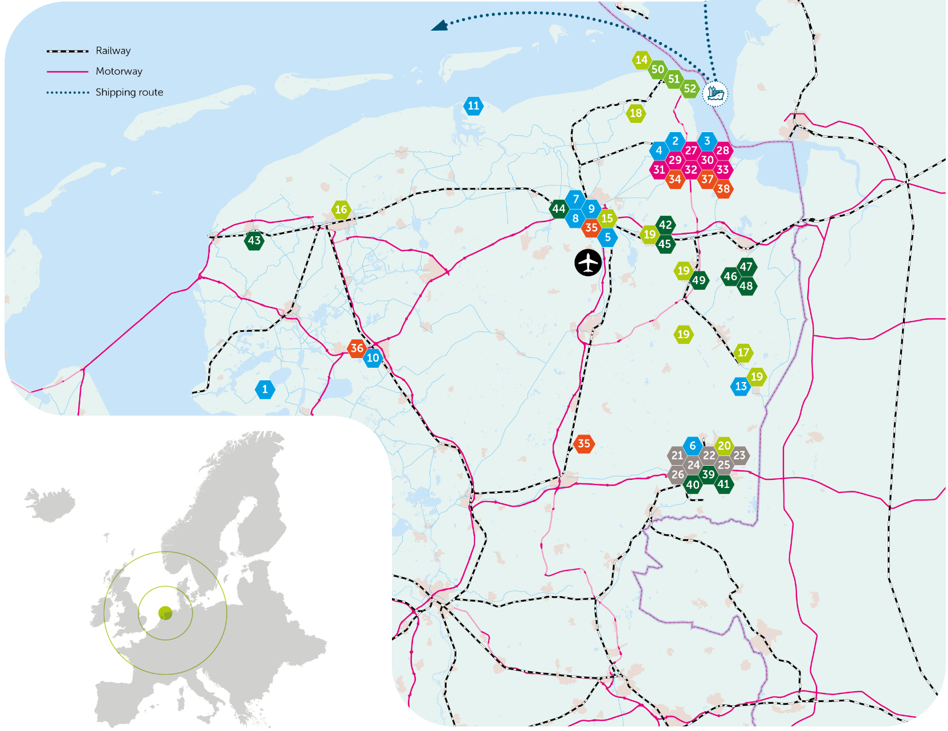
Integrated and connected
Connections
Businesses

Slide 6
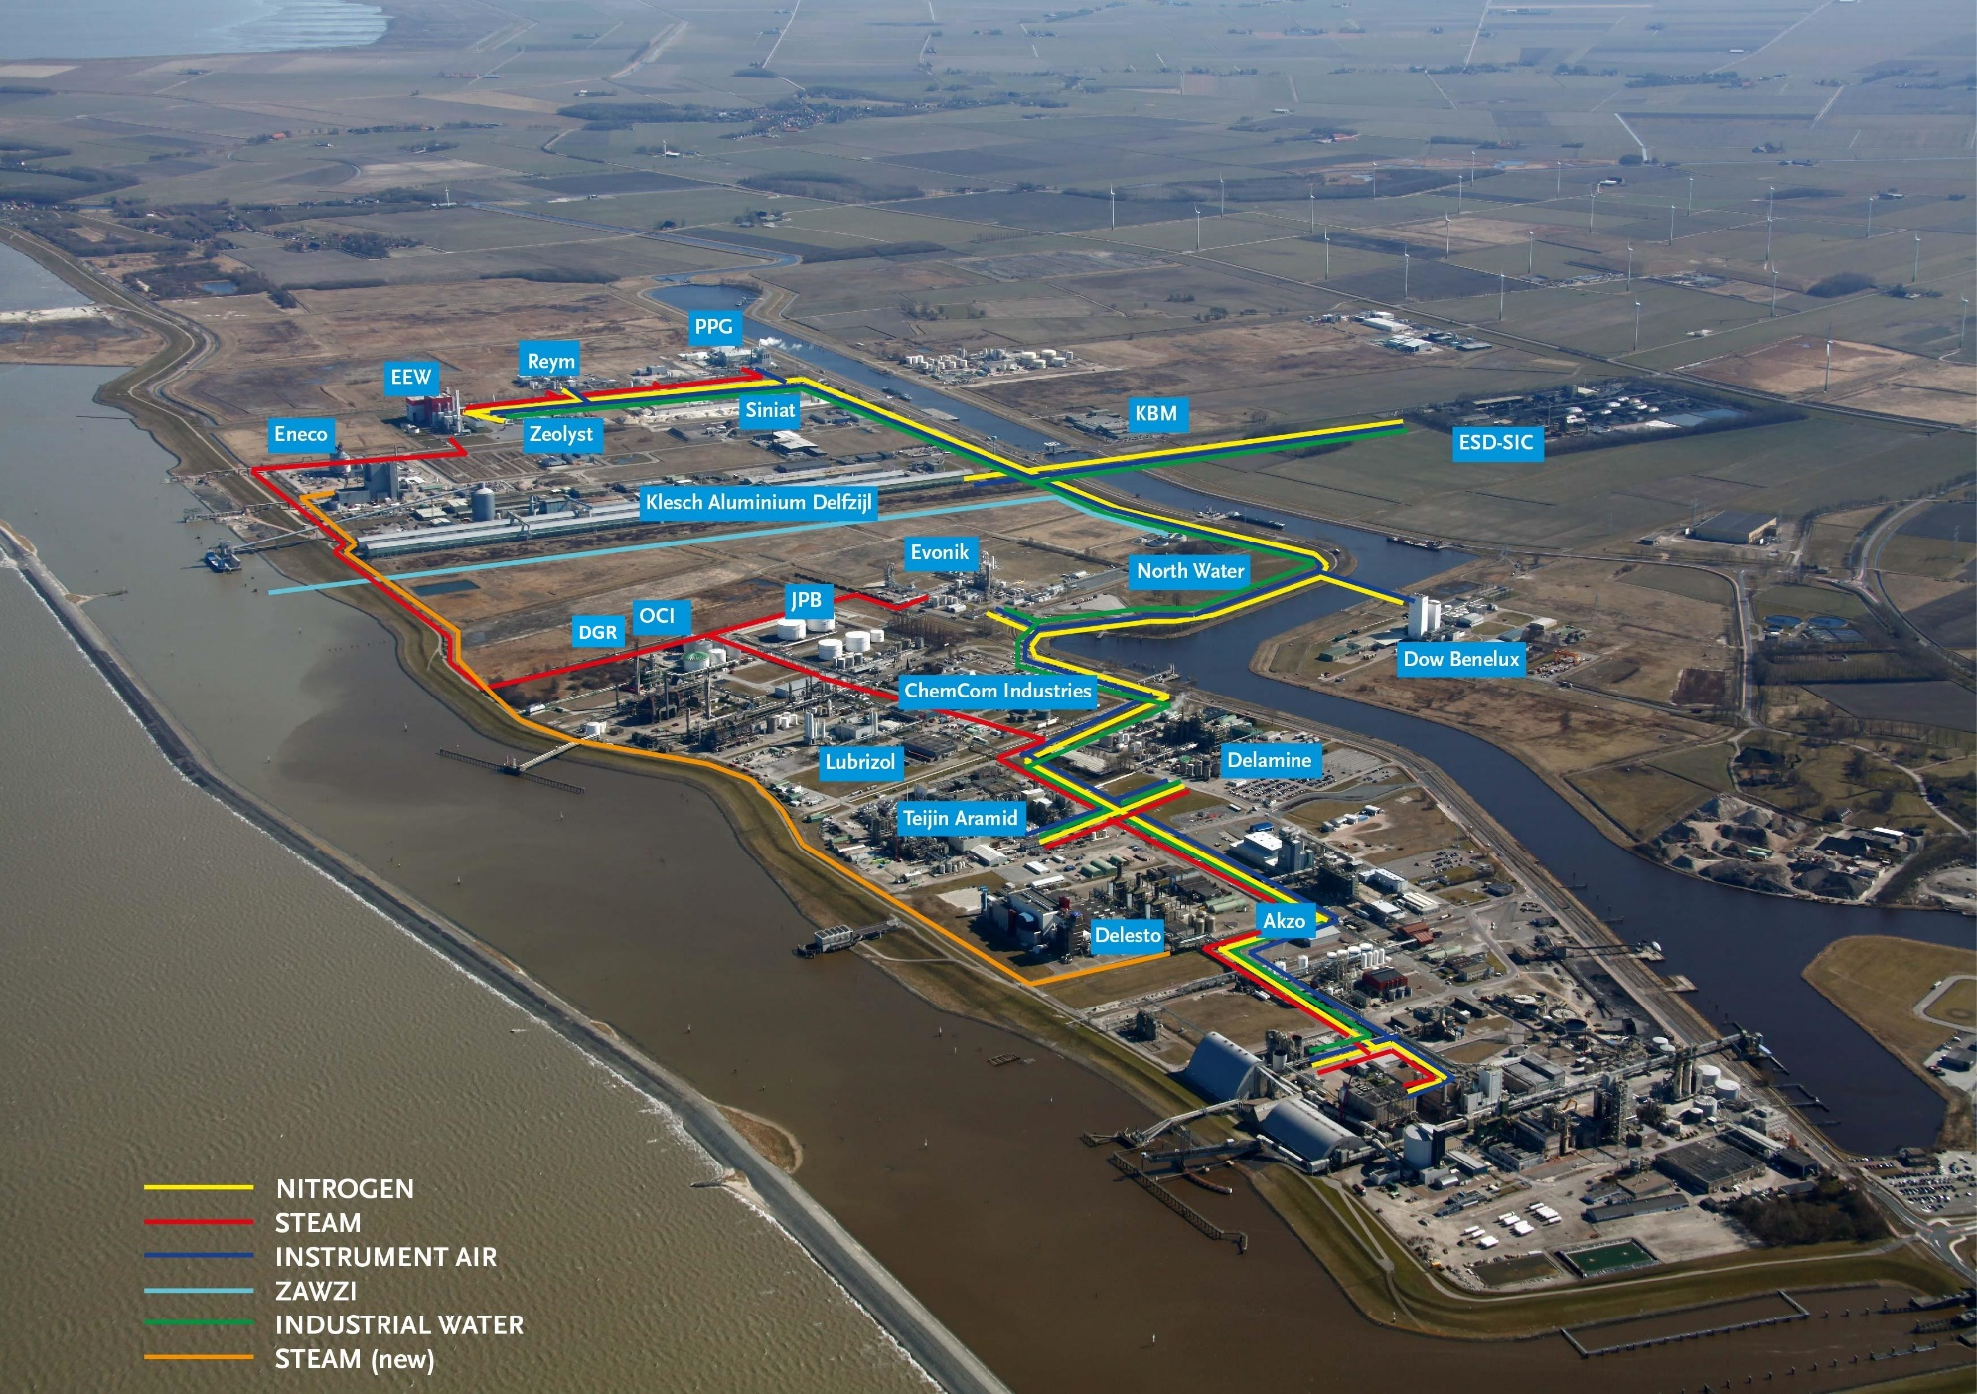
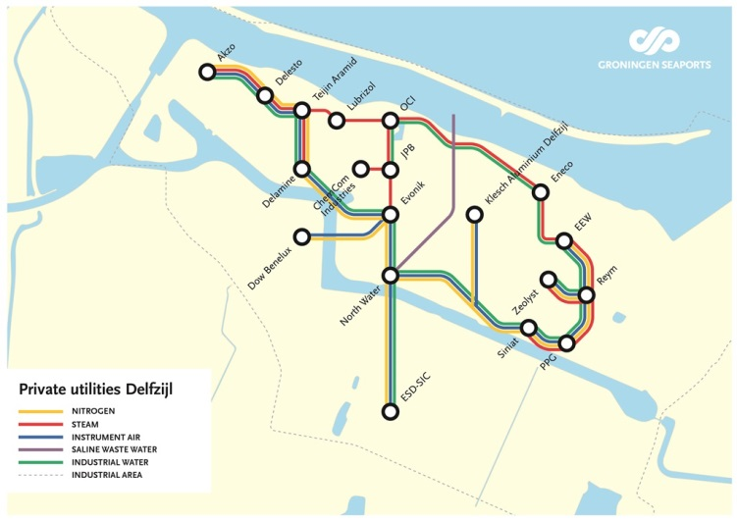
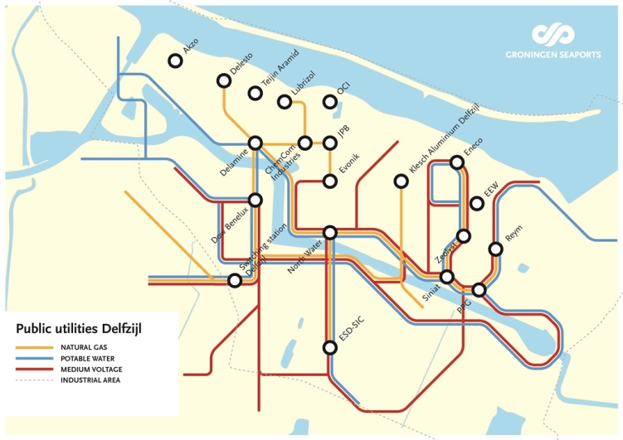
Utilities Chemical Cluster Delfzijl

Slide 7
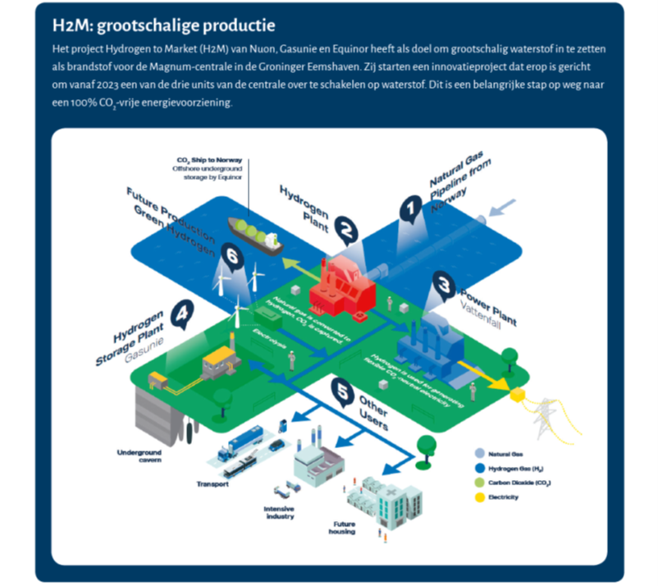
Hydrogen: future dominant core technology? Building on existing strength: natural gas resource and infrastructure

Slide 8
What do we hope to learn from the JRC review?
Feedback on the strategic report by the Industry Table Northern Netherlands (Dec. 2018). Specifically:
How to get started? Investment hold-up situation
Overcoming last stages TRL; moving from living lab initiatives to scale
Getting large companies with foreign owners on board
EZK role in governance with regard to industrial cluster transition
Learning from international experiences

