Slide 1
Providing R&D-related evidence towards re-industrialization strategies
^{National}
^{Documentation}
^{Centre}
^{Dr. Nikos Karampekios}
^{Head of RDI Analysis Unit}
Seville, 9 July 2019
"Understanding and Managing Industrial Transitions"
Inception and Review Methodology Validation workshop

Slide 2
Contextualizing the initiative (I)
Early 2019
As a response to Important Projects of Common European Interest – «IPCEI»
Participant: Greek Ministry of Economy and Development / General Secretariat for Industry
In reference to European-led Key Enabling Technologies – KETs
In need to pinpoint value chain ‘niches’ of high potential/worth
www.ekt.gr

Slide 3
Contextualizing the initiative (II)
Thematic areas’ selection – ‘macro-technological’ sectors
Batteries
Microelectronics
High-performance computing
Connected, clean and autonomous vehicles
Smart health
Low-carbon industry
Hydrogen technologies and systems
Industrial I.oT.
Cybersecurity
www.ekt.gr

Slide 4
Contextualizing the initiative (III)
Initiation of domestic, wide-ranging stakeholder engagement in order to point out national position on the above thematic priorities
In other words: attempt answering the question ‘‘where do we (Greece) exhibit qualitative traits within those ‘macro-technologies’ so as for the Greek government enhance/further incentivize/etc.’’.
EKT was part of this engagement
Cut short due to the elections
Meetings took place in relation to ‘Batteries’ and ‘Smart Health’
www.ekt.gr

Slide 5
Addressing the question – EKT’s take
www.ekt.gr

Slide 6
EKT – what is EKT? A bit of background information
www.ekt.gr
Indicators & statistics on RDI

Slide 7
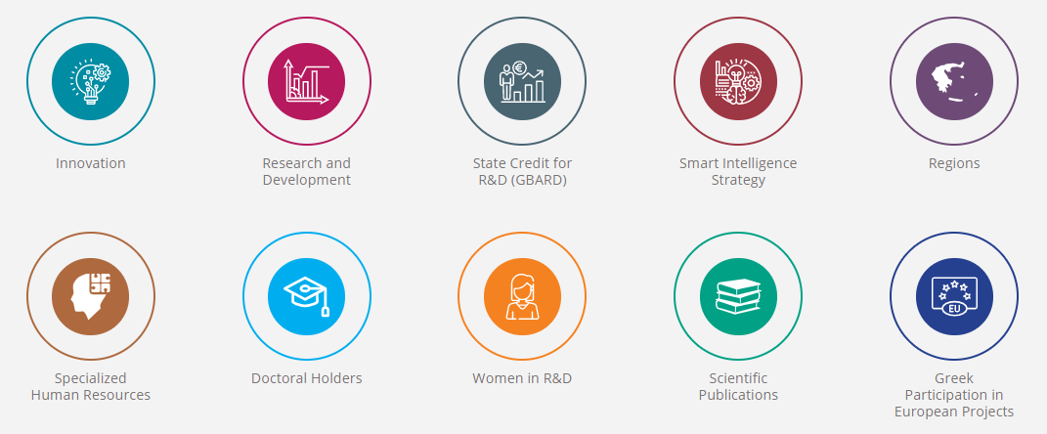
www.ekt.gr
Statistics on Research and Development (RD Statistics) for expenditure and personnel in R&D activities
Government Budget Appropriations or Outlays on Research and Development / GBAORD
Community Innovation Survey
Plus…
Human resources
Bibliometric indicators
PhDs
Research participation (grants, projects,…)
Etc.

Slide 8
Addressing the question – EKT’s take
How can we (EKT) enable this policy-making process as a metrics-abled organization?
Answer: by way of providing R&D-related evidence in those ‘macro-technologies’.
www.ekt.gr

Slide 9
The case of ‘Batteries’
What is ‘Batteries’?
A huge constellation of technologies and technological groups…
Back to the bibliography and EU policy positions
E.g. 17.5.2018 COM(2018) 293 final - Sustainable Mobility for Europe: safe, connected and clean
Barrios Vasquez, J. 2018. Current in the Energy Field 2014-2018: A Bibliometric Analysis of Scientific Trends, International Association for the Management of Technology, IAMOT-18, Conference Proceedings
Key – words identification
Technical and policy-related terms (as comprehensive as possible)
www.ekt.gr

Slide 10
Examples would include
design of battery cells and battery packs
manufacture of battery cells and battery packs
raw materials for battery cells and battery packs
Lithium-ion technologies (lithium, cobalt, nickel, manganese, graphite, silicon, copper and aluminium)
solid state technologies
battery management systems
battery cell manufacturing industry
supply chains for batteries raw materials
develop standards for battery cells and battery packs
battery chemistries
stationary energy storage
battery testing laboratories
life cycle for batteries
life cycle assessment scheme for batteries
(re-)use and recycling of batteries
second-use of advanced batteries
battery technology
electric vehicles
www.ekt.gr

Slide 11
Scimago journal and country rank
www.ekt.gr

Slide 12
Two tries
Publication search based only affiliation in both subject lists (wide net)
Publication search based on affiliation and selected terms in both subject lists
www.ekt.gr

Slide 13
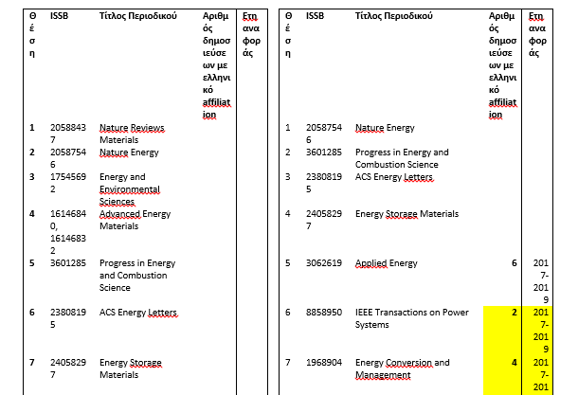
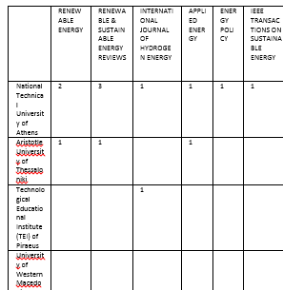
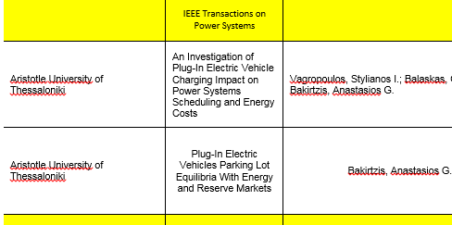
In the top-50 journals
No of pubs per year ; distribution per university ; details of authors

Slide 14
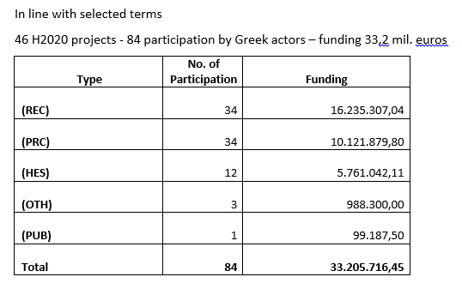
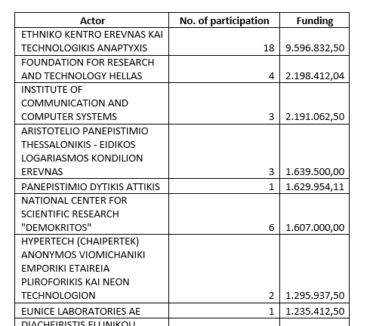
Participation in EU R&D Projects
ww.ekt.gr

Slide 15
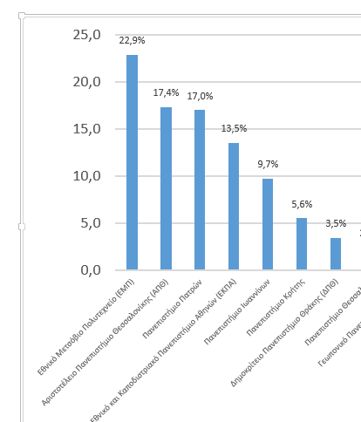
Greek PhD Holders
ww.ekt.gr
National Archive of PhD Theses
According to selected terms
Absolute number: 288 – distribution per year ; per university

Slide 16
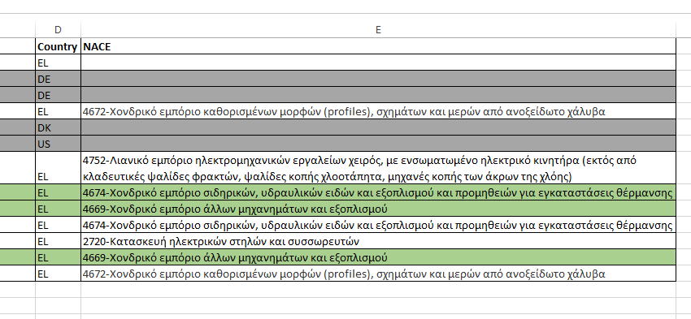
NACES – the case of 25.6V and 51.2V supply chain of a major battery systems company
ww.ekt.gr

Slide 17
What else?
Patents
New firms (registry)
Other populations of human capital (e.g. post-doctoral, research teams, PhD cand.)
Etc.

Slide 18
Where do we go from here?
Two-way street:
Waiting for the new government to keep up the re-industrialization strategy-setting initiative
Establishing an in-house IT infrastructure (‘A Statistical Information Portal’!)
(i.e. development of a single register infrastructure linking all information (from surveys; administrative data; kept in registries; etc.)
www.ekt.gr

Slide 19
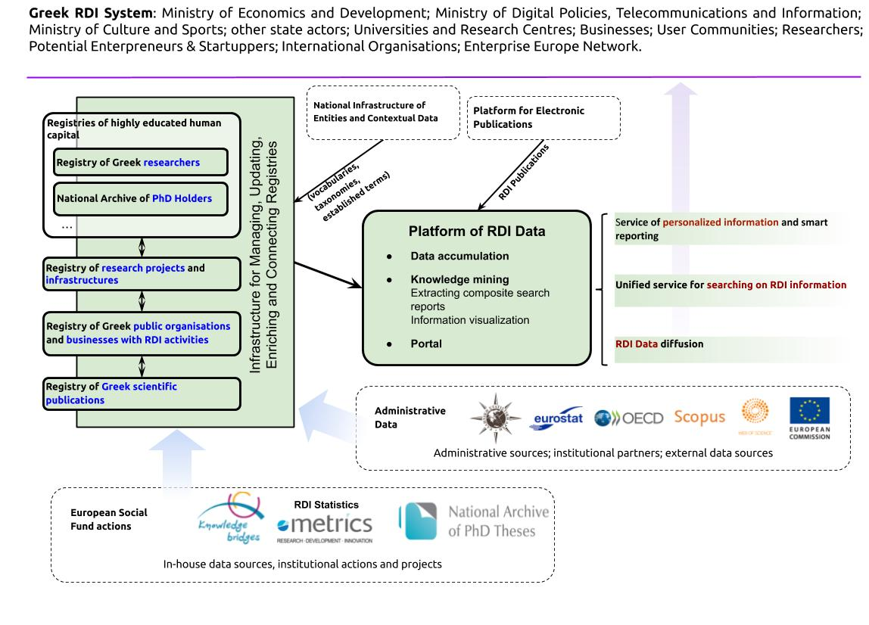

Slide 20
What we hope to learn from JRC
JRC’s Working Group "Understanding and Managing Industrial Transitions“ as a lesson-learning/feedback exercise!
www.ekt.gr
Notes:
Διεθνώς, η έμφαση είναι στην καλύτερη κατανόηση της καινοτομικής διαδικασίας, και πως αυτή προσδίδει ανταγωνιστικό πλεονέκτημα στην βιομηχανία. Προς την κατεύθυνση αυτή, απολύτως κρίσιμη είναι η ηλεκτρονική ψηφιακή υποδομή η οποία επιτρέπει την ομογενοποίηση των δεδομένων ΕΤΑΚ, καθώς και την εξαγωγή σύνθετων συμπερασμάτων. Πιο συγκεκριμένα, οι τάσεις των οργανισμών μετρικών ΕΤΑΚ είναι οι ακόλουθες:

Slide 21
Thank you
nkarampekios@ekt.gr
^{www.ekt.gr}

