Slide 1
POINT Reviews – Part 3
Matthijs Janssen

Slide 2
Step 3 in perspective
Current industrial configuration
Future industrial configuration
Ambition/Strategy
Region
Step 1
Current system components
Future system components
POINT
Step 4
(Actions)
Step 2
Step 3
(Vision)
Notes:
At some points: future society. But then unclear why solution would be locally produced. Thus: stick to upgrading, which is already complex.
System components are much like regime.
This session about Step 3: the vision (closely related to Future industrial configuration).

Slide 3
Brief reflection
Strength of the POINT approach:
Industrial Policy meets Transitions (“Holistic S3”)
Concern:
Where exactly do they meet?
(→ what kind of future should we envisage?)
Notes:
Interesting. Often opposed, but increasingly acknolwedged that spurring industrial change requires broad set of complementary public-private factors, just like in case of transitions. Both boil down to guiding collective public-privately backed socio-economic changes.
Also some unclarities on where scope of the study exactly lies. Therefore relevant for discussion, because it also presents some questions for methodology.

Slide 4
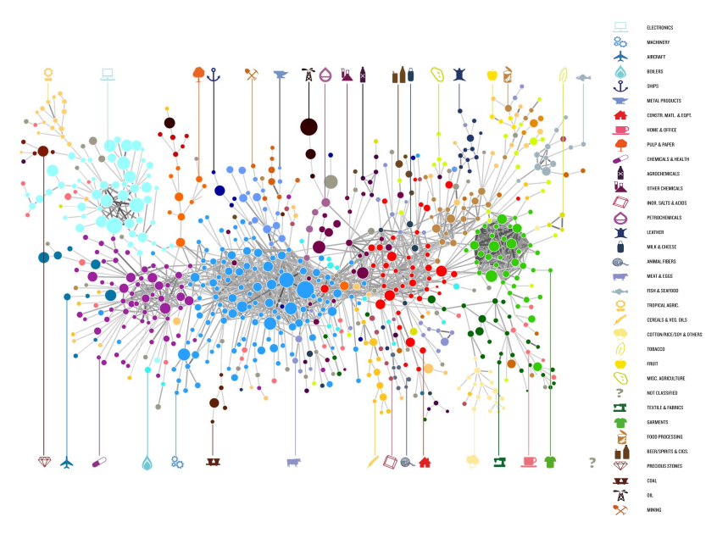
Industrial policy:
Diversifying into complex industries
Notes:
Much of the debate concerns which possibilities lagging regions would have to move towards more productive industries, given the endowment of capabilities, infrastructures etc. Route: diversify via related industries, or ambitions jump? Policy capabilities: how do regions learn which potential they have, and how can policy makers respond to such intellegence and facilitate by offering collective inputs, like research, infra or Human capital. What bottlenecks prevent growth? Exploration as joint public-private endeavour.

Slide 5
“Transformative” STI policy:
Collective and directed innovation
G
S₂
direction of search
S₁
S₁
S₂
B₁
B₂
G
G
B₁
B₂
B₁
B₄
B₃
= existing system
G
= government
B
= businesses
S
= stakeholders

Slide 6
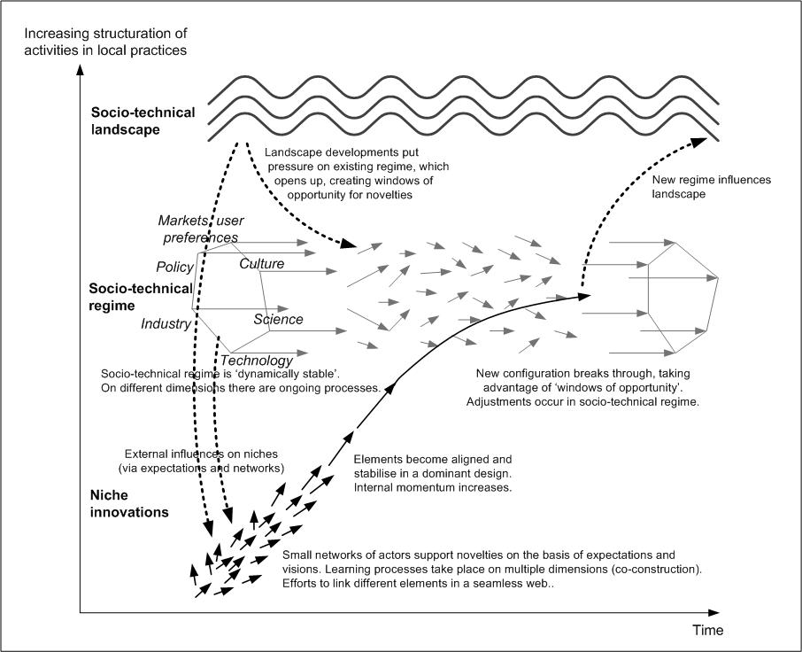

Transition policy:
Alligning complementary factors
S₁
S₂
G
B₁
B₄
Geels & Schot (2007)
Notes:
Theoretical foundations underlying the scope of the POINT study. Question: what is informing what?
What does this mean for methodology of the study; what could and should we be studying?

Slide 7
Questions on overall scope
Are we extending industrial policy strategies with transitions thinking, or are we applying transitions thinking in an industrial context?
What vision types will we find / develop (starting or end point of a transition?); how specific can step 3 ‘envisaging’ be?
Notes:
Visions for industrial policy with a transitions-twist. Or for transitions with an industrial policy topping?
- And if 2: diffusion approach?
“mention orders of magnitude in terms of human resources, investment”

Slide 8
Solving societal challenge
Current industrial configuration
Future industrial configuration
Ambition /
Strategy
Region
A
B
Current system components
Future system components
POINT
Step 3
Notes:
Focus on A or B

Slide 9
Discussion points
What is core of step 3 if ‘transition endpoint’ is known: do we mainly validate (e.g. complexity), improve, implement?
What if ‘transition endpoint’ is not known? What if ambition does not focus on a narrow ‘industrial theme’, but on informed ways of moving away from the present industrial configuration (or on solving a challenge)? More focus on governance (e.g. accountability, collectivity, leadership)?
Relevant to study how the directions/ambitions have been set? Who was involved in the process (policy, industry, science, …), are there ‘losers’, is there legitimacy, etc.?
To what extent should the to-be-developed vision draw on insights from stakeholders? What if there are discrepancies?
Notes:
Discussion points, mainly on: what ‘visions’ will we encounter / develop? I like to become creative, but would be helpful to know what are anticipating, or what situations/challenges are we addressing?
1. Framing doesn’t look for cases where governments want to roll out electronics or salmon farms, so isn’t mapping of ‘future system’ too much focused on a known endpoint?

Slide 10
Tasks in Step 3
a. Are there already elements of a vision for the territory codified in strategic documents by state actors or by other stakeholders? What is their current scope and degree of ambition?
b. How do various stakeholder constituencies envision the territory's future? What do they see as "low-hanging fruit" for quick gains, and what kind of other, more radical, connections and reconfigurations can they imagine if there was broader support?
c. Are there any areas in which the underlying science and technology is uncertain and the technological obstacles unlikely to be lifted within predictable timeframes?
d. Are there any (actually or potentially) complementary themes to the ones examined as part of Step 2? Could some outputs of one production system become inputs for another (as in e.g. the case of agricultural waste and fertiliser production)?
e. Can we envisage "missing" parts of the system with strong complementarities to the core elements of future sub-systems (orientation and planning, resource mobilisation, production and consumption sub-systems)? What would it take to "create" these missing parts? Can (some of) their functions be provided from outside the territory?
Notes:
Discussion points, mainly on: what ‘visions’ will we encounter / develop? I like to become creative, but would be helpful to know what are anticipating, or what situations/challenges are we addressing?
1. Framing doesn’t look for cases where governments want to roll out electronics or salmon farms, so isn’t mapping of ‘future system’ too much focused on a known endpoint?

Slide 11
From industrial and R&D policy to challenge-based (innovation) policy

