Slide 1
European Commission / Joint Research Centre Working Group “Understanding and Managing Industrial Transitions”: Inception and Review Methodology Validation workshop
Strategic Planning in Greece for the next decade
Sevilla, 9 July 2019

Slide 2
Outline of the presentation
Greece: A Growth Strategy for the Future
Planning of the Partnership Agreement 2021-2027
OECD Territorial Review: Regional Policy for Greece Post 2020
National Energy and Climate Plan

Slide 3
Greece: A Growth Strategy for the Future
The National Strategy for Sustainable and Fair Growth 2030 was published in July 2018 by the Greek Government. It was presented to the Eurogroup on April 27, 2018.
The strategy has incorporated the results of a broad and open round of consultations held on many levels, mainly through the process of Regional Development Conferences. It adopts a holistic way of planning and embraces the three dimensions (economic, social, and environmental) set out in the Sustainable Development Goals (SDGs).
In May 2019 the Greek authorities have proceeded to the 1st update of the Strategy.

Slide 4
Greece: A Growth Strategy for the Future
Five (5) pillars:
Ensuring Fiscal Sustainability
Fostering Sustainable Growth
Structural Conditions for Growth (infrastructure, networks, etc.)
Fair and Inclusive Growth
Financing Growth

Slide 5
Greece: A Growth Strategy for the Future
Pillar 2: Fostering Sustainable Growth
Creating More and Better Jobs
Enhancing productivity, innovation and competitiveness
Improving the business environment and boosting investment
Pillar 3: Fair and Inclusive Growth
Promoting the Social and the Circular Economy
….
Pillar 5: Financing Growth
The Development Law 4499/2016 provides incentives for private investments. Special financial support is provided to innovative SMEs.
…

Slide 6
Planning of the Partnership Agreement 2021-2027
The planning process of the Partnership Agreement (PA) 2021-2027 has begun. The Ministry of Economy and Development has already asked ministries, regions, socio-economic partners and civil society organizations to come forward with proposals on the guidelines for the preparation of the PA as well as the Operational Programmes. These proposals are expected to be submitted in September.
The official submission of the PA to the European Commission will take place in March 2020.
The official submission of the Operational Programmes to the European Commission will take place on 30 June 2020.

Slide 7
Planning of the Partnership Agreement 2021-2027
According to the Commission proposal, the majority (65%) of resources (EU support) will be concentrated on contributing to the policy objectives which evaluation evidence and the impact assessment suggest have the highest added value, as well as the greatest contribution to EU priorities:
Policy Objective 1:"a smarter Europe by promoting innovative and smart economic transformation“ (35% of resources i.e. 3.578 M€);
Policy Objective 2: "a greener, low-carbon Europe by promoting clean and fair energy transition, green and blue investment, the circular economy, climate adaptation and risk prevention and management" (30% of resources i.e. 3.067 M€).

Slide 8
Planning of the Partnership Agreement 2021-2027
Good governance of national or regional smart specialisation strategy is an enabling condition for the Policy Objective 1.
Fulfilment criteria for the enabling condition
Smart specialisation strategy(ies) shall be supported by:
Up-to-date analysis of bottlenecks for innovation diffusion, including digitalisation
Existence of competent regional / national institution or body, responsible for the management of the smart specialisation strategy
Monitoring and evaluation tools to measure performance towards the objectives of the strategy
Effective functioning of entrepreneurial discovery process
Actions necessary to improve national or regional research and innovation systems
Actions to manage industrial transition
Measures for international collaboration.
It is therefore necessary to design new national / regional smart specialization strategies.

Slide 9
OECD Territorial Review: Regional Policy for Greece Post 2020
The Greek Government (Ministry of Economic and Development) and the European Commission (under Regulation (EU) 2017/825 on the establishment of the Structural Reform Support Programme) have engaged the OECD to develop a Territorial Review on “Regional policy for Greece post 2020”. The OECD methodology for Territorial Reviews can provide key public and private stakeholders with an independent and internationally recognised diagnostic of key trends, challenges and untapped opportunities, as well as recommendations on policies, strategies, planning, multi-level governance and resource allocation, based on successful experience in other OECD countries.

Slide 10
OECD Territorial Review: Regional Policy for Greece Post 2020
The Review will address four key aspects:
Socio-economic trends, growth potential and underexploited resources
Policies and strategies for development and inclusive growth
Multi-level governance for Regional and Cohesion policy
Capacity for Regional and Cohesion policy programming and implementation

Slide 11
National Energy and Climate Plan – targets (2030)
REDUCTION OF GHGs EMISSIONS AND ENVIRONMENTAL TARGETS
Reduction of GHGs emissions (non-ETS) vs 2005 | > 16%
Reduction of GHGs emissions (ETS) vs 2005 | > 43%
Reduction of other gases’ emissions (SO_{2,} NO_{X,} etc)

Slide 12
National Energy and Climate Plan – targets
SHARE OF RENEWABLE ENERGY SOURCES | 2016 | 2030
Share of RES in gross final energy consumption | 15,23% | >31%
Share of RES in the heating and cooling sector | 24% | >30%
Share of RES in the gross final consumption of electricity | 23,8% | >56%
Share of RES in the transport sector | 2% | >14%

Slide 13
National Energy and Climate Plan – targets 3/3
ENERGY EFFICIENCY | 2016 | 2030
Primary energy consumption (Mtoe) | 23,6 | <25
Final energy consumption (Mtoe) | 16,7 | <18,1
Cumulative amount of energy savings 2021-2030 (Mtoe) |  | >7
Renovation of the public buildings* (% of the total floor area per year) *Buildings of central public administration. |  | 3%

Slide 14
Measures of the National Energy and Climate plan in all six thematic dimensions
RES
9 POLICY PRIORITIES
LEGISLATIVE MEASURES
ECONOMIC MEASURES
TECHNICAL MEASURES
EE
8 POLICY PRIORITIES
LEGISLATIVE MEASURES
ECONOMIC MEASURES
TECHNICAL MEASURES
GHGs
8 POLICY PRIORITIES
LEGISLATIVE MEASURES
ECONOMIC MEASURES
TECHNICAL MEASURES
Security of supply
4 POLICY PRIORITIES
LEGISLATIVE MEASURES
ECONOMIC MEASURES
TECHNICAL MEASURES
Energy Market
5 POLICY PRIORITIES
LEGISLATIVE MEASURES
ECONOMIC MEASURES
TECHNICAL MEASURES
R&I , competitiveness
10 POLICY PRIORITIES
LEGISLATIVE MEASURES
ECONOMIC MEASURES
TECHNICAL MEASURES

Slide 15
In conclusion
The timing is ideal for integrating the results of the work of the working group “Understanding and Managing Industrial Transitions” in the national strategic plans and operational programmes.
«Οι καιροί ου μενετοί» (Θουκυδίδης)
“Τhe times do not wait” (Thucydides)

Slide 16
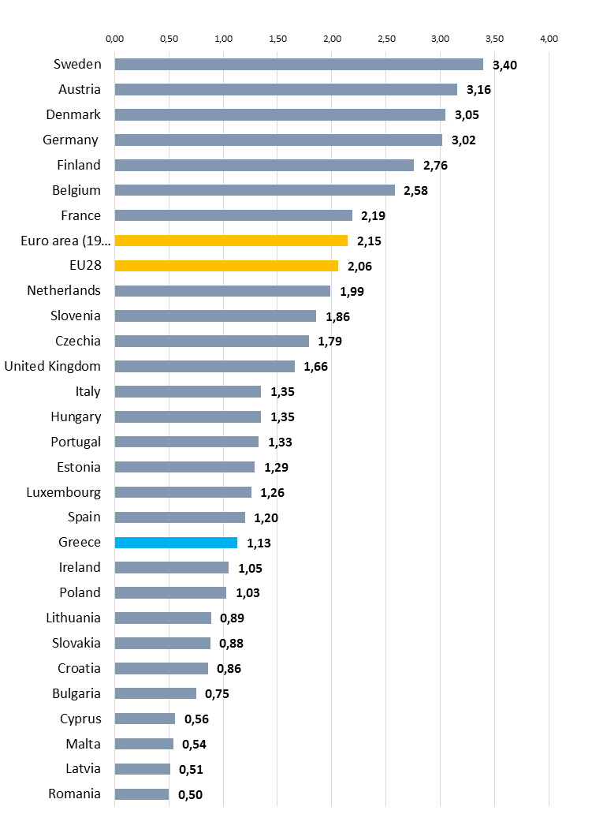
The SMALL Size of the R&I system in greece
R&D Expenditure as a percentage of GDP (2017)

Slide 17
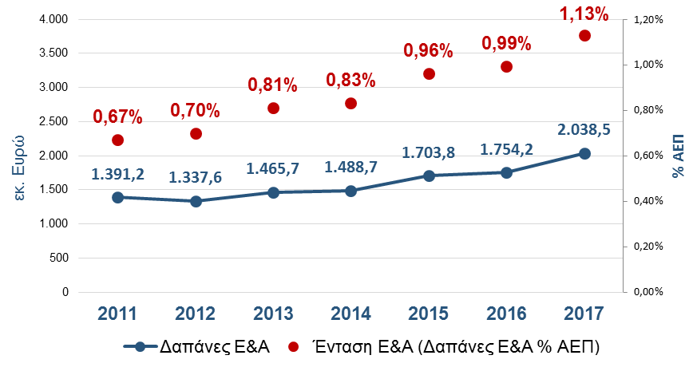
But the system is dynamic !
R&D Expenditure 2011-2017

Slide 18
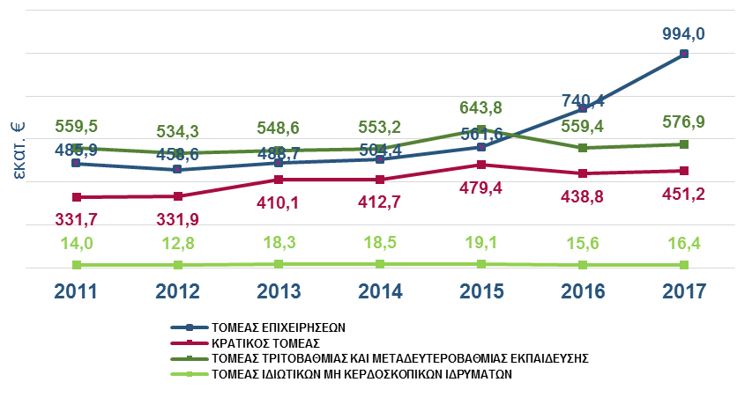
the business sector is the most dynamic
R&D expenditure by sector 2011-2017

Slide 19
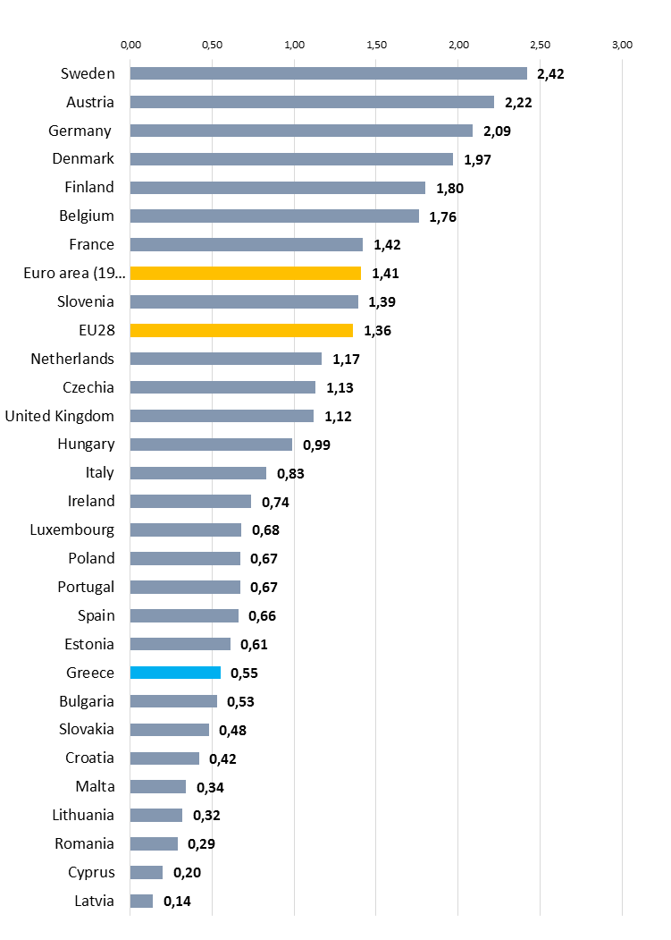
But it is always “lagging behind”
Comparisons with the EU countries

Slide 20
The main strategy : National RIS3 2014 -2020
Focuses in 8 domains
Agrifood
Energy
Information and Communication Technologies
Environment and Sustainable Development
Health and Pharmaceuticals
Transportation and Supply Chain
Tourism, Culture and Creative Industries
Materials and Construction

Slide 21
The national RIS3 2014 -2020 Methodology
COORDINATOR
(Expert from GSRT)
STEERING GROUP
(Experts from Enterprises, Research Centers, Universities)
THE ASSEMBLY OF THE PLATFORM
(Enterprises, Researchers, Academicians, Staff of National and Regional AuthoritiesCivil Society etc.)

Slide 22
The demand of the system is high
RESEARCH – CREATE - INNOVATE (in million Euros) | A' Call 2017 | B' Call 2019 | Percentage Difference
TRANSPORT, LOGISTICS | 65 | 118 | 82%
ENERGY | 108 | 105 | -3%
MATERIALS, CONSTRUCTION | 97 | 149 | 55%
ENVIRONMENT | 154 | 193 | 25%
TOURISM, CULTURE | 172 | 228 | 33%
INFORMATION AND COMMUNICATION TECHNOLOGIES | 263 | 285 | 9%
HEALTH - PHARMACEUTICALS | 258 | 291 | 13%
AGRIFOOD | 278 | 367 | 32%
TOTAL | 1395 | 1737 | 24%

Slide 23
Other Implementation
Special Actions (Aquaculture, Industrial materials, Innovation in Culture)
R&I Infrastructures
Strategic development of Research Institutions
Bilateral – Multilateral actions (Germany, Russia, China, Israel, ERANETs)
Regional Excellence (reinforcing the weak regions)

Slide 24
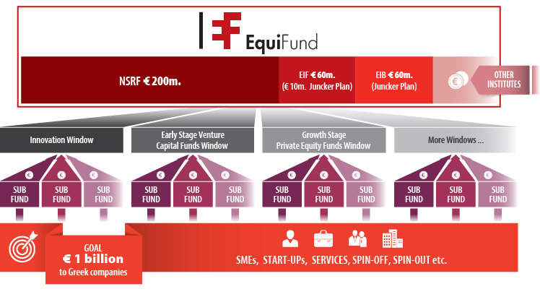
EQUIFUND (a Venture Capital)

Slide 25
Other Actions
The Greek Foundation for Research and Technology (ELIDEK) (Doc, Post – Doc, University research) Objective : mitigate the brain drain, promoting the brain circulation
Flagship projects (Precision medicine (cancer), Quantum technologies, Agrifood (vine, olive, honey), Climate change, Cardiovascular Diseases etc)

Slide 26
THANKS FOR YOUR ATTENTION

