Slide 1
Extending RIS3 governance beyond science and technology: Working Group on Industrial Transitions
Mark BODEN & Dimitrios PONTIKAKIS
JRC.B3 Territorial Development
Sevilla, 9th July 2019

Slide 2
Summary
JRC "Lagging Regions 2" Project
Fulfilment criteria for enabling condition
Challenges of lagging regions
A unique window of opportunity
The JRC Working Group
Transition Review Pilots
Expected Outcomes

Slide 3
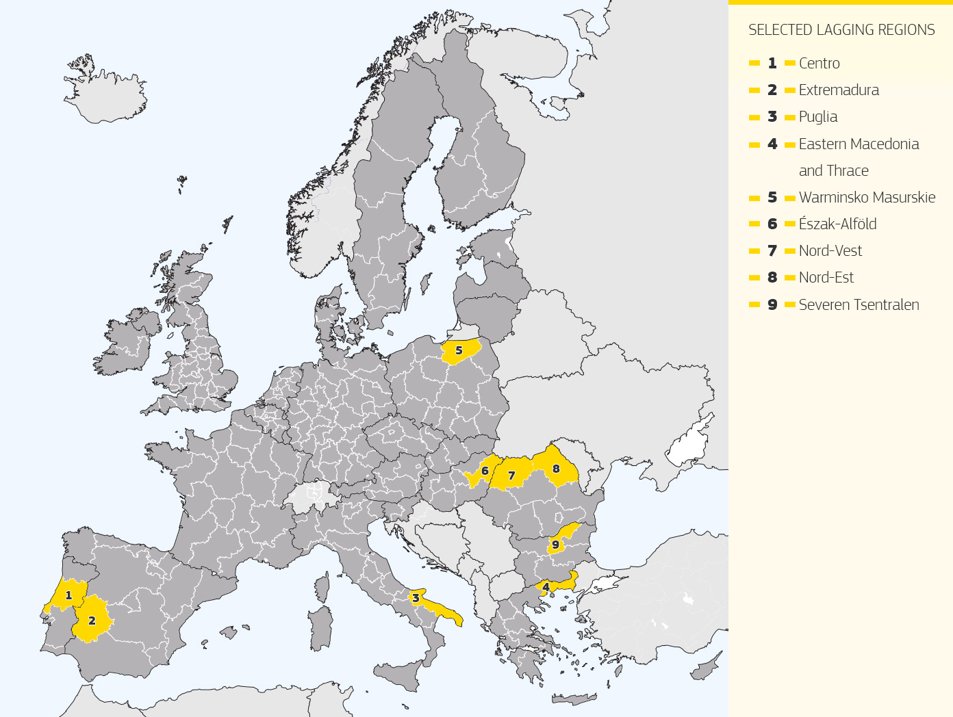
Lagging Regions 2: Main objectives
Targeted support to RIS3 implementation in selected regions
Low-growth regions:
GDP/capita below EU average
MAIN AIM:
Support the refinement and implementation of the RIS3 of selected EU regions
Less developed regions:
GDP/capita <50% of EU average
Warminsko Masurskie
Észak-Alföld
Nord-Vest
Develop and provide appropriate and specific support to selected regions in RIS3 implementation
Nord-Est
Generate lessons and a model for other regions
Develop and implement horizontal approaches to key issues in the growth and governance of RIS3
Test-bed for theories on S3 and for understanding RIS3
Puglia
Eastern Macedonia
and Thrace

Slide 4
Geographical Coverage
1. Low-growth regions
(GDP/capita below EU average)
Greece
2. Less developed regions
(GDP/capita <50% of EU average)
Bulgaria
Italy
Romania
Hungary
Portugal
Poland
Croatia (stage 2)
Spain
 | Lagging Regions (Stage 1) | Lagging Regions (Stage 2)
BG | Severen Tsentralen | national level
HR |  | national level
EL | Eastern Macedonia and Thrace, national roll-out | Central Macedonia, Western Greece, national level
HU | Észak-Alföld (Hajdú Bihar county) | national level
IT | Puglia | Puglia & Campania
PL | Warminsko Mazurskie | Kujawsko-Pomorskie, Lubuskie, Podlaskie
PT | Centro | Centro, national level (HESS)
ES | Extremadura | Extremadura, national/regional linkages
RO | Nord-Est, Nord-Vest | Rollout to all 8 regions, national level

Slide 5
Specific (Vertical) vs. General (Horizontal) Support
Specific (Vertical) Support:
Specifically tailored to the needs of the region/country
Defined in collaboration with the local government authorities and REGIO.
General (Horizontal):
Based on peer-learning
Workshops involving representatives from all the regions of the project
Focused on RIS3 Monitoring and Governance in both project stages
Collaboration:
JRC, REGIO, independent experts, local stakeholders (quadruple helix).

Slide 6
Project Toolbox
Specific (vertical) support
Profiling and analysis
EDP
focus groups
in several regions
Project
Development
Labs
General (horizontal) support
WGs on RIS3 governance, monitoring & evaluation
MOOC on RIS3 monitoring
Board of critical friends

Slide 7
Project timeline 2014-2020
Lagging Regions I
(July 2016 –June 2018)
Lagging Regions II
(July 2018 –June 2020)
RIS3 in REMTh
(Sept 2014 –Dec 2015)
RIS3 in Romania
(July 2016 –December 2019)
Sept
2014
Dec
2015
July
2016
July
2018
July
2019
Dec
2019
June
2020

Slide 8
Managing Industrial Transitions
Addressing the challenge of deindustrialisation (DG REGIO Pilot Action: Regions in Industrial Transition)
Exploring the central role of RIS3 strategies in responding to deindustrialisation
How best to support regions in better tailoring RIS3 to the specific challenges of industrial transitions?
How to frame coordination for industrial transformation beyond RIS3?

Slide 9
Challenges of Lagging Regions
→ Regions with low growth / low income per capita
Long-term challenges:
Industrial decline and mass emigration
Structural change: low-productivity agriculture/tourism
Lacking large-scale production and business innovation
Barriers to investment
Societal and environmental challenges
Large infrastructure gaps
Pressing need to develop knowledge-intensive production capabilities
→ Problem: no framework available for full-blown industrial policy!

Slide 10
Global impulses present a unique window of opportunity
Global impulses: climate change and massive investments in renewables, batteries and electric mobility (not just TESLA, but importantly China). Circular economy. AI.
Paradigm shift in electric mobility (a technological revolution?):
strong backing from global finance
consumer shift + old comparative advantages nullified = massive business opportunities
massive implications for infrastructures
strong synergies with other global impulses (renewables + AI + circular economy)
→ Example: RIMAC in Croatia (est. 2011). 500+ people, producing world's fastest (until last year) sports car.

Slide 11
The JRC Working Group: "Understanding and Managing Industrial Transitions"
How to mobilise efforts from all levels/portfolios to develop knowledge-intensive production capabilities
Contribute to the development of:
An integrated policy framework in support of industrial transitions
Appropriate lessons for the revision and extension of S3
Central to the approach:
Credible vision
Interdependencies
Sequences
Cross-portfolio coordination

Slide 12
Conceptual framework
Literature on system innovation/
"Transition management"
Not the same as "innovation system"!
Builds on:
Socio-technical transition experiences (mostly in NL)
Multi-level perspective
See links below::
https://www.innovationpolicyplatform.org/sites/default/files/general/SYSTEMINNOVATION_FINALREPORT_0.pdf
http://www.tipconsortium.net/
https://www.sciencedirect.com/science/article/pii/S0048733302000628

Slide 13
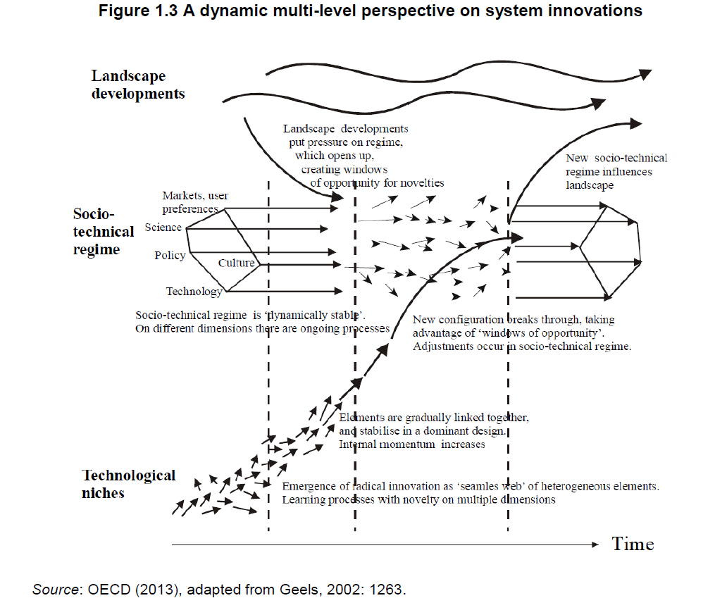

Slide 14
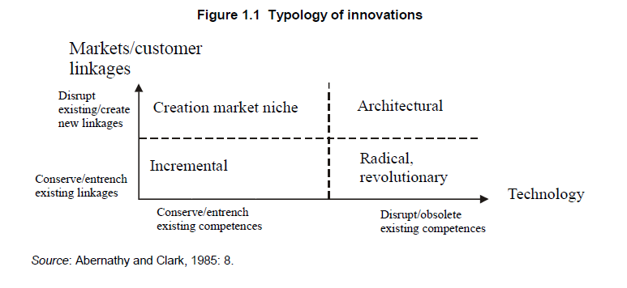
What is "transformative"?

Slide 15
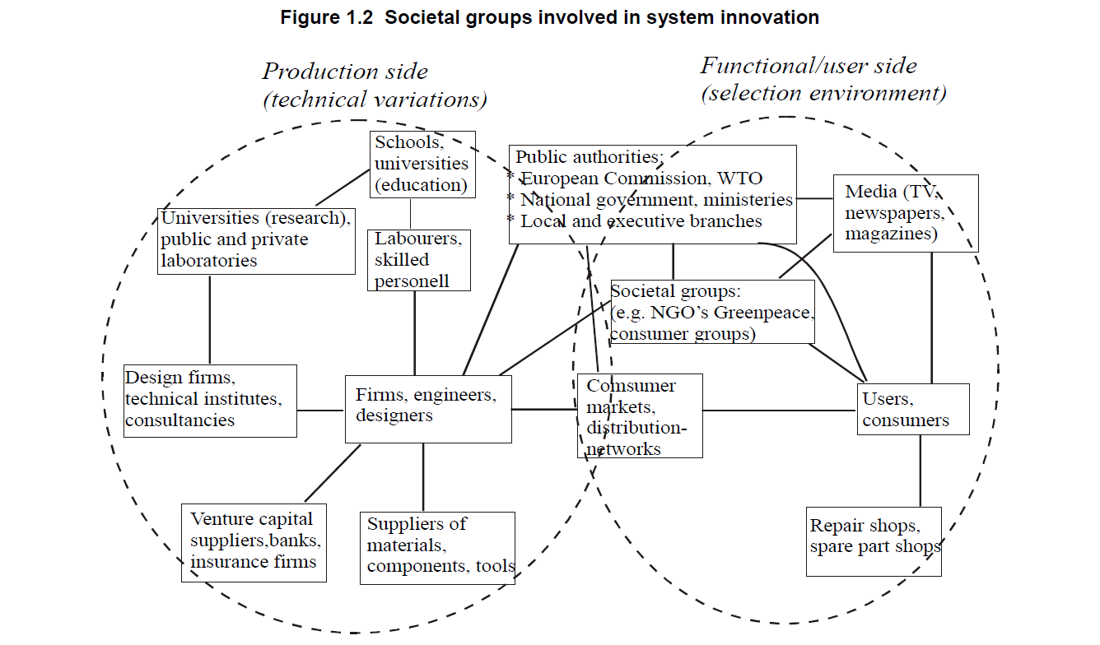
Not just R&I, not just '3-ple/4-ple helix'

Slide 16
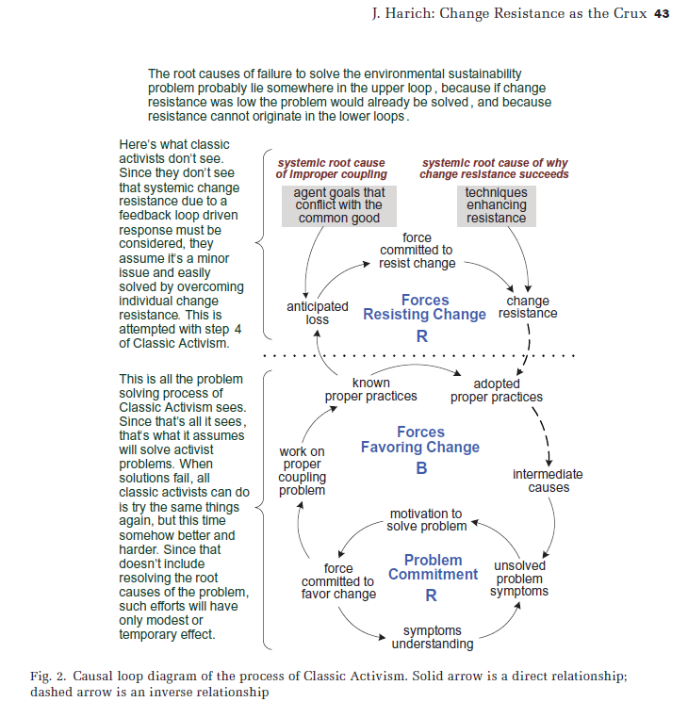
Resistance to change:
Can be adaptive (not passive)
Can (has) cancel(led) out sustainability efforts

Slide 18
Working Group on Understanding and Managing Industrial Transitions
Regional responses to global impulses for change
e.g. the electrification of transport, renewable energy, climate change, circular economy and digitisation
Thorough understanding of the relationships and interdependencies within/between existing vs desirable systems.
Extend S3 governance: whole-of-government mobilisation
Development of novel instruments (experiments) that reinforce legitimacy and foster virtuous cycles between emerging and declining sectors

Slide 19
Transition Review Pilots
~50-page reports, product of thorough expert review
First wave: Andalucía, Greece, Bulgaria, Netherlands (Northern NL/Groningen?)
Steps:
Select 1-3 themes with authorities and set targets
Map existing production and consumption systems
Envision future configuration of systems that meet targets
Develop recommendations across 4 axes

Slide 20
Review outcomes
Guidance along 4 axes of actions
Governance of government
Support coalitions
Managing resistance to change
Experiments, reforms, policies and instruments
Co-define a policy experiment
Low total cost/quick signalling
In area with high spillovers
Potentially scalable / replicable

Slide 21
Outputs and outcomes
First meeting today.
Advisory Board with distinguished experts
Expected outcomes by June 2020:
up to 4 transition reviews in lagging regions/countries
co-develop policy experiments (scalable/replicable)
A horizontal synthesis report

