Slide 2
Smart Sensors 4 Agri-food
Veerle Rijckaert
Flanders’ FOOD, spearhead cluster for the
agri-food industry in Flanders

Slide 3
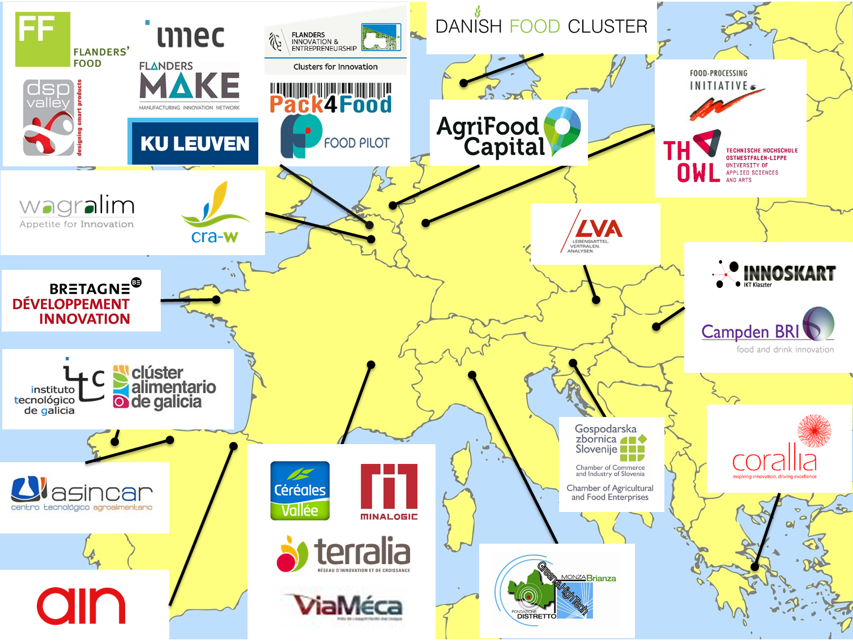

Slide 4
Your partnership's progress since 2019 Spring AF Working Committee Meeting
2 approved and running projects:
Smart sensor systems for food safety, quality control and resource efficiency in the food processing industry
INNOSUP
1/05/’19 – 30/04/’22
Connecting smart sensor systems for the food industry
COSME
1/11/’18 – 31/10/’20
Vouchers (€) for SMEs - 2 open calls:
€ 5 mio → 79% for SMEs
Direct (vouchers): € 2.875.000
Max € 60.000 / SME
Strategy
Roadmap
EU network living labs
Study visits
Matchmaking
Demo cases
4

Slide 5
Your partnership's progress since 2019 Spring AF Working Committee Meeting
Accomplishments in the framework of these 2 projects:
Partnership Agreement (in the process of signing) – see further
Detailed inventorization:
Needs agri-food companies related to digitalization
Capabilities of technology & digital solution providers (incl. RTO’s)
Living labs
Operating principles of the network of living labs
Study visits (to living labs, etc.)
Enhance mutual learning
Building trust zone
Preparing matchmaking event (Feb ‘20; Asturias (Spain))
Value chain maps (under construction)

Slide 6
Your partnership's progress since 2019 Spring AF Working Committee Meeting
Partnership Agreement: content:
Cluster Partnership Agreement + signature pages (annexes form integral part of this Agreement):
Annex 1: Governance Structure of ‘Smart Sensors 4 Agri-food’
Annex 2: Strategy
Annex 3: Implementation Roadmap
Important!:
Guarantee long-term sustainability of partnership + structure and divide responsibilities
Deliverables in the framework of Connsensys and S3FOOD

Slide 7
Your partnership's progress since 2019 Spring AF Working Committee Meeting
Governance Structure: Some attention points:
Agreement between clusters – RTO’s (max 2 Regular Members per region) → Letter of Support from regional authorities
Informal network of organisations
Established Office: organized by Flanders’ FOOD, who is a legal entity:
Will stay fixed at Flanders ’FOOD
Responsible for all the administrative and financial tasks linked to the Partnership
Associated Organizations have no voting rights in Steering Committee and can’t be member of the Board

Slide 8
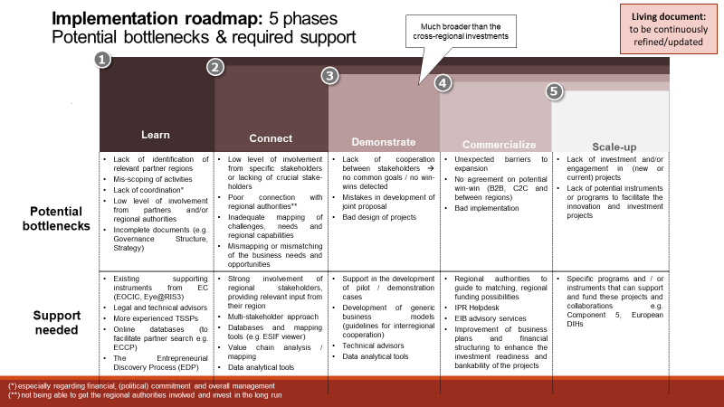
Your partnership's progress since 2019 Spring AF Working Committee Meeting
Governance Structure: Some attention points:
Agreement between clusters – RTO’s (max 2 Regular Members per region) → Letter of Support from regional authorities
Informal network of organisations
Established Office: organized by Flanders’ FOOD, who is a legal entity:
Will stay fixed at Flanders ’FOOD
Responsible for all the administrative and financial tasks linked to the Partnership
Associated Organizations have no voting rights in Steering Committee and can’t be member of the Board

Slide 10
Progress towards business and investment projects
Study visits → involving companies
Ideation sessions:
Seeding collaborations between agri-food companies and technology & digital solution providers
Voucher calls
Different types of voucher projects
Preparing matchmaking events + launch of voucher calls:
Communication towards companies (what’s in it for them?)
Working on demonstration cases and generic business models

Slide 11
Digital services and technologies
Sector oriented partnership: Agri-food industry
In the end all digital services and technologies might be relevant for our sector!
Developed a 5-step model to introduce technologies in the agri-food industry → not linked to specific technology:
Awareness creation
Building trust zone
Validation
Implementation
Leverage: via testimonials and living labs

Slide 12
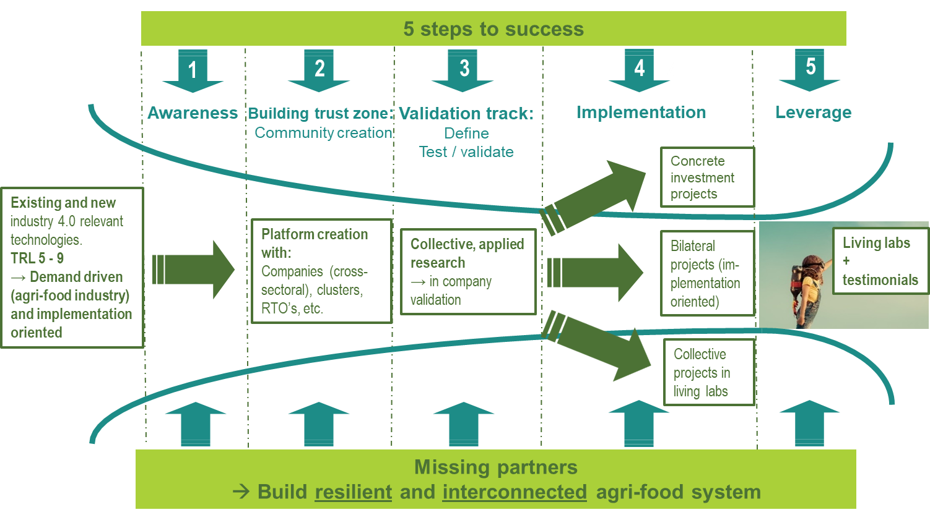
What is added value and contribution of the Partnership?

Slide 13
Digital services and technologies
And also:
Mapping of technology & digital solution providers (CRAFT tool)
Operational handbook of network of living labs
Tech catalogue → linked to CRAFT tool
Training and workshops
Ask@ service
Set-up in the framework of Connsensys and/or S3FOOD
Successful services will be continued in the framework of ‘Smart Sensors 4 Agri-food’

Slide 14
Future plans
Continue the good work linked to Connsensys & S3FOOD ☺
First Steering Committee meeting of ‘Smart Sensors 4 Agri-food’:
Feb ’20
Annual workplan will be prepared prior to the meeting
What support is needed and is currently lacking?
More visibility of the agri-food partnerships:
Branding and communication
Website more interactive and up-to-date
Newsletter articles? Social media?
Guidance towards relevant calls and topics

Slide 15
Thank you!
Veerle Rijckaert
Business Development & Internationalization Manager
veerle.rijckaert@flandersfood.com

