Slide 1
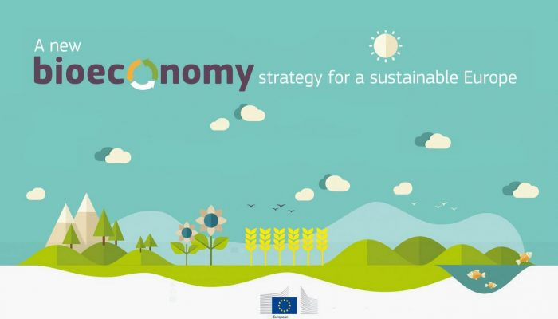
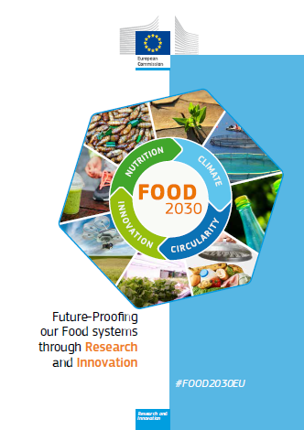
Needs & support
for 2019–2021
- Roundtable discussion -
3 December 2019, Malaga
Thematic S3 Platform Agri-Food
Working Committee Meeting
Wim HAENTJENS
DG Research & Innovation
European Commission

Slide 2
Horizon 2020: post-farm gate digitalisation
(A selection of ongoing projects)
IOF2020
ICT-AGRI 2
SmartAgriHubs
ILIAD
INSYLO
Freshdetect
MOLOKO
S3 FOOD
COMPARE
FoodSmart
PROTEIN
NoHow
My-AHA
Automation
Monitoring
Sensors
Personalisation

Slide 3
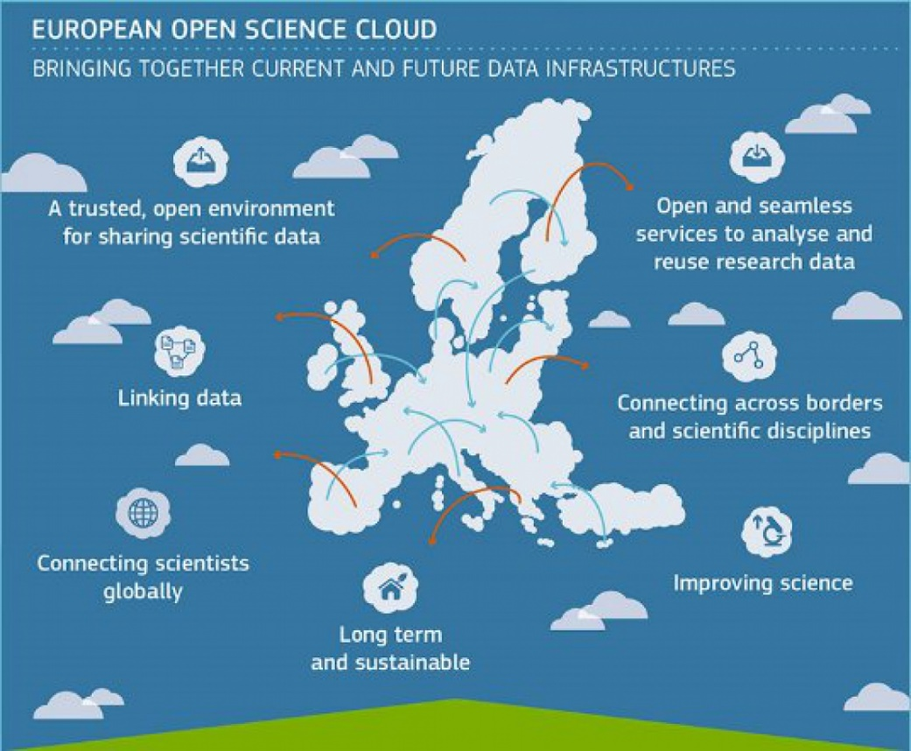
European Open Science Cloud (EOSC)
Enabling the digital transformation of research: data-intensive, collaborative and cross-discipline
EOSC will provide 2 million EU researchers and innovators an environment with services for data management, analysis and re-use across disciplines, increasing the creativity, productivity and reproducibility of research

Slide 4
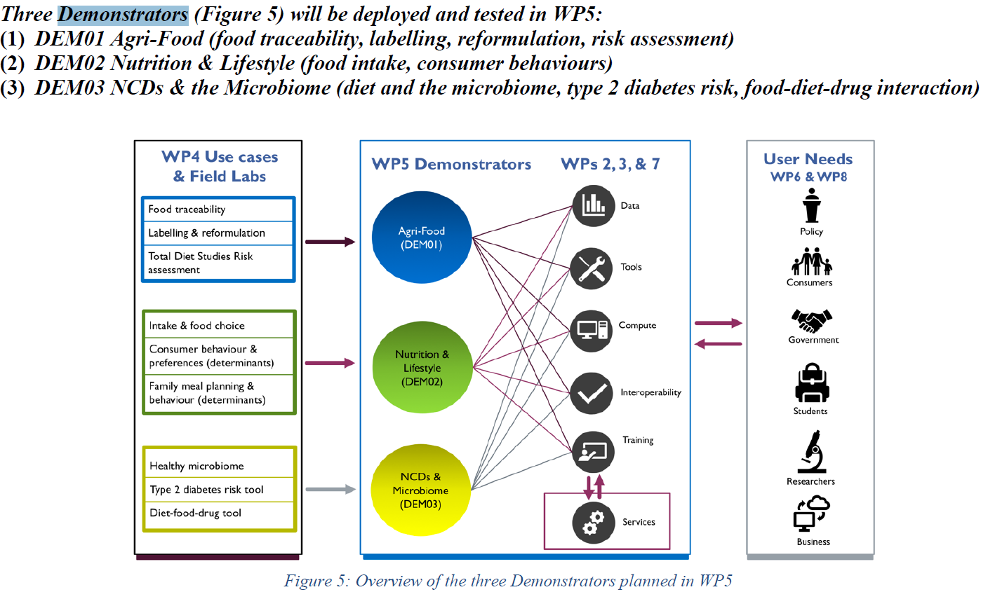
FNS-Cloud (10M€; 2019-2023) FNS data fragmentation & demonstrate

Slide 6
POST 2020

Slide 7
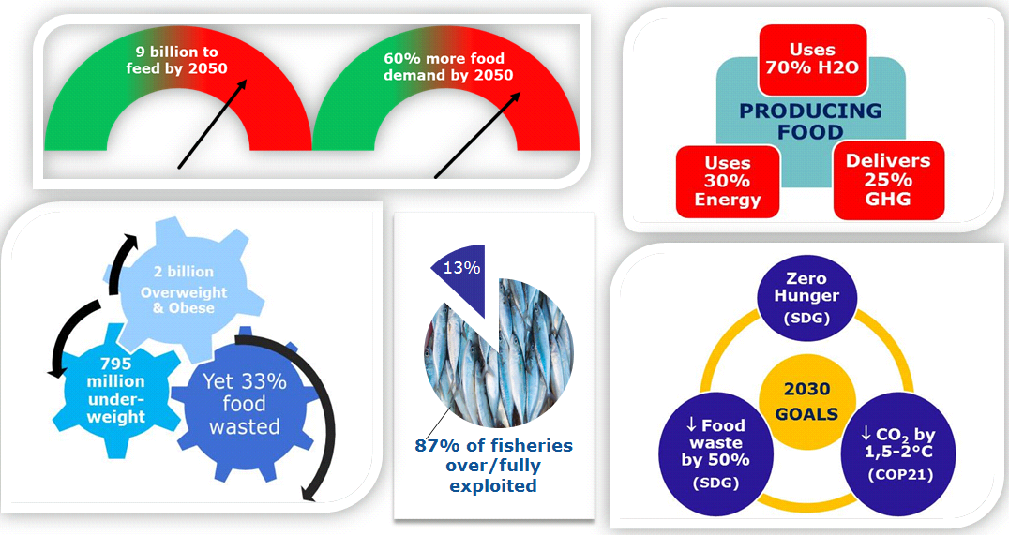
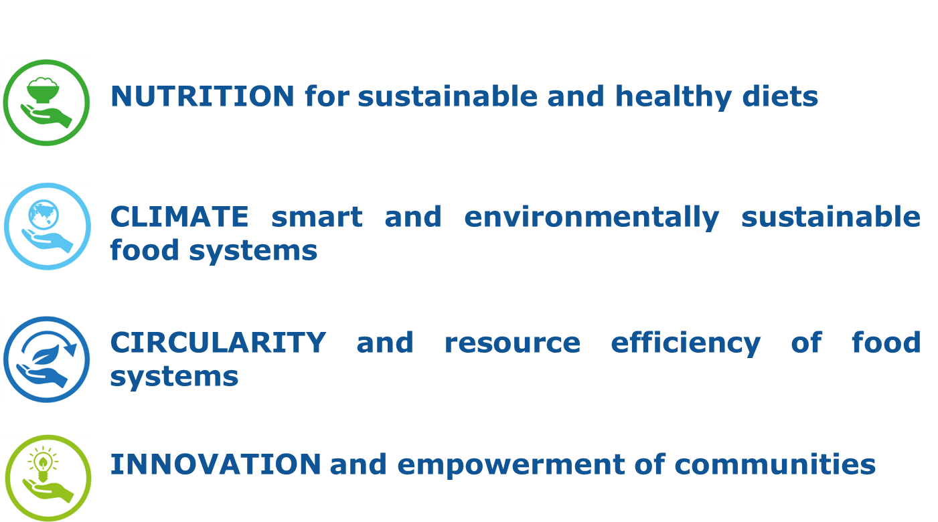
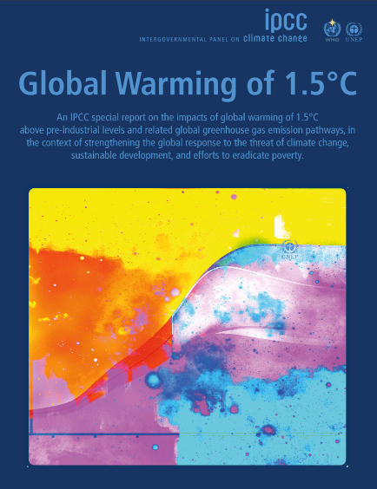
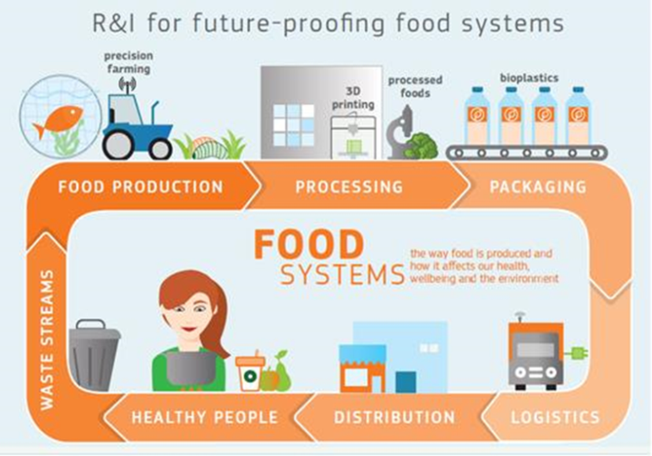
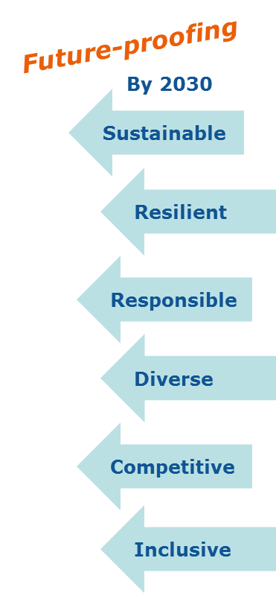
Accelerate towards Sustainable Food System
FOOD 2030 : Priorities

Slide 8
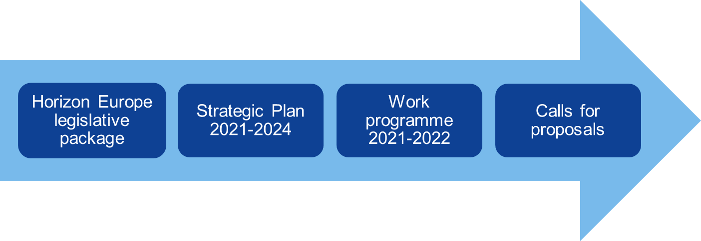
HORIZON EUROPE PREPARATIONS (Cluster 6)
Digital innovation and the improved management and sharing of data will optimize the sustainable use of natural resources along the food system, monitoring its potential impacts on natural resources and contribute to foster food safety, crisis management, traceability, transparency, and system resilience, to respond to the trend for more personalized, sustainable and healthy food, and to increase the competitiveness and sustainability of the European food industries and related food service sectors.

Slide 9
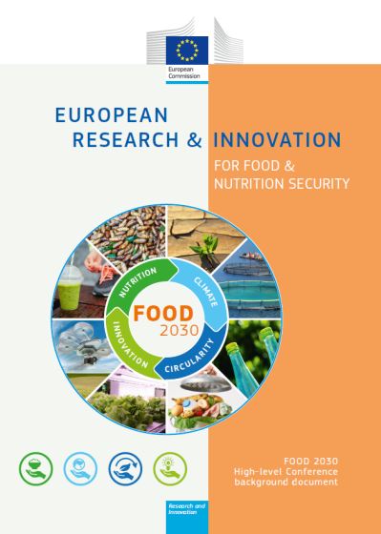
Thank you!
http://ec.europa.eu/research
#FOOD2030EU

