Slide 1
Exploring synergies between
Digital Innovation Hubs and
Agri-food Partnerships
Workshop
Málaga (Spain), 4 December 2019
Gabriel Rissola, Senior Researcher
JRC B3 – Territorial Development
Gabriel.RISSOLA@ec.europa.eu

Slide 2
Workshop Agenda
09:30 – 09:45 Introduction and setting the scene
09:45 – 11:15 Digital Innovation Hubs meeting Agri-food needs
11:30 – 13:00 DIH Parallel Discussion Groups | SmartAgriHubs’ Innovation Portal
13:00 – 13:30 Groups Reporting & Closing
15:00 – 17:00 Field visits

Slide 3
European companies are not making the most of all the opportunities digital has to offer
Highly digitised companies across Europe
Countries
Sector
Size
of Danish companies
of computing companies
20%
of SMEs
53%
56%
of Romanian companies
of metal products companies
58%
of large enterprises
8%
6%

Slide 4
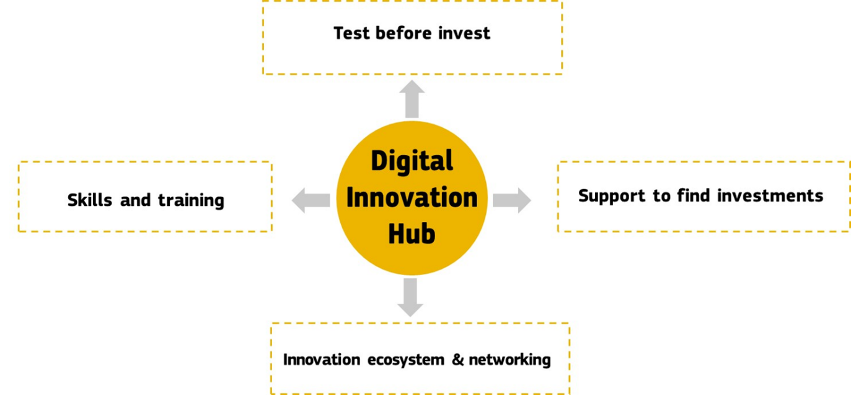
Digital Innovation Hubs provide technological expertise and experimentation facilities to enable the digital transformation of the industry and the public sector
Built around Competence Centres (CC):
Research and Technology Organisations (RTO)
Technical Universities
In collaboration with:
Industry associations
Clusters
Accelerators/Incubators
Innovation agencies
Enterprise Europe Network (EEN)
DIHs are innovation intermediaries matching demand & offer of digital services & technologies

Slide 5
SO2: Artificial Intelligence
SO3: Cybersecurity and Trust
SO4: Advanced Digital Skills
SO5: Deployment, best use of digital capacity and interoperability
SO1: High Performance Computing
Supported by horizontal activities through a service contract
Guidance for hubs
Community building
Matchmaking
Impact assessment
Train the Trainer
Request specialised support
European DIHs
in
Digital Europe Programme
(2021-2027)
EDIH
EDIH
EDIH
EDIH
EDIH
Networking,
Transfer of
expertise
European DIH Z
Region C
Specialisation 3
EDIH
EDIH
European DIH X
Region A
Specialisation 1
EDIH
EDIH
EDIH
European DIH Y
Region B
Specialisation 2
Public administrations
SMEs/Midcaps

Slide 6
Focus/expertise
DEP | Other Technologies | Application areas | Sector
AI, HPC, or Cybersecurity | Simulation Supply chain integration Blockchain Advanced Materials, … | Industry 4.0 Circular economy | Manufacturing
 | Remote sensing, Photonics, Life-Science Technologies, … | Precision farming | Agri-food
 | Robotics, Simulation, … | Exo-skeletons, Automated building | Construction
 | Digital solutions for governments, Blockchain, … | Services for citizens, once only principle | Public administration
 | …
(Focus on detected local SME/Public Sector needs
+ Smart Specialisation priorities)

Slide 7
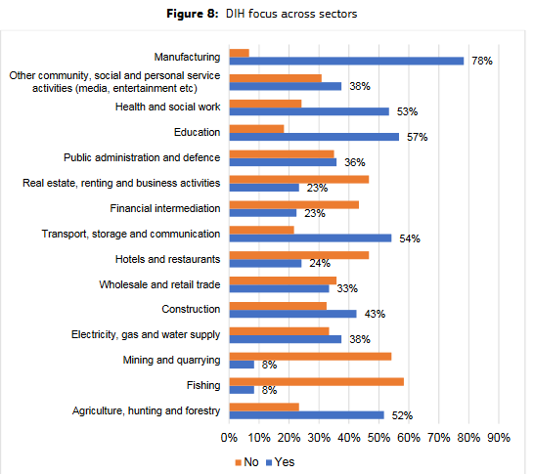
DIHs & Smart Specialisation – EU Survey

Slide 8
Planned synergies with other EU initiatives
Horizon Europe: Support to SMEs and mid-caps to experiment with innovative digital technologies in a cross-border setting. European Digital Innovation Hubs and others may apply for these grants, and cascade a large part of the funding to SMES
Allocated at European level
Digital Europe: Support to the facilities and personnel of the European Digital Innovation Hubs. They will focus on broad roll out of the latest digital innovations across SMEs and administrations.
InvestEU: Incentives and risk reduction programmes to help companies find follow-up investment to further complete their digital transformation. The work of the European Digital Innovation hubs will diminish the knowledge gap that exists.
European Regional Development Fund: Investments allocated by the Member States to build-up or strengthen the Digital Innovation Hubs infrastructures in their territories and reduce the digital divide. ERDF can be used by Member States to co-invest on EDIHs in Digital Europe.
Allocated at national level

Slide 9
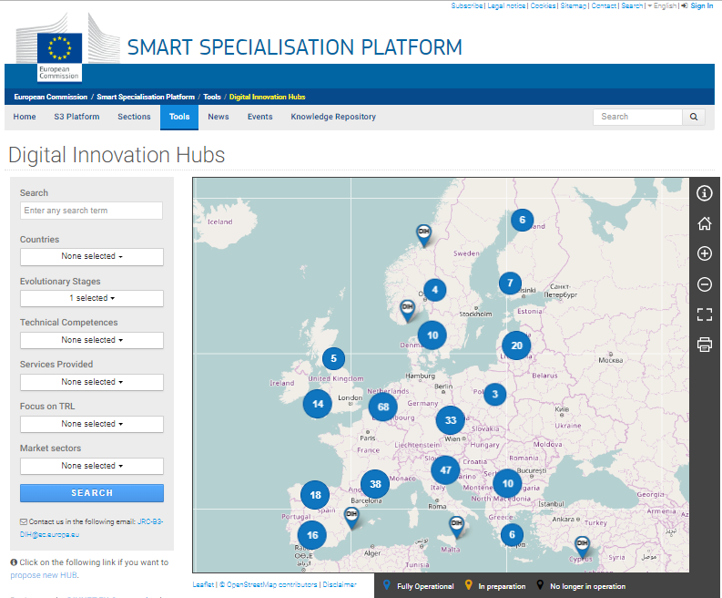
DIH Catalogue
DIH yellow pages
https://s3platform.jrc.ec.europa.eu/digital-innovation-hubs-tool
Coverage:
> 300 FO DIHs
> 150 NUTS2 regions
in almost every MS
Additional info:
DIHs per country
Examples of DIHs
Services to SMEs
DIHs & market sectors
DIH & clusters/EEN

Slide 10
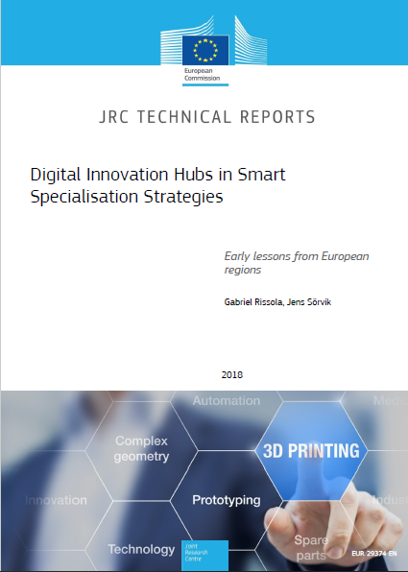
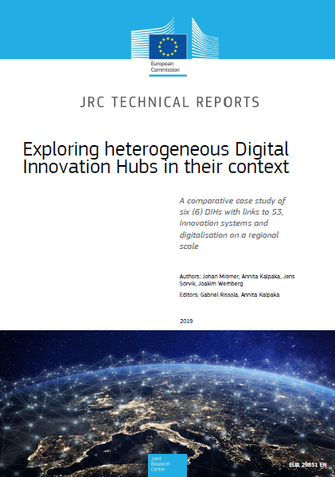
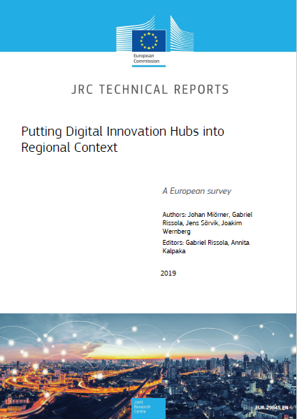
https://s3platform.jrc.ec.europa.eu/knowledge-repository

Slide 11
https://s3platform.jrc.ec.europa.eu/digital-innovation-hubs-tool https://s3platform.jrc.ec.europa.eu/digital-innovation-hubs-catalogue https://s3platform.jrc.ec.europa.eu/knowledge-repository Gabriel.RISSOLA@ec.europa.eu Annita.KALPAKA@ec.europa.eu
Thank you!

Slide 12
Digitalisation Challenges proposed by AF Partnerships
AgriFood Living Labs
DIH models for AF
Collection and handling of Big Data
Consumer involvement in AF innovation
Business models for interregional joint funding

